Slide 1
LINK STATE ROUTING SIMULATOR
BARANI KUMAR
CWID A20434813
CS 542 - PROJECT

Slide 2
CONTENT
INTRODUCTION
PROGRAM COMPILATION AND EXECUTION
PROGRAM WORK FLOW
CONCLUSION

Slide 3
INTRODUCTION
Link State Routing Protocol Link state algorithm basically creates a map of link between each and every router in the network in the form of a graph .This graph clearly shows the exact connectivity link between the routers . Then using the Dijkstra's algorithm , it create a shortest path from one router to another which finally results in the routing table
Dijkstra’s algorithm
The Dijkstra algorithm is used to generate the shortest path from source to destination router.
Sets the source router as the root and appends it to the path. And finds out the shortest distance from source router to all other adjacent routers. Finally sets the distance of the source to zero
And it repeats below two steps in a loop until all the routers are added to the path set
1. searches for the neighboring nodes with minimum distance from the source , and appends it to the path
2. sets the shortest distance of the router ,which is recently appended to the path , to the other routers which are in network.

Slide 4
PROGRAM COMPILATION AND EXECUTION
Extract the package
Open Command Prompt in the extracted project directory
Type python lsp_project.py to compile and run the program

Slide 5
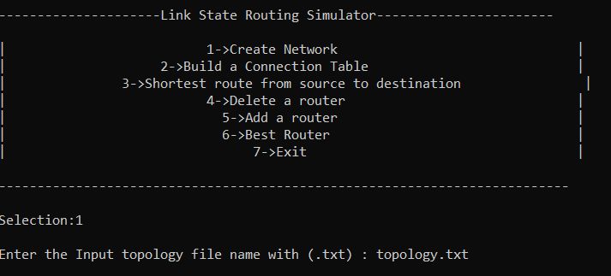
PROGRAM WORK FLOW Menu
User can type in the required option to complete the required task

Slide 6
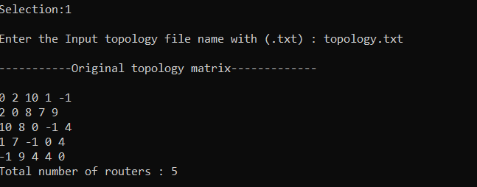
Generating topology matrix
Enter selection 1
Type the name of input file with .txt
If file exist , the topology matrix and total number of router will be displayed

Slide 7
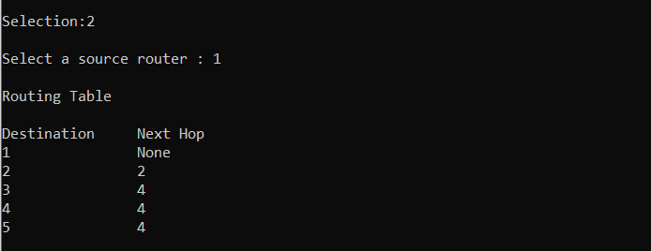
Generating Routing table
Enter selection 2
If router with in the range is entered , the routing for it will be displayed

Slide 8
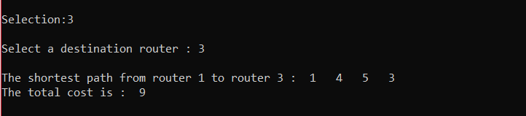
Shortest path and cost
Enter selection 3
If entered valid destination router , shortest path from source to destination with cost will be displayed

Slide 9
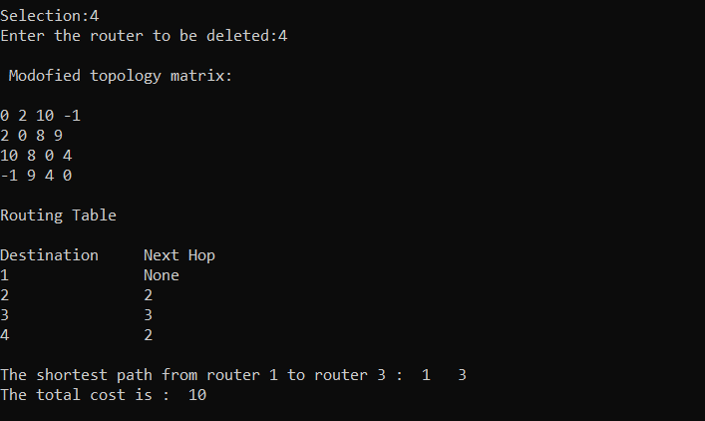
Deleting a router
Enter selection 4
If valid router entered
The particular router will be removed from the matrix with cost.
Updated routing table and shortest path with cost will be displayed

Slide 10
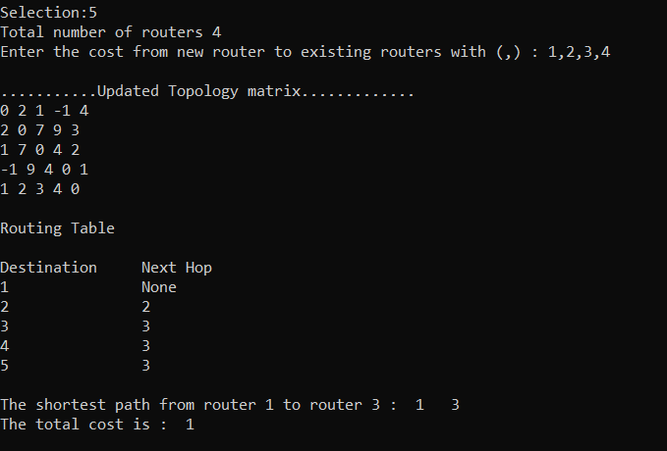
Adding a router
Enter selection 5
Program will prompt to enter cost for each existing router from new router
Once done ,updated routing table , shortest path and cost will be displayed

Slide 11
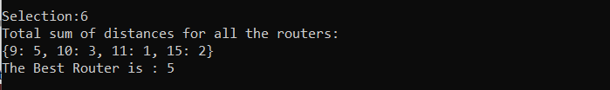
Optimal Router
Enter selection 6
Program displays the total cost of between all the routers in the network
And displays the optimal router which has least distance between all other routers

Slide 12

Exit
Selection 7 exits the program

Slide 13
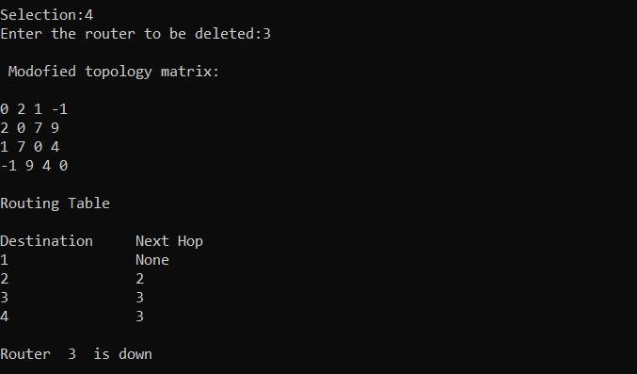
Deleting a source/destination router
if the destination router/source router is equal to router which user wants to delete , then the program will display the updated matrix and routing table , and but doesn’t show the shortest path and cost

Slide 14
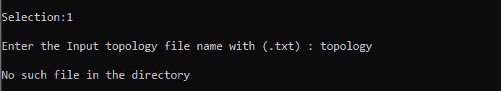
Exceptions invalid input file
If entered in valid input file name , program will display an error
And returns to main menu

Slide 15

Same source and destination router
If the user’s source router and destination router are the same , the program will prompt an error message , and requests user to try again will different router
And returns to main menu

Slide 16

Out of bound selection
If user selects an option which is not listed in the main menu , program will prompt an error message
And returns to main menu

Slide 17
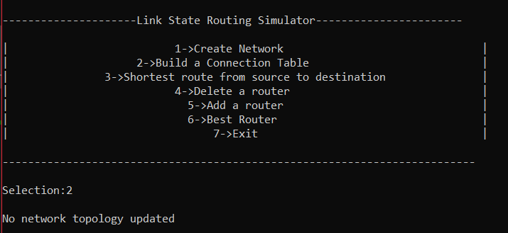
No input file updated
If the user directly jumps to 2 nd option , without updating the input topology file , the program will prompt an error message
And returns to the main menu

Slide 18
Conclusion
Given valid input ,this program is capable of find out the shortest path from source to destination in a network with N routers

