Slide 1
SMART PARKING
TEAM MEMBERS:
Baranipriya.R
Manikandan.S
Surya.J
Sakthivel.S
Lalith Kumar.B

Slide 2
Steps to Integrate Camera-Based Solutions for Parking Space Detection
Camera Installation
Image Capture
Image Processing
Parking Space Detection
Data Storage
Communication and Notification
Integration with Existing Systems
Machine Learning (Optional)
Security and Privacy
Maintenance and Calibration

Slide 3
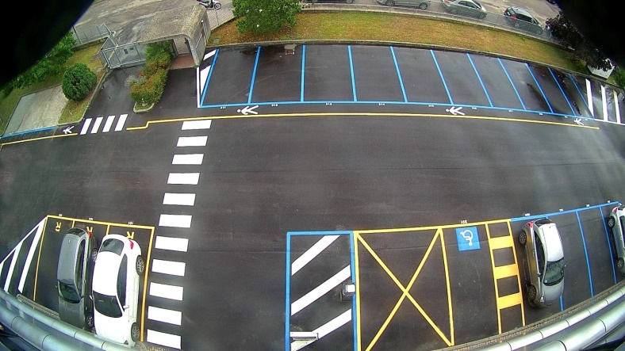
Camera Installation
Install cameras in strategic locations with a clear view of parking spaces.
Ensure proper alignment and coverage for effective image capture.

Slide 4

Image Capture
Configure cameras to capture high-resolution images of the parking area.
Adjust settings for different lighting conditions and weather.

Slide 5
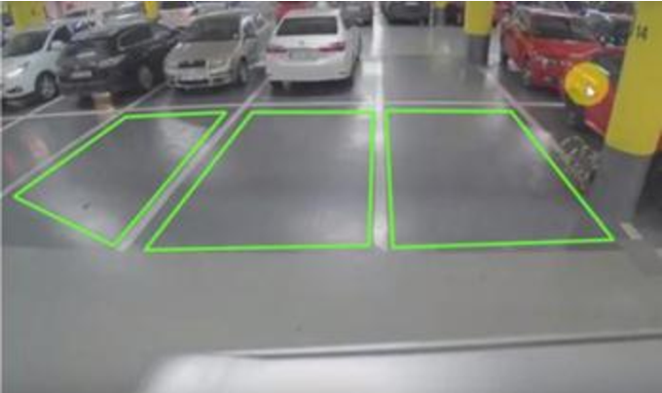
Image Processing
Use image processing techniques to analyze captured images.
Apply computer vision algorithms for object detection and recognition.
Identify and classify vehicles within the images.

Slide 6
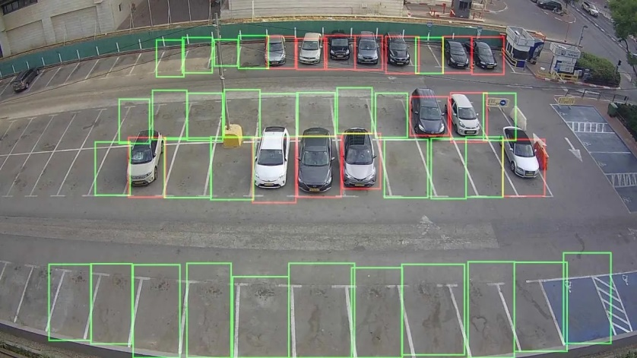
Parking Space Detection
Implement algorithms to detect empty and occupied parking spaces.
Utilize object segmentation to identify the boundaries of each parking spot.
Apply machine learning models for better accuracy over time.

Slide 7

Data Storage
Store the processed data in a centralized database.
Include information such as parking space ID, status (occupied or vacant), and timestamp.

Slide 8

Communication and Notification
Set up a communication system to update the parking status in real-time.
Integrate with a user interface (e.g., mobile app or web portal) for users to check parking availability.
Send notifications to users about available spaces or alerts for unauthorized parking.

Slide 9
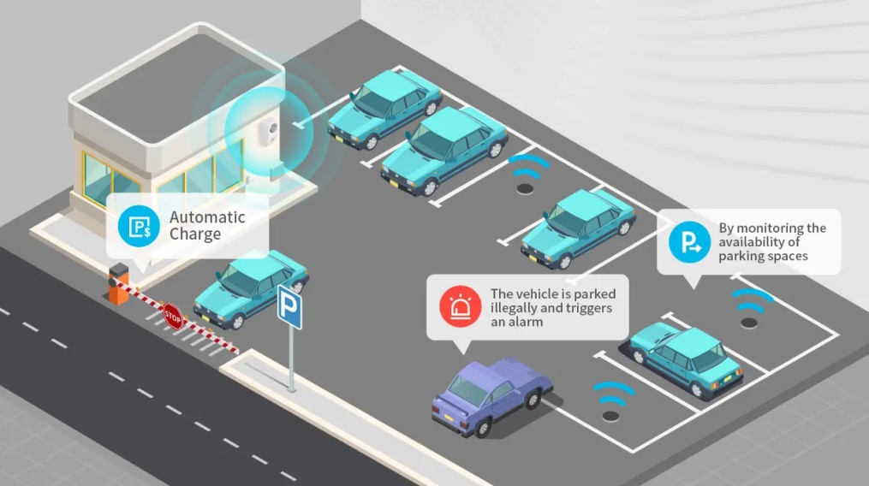
Integration with Existing Systems
If applicable, integrate the parking space detection system with existing smart city or parking management systems.

Slide 10

Machine Learning (Optional)
Train machine learning models for improved accuracy.
Use historical data to enhance the system's ability to predict parking space availability.

Slide 11

Security and Privacy
Implement security measures to protect captured data.
Ensure compliance with privacy regulations by anonymizing and securing personally identifiable information.

Slide 12
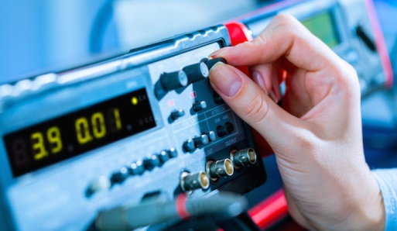
Maintenance and Calibration
Regularly maintain and calibrate cameras to ensure optimal performance.
Monitor system performance and address any issues promptly.

Slide 13
Considerations
Scalability: Design the system to scale with the growing number of cameras and parking spaces.
Redundancy: Include redundancy measures to ensure continuous operation, even in the case of camera failures.
User Experience: Prioritize user-friendly interfaces for both administrators and end-users.
Integration with Payment Systems: If applicable, integrate with payment systems for seamless transactions.

Slide 14
THANK YOU

