Slide 1
HBSの製品インパクト関連論文
A Framework for Product Impact-Weighted Accounts (pdf)
Accounting for Product Impact in the Airlines Industry (pdf)
Accounting for Product Impact in the Consumer Finance Industry (pdf)
Accounting for Product Impact in the Consumer-Packaged Foods Industry (pdf)
Accounting for Product Impact in the Interactive Media and Services Industry (pdf)
Accounting for Product Impact in the Oil and Gas Industry (pdf)
Accounting for Product Impact in the Pharmaceuticals Industry (pdf)
Accounting for Product Impact in the Telecommunications Industry (pdf)
Accounting for Product Impact in the Water Utilities Industry (pdf)
Impact Accounting for Product Use: A Framework and Industry-specific Models (pdf)
うえにあるpdfをまとめているような論文
Product Impact Dataset
上の例のデータをエクセルでまとめている(会社名は実名。2015 - 2018)
Product Impact Template for Water Utilities Industry (Excel)
Water utility 会社の製品インパクトを計算した際のエクセル

Slide 2
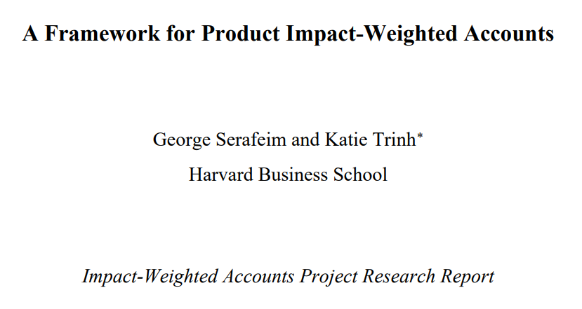

Slide 3
1 introduction
As of 2017, 75% of the largest 100 companies in each of 49 countries (75% of 4,900 companies) were issuing sustainability reports with ESG data, a marked increase from the 12% in 1993.1
Product impact refers to impact that occurs once a company has transferred control of goods or services, which is consistent with traditional accounting recognition of a sale
Of the 56 companies that have experimented with monetary impact valuation, only twenty percent estimate product impact. 4
NS Rail applies a monetary value to the mobility trains provide, whereas Safaricom measures the value of secure financial connectivity created by M-Pesa.
As demonstrated, the dimensions on which these companies measure product impact are highly specific to individual products. Therein lies the difficulty with measuring product impact: such impacts, in contrast to employment or environmental impacts from operations, tend to be highly idiosyncratic limiting the ability to generalize and scale such measurements.
論文の中でも、製品インパクトは雇用・環境と異なり各企業固有のものであり、一般化が難しいことを認めている。

Slide 4
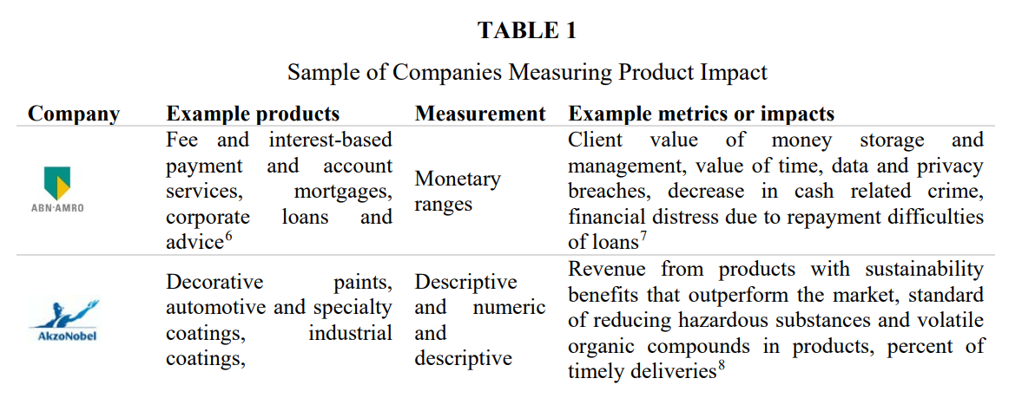
2.1 companies
the Handbook for Product Social Impact has created a consensus-based methodology to inform companies on how they can assess the impacts of products.5

Slide 5
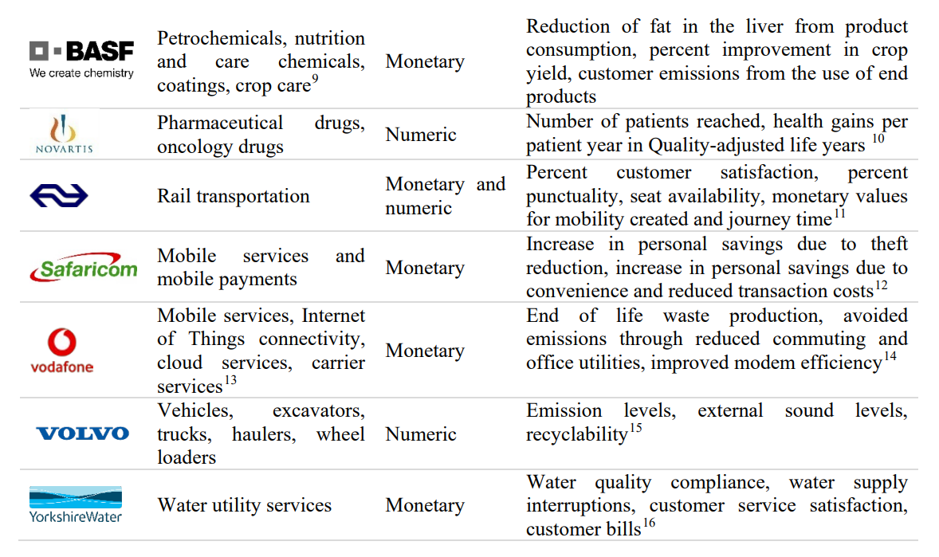

Slide 6
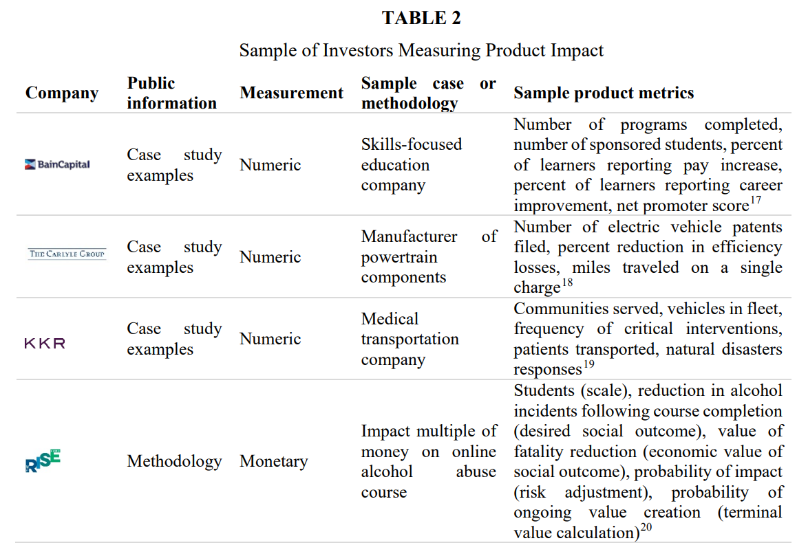
2.2 Investors

Slide 7
3.1 Framework design principle
In designing a standard product impact measurement framework, the five preliminary design principles for creating a methodology for impact-weighted accounts were applied.21
Consistency ensures the framework has constant units, scale, and approach.
Incentive alignment encourages consideration of the behavior that is incentivized by the framework to ensure it is aligned with positive social and environmental impact
Best-in-class benchmarking protects the impact of a product or industry from moving towards an unwanted average
Conservatism bases the framework in feasible assumptions and comparisons
the scope of impacts considered is limited to first-order effects from general usage of the product or service
We recognize this excludes impacts to both broader stakeholders in the value chain and higher-order impacts to the direct stakeholder, but make this limitation to allow for clear delineation and attribution
論文では、1次の効果までに制限すると明記している。

Slide 8
3.2 building the framework
a thought experiment was conducted in which the product impact of two products with identical features and qualities are compared. All else equal, the product with greater reach would have greater impact. Therefore, reach must be a dimension of product impact, composed of a product’s quantity and duration
Reach・・・性質が同じ二つの商品を比べたとき、リーチの大きい商品(販売量と持続長さ)のほうがインパクトが大きいだろう。
additional thought experiments can be conducted to explore the elements of a customer’s interaction with a product. Consider the impact of designer handbags and water where both products have the same reach.
Water would be viewed as more impactful because of the inherent goodness of the product. While water is a basic need that provides sanitation and prevents dehydration, a designer handbag is a luxury item with lower inherent utility. This example illustrates that quality is a dimension of a product’s impact.
To specify, quality as a dimension of impact therefore captures the extent to which a product provides a basic need of inherent goodness and the effectiveness of a product which can be measured by customer satisfaction, rather than the level of craftsmanship or leather that might be used in a designer bag
Quality・・・同じaccessの水とデザイナーハンドバックを比べたときに、水の方がinherent goodnessがあるため、インパクトが大きい(公衆衛生の提供と脱水予防)。技術の高さや皮の質ではなく、人間に対する本源的な価値や顧客満足度で測れるような効率性
consider the impact of a generic and prescription drug where both products have the same reach and quality, but the generic has a lower price. The lower priced generic would be viewed as more impactful since its pricing makes it more accessible to consumers.
Access・・・ジェネリックと普通の薬を比べたときに、安いほうがよい
Cigarettes have accessible pricing (especially in the absence of taxes), broad reach, and high customer satisfaction but are generally accepted as a product that is unequivocally bad. Regardless of the negative impacts of cigarettes, the product maintains broad reach due its addictive nature. Therefore, a dimension that product impact should capture is consumer optionality (i.e. if the consumer has the freedom to make choices). In cases of addictive products or monopolies this optionality is limited
Optionality・・・タバコは依存性があるために買ってしまう。消費者に選択の自由があること。依存性のある商品や独占市場はダメ

Slide 9
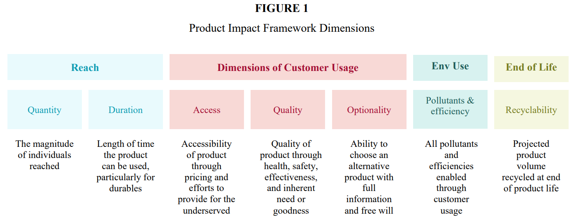
3.2 building the framework2
consider various products that produce energy, such as coal and solar. If the two products had the same price, reach, quality, and optionality, solar energy would have greater positive impact than coal because solar energy produces fewer emissions than coal when used. A product’s environmental impact through usage efficiency and end of life recyclability is a dimension of capturing a product’s overall impacts
太陽光発電は石炭よりもエコなのでインパクトが大きい

Slide 10
Reach
Reach examines how many individuals are reached by the product and the length of time for which the product can be used
Some sample metrics that can be used to estimate a product’s reach are sales volume or number of customers
Duration can be estimated with metrics such as average or expected product life
Reachはどのくらいの顧客に届いたか(売上 or 顧客数)×どのくらい使えるか (平均/期待商品寿命)

Slide 11
access
Access is how available a product is to consumers. This can be measured through product pricing and efforts to make the product available for underserved populations
Sample metrics that can be used to estimate affordability include the difference between a product’s price and average pricing in the market
For example, a consumer-packaged goods company could compare the price per calorie of their own products to the average price per calorie of all alternatives in the relevant product categories as identified by a standard research or reporting firm such as Nielsen.
Products that are priced below the relevant benchmark are deemed affordable and have a positive impact. Products that are priced above the relevant benchmark and luxury products are not deemed affordable and therefore do not have an affordability impact
For a product to qualify as accessible to the underserved, the product must address a UN Sustainable Development Goal in a market that would usually not have access to the product
cigarettes do not address a sustainable development goal but are sold in developing markets. They would not be viewed as products that address an underserved population even though they are serving a developing market because they make no contributions to development
On the other hand, a pharmaceutical company could estimate the averted medical and mortality costs and productivity gains of providing qualified drugs to underserved markets.
Accessはどのくらい商品が消費者に利用可能かを表す指標で、価格と利用可能でない人々(underserved population)へ商品を届けようとする努力で計算される
価格は市場価格との差で指標化。例えば、カロリー当たりの価格など。
Underservedへ利用可能にするために、SDGsのゴールを満たす必要。タバコは途上国でも売れているが、発展に寄与していないのでインパクトはなし。製薬会社はunderservedへの薬の提供による医療費/死亡費用の削減や生産性向上を計算できる

Slide 12
quality
Quality of a product can be measured by the health and safety, effectiveness, and inherent goodness of the product.
The health and safety of a product examines whether the product performs to expected health, safety and privacy standards
For a packaged food product, its health and safety would not be captured by how healthy the food product is, but by the costs associated with foodborne illnesses from product recalls.
Other metrics that can capture the health and safety of a product include controversies or data leaks associated with the product
The effectiveness of a product is whether the product works as it should
For packaged food products, effectiveness would be where the nutritional value of the product is captured. For example, the whole grains, fiber, added sugar, sodium, and trans-fat content of a product can be translated to costs associated with changes in risk of coronary heart disease or diabetes.
Where effectiveness cannot be readily observed, customer satisfaction can be used as a proxy measure
the necessity dimension of the product examines whether the product provides some basic need to the population
Elasticity can be used to identify products that are basic needs
Some other relevant metrics for estimating how the product addresses a basic need include global economic losses avoided through the product
the basic need component of a utilities company providing water would be captured through the averted economic losses from sanitation. Similarly, the basic need component of certain food products would be the averted economic losses of starvation
Qualityは健康/安全性、効率性、inherent goodnessで測定可能
健康/安全性は、製品がいかに期待された健康/安全/プライバシー標準を実現できたか。例えば、食品の安全/健康は、その商品がどのくらい健康であるかではなく、その食品によって食中毒を引き起こした場合のコストによってとらえることができる。
効率性は、製品が仕様通りに動いているか。例えば、食品なら含まれている成分から心臓病や肥満になるリスクに関連した費用。測れない場合、顧客満足度を代理に使うことも可能。
Inherent goodnessは基本的なニーズを満たしているか。価格弾性力は使える。また、製品による世界経済の損失の回避額。水道会社なら公衆衛生を保たなかった場合の損失や、食品会社は飢餓が生じた場合のロスなどが該当する

Slide 13
optionality
Optionality of a product is the extent to which consumers have free will and full information in their purchasing choices. The optionality in product choice is composed by information availability, monopolistic nature of the industry, and decision altering characteristics
Under information availability, sample metrics would include labeling and marketing controversies. For example, a water utilities company could use warning letters and fines around improper marketing to estimate the costs of inaccurate information to consumers
To identify products in an industry with monopolistic behavior, the Herfindahl-Hirschman Index (HHI) or four-firm concentration ration (CR4) can be used.
Monopolistic industries such as the pharmaceutical industry can estimate extractive rents to consumers by using the excess of costs associated with marketing to research and development
For decision altering products, sample metrics include how addictive a product is. A tobacco company could estimate the productivity and treatment costs associated with addiction itself
Optionalityは購入する選択をする際の情報の利用可能性/独占市場/中毒性によって計算できる
情報の利用可能性はラベルやマーケティングに対する苦情で測定できる。苦情の手紙や不適切なマーケティングに伴う罰金で測定可能
独占市場は、HHI/CR4などの指標で測定可能
中毒性。例えば、たばこ会社は中毒性による生産性と治療費を計算する。

Slide 14
Environmental use
Environmental impacts from product usage include emissions and other pollutants to the environment and efficiencies enabled through product use
Some sample metrics that capture the efficiency of a product are carbon or particulate emissions from use or energy required from use. A consumer-packaged goods company could identify the carbon cost of emissions that would be used for cooking and storage of the product

Slide 15
End of life recyclability
End of life environmental impacts are based on the end of life treatment of the product.
Sample metrics could include volume or percentage recyclability and recoverability. A pharmaceutical company could identify the associated carbon costs with the end of life treatment of products sold

Slide 16
5 application of the product impact framework
We focus our impact estimates on those of passenger fleet vehicles
5.1 Data collection process
The examples below are based on publicly disclosed data and industry-wide assumptions
Company datapoints reflect information found in the most recent annual financial statements such as the company’s Form 10-K and annual sustainability reports which often disclose SASB and GRI metrics. These examples make use of existing data and metrics from the perspective of incorporating publicly available data rather than judgement of materiality.
Industry-wide assumptions come from government agencies such as the US Department of Transportation or the Food and Drug Administration. Given the methodology determines monetary impacts, the industry wide assumptions inevitably rely on some market-determined price and valuations

Slide 17
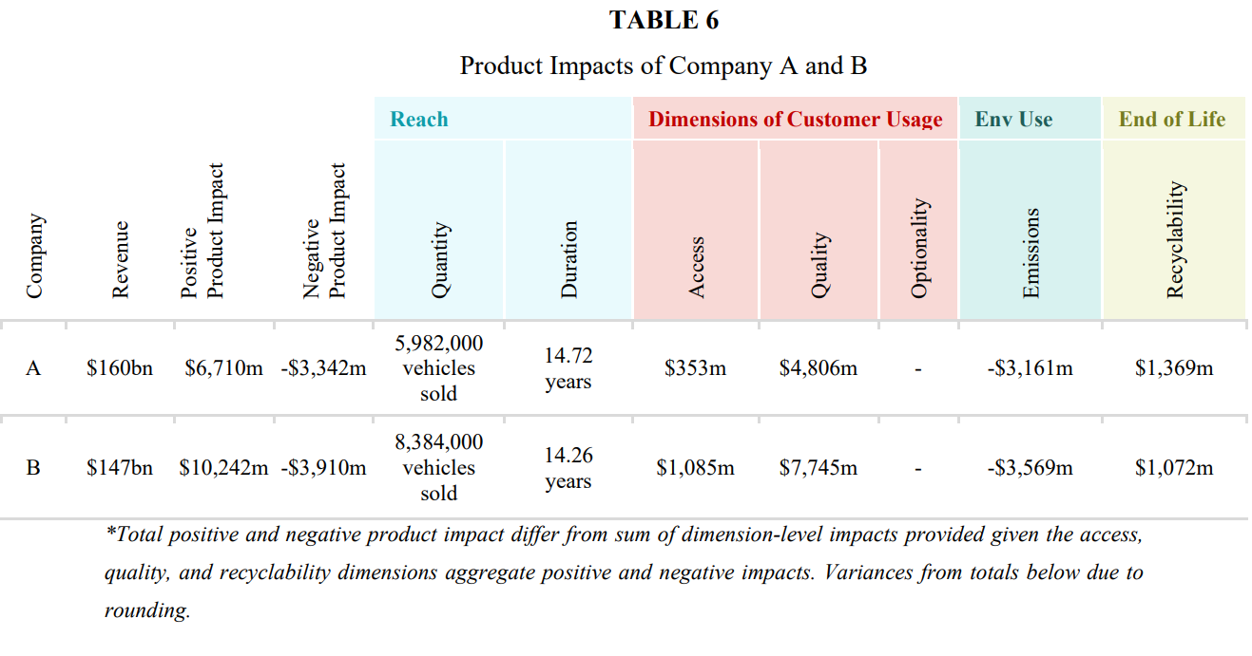
6 automobile manufacturing application of the product impact framework

Slide 18
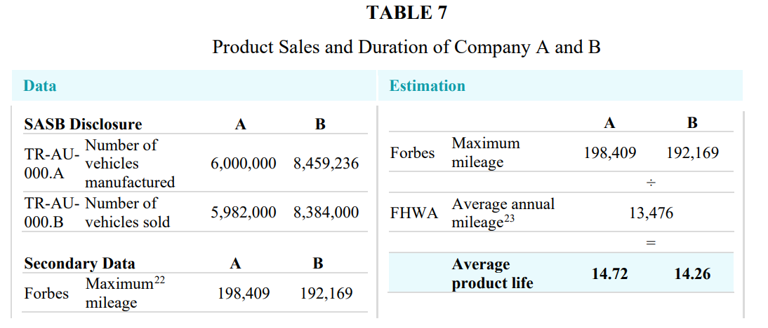
Reach
average annual mileage in the United States are used
Although annual mileage is specific to the United States, this does not indicate that the framework itself is only applicable in the United States. Instead, this is indicative of how an estimate can be influenced by data availability
If a company were to apply this framework, internal data on product life could be applied instead of calculating duration from a localized assumption

Slide 19
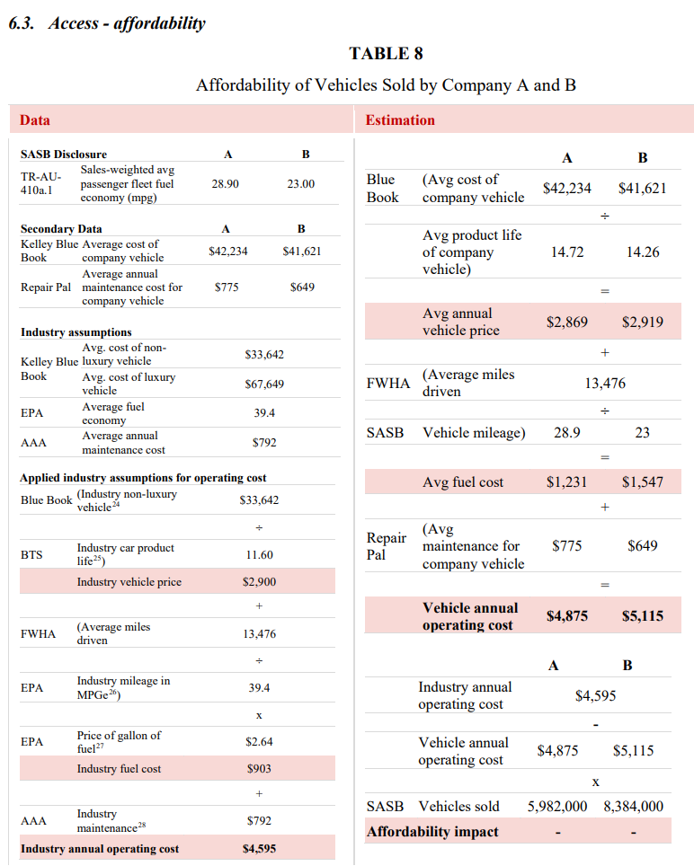
Access- affordability
kk

