Slide 1
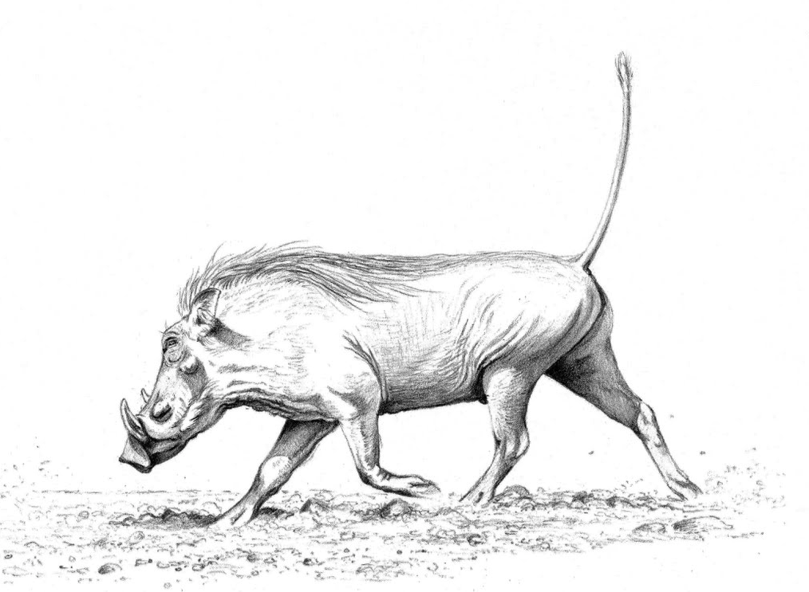
The Hog Language
Jason Halpern
Testing/Validation
Samuel Messing
Project Manager
Benjamin Rapaport
System Architect
Kurry Tran
System Integrator
Paul Tylkin
Language Guru
A scripting MapReduce language.

Slide 2
outline
Introduction (Sam)
Syntax (Paul)
Compiler Architecture (Ben)
Runtime Environment (Kurry)
Testing (Jason)
Conclusion

Slide 3
Introduction
Samuel Messing (Project Manager)

Slide 4
The simplest merge sort
0 @Map (int lineNum, text line) -> (text, text) {
1 foreach text number in line.tokenize(" ") {
2 emit(number, number);
3 }
4 }
5 @Reduce (text number, text garbage) -> (text, text) {
6 emit(number, "");
7 }
8 @Main {
9 mapReduce();
10 }

Slide 5
Word count (@Map)
0 @Map (int lineNum, text line) -> (text, int) {
1 # for every word on this line,
2 # emit that word and the number ‘1’
3 foreach text word in line.tokenize(" ") {
4 emit(word, 1);
5 }
6 }

Slide 6
Word count (@Reduce)
7 @Reduce (text word, iter<int> values) -> (text, int) {
8 # initialize count to zero
9 int count = 0;
10 while( values.hasNext() ) {
11 # for every instance of '1' for this word, add to count.
12 count = count + values.next();
13 }
14 # emit the count for this particular word
15 emit(word, count);
16 }

Slide 7
Word count (@Main)
@Main {
# call map reduce
mapReduce();
}

Slide 8
Syntax
Paul Tylkin (Language Guru)

Slide 9
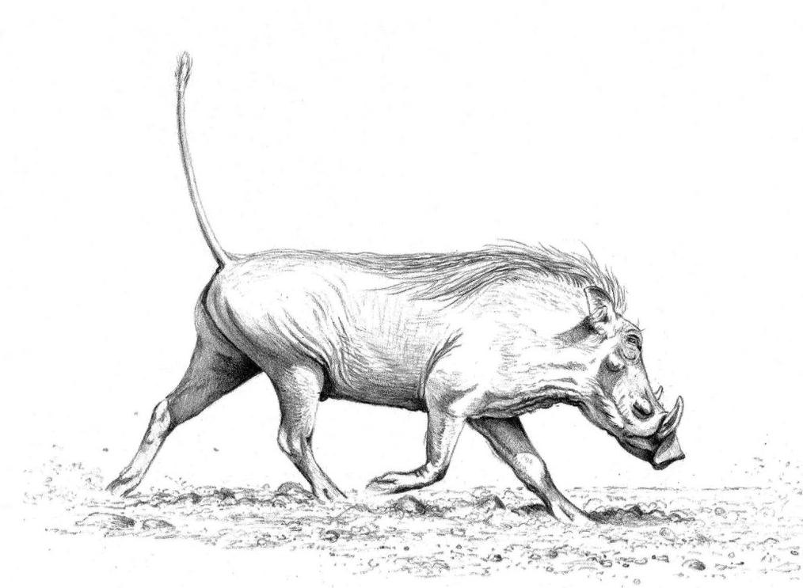
Thank you!

