Slide 1
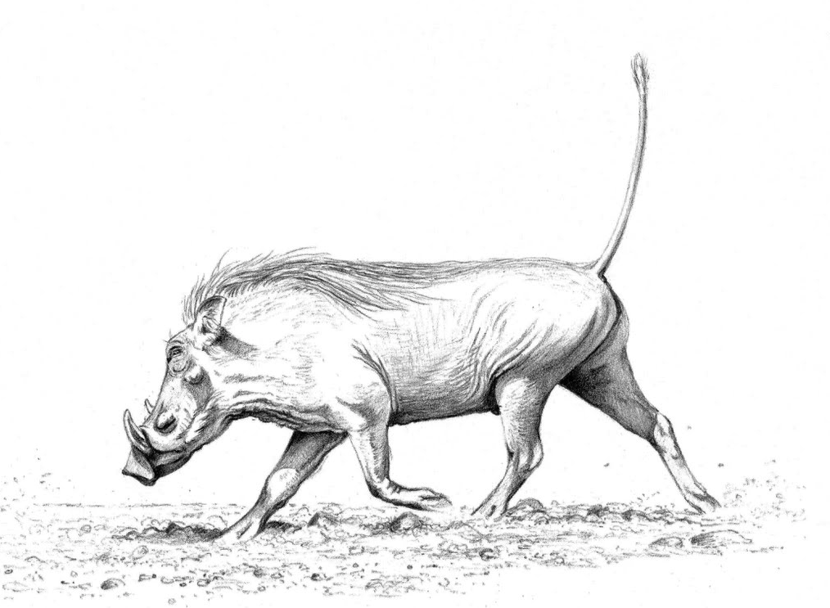
The Hog Language
Jason Halpern
Testing/Validation
Samuel Messing
Project Manager
Benjamin Rapaport
System Architect
Kurry Tran
System Integrator
Paul Tylkin
Language Guru
A scripting MapReduce language.

Slide 2
outline
Introduction (Sam)
Syntax (Paul)
Compiler Architecture (Ben)
Runtime Environment (Kurry)
Testing (Jason)
Demo
Conclusions

Slide 3
Introduction
Samuel Messing (Project Manager)

Slide 4
Motivation
Say you…
Say you…
are a webhost,
with terabytes of web logs,
and you just noticed a massive spike in avg. I/O times…
are a statistician,
with millions upon millions of data points,
and you need descriptive statistics about your sample…

Slide 5

It’s time to think distributedly.
More and more, we’re looking to distributed-computation frameworks such as Apache’s Hadoop MapReduce™ for ways to process massive amounts of data as quickly as possible…
Out
R
M
R
M
R
M
M
M
In
M

Slide 6
The simplest distributed sort
0 @Map (int lineNum, text line) -> (text, text) {
1 foreach text number in line.tokenize(" ") {
2 emit(number, number);
3 }
4 }
5 @Reduce (text number, text garbage) -> (text, text) {
6 emit(number, "");
7 }
8 @Main {
9 mapReduce();
10 }

Slide 7
The simplest distributed sort
These eleven lines of Hog code are enough to,
Read in gigabytes of data formatted as,
1293581234 821958 73872 87265982 4272 112371 5455423...
Distribute the data of over a highly-scalable network of computers,
Synchronize computation across multiple machines to sort and remove duplicate numbers,
Store the sorted set of numbers on a fault-tolerant distributed file-system.

Slide 8
Syntax
Paul Tylkin (Language Guru)

Slide 9
Word count (@Map)
0 @Map (int lineNum, text line) -> (text, int) {
1 # for every word on this line,
2 # emit that word and the number ‘1’
3 foreach text word in line.tokenize(" ") {
4 emit(word, 1);
5 }
6 }

Slide 10
Word count (@Reduce)
7 @Reduce (text word, iter<int> values) -> (text, int) {
8 # initialize count to zero
9 int count = 0;
10 while( values.hasNext() ) {
11 # for every instance of '1' for this word, add to count.
12 count = count + values.next();
13 }
14 # emit the count for this particular word
15 emit(word, count);
16 }

Slide 11
Word count (@Main)
@Main {
# call map reduce
mapReduce();
}

Slide 12
architecture
Benjamin rapaport (system Architect)

Slide 13
Hog Platform Architecture
Hog Source
Hog Compiler
Output
Hog.java
Java Compiler
Reduce
Hog.jar
Input
Hadoop Framework
Map

Slide 14


Hog Compiler Architecture
Hog Source
Java MapReduce Program
Lexer
Java Generating Visitor
Token Stream
Fully Decorated AST
Parser
Symbol Table
Semantic Analyzer
AST
Fully Decorated AST
Symbol Table Visitor
Type Checking Visitor
Partially Decorated AST

Slide 15
runtime
Kurry tran (System integrator)

Slide 16
Testing
Jason halpern (testing/validation)

Slide 17
demo

Slide 18
conclusions
The hog team

Slide 19
conclusions
Modularity is key
Expend the effort to reduce development time
Pair down your goals as much as possible in the beginning, allow yourself to not know at every stage how your language will develop.
Work in the same room as your teammates

Slide 20
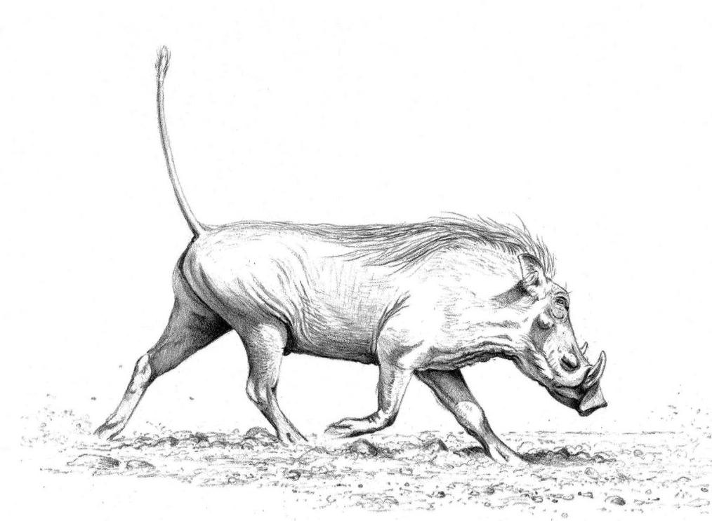
Thank you!

