Slide 1
CIRCUIT THEORY II
LECTURE NO. 5
By Severinus Kifalu
2021

Slide 2
INTRODUCTION
This lecture is based on the spirit in some excerpts from the book “Theoretical Fundamentals of Electrical Technology”, by Lev Alexison Bessonov (Lev Alekceivich Bessonov), translated and ,where necessary, modernized by Severinus Kifalu.
The original book is listed in Amazon by the title, “Applied Electricity for Engineers, by L.A. Bessonov”
Severinus Kifalu is a lecturer at the department of Electrical and Communications Engineering of Moi University.

Slide 3
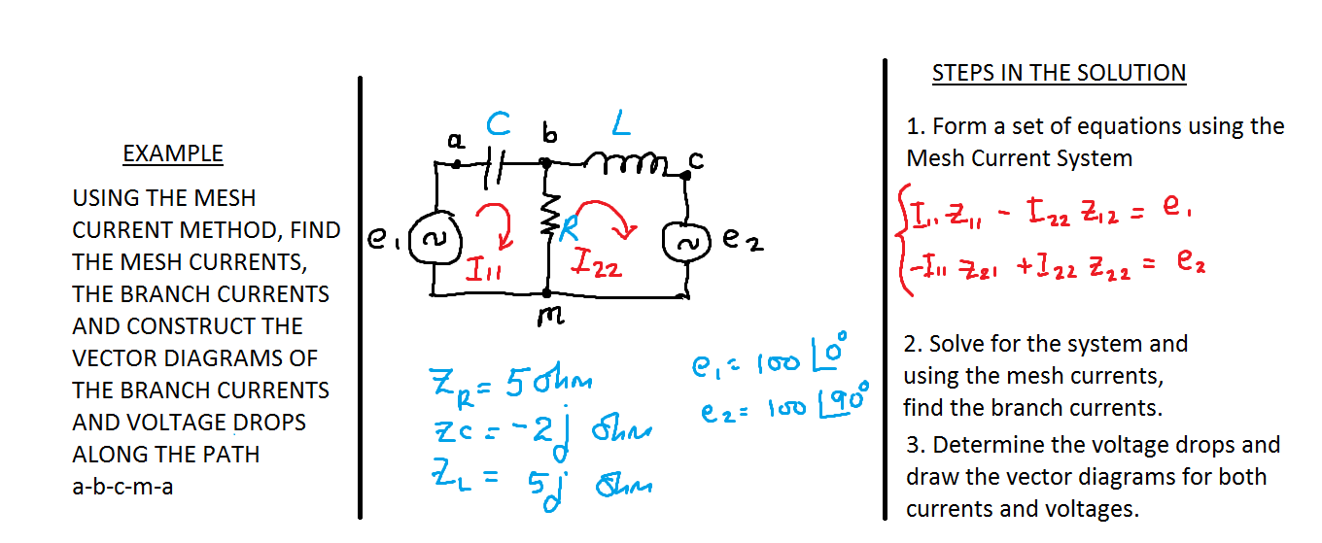
AC MESH CURRENT SYSTEM EXAMPLE

Slide 4
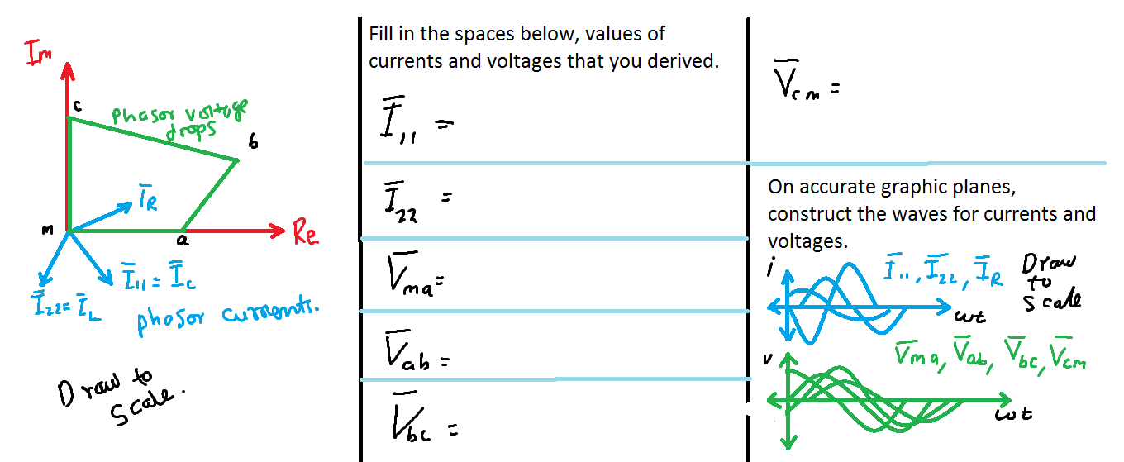

Slide 5
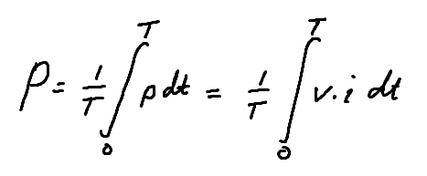
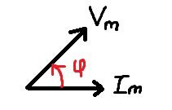
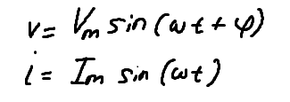
ACTIVE, REACTIVE AND COMPLETE POWER IN AC CIRCUITS
The ACTIVE POWER, P, is defined as the average value of the instantaneous power wave over a period T.
Where:

Slide 6
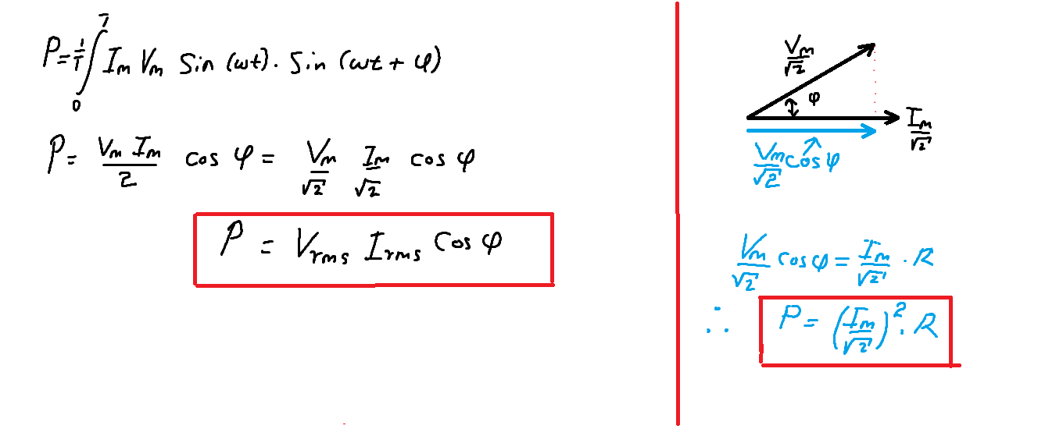
Further we see that the ACTIVE POWER is physically the heat that is delivered on a Resistor R over a period T. The unit of active power is - Watts.

Slide 7
Therefore the ACTIVE POWER is the power delivered as heat on the resistance R and is summarily defined as:
Where:

Slide 8
The REACTIVE POWER, Q, is defined as the product of the voltage ν , the current ί and the sine of the angle ϕ (where ϕ is the difference of the phase angles between the voltage and current waves).
This is not a dissipated form of energy. Rather it is the energy used to set up an Electric and Magnetic field in the capacitor and inductor respectively. During the ac cycle the reactive power is taken back and forth, to source. The unit of this power is VAR

Slide 9
The COMPLETE POWER , S, is mathematically defined as
The unit of this power is Volt-Ampere (V.A)
The power quantities P, Q and S are linked through the following relationship,

Slide 10
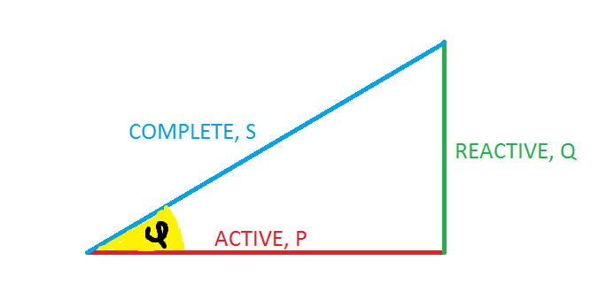
Graphically the above relationship can be presented through what is now widely known as “Power Triangle”.

Slide 11
NOTE that most generating machines and transformers are supplied with the S power specification in ratings such as VA, KVA, MVA,GVA etc. This is the power that the machine would supply under the conditions that Cos ϕ=1 (meaning ϕ in the power triange is ZERO, that is saying the load is a pure resistance ).

Slide 12
CALCULATION OF AC POWER USING COMPLEX FORM OF EXPRESSION
FROM MATHEMATICS
If there is a complex number or quantity
Then the complex conjugate of this is

Slide 13
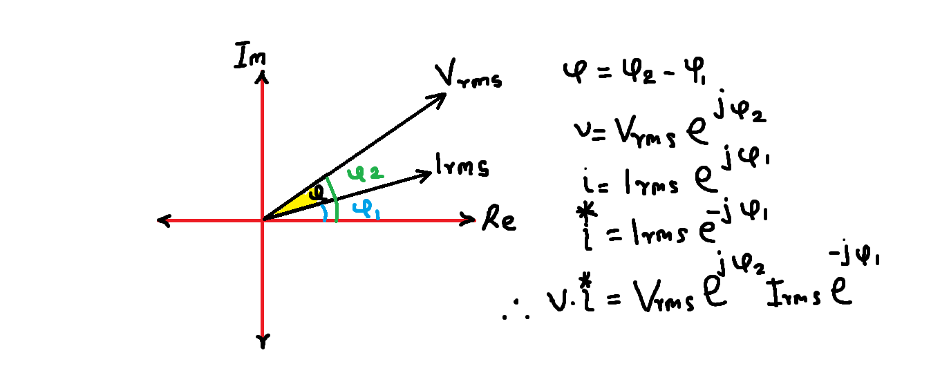
On the basis of complex numbers and their conjugates we can write the following below equations.

Slide 14
A simple method of calculating all the power quantities - S,P and Q -that relies on only the complex voltage across the load and the complex current in the load is shown here. The complex RMS voltage is multiplied with the complex conjugate of the RMS current and from the resulting product, the magnitude of the phasor is the complete power S. The real part of the phasor is the active power P. And the imaginary part of the phasor is the reactive power Q.
This is illustrated below.

Slide 15
It is now shown how these quantities are related in complex number notation.
Let
Then S, P and Q are given by the relationships

Slide 16
Therefore it follows that

Slide 17
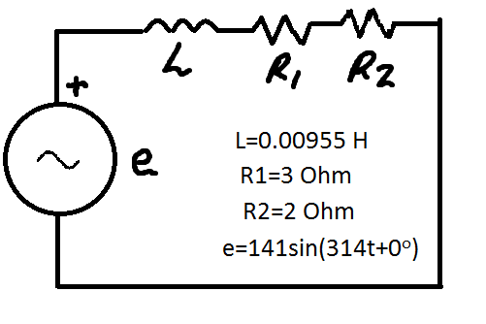
EXAMPLE:
Determine the Active, Reactive and Complete power for the given

Slide 18
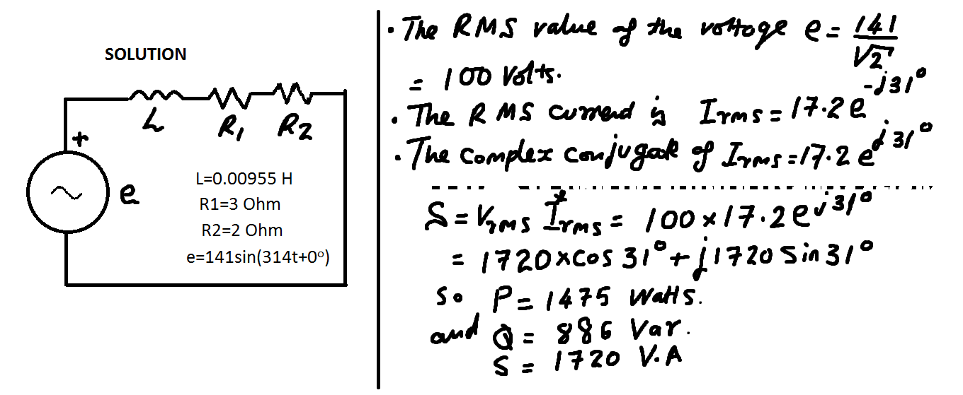
SOLUTION SUMMARY

Slide 19
USING A WATTMETER TO MEASURE AC POWER
In present day engineering practice, the active, reactive and complete powers are measured using digital electronic wattmeters.
A simple moving coil wattmeter that is based on Electro-dynamic Meter movement is found in many Laboratories (discussed in courses on electrical measurements)

Slide 20
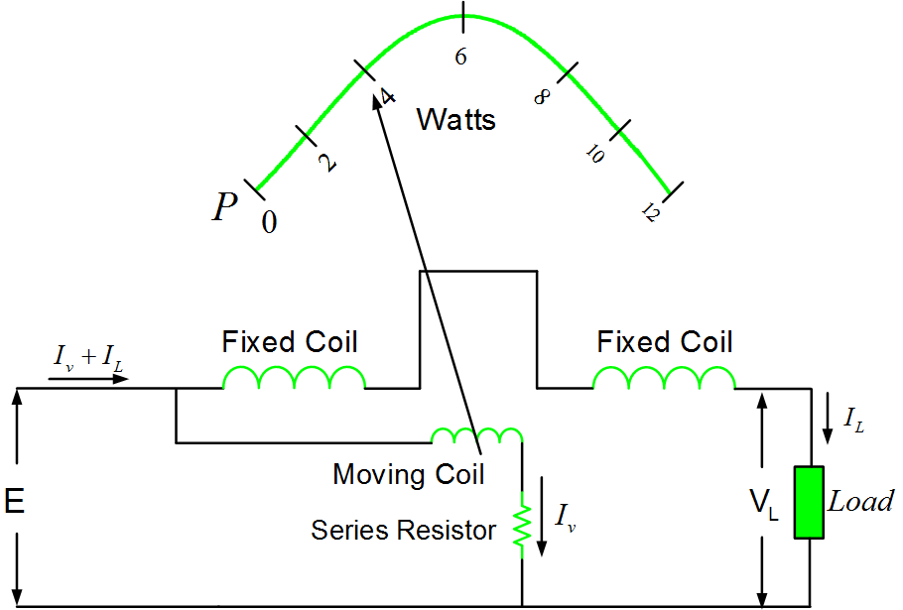
Figure of Power Meter (source: electricalacademia.com)
Shown here is
an Electro-
dynamic
Meter movement.

Slide 21
The Electrodynamic Wattmeter has two coils.
One coil of low resistance carries a heavy current which is equal to the current I_{L} in the load R_{L}. This coil is called the series coil and, in some literature, it is called the current coil. Since it doesn’t move it is also called the Fixed coil.
The other coil has a high resistance. It carries the current I_{v} and it is connected in parallel with the Load R_{L}. This coil is called the Parallel coil, and it is also called the pressure coil, Voltage Coil or Movable Coil-it moves the pointer.

Slide 22
On the real Wattmeter, one end of each of these coils is marked with a dot or star. This mark signifies the start side of the coils. These should be considered as the entry ends for the current and voltage to be measured.
The Electrodynamic Wattmeter can measure both DC and AC power. Reversing the connections for the current or voltage will result in a negative deflection whether it is AC or DC power being measured. The figure below illustrates all points discussed above

Slide 23
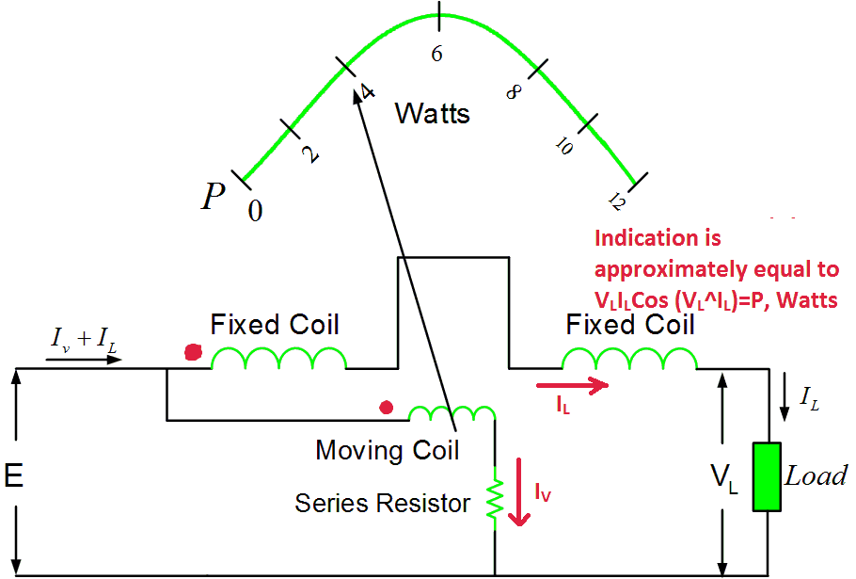
How it measures power

Slide 24
The indication of the power meter is proportional to average value of the power wave. If a sine wave current is I and a sine wave voltage is V then the product VxI is a power wave (no longer sine). The average value of this power wave is actually V_{rms}xI_{rms}xCos ϕ =P. Now P is the active power in Watts. Therefore the Electrodynamic power meter primarily measures the Active Power in Watts, and special arrangements or supporting instruments are used to with it for measurement of reactive power.

Slide 25
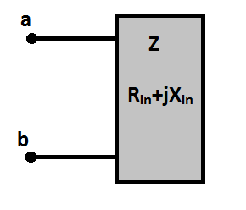
EXAMPLE
Consider a “AC - one port network” with an input impedance z= R_{in}+jX_{in}. Experimentally determine the values of R_{in} and X_{in} and also determine the character (Inductance or Capacitance) of X_{in}.

Slide 26
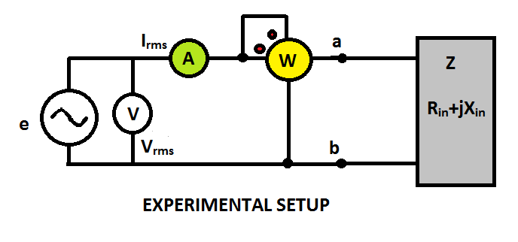
Pattern of solution.
Using the above experimental setup we get

Slide 27
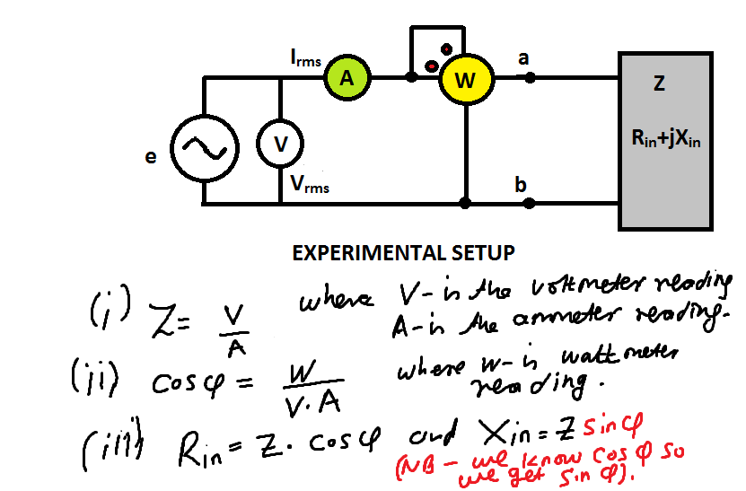
Cont.

Slide 28
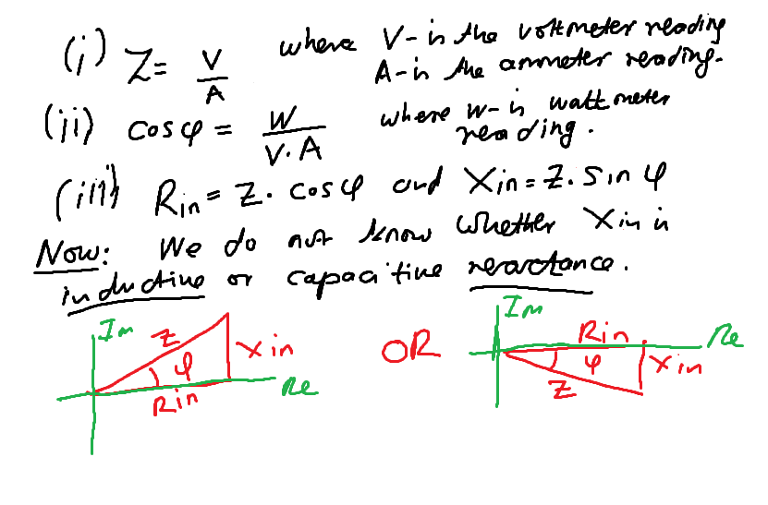

Slide 29
To determine if the reactance is inductive, therefore resulting in a lagging power factor, connect a small capacitance across the terminals a-b in the experimental circuit above. If the ammeter current reduces, then Xin is inductive, causing a lagging power factor.
The opposite is true if the ammeter current increased (i.e we have a leading power factor and the reactive load is capacitive).

Slide 30
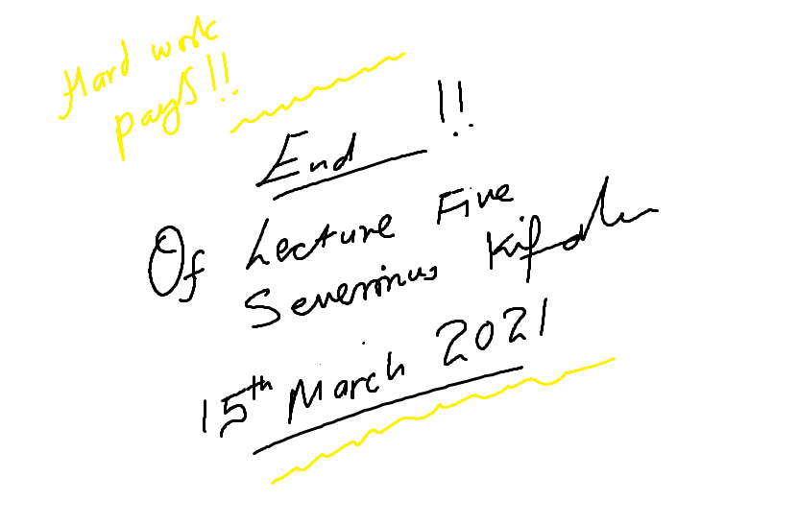
END OF LECTURE

