Slide 1

EMPLOYEE MANAGEMENT SYSTEM
DATA ANALYSIS USING SQL
Project Associates
Vinjamara Vamshi Krishna
Rapalli Sriram
Baratam Balaji Sai Rohith
Gogireddy Sivamani Kumar Reddy

Slide 2

About Us
Name : Vinjamara Vamshi Krishna
Education : MBA (Business Analytics & Human Recourse)
Linked in : https://www.linkedin.com/in/vinjamara-vamshi-krishna-581611354/
Name : Gogireddy Sivamani Kumar Reddy
Education : Btech (CSE Data Science)
Linked in : www.linkedin.com/in/sivamani-kumar-reddy-gogireddy-346665259
Name : Rapalli Sri Ram
Education : Btech (EEE)
Linked in : https://www.linkedin.com/sriram-rapalli-3b08a133b
Name : Baratam Balaji Sai Rohith
Education : Btech (IT)
Linked in : https://www.linkedin.com/in/baratam-balaji-sai-rohith-434571254/

Slide 3
Objectives of the Employee Management System
To design and develop a relational database for managing employee information.
To store employee details such as Employee ID, Name, Department, Salary, and Designation.
To establish relationships between Employees, Departments, and other related tables.
To perform CRUD operations (Create, Read, Update, Delete) efficiently using SQL.
To retrieve and analyze employee data using JOIN, GROUP BY, and aggregate functions.
To maintain data integrity using Primary Key and Foreign Key constraints.
To improve accuracy, reduce manual work, and ensure organized data management.

Slide 4
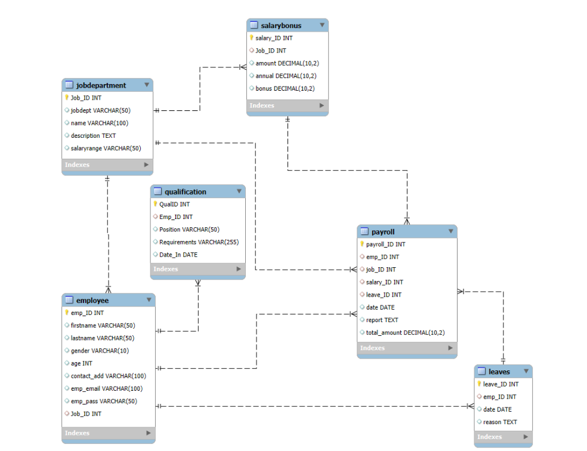
ER Diagram

Slide 5
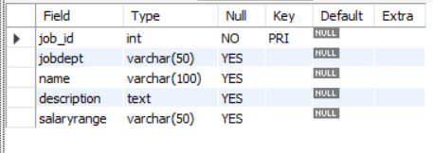
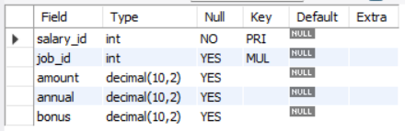
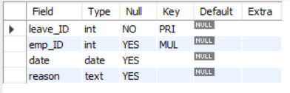
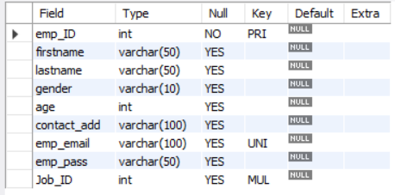
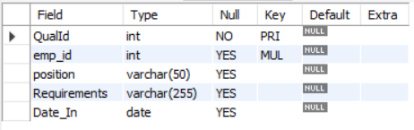
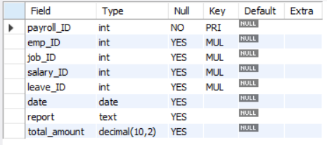
Tables
1. Job Department Table
2. Salary Bonus Table
3. Leaves Table
4. Employee Table
5. Employee Qualification Table
6. Payroll Table

Slide 6
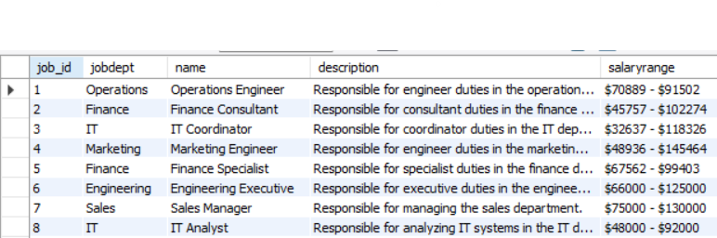
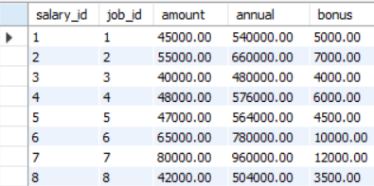
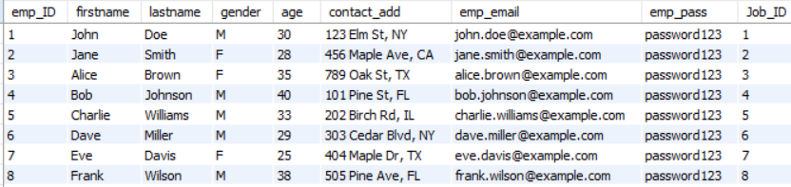
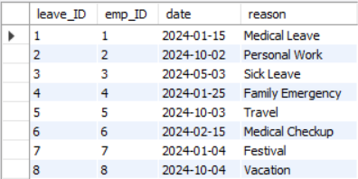
Tables After Data Insertion
1. Job Department Table
2. Salary Bonus Table
3. Employee Table
4. Leaves Table

Slide 7
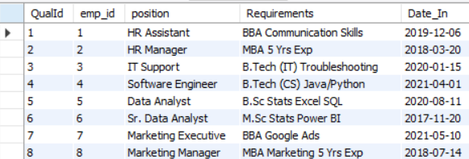
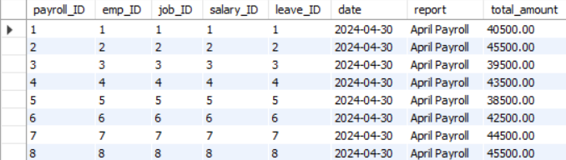
5. Employee Qualification Table
6. Payroll Table

Slide 8
Key Analysis Questions (Use Cases)
1. EMPLOYEE INSIGHTS
1.1 How many unique employees are currently in the system?
1.2 Which departments have the highest number of employees?
1.3 What is the average salary per department?
1.4 Who are the top 5 highest-paid employees?
1.5 What is the total salary expenditure across the company? 2. JOB ROLE AND DEPARTMENT ANALYSIS
2.1 How many different job roles exist in each department?
2.2 What is the average salary range per department?
2.3 Which job roles offer the highest salary?
2.4 Which departments have the highest total salary allocation?
3. QUALIFICATION AND SKILLS ANALYSIS
3.1 How many employees have at least one qualification listed?
3.2 Which positions require the most qualifications?
3.3 Which employees have the highest number of qualifications?
4. LEAVE AND ABSENCE PATTERNS
4.1 Which year had the most employees taking leaves?
4.2 What is the average number of leave days taken by its employees per department?
4.3 Which employees have taken the most leaves?
4.4 What is the total number of leave days taken company-wide?
4.5 How do leave days correlate with payroll amounts?

Slide 9
5. PAYROLL AND COMPENSATION ANALYSIS
5.1 What is the total monthly payroll processed?
5.2 What is the average bonus given per department?
5.3 Which department receives the highest total bonuses?
5.4 What is the average value of total_amount after considering leave deductions?

Slide 10

1. EMPLOYEE INSIGHTS
1.1 How Many Unique Employees are currently in the System?
Insight :
The system currently records 60 employees, representing the total workforce managed within the database. This dataset enables further analysis of department distribution, salary expenditure, leave patterns, and payroll trends.
Output :

Slide 11
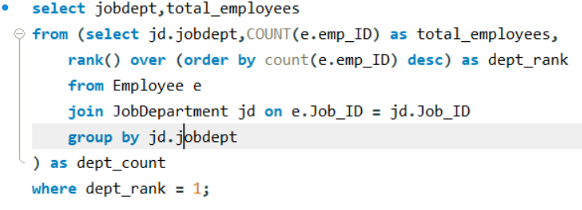
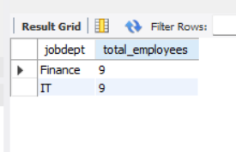
1.2 Which departments have the highest number of employees?
Insight :
The Finance and IT departments have the highest number of employees (9 each), indicating that these departments require the largest workforce to support the organization’s operational and technological functions.
Output :

Slide 12
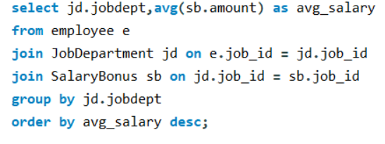
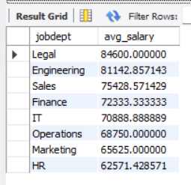
1.3 What Is the Average salary Per department ?
Insight :
The Legal department has the highest average salary (84.6K), followed by Engineering (81.1K), reflecting the need for specialized expertise in these fields. In contrast, HR and Marketing have lower average salaries, suggesting a different compensation structure based on role specialization and operational requirements.
Output :

Slide 13
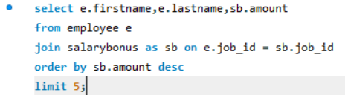
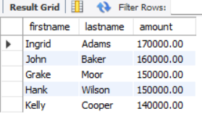
1.4 Who are the top 5 highest-paid employees?
Insight :
The top five highest-paid employees earn between 140,000 and 170,000, with Ingrid Adams receiving the highest salary of 170,000. This indicates that senior or specialized roles in the organization command significantly higher compensation.
Output :

Slide 14
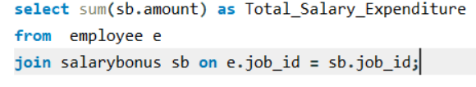

1.5 What is the total salary expenditure across the company?
Insight :
The company’s total salary expenditure is approximately 4.32 million, indicating a significant investment in employee compensation. With 60 employees in the system, the estimated average salary per employee is around 72K, reflecting the organization’s compensation structure across departments.
Output :

Slide 15
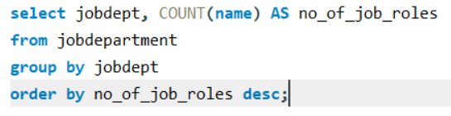
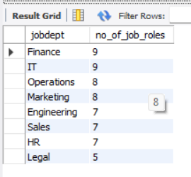
2. JOB ROLE AND DEPARTMENT ANALYSIS
2.1 How many different job roles exist in each department?
Insight :
The Finance and IT departments have the highest role diversity with 9 job roles each, indicating complex functional structures. In contrast, the Legal department has only 5 roles, reflecting a more specialized and streamlined team.
Output :

Slide 16
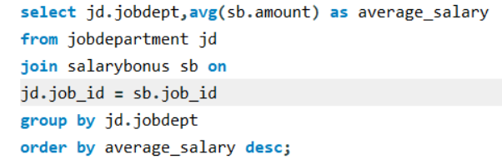
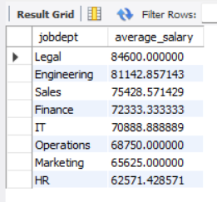
2.2 What is the average salary per department?
Insight :
The Legal and Engineering departments have the highest average salaries, reflecting the need for specialized expertise. In contrast, HR and Marketing have lower average salaries, indicating different compensation structures based on role specialization and operational responsibilities.
Output :

Slide 17
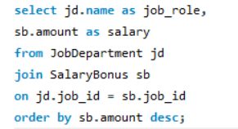
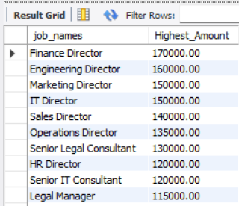
2.3 Which Job roles offer the highest salary
Insight :
The Finance Director role offers the highest salary (170,000), followed by other director-level positions such as Engineering and Marketing Directors. This indicates that leadership and strategic roles receive the highest compensation within the organization.
Output :

Slide 18
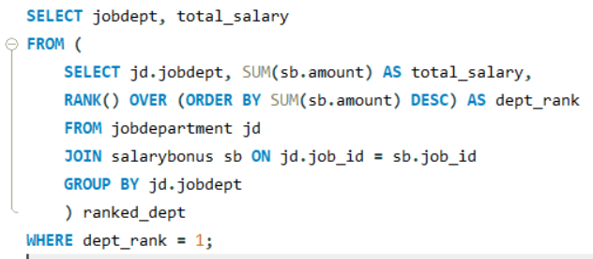

2.4 Which departments have the highest total salary allocation?
Insight :
The Finance department has the highest total salary allocation (651,000), indicating that the organization invests significantly in financial leadership and expertise to manage budgeting, planning, and strategic financial operations.
Output :

Slide 19

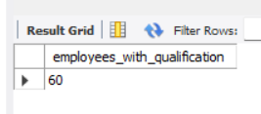
3. QUALIFICATION AND SKILLS ANALYSIS
3.1 How many employees have at least one qualification listed?
Insight :
All 60 employees in the system have at least one qualification recorded, indicating a fully qualified workforce and suggesting that the organization prioritizes education and professional credentials during recruitment.
Output :

Slide 20
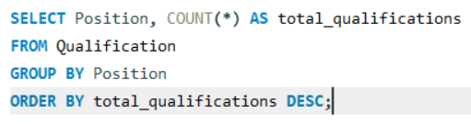
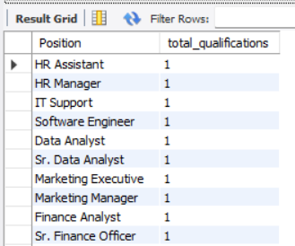
3.2 Which positions require the most qualifications?
Insight :
Each job position in the dataset has exactly one qualification requirement, indicating a standardized and clearly defined qualification structure for roles within the organization.
Output :

Slide 21
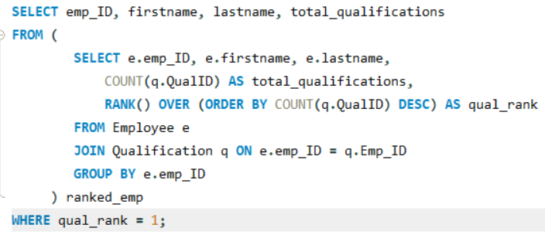
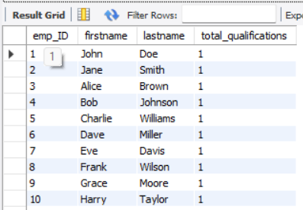
3.3 Which employees have the highest number of qualifications?
Insight :
All employees have exactly one qualification recorded, indicating a standardized qualification structure where each employee is associated with a single primary credential.
Output :

Slide 22
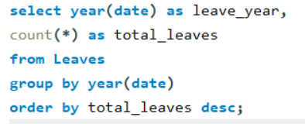

4. LEAVE AND ABSENCE PATTERNS
4.1 Which year had the most employees taking leaves?
Insight :
The year 2024 recorded the highest number of leaves with 60 leave entries, indicating that all recorded leave activity in the dataset occurred during this year.
Output :

Slide 23
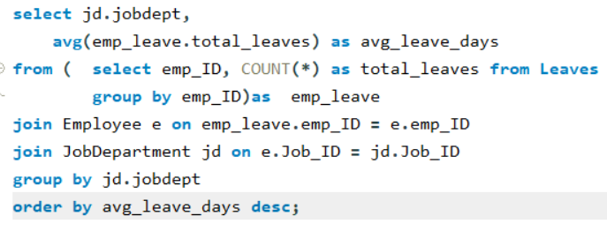
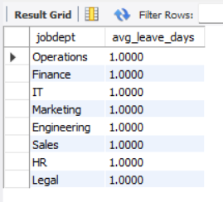
4.2 What is the average number of leave days taken by its employees per department?
Insight :
The average number of leave days per employee is 1 across all departments, indicating consistent leave utilization and balanced workforce attendance throughout the organization.
Output :

Slide 24
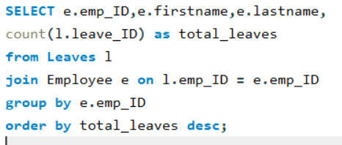
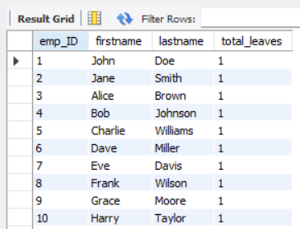
4.3 Which employees have taken the most leaves?
Insight :
All employees have exactly one recorded leave, indicating a uniform leave distribution with no employee taking more leave than others in the dataset.
Output :

Slide 25

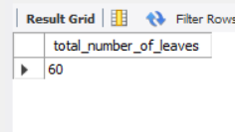
4.4 What is the total number of leave days taken company-wide?
Insight :
Employees collectively took 60 leave days across the organization, averaging one leave day per employee, indicating balanced leave utilization within the workforce.
Output :

Slide 26
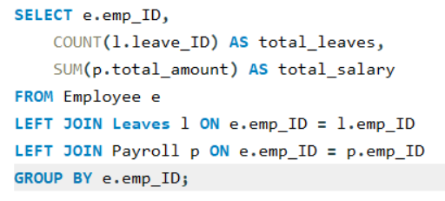
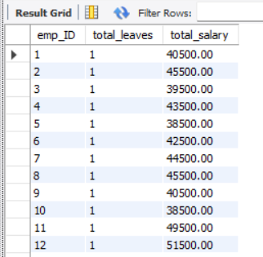
4.5 How do leave days correlate with payroll amounts?
Insight :
All employees have one leave day, while payroll amounts vary across employees. This indicates that payroll differences are driven by job roles and salary structures rather than leave deductions, making it difficult to identify a correlation between leave days and payroll in this dataset.
Output :

Slide 27
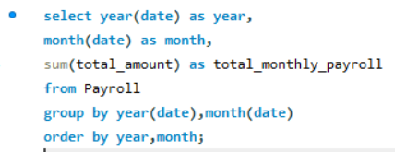
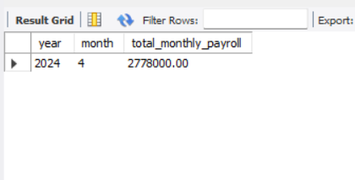
5. PAYROLL AND COMPENSATION ANALYSIS
5.1 What is the total monthly payroll processed?
Insight :
The total payroll processed in April 2024 was 2,778,000, representing the company’s monthly salary expenditure for employees during that period.
Output :

Slide 28
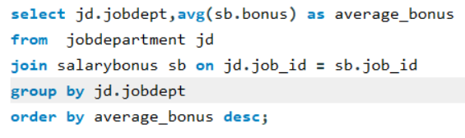
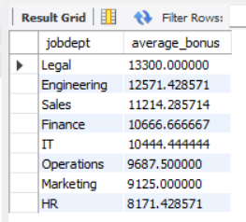
5.2 What is the average bonus given per department?
Insight :
The Legal department receives the highest average bonus (13.3K), followed by Engineering (12.6K). In contrast, HR and Marketing have lower average bonuses, indicating differences in incentive structures across departments based on role specialization and responsibilities.
Output :

Slide 29
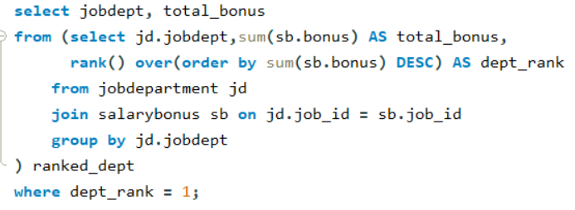
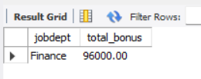
5.3 Which department receives the highest total bonuses?
Insight :
The Finance department receives the highest total bonus allocation (96,000), indicating that employees in this department receive the largest share of incentive rewards within the organization.
Output :

Slide 30
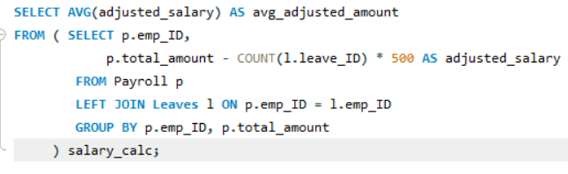

5.4 What is the average value of total_amount after considering leave deductions?
Insight :
After considering leave deductions, the average adjusted payroll amount is 45,800, showing the average salary employees receive after accounting for leave-related deductions.
Output :

Slide 31
SQL Query Results & Insights
To wrap things up, our data analysis doesn't just show us where we are; it highlights what we need to fix.
On the business side, we need to review if our top-heavy compensation and flat bonus structures are actually driving the behaviors we want.
On the technical side, this analysis exposed some major gaps in our data collection.
Our leave tracker is currently generating uniform, constrained data, and our payroll records are limited to a single month.
My primary recommendation is that IT and HR collaborate to clean up these data pipelines so our future reporting can be even more accurate.

Slide 32
Final business insights and recommendations
To conclude, running the numbers is only half the job; the real value is in how we respond to them.
From a strategic standpoint, we have an opportunity to modernize our compensation bands—specifically by making our bonus structures more performance-driven to engage our mid-level talent.
From a technical and analytics standpoint, this project highlighted critical blind spots.
Our leave tracking is capturing default constraints rather than real human behavior, and our payroll data lacks the historical depth needed for predictive forecasting.
Fixing these data pipelines should be an immediate priority for our internal technical teams.
If we look at cost efficiency, we see an interesting split in our HR strategy. We are maintaining large, operational teams in Finance and IT where the average compensation is tightly controlled in the $70,000 range.

Slide 33
Conclusion
Operational Investment vs. Premium Talent: The organization concentrates its largest headcount and total payroll budgets in core infrastructure teams (Finance and IT), while paying the highest per-capita premiums for specialized roles (Legal and Engineering).
Top-Heavy Compensation Structure: Financial rewards are strictly hierarchical, with Director-level positions exclusively dominating the top earnings and average bonuses acting as a rigid percentage of base pay rather than reflecting dynamic performance.
Critical Data Integrity Limitations: The HR database exhibits severe synthetic constraints—specifically, an artificial flat-rate of exactly one leave day per employee and a lack of historical payroll data outside of April 2024.
Strategic Path Forward: To transition from basic baseline reporting to advanced HR analytics, leadership must first audit the data ingestion pipelines to capture real-world variance, followed by a strategic review of mid-level compensation and performance metrics.

Slide 34


Slide 35
Experience & Challenges
Before we conclude, I want to briefly touch on the experience of working with this dataset and the challenges we encountered.
On the positive side, the relational structure of the database was very clean, which made it straightforward to aggregate our core HR metrics.
However, our biggest challenge was the data constraints.
Because the attendance data assigned exactly one leave to every employee, and the payroll data was isolated to just April 2024, we were limited in our ability to run real-world correlation models or long-term forecasts.
Recognizing these limitations is what drives our recommendation to expand our historical data ingestion moving forward.

Slide 36

THANK YOU

