Slide 1
Lottery
File created on: 5/3/2025 6:16:50 PM

Slide 2
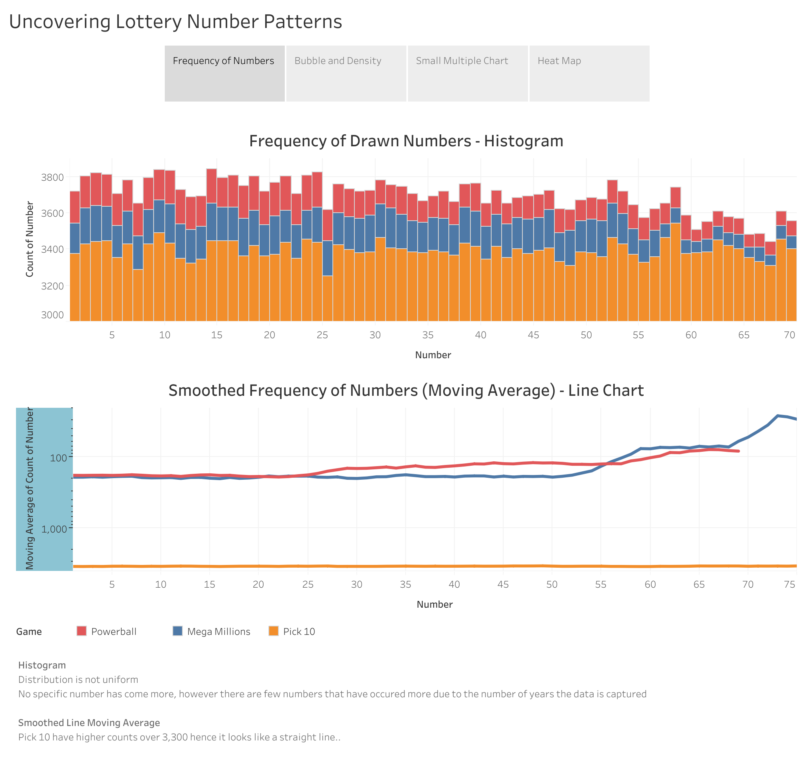

Slide 3
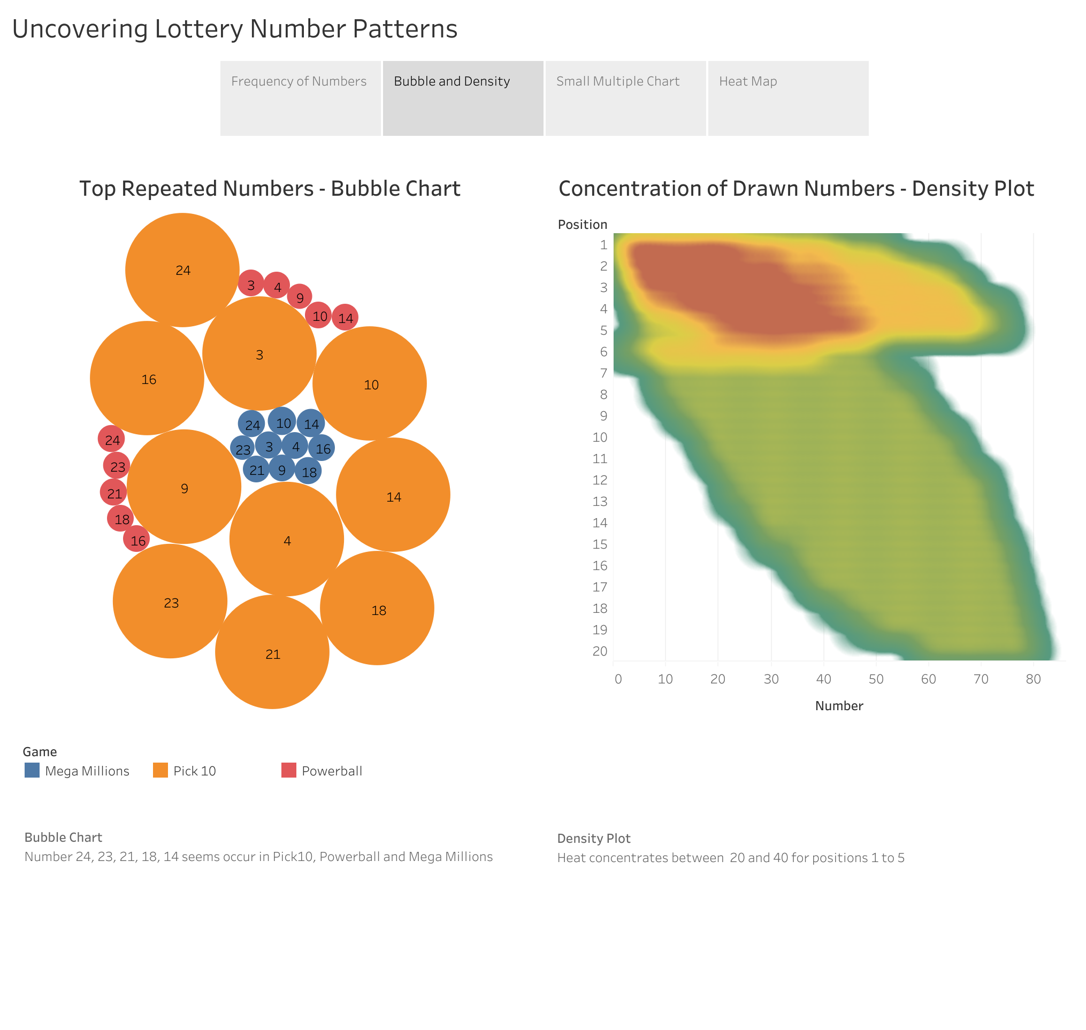

Slide 4
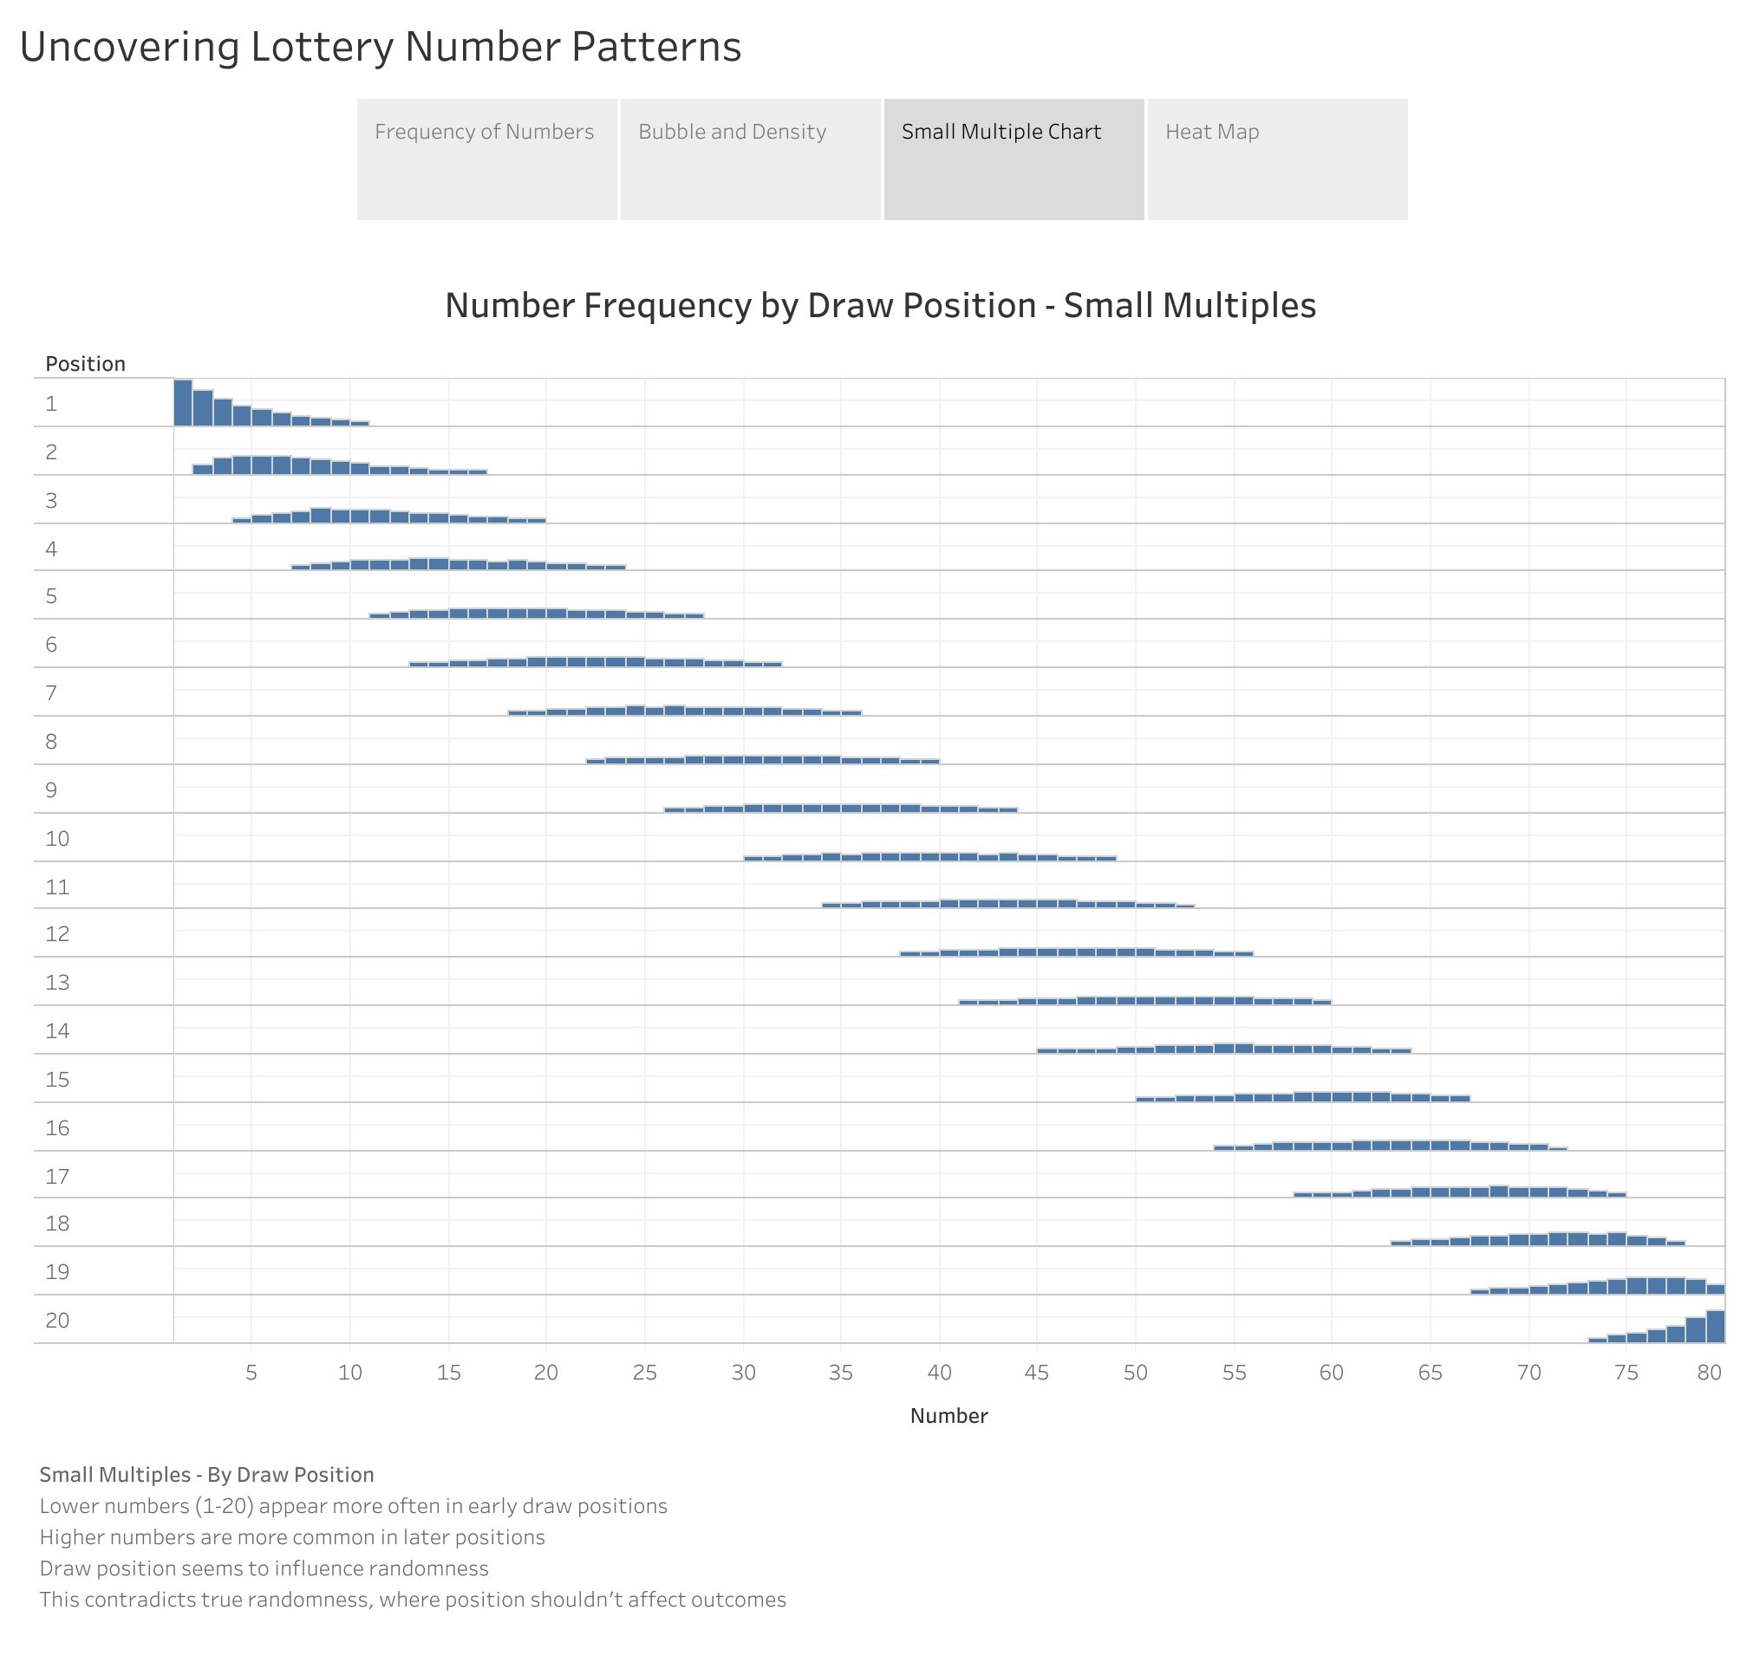

Slide 5
