Slide 1

Prepared by Barath Anandaraman
TSA Complaints
Pattern Identification
May 17, 2025

Slide 2
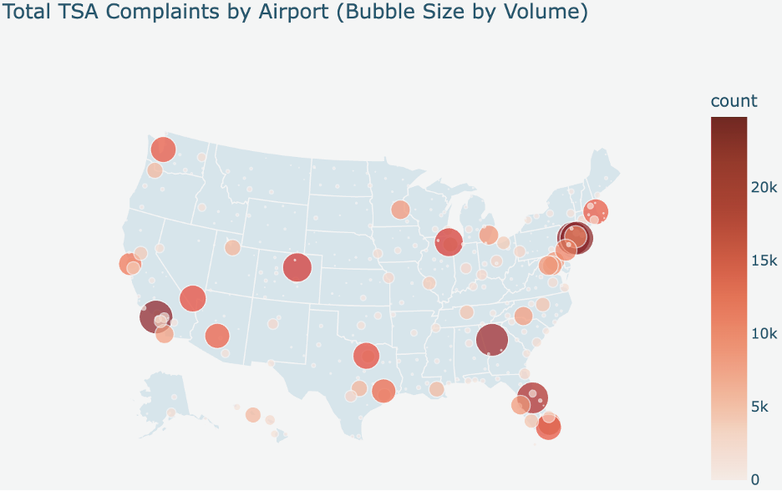
Complaints by Geo location
The map clearly visualizes the geographical distribution of TSA complaints, highlighting specific airports or regions that experience a higher concentration of complaints. This pinpoints areas where operations or passenger experiences might require localized attention.
Different regions exhibit varying densities of complaints, suggesting that factors such as airport size, passenger volume, operational procedures, or regional passenger demographics might influence complaint rates.

Slide 3
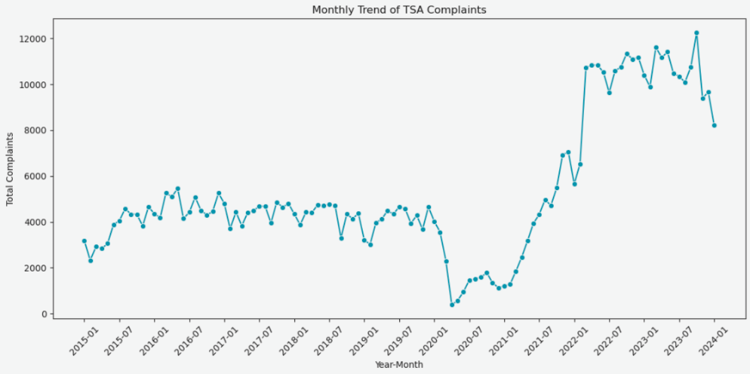
Trend of TSA Complaints
Briefly during the Covid pandemic period the complaints have dropped off significantly mostly due to lesser air travel
More complaints from 2022 showing significant increase post the pandemic
Further review needed for the sudden surge from 2022 January
Occasional spikes noticed on the graph, this could be regular seasonal travel spike

Slide 4
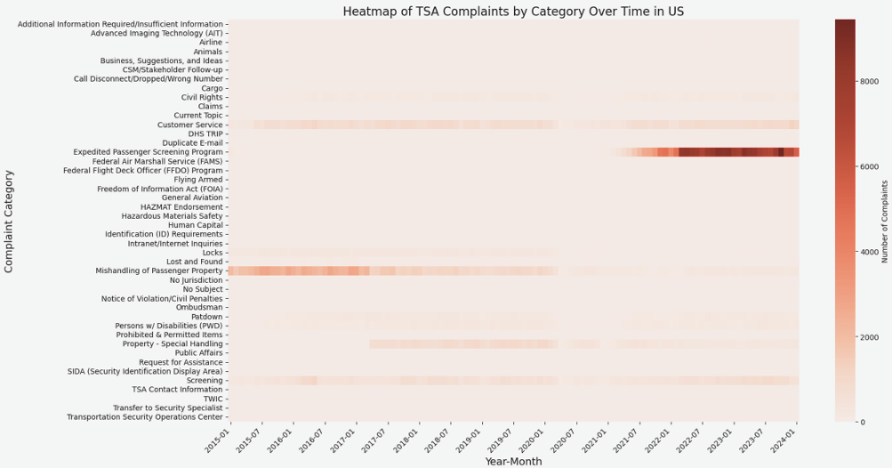
Heatmap Complaints over Time
Heat is more in 'Expedited Passenger Screening Program' followed by 'Mishandling of Passenger Property'
'Expedited Passenger Screening Program' seems to have started from 2021
Similarly 'Mishandling of Passenger Property' seems to have reduced significantly from 2021

Slide 5
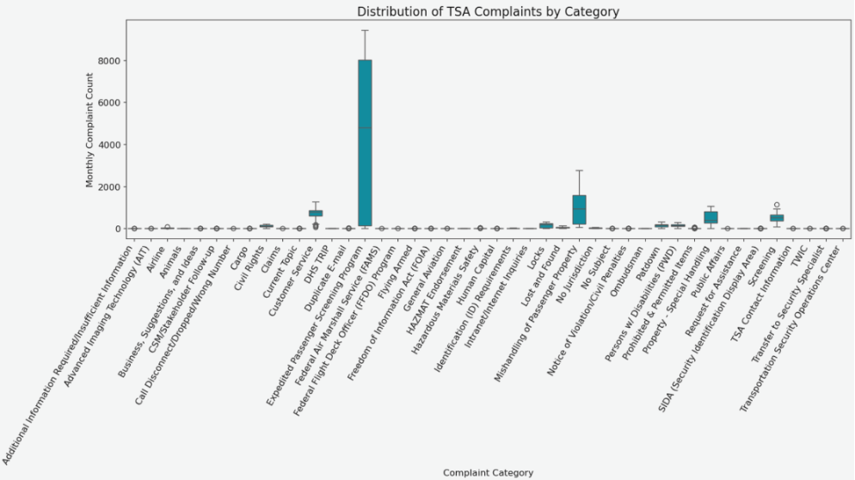
Boxplot distribution by Category
Certain categories (e.g., "Expedited Passenger Screening Program", "Customer Service", "Mishandling of Passenger Property") tend to show higher median complaint counts and potentially a broader distribution of complaints, affirming their status as significant areas of concern
Complaints seems to be more towards the 5 categories based on box plot
No major outliers noticed in the box plot

Slide 6
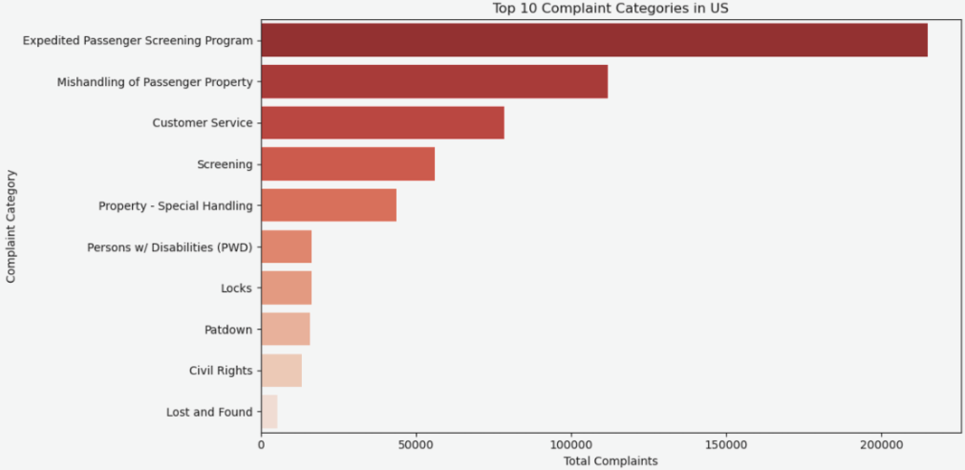
Bar Chart Top 10 Categories
Top 5 categories have counts considerably higher than the others
'Expedited Passenger Screening Program', 'Mishandling of Passenger Property' followed by 'Customer Screening' are top reported complaint categories

Slide 7
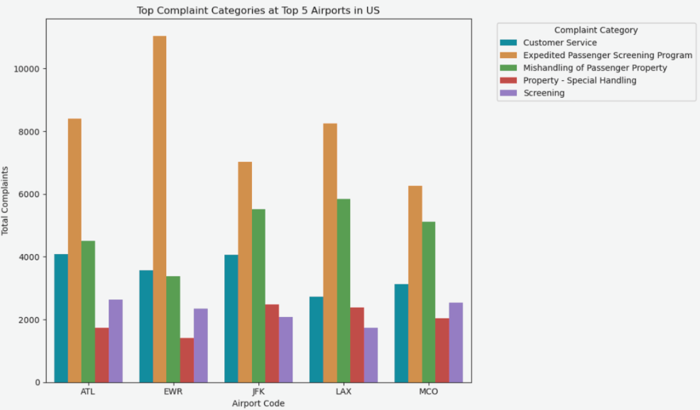
Bar Chart Categories by Airport
'Expedited Passenger Screening Program', 'Mishandling of Passenger Property' are top reported complaint categories
EWR, ATL, LAX, JFK, MCO airport are the airports with highest complaint categories.
EWR has higher counts of complaints on ‘Expedited Passenger Screening Program’

Slide 8
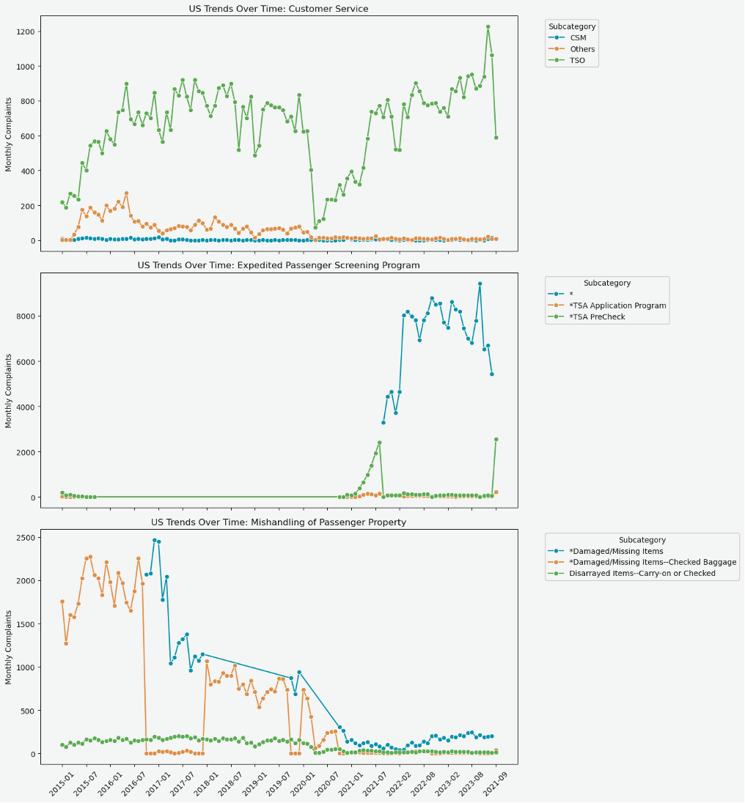
Multi line graphs of Top 3 Complaint Sub Categories
"Expedited Passenger Screening Program" Surge: This category shows a distinct and significant upward trend in complaint volume, particularly noticeable starting around 2021. This indicates a growing concern or issue related to this program. The dominant subcategory for "Expedited Passenger Screening Program" is consistently identified as '*', with its emergence and growth mirroring the overall trend of the parent category.
Conversely, complaints related to "Mishandling of Passenger Property" appear to have a decreasing trend, especially around the same period (2021). This suggests potential improvements or a positive shift in this area. The general reduction in "Mishandling of Passenger Property" complaints is reflected across its primary subcategories, suggesting that the decline is broad-based rather than limited to a single sub-issue.

Slide 9

Call to Action
Divide and Conquer:
Training effort:
Prioritize high-complaint airports for internal reviews and compliance audits.
Focus training efforts on TSA agents in areas of repeated complaint subcategories such as:
Expedited Passenger Screening Program
Customer Service (TSO)
Feedback Loop:
Implement feedback loops to monitor progress post-intervention
Proactive reviews:
Regularly review subcategory-level trends to proactively adjust policies before complaint spikes escalate.
Performance metrics:
Integrate findings into performance metrics and public transparency dashboards.

