Slide 1
Investment Recommendation System
Barath K - 21PC06

Slide 2
ABOUT THE PROJECT
This project, the investment recommendation system, is designed to empower users in making well-informed decisions regarding their investments. It harnesses demographic insights, employment particulars, and investment behavior patterns to tailor personalized recommendations. Employing sophisticated machine learning techniques such as MLPClassifier and XGBClassifier, the system predicts potential investment returns and delivers actionable insights for optimal decision-making.

Slide 3
WORK FLOW
Data Loading and Preprocessing
Data Splitting & Scaling
Model Training & Evaluation
Recommendation Generation
Example Recommendation
Why Neural Network and XGBoost ?
System Design

Slide 4
Data Loading and Preprocessing
The algorithm starts by loading the dataset from an Excel file named "Sample Data for shortlisting.xlsx" into a pandas DataFrame.
Categorical variables in the dataset are encoded into numerical representation using LabelEncoder from scikit-learn.
Missing values in the dataset are filled with the mean of the respective columns.

Slide 5
Data Splitting & Scaling
The dataset is split into features (X) and the target variable (y). Features include all columns except for the ones specified to be excluded.
The data is further split into training and testing sets using train_test_split function from scikit-learn.
StandardScaler from scikit-learn is used to scale the features to have a mean of 0 and a standard deviation of 1.

Slide 6
Model Training & Evaluation
Two machine learning models are trained:
MLPClassifier (Neural Network) with 1 hidden layer of 100 neurons and another hidden layer of 50 neurons.
XGBClassifier (XGBoost) with scale_pos_weight set to 5 and objective set to 'binary:logistic'.
Performance metrics such as accuracy, precision, recall, F1-score, and ROC-AUC are calculated for both models using the testing data.

Slide 7
Recommendation Generation
A function named generate_recommendation is defined to generate investment recommendations based on user input.
User input is encoded and scaled to match the format expected by the trained models.
Predictions are made using both the Neural Network and XGBoost models, and the recommendation is determined based on the model with higher accuracy.
If both models give the same recommendation, that recommendation is returned.

Slide 8
Why Neural Network and XGBoost ?

Slide 9
Neural Network
A Neural networks, especially Multi-Layer Perceptrons (MLPs), are known for their capability to learn complex non-linear relationships between input features and target variables.
MLPs are highly flexible and can capture intricate patterns in the data, making them suitable for tasks where the relationship between features and target is not easily discernible or linear.
In the context of investment recommendation, neural networks can effectively learn from the diverse set of features such as demographic information, employment details, and investment behavior to predict investment returns

Slide 10
XGBoost
XGBoost is an ensemble learning technique based on decision trees, known for its efficiency and effectiveness in handling structured/tabular data.
XGBoost is particularly well-suited for handling tabular data with a large number of features, as it can capture both linear and non-linear relationships effectively.
It provides robustness against overfitting and handles missing data well, making it suitable for real-world datasets with diverse characteristics.
In the investment recommendation context, XGBoost can complement the Neural Network by providing a different perspective on the data and capturing additional nuances that may not be fully captured by the neural network.

Slide 11
SYSTEM DESIGN

Slide 12
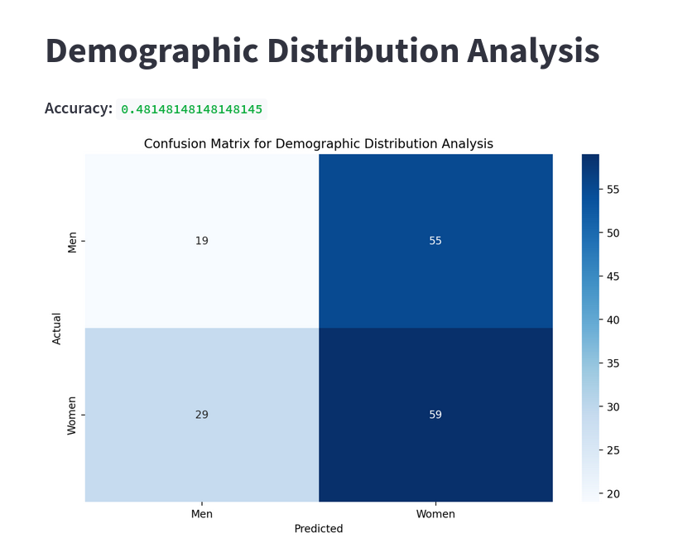
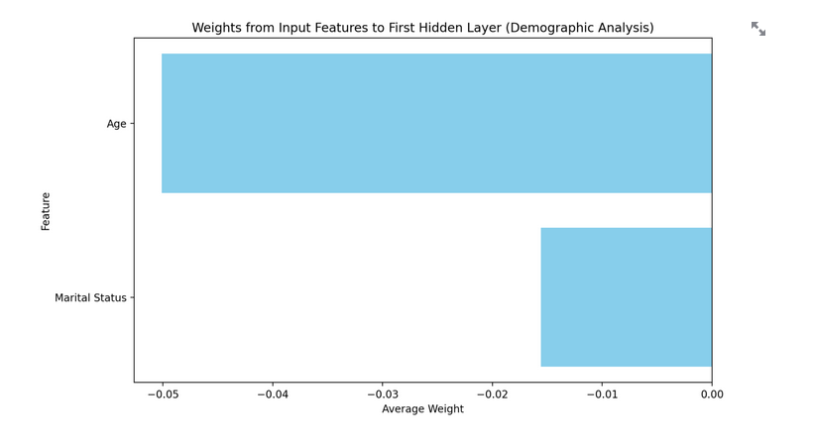
Demographic Distribution Analysis

Slide 13
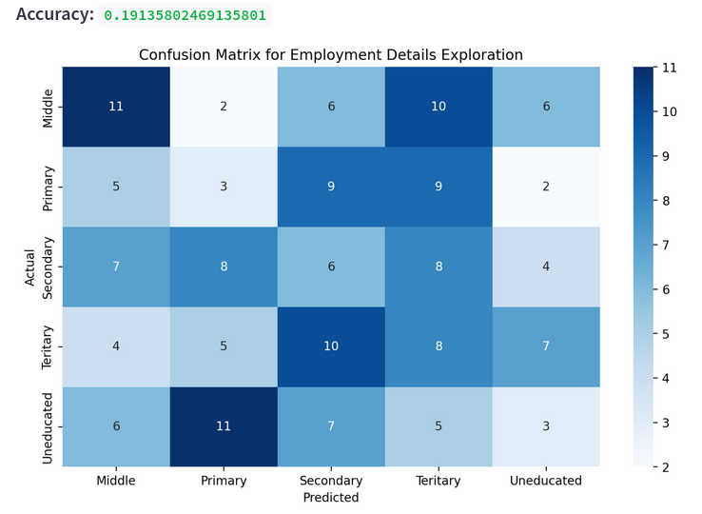
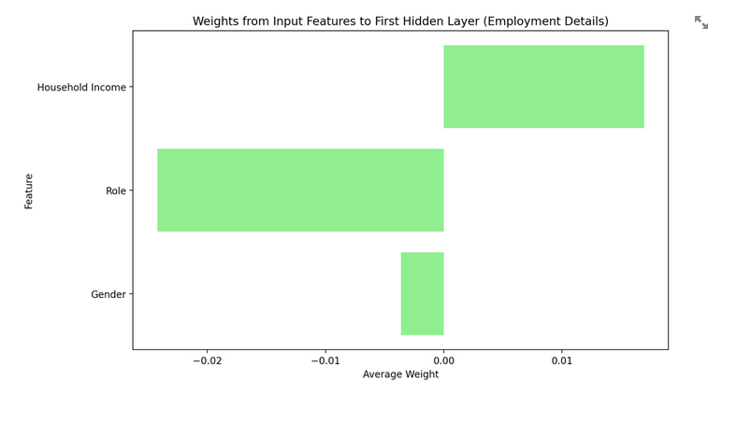
Employment Details Exploration

Slide 14
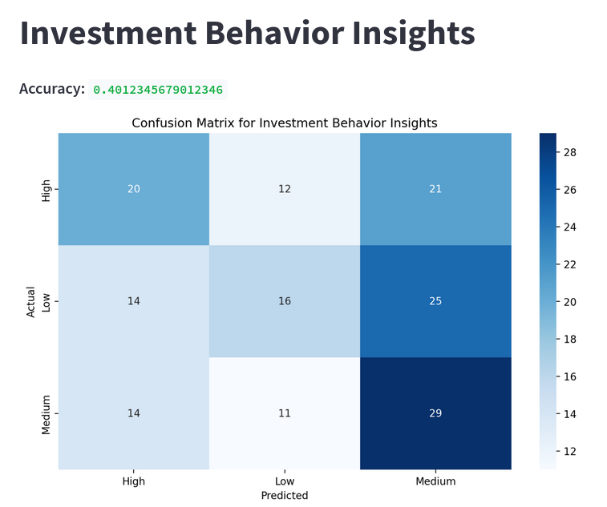
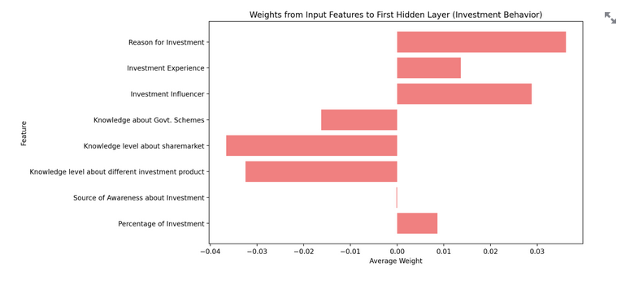
Demographic Distribution Analysis

Slide 15
RECOMMENDATION SYSTEM DESIGN

Slide 16
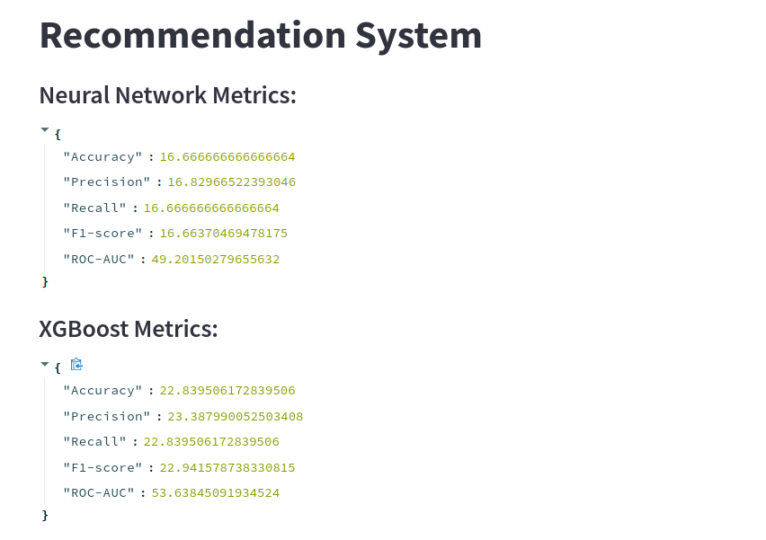

Slide 17
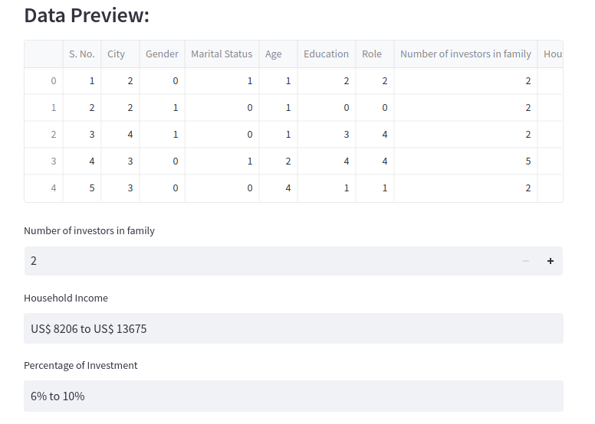

Slide 18
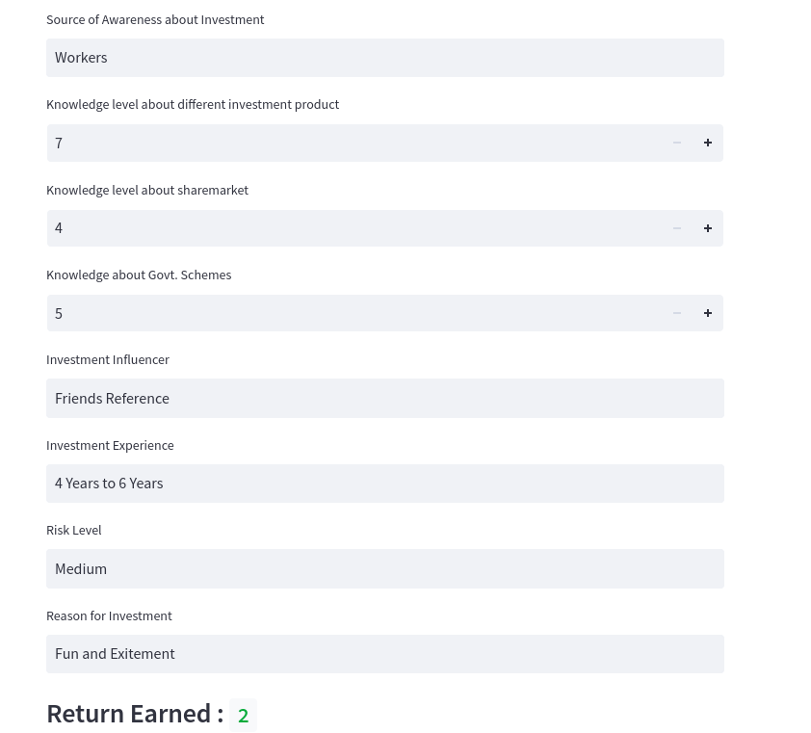

Slide 19
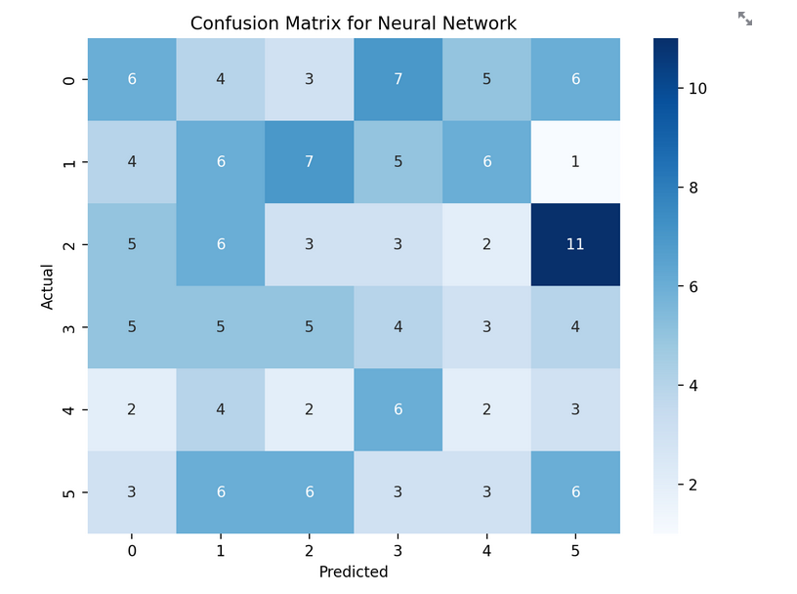
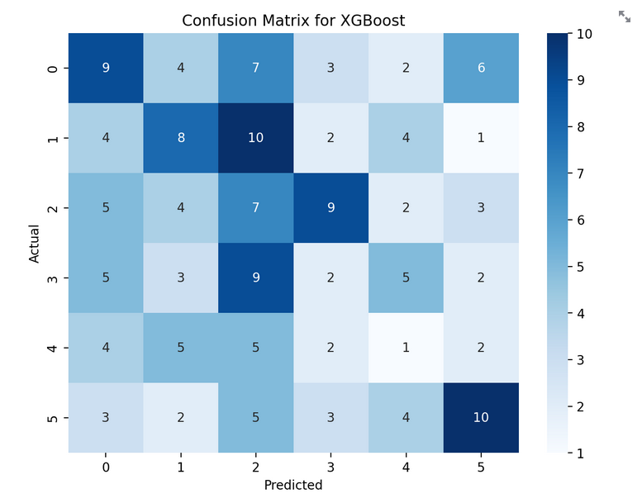

Slide 20
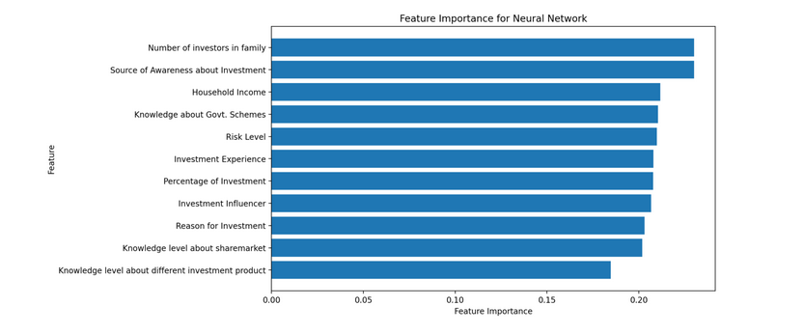

Slide 21
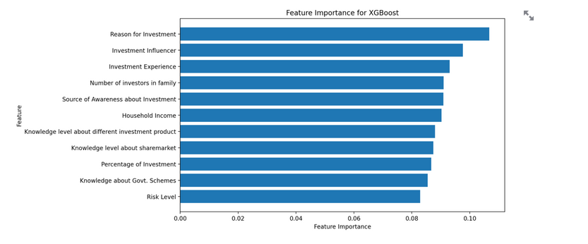

Slide 22
CONCLUSION
In summary, by combining the strengths of Neural Network and XGBoost, our investment recommendation algorithm offers a robust solution for handling complex financial datasets.
Neural Networks excel at capturing non-linear relationships, while XGBoost efficiently handles structured data. This synergistic approach enhances the accuracy and reliability of investment recommendations, providing investors with valuable insights for informed decision-making.

Slide 23
THANK YOU

