Slide 1
Securing Legal Records:
A Blockchain eVault Solution
Ensuring Security, Transparency, and Accessibility

Slide 2

Objective
Benefits
The objective of our project is to develop a secure and transparent platform for storing legal records. This platform aims to enhance accessibility, privacy, and interoperability compared to traditional methods.
Enhanced Accessibility : Stakeholders can securely access their legal records from anywhere at any time.
Improved Privacy : Utilizing encryption and access controls ensures the confidentiality of sensitive legal information.
Increased Interoperability : The system will seamlessly integrate with existing legal databases, facilitating efficient data sharing and collaboration.

Slide 3
Challenges
Solution
Lack of Transparency : Users may not have full visibility into who accesses or modifies their records.
Security Vulnerabilities : Centralized databases can be susceptible to hacking and unauthorized access, compromising data integrity.
Complex Access Management : Traditional systems may struggle to efficiently manage access permissions across various stakeholders.
To address these challenges, we propose implementing a blockchain-based eVault system for legal records management.

Slide 4
Architecture
Components
Our system will be built on a robust blockchain platform such as Ethereum. These platforms offer secure and decentralized environments ideal for managing sensitive legal data.
Smart Contracts : These will manage access permissions, transactions, and enforce rules governing document interactions.
Decentralized Storage : Utilizing Blockchain's distributed ledger for storing encrypted legal records ensures redundancy and security.

Slide 5

Features
Document Upload : Users can securely upload legal documents to the eVault, where they are cryptographically secured and timestamped.
Retrieval : Stakeholders can easily retrieve their documents through a user-friendly interface, ensuring quick access when needed.
Sharing : Secure sharing capabilities allow authorized parties to collaborate on documents while maintaining audit trails of all interactions.
Change Tracking : The system tracks all changes made to documents, providing a transparent and immutable record of document history.

Slide 6

Smart Contracts
Accounts :
Manages user accounts (verifiers and requesters).
Includes functions for registration, account type management, and verifier payments.
Documents :
Handles document management.
Functions include adding documents, verifying them, tracking & retrieving document details.
EmailRegex & StringUtils :
Utility contracts providing email validation and string manipulation functions, respectively
Migrations :
Truffle migration contract for deploying smart contracts.

Slide 7
Business Impact
Market Opportunities
Enhanced Accessibility : Secure access to legal records anytime, anywhere.
Improved Privacy : Robust encryption and access controls ensure confidentiality.
Efficient Integration : Seamless interaction with existing legal databases for interoperability.
Growing Demand : Increasing need for secure and efficient legal record management solutions.
Target Audience : Law firms, corporate legal departments, and government agencies seeking modernized document management.
Industry Trends : Rising adoption of blockchain for enhanced security and transparency in legal tech.

Slide 8
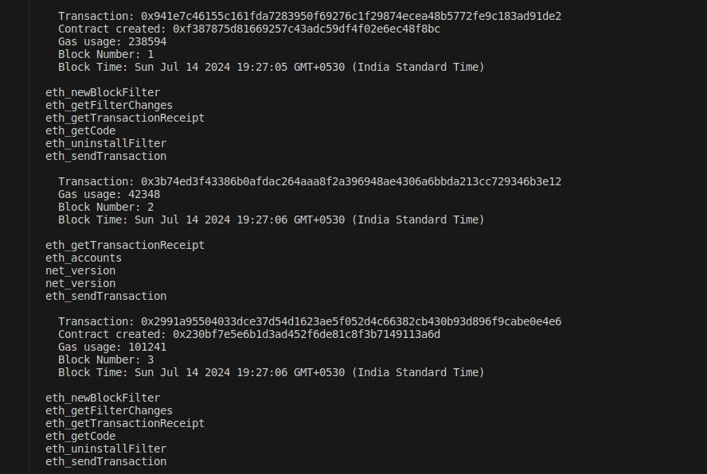
Backend

Slide 9
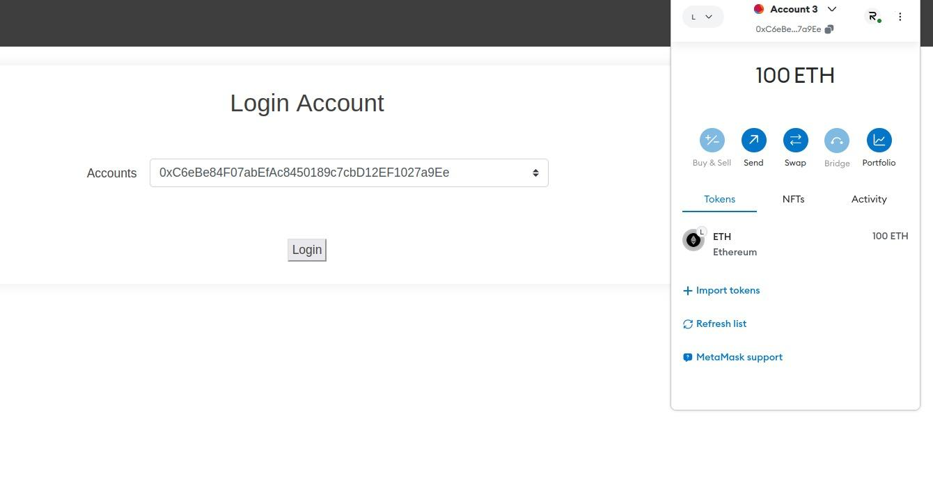
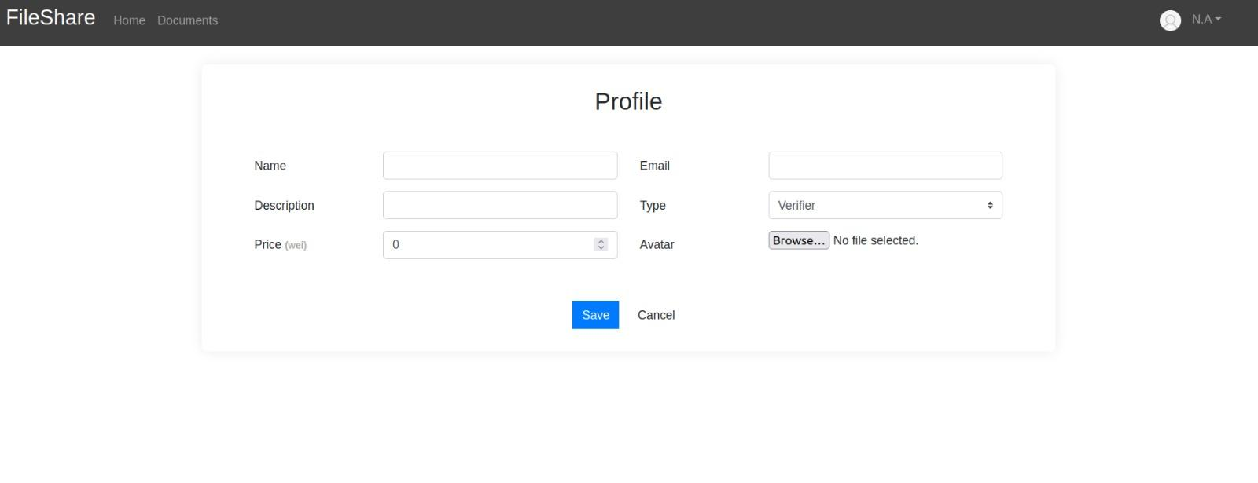
UI interface

Slide 10
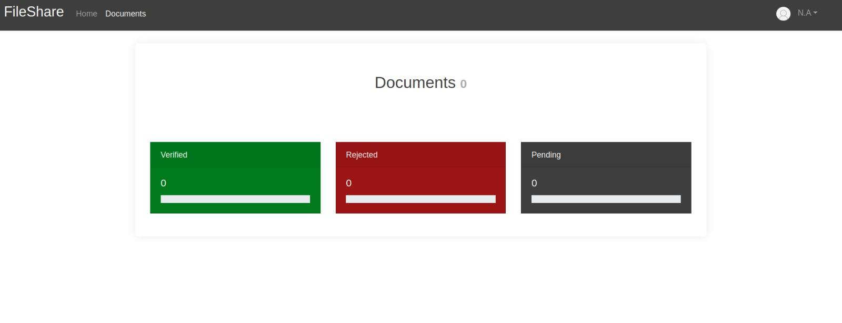
UI interface

Slide 11
Github :
https://github.com/barath-sk17/file-share

