Slide 1




SMART INDIA HACKATHON 2026
  Problem Statement ID – SIH26042
  Problem Statement Title- AI-Powered Vernacular Pedagogy and Real-Time Translation Tool for Mother Tongue-Based Primary Education
  Theme- Smart Education
  PS Category- Software
  Team ID- 168531
  Team Name (Registered on portal) – VITV 8-bitPool

Slide 2
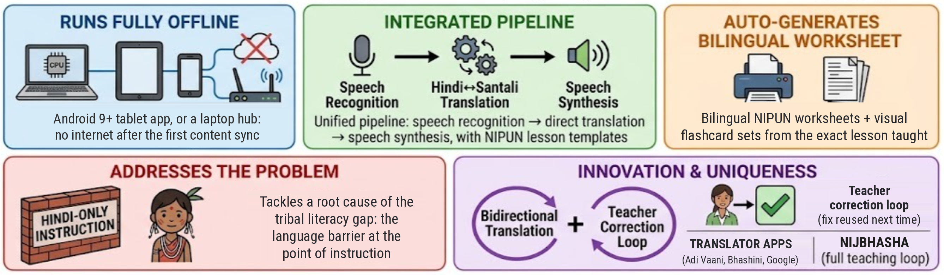
Nijbhasha — Proposed Solution
8-bitPool
Teacher speaks or types Hindi (no Santali training needed)
Nijbhasha — offline AI on an Android tablet or a school laptop
Student hears Santali (mother tongue)
Teacher hears Hindi (reply)
Auto-generated bilingual worksheet + visual flashcard set
What Nijbhasha adds over translation apps
Adi Vaani (MoTA), Bhashini and Google Translate translate text. Nijbhasha runs the whole lesson:
Lesson script → speech → comprehension check
Bilingual NIPUN worksheet + flashcards from that lesson
Teacher corrections reused next time
Offline on an Android tablet in airplane mode
Reading-fluency check against NIPUN words-per-minute goals
@SIH Idea submission
2

Slide 3
TECHNICAL APPROACH
8-bitPool
• WHAT'S BUILT & RUNNING TODAY
• Android app: lessons, worksheets, spoken lesson lines, typed translation; tested offline on a 4 GB tablet and a 2 GB Android 9 emulator
• Laptop hub: Flask API + one HTML page; tablets join over Wi-Fi
• Real models live: speech recognition, translation, synthesis
• Hindi / Santali / English UI; 18 NIPUN lessons, Balvatika–Grade 3
• Teachers add lessons from Hindi text; progress by NIPUN Lakshya
• THE AI PIPELINE — INTEGRATED, NOT PLANNED
• ASR: IndicConformer — 600M on the hub, 120M int8 on the tablet
• NMT: IndicTrans2 320M, direct Hindi↔Santali, no English pivot
• TTS: Piper voice reads Santali via our Ol Chiki transliterator
• Offline: sockets-off laptop test; tablet tested in airplane mode
• Santali live; Mundari translation preview; Ho voice preview
Methodology and process for implementation
TEACHER INTERFACE
AI ENGINE — OFFLINE
STUDENT OUTPUT
– Voice or typed input (Hindi)
– Lesson / activity / assessment modes
– Add a lesson from Hindi text
– One-click worksheet download
– Android tablet app, or laptop browser
– Signed content sync, then no network
– Hindi + Santali ASR — IndicConformer
– NMT — IndicTrans2, direct Indic↔Indic
– TTS — Piper, offline voice
– Teacher corrections reused first
– Doubtful output flagged for review
– Long sentences streamed by clause
– Santali audio + Ol Chiki text
– Hindi response heard by teacher
– Bilingual worksheet + flashcards
– Green / yellow / red answer check
– Reading-fluency score (words/min)
– NIPUN Lakshya-tagged; NEP §4.11
@SIH Idea submission
3

Slide 4
FEASIBILITY AND VIABILITY
8-bitPool
  Analysis of the feasibility of the idea
• On-device today: Realme Pad Mini (4 GB) and a 2 GB Android 9 emulator, airplane mode: IndicConformer 120M, IndicTrans2 int8, Piper. New typed sentences translated on the tablet: p50 1.50 s (Realme), 0.60 s (emulator).
• Published evidence: Singh, Ekbal & Pakray (MMLoSo 2025): fine-tuned IndicTrans2 beats ByT5 for English↔Santali; we use the same family for Hindi↔Santali.
• Benchmarks: Hindi→Santali chrF++ 31.3 / 32.2 / 27.4 (IN22-Gen / IN22-Conv / FLORES-200), leakage-guarded; 300+ automated tests run in CI.
• Next: Mundari translation preview built (LoRA on MMLoSo 2025 data; held-out chrF++ 30.92). Ho: voice only. Native-speaker review for all three.
Offline · Realme Pad Mini (4 GB) · 2 GB emulator · laptop hub
0.70 s
lesson lines on the tablet, median (p90 1.20 s); 2 GB emulator 0.50 s
2.85 s
p90 hub, Hindi speech ≤ 17 words; Santali → Hindi p90 2.58 s
32.2 chrF++
Hindi→Santali, IN22-Conv public test set (n = 1,503)
24 / 24
app checks in airplane mode, on the Realme and the 2 GB emulator
Potential challenges / risks → Strategies for overcoming them
Ho & Mundari have far less parallel data than Santali (already built) → lower initial accuracy
LoRA on IndicTrans2 already gives a Mundari preview; add PALASH textbooks, community recordings and teacher corrections
Low-end tablets vary in RAM, CPU speed and heat — the weakest devices could exceed the 3-second latency limit
INT8 models on the tablet, lessons pre-translated at sync, spoken lesson lines matched on-device, live latency readout
Processing children's voice data raises data-privacy concerns
No cloud: speech stays on the tablet or school laptop; no child names in reports; reading-check audio deleted
Teachers with low digital literacy may resist adoption
Hindi, Santali and English interface, 18 pre-loaded NIPUN lessons — teachers start teaching, not configuring
@SIH Idea submission
4

Slide 5
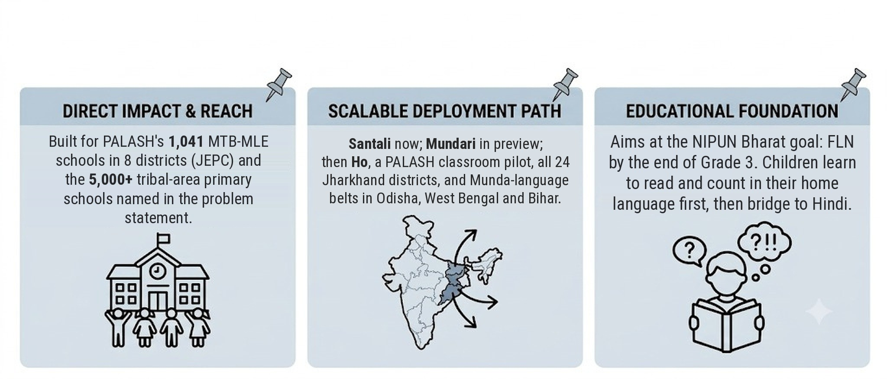
IMPACT AND BENEFITS
8-bitPool
  Potential impact on the target audience
1,041
PALASH schools (JEPC, Jan 2026) — first deployment target
8 of 24
PALASH districts today → path to all 24
Rs. 0
Licence and cloud fees — open models, runs offline
18 lessons
every NIPUN Lakshya, Balvatika to Grade 3, with worksheets
Benefits of the solution (social, economic, operational, policy)
SOCIAL
ECONOMIC
OPERATIONAL
POLICY
Hindi-medium teachers can teach in the child's mother tongue — aims to lift comprehension before Grade 3
No licence fees or per-query cloud billing — IndicConformer and IndicTrans2 are MIT-licensed
Offline on low-cost Android 9+ tablets, no new hiring; teacher corrections sync between tablets as signed files
Supports NEP 2020 §4.11 (mother tongue), NIPUN Bharat FLN goals and SDG 4 (Quality Education)
@SIH Idea submission
5

Slide 6
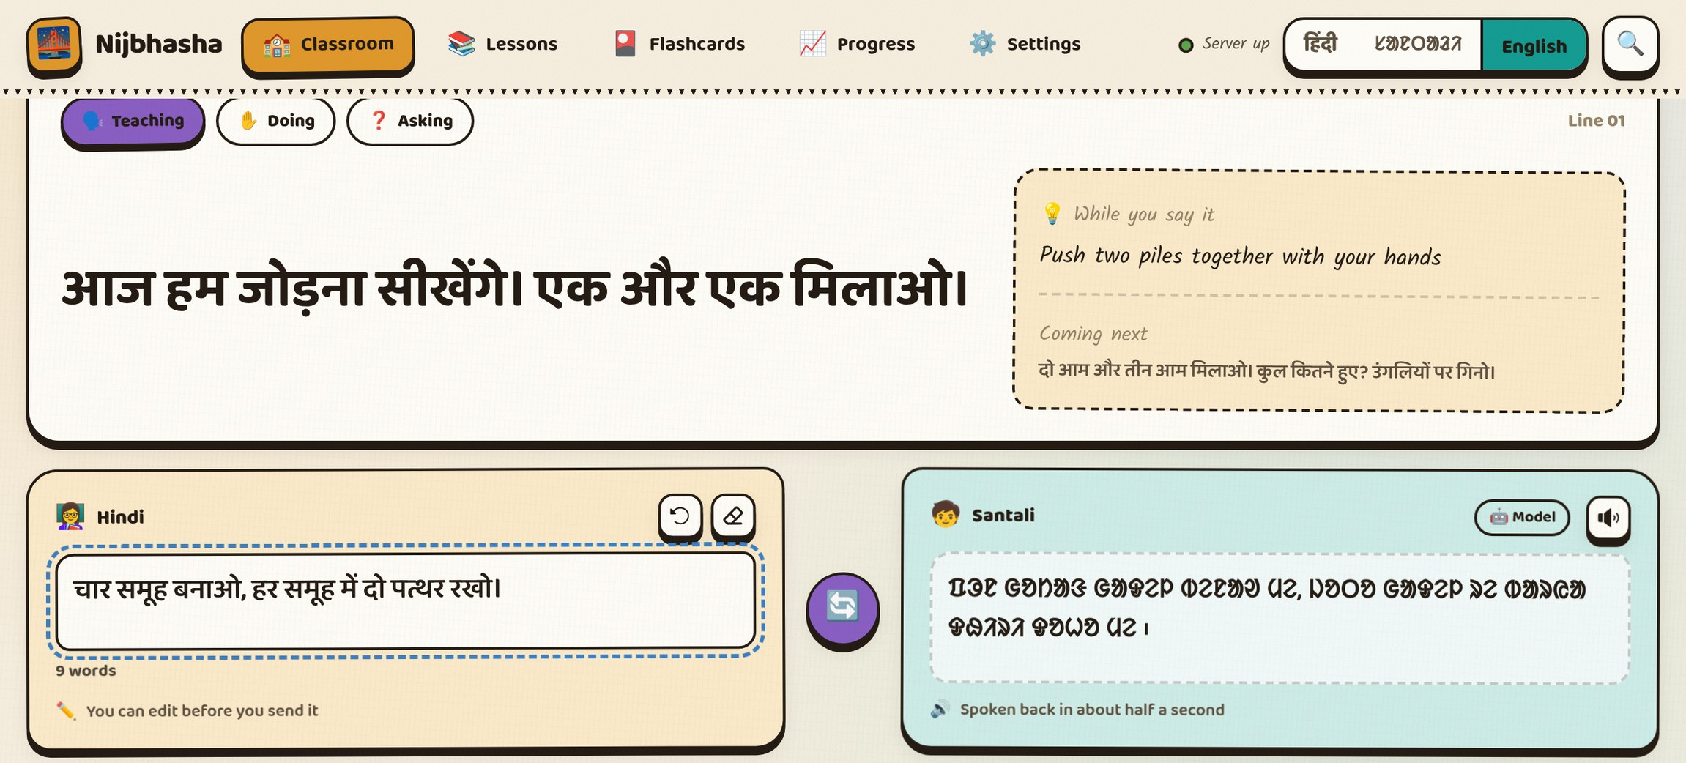
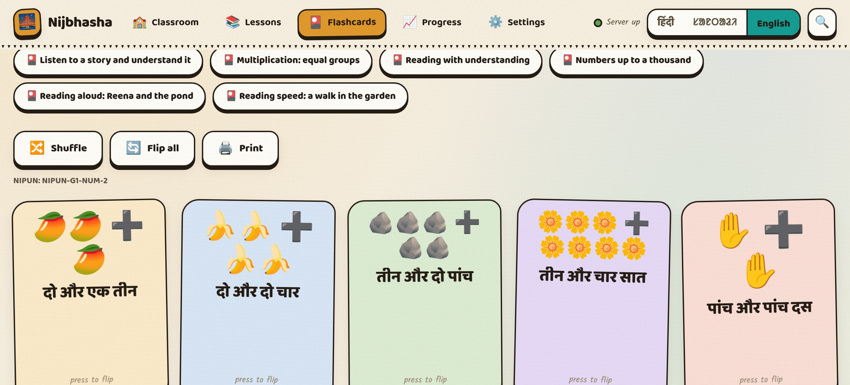
RESEARCH AND REFERENCES
8-bitPool
  Details / Links of the reference and research work
English-Santali MT Eval
LINK
AI4Bharat BPCC
LINK
IndicTrans2 Repo
LINK
IndicConformer ASR
LINK
NIPUN Bharat Framework
LINK
Adi Vaani (MoTA)
LINK
JEPC
LINK
  UI/UX Interface Current build, English view (also Hindi / Santali)
Demo video: [add link after recording]
GitHub repo: github.com/barath0512s-rgb/nijbhasha
@SIH Idea submission
6

