Slide 1

Nijbhasha
निजभाषा
A Hindi-medium teacher teaches in Santali. Offline, on a tablet.
SIH26042 · Smart Education · Software | Team 8-bitPool (VITV) · Team ID 168531
Notes:
Good morning. We are 8-bitPool, and this is Nijbhasha, which means 'one's own language'. In one line: a Hindi-medium teacher in Jharkhand runs a lesson in Santali, on a tablet, with no internet. Everything we show today is running code, and every number has a file behind it in our public repository.
Likely question: Why the name change from VaaniSetu? Answer: another team used that name; we renamed on 26 September to avoid confusion.

Slide 2
Children are taught in a language many do not speak at home
Jharkhand, Grade 1: the teacher speaks Hindi; the child may speak Santali, Ho or Mundari.
~98%
17 · 13 · 7 %
5,000+
of surveyed schools teach in Hindi
Ho · Santali · Mundari: Grade 1 home languages
tribal-area primary schools named in the problem statement
PALASH shows mother-tongue teaching works; it cannot find enough teachers who speak these languages.
A child who cannot answer “दो और तीन कितने होते हैं?” may not be failing at addition, but at Hindi.
Nijbhasha · SIH26042 · Team 8-bitPool
Source: JEPC Language Mapping Survey Ph. 1 (2024), pp. 17-18 (8,244 schools, 7 districts); SIH26042 brief
2
Notes:
The JEPC language-mapping survey of 8,244 schools found that about 98 percent teach in Hindi, while Grade 1 children's home languages include Ho 17.03 percent, Santali 13.07 percent and Mundari 7.32 percent. The problem statement names more than 5,000 tribal-area schools. PALASH shows mother-tongue teaching helps, but there are not enough teachers who speak these languages. A child who cannot answer 'two plus three' may not be failing at addition; they may not understand the Hindi question.
Likely question: Are those percentages from your own data? Answer: No, from the JEPC survey report, pages 17 and 18; the brief gives the 5,000+ figure.

Slide 3
Not a translator: a bridge the teacher can use tomorrow
1
2
3
Teacher speaks Hindi
Child hears Santali
Teacher reads it back
No Santali training needed
Text in Ol Chiki and speech, in under a second on the tablet
Devanagari reading guide; lesson plan to print
The community corrects it; every doubtful line is flagged, never played as right.
Nijbhasha · SIH26042 · Team 8-bitPool
3
Notes:
Our insight: the teacher does not need a translator app; they need a bridge they can use in tomorrow's lesson. The teacher speaks Hindi; the child hears Santali, in Ol Chiki and in speech; and the teacher gets the Santali back in Devanagari to read aloud, so over time they learn it too. Teachers correct lines, corrections spread to other tablets, and anything the system is unsure about is flagged instead of played.
Likely question: Why not just use Google Translate? Answer: it needs the internet, gives no lesson structure or worksheets, and has no way to mark doubtful output for a teacher.

Slide 4
One pipeline, two devices, no internet after the first sync
Laptop hub (optional)
Signed content + model packs
Android tablet (Android 9+)
Speech: IndicConformer 600M
Translation: IndicTrans2 320M, direct
Voice: Piper (offline)
Makes worksheets, flashcards, lesson plans
SQLite: corrections, sessions
Speech: IndicConformer 120M int8
Translation: IndicTrans2 int8
Voice: Piper via sherpa-onnx
Lesson-line matcher; PDFs from the pack
Runs in airplane mode
Signed teacher corrections
Mic
Speech recognition
Teacher fix → glossary → cache → model
Guards: loop · round trip · script
Speech + reading guide
Speaker
The same page (frontend.html) runs on both; the same 24-case REST contract is tested on both.
Nijbhasha · SIH26042 · Team 8-bitPool
Source: README §4; contract/rest_contract.json; android/
4
Notes:
Two set-ups. The laptop hub runs the larger models and makes printable material; it is optional. The Android tablet runs smaller int8 models on the device. Content and models reach the tablet as signed packs; teacher corrections come back as signed files. The voice path is the same on both: speech recognition, then four translation layers where a teacher's correction or a verified sentence wins over the model, then three guards, then speech plus a Devanagari reading guide. One web page and one tested REST contract serve both devices.
Likely question: Do you need the laptop? Answer: No for lessons, spoken lesson lines, typed translation and worksheets; yes for free-form speech and making new content packs.

Slide 5
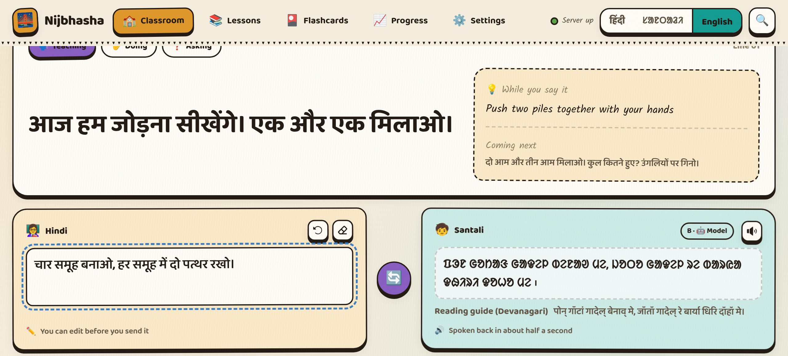
R1: every lesson line in Santali text and speech, with a trust tier
Human first: teacher correction → verified sentence → cache → model
Direct Hindi → Santali (IndicTrans2), Ol Chiki script
Speech offline; Devanagari reading guide for the teacher
Tier A human-written · B model · C flagged
Live page: Santali (Ol Chiki), reading guide in Devanagari, badge "B · Model".
32.2
119
Santali is spoken by a Hindi voice reading our transliteration: no offline Santali voice exists; two alternatives lost on a pre-set rule.
chrF++ Hindi → Santali, IN22-Conv (n = 1,503)
lesson lines checked: script, numbers, flags
Nijbhasha · SIH26042 · Team 8-bitPool
Source: eval/results/benchmarks.md; docs/fln_translation_sample.md; bench/results/voice_rule_finale.md
5
Notes:
R1. Every lesson line has Santali in Ol Chiki and offline speech. Translation goes human-first: a teacher's correction, then our verified sentences, then the cache, then the model, IndicTrans2, direct from Hindi with no English in between. On a public test set the model scores 32.2 chrF++ Hindi to Santali. Each reply shows where it came from as a tier: A human-written, B model, C flagged. Under the Santali, the teacher sees it in Devanagari to read aloud. We are open about the voice: a Hindi voice reads our transliteration, because no offline Santali voice exists; our own fine-tuned voice and Indic Parler-TTS both lost to it on a rule we fixed before testing.
Likely question: Is 32 chrF++ good? Answer: It is the published model's level for Santali (the paper's average into Santali is 30.4 on the same set); we do not claim it is good enough alone, which is why the tiers and flags exist.

Slide 6
R2: spoken lesson lines on the tablet take 0.70 s (median), 1.27 s at p95
Laptop hub, per stage (median)
Honest tail: on the laptop, 8 of 96 free-speech sentences took over 3 s (p95 3.29 s). Free speech stays on the laptop; the tablet matches lesson lines and refuses anything else.
Nijbhasha · SIH26042 · Team 8-bitPool
Source: bench/results/latency_percentiles.md (50 lines per device; 3 hub runs × 32 sentences, FLEURS)
6
Notes:
R2, the three-second limit. On the tablet, a spoken lesson line takes 0.70 seconds median and 1.27 seconds at the 95th percentile on the Realme Pad Mini, and 0.93 seconds at p95 on a 2 GB Android 9 emulator: measured over 50 lines each, in airplane mode, from the end of speech to the reply audio being ready. On the laptop hub, free Hindi speech of up to 17 words takes 2.04 seconds median, 2.90 at p90, but 3.29 at p95: eight of 96 sentences went over three seconds. We show that. Recognition and translation take about 0.85 seconds each, speech 0.36.
Likely question: Is this with children's voices and classroom noise? Answer: No. Public adult speech and synthetic lesson lines; children's speech is the first thing we would measure in a pilot.

Slide 7
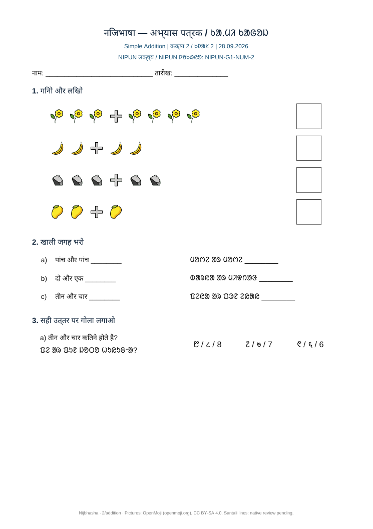
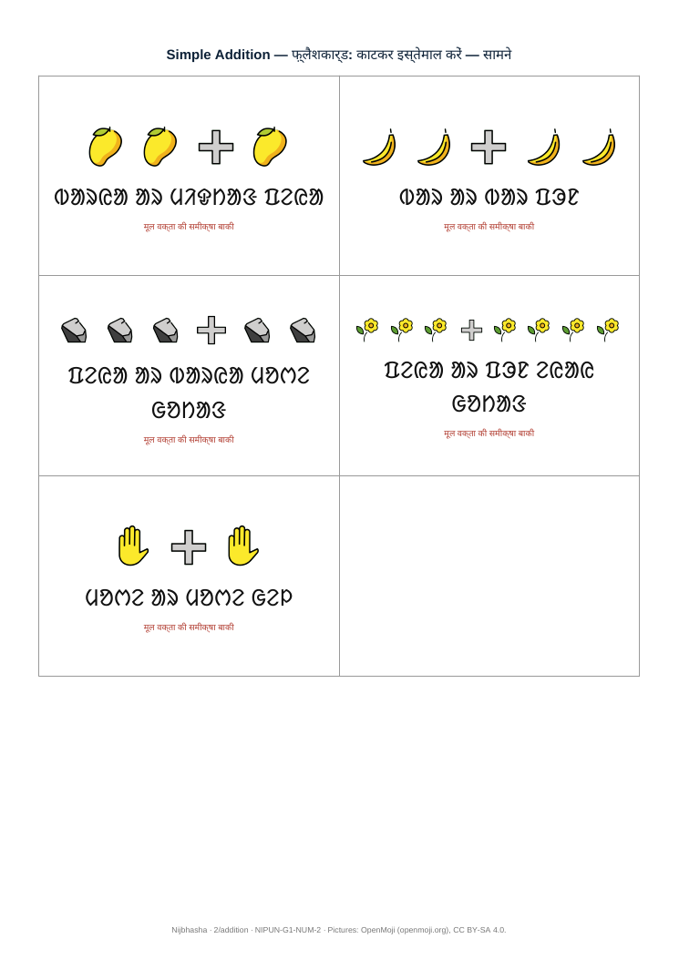
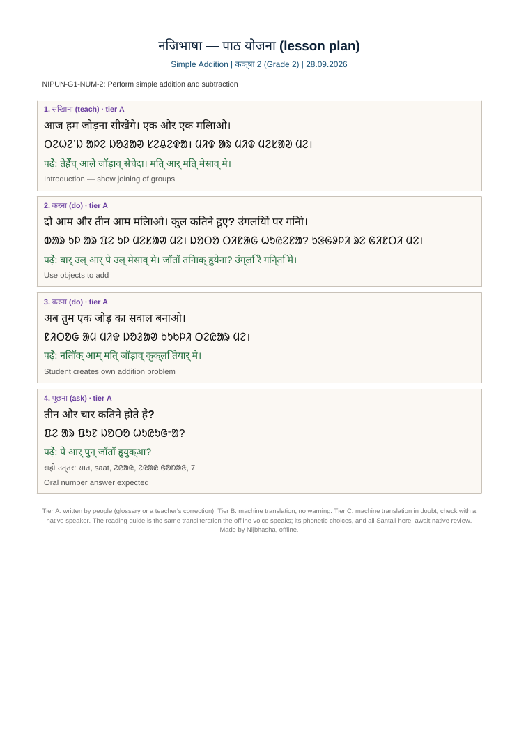
R3: each lesson prints a worksheet, flashcards and a teacher plan, tagged to NIPUN
Worksheet: count, match, fill, circle, trace; answer key
Cut-out flashcards, mirrored backs, review mark
Teacher's plan: Hindi, Santali, reading guide, answers
NIPUN-G1-NUM-2: Perform simple addition and subtraction
18 lessons · every Lakshya
Nijbhasha · SIH26042 · Team 8-bitPool
Source: docs/samples/; nipun/lakshya.py (Ministry text, 2021)
7
Notes:
R3. For every lesson the app produces a bilingual worksheet with five kinds of exercise and an answer key, cut-out flashcards with Santali on the front and Hindi on the back, and new this week, a teacher's lesson plan with the Santali in Ol Chiki and in Devanagari to read aloud, plus the accepted answers. Every lesson is tagged with the Ministry's NIPUN Lakshya, quoted word for word. Eighteen lessons from Balvatika to Grade 3 cover every Lakshya; teachers can add their own from Hindi text.
Likely question: Who checked the mapping to NIPUN? Answer: we did, per lesson, marking full or partial fit; it has not been reviewed by a teacher yet, and we say so.

Slide 8
R4: airplane mode, 24 of 24 checks on a 2 GB Android 9 emulator and a real tablet
Android 9+
72 MB
Peak memory (app + WebView), GB
minSdk 28
release APK
361 MB
38 MB
model pack, int8, signed
content pack, signed
Tested: Realme Pad Mini (4 GB, Android 11) and a 2 GB Android 9 emulator. Not yet: a real 2 GB tablet, a 32-bit build.
Translation (1.3 GB) loads only when needed; the recogniser is released first.
Nijbhasha · SIH26042 · Team 8-bitPool
Source: bench/results/realme-…-rc2_2026-09-28_m1.md; emulator-2gb-android9_2026-09-26_{m1,voice,nmt_memfix}.md
8
Notes:
R4. The app targets Android 9 and up. In airplane mode, all 24 contract checks pass on a real tablet, the Realme Pad Mini, and on a 2 GB Android 9 emulator. Models arrive once as a 361 MB signed int8 pack, content as a 38 MB signed pack; a changed pack is refused. Memory: lessons need about 0.3 GB, spoken lesson lines 0.75 GB, typing new sentences 1.3 GB, so translation is loaded only when needed. What we have not done: a real 2 GB tablet, and a 32-bit ARM build, which many cheap tablets need. Both are first on our list.
Likely question: Will 1.3 GB fit on a 2 GB tablet with Android running? Answer: it ran on the 2 GB emulator; free-form speech did not (13.5 s, models swapped), so that stays on the laptop hub.

Slide 9
Eight things a classroom needs that a translator does not do
built
new
built
sample
Teacher corrections
Devanagari reading guide
Trust tiers + 3 guards
Local-context lessons
reused first; synced between tablets as signed files
the teacher can read the Santali aloud
loop, round trip, script; C is never auto-played
teachers import village examples; app translates
new
built
new
built
Lesson plans
Progress per NIPUN Lakshya
Community voice corpus
Low-resource bootstrapping
daily script with pronunciation guide and answers
by week; CSV and PDF; no names
adults only, consent, stays on the laptop
glossary-first; Mundari by LoRA (preview)
Nijbhasha · SIH26042 · Team 8-bitPool
Source: docs/feature_traceability.md
9
Notes:
Our novelty is not one model; it is what a classroom needs around the model. Teacher corrections are reused first and shared between tablets. The Devanagari reading guide lets the teacher say the Santali themselves. Tiers and three guards stop doubtful output from being played. Teachers can import lessons with village examples. A printed daily plan with pronunciation. Progress per NIPUN goal, with no names. A voice corpus where adults from the community record lines, with consent, to grow better voices. And a low-resource strategy: human-written sentences first, and new languages by light fine-tuning, as we did for Mundari.
Likely question: Which of these are new this week? Answer: the reading guide, the tiers, the lesson plans and the voice corpus; each has tests in the repository.

Slide 10
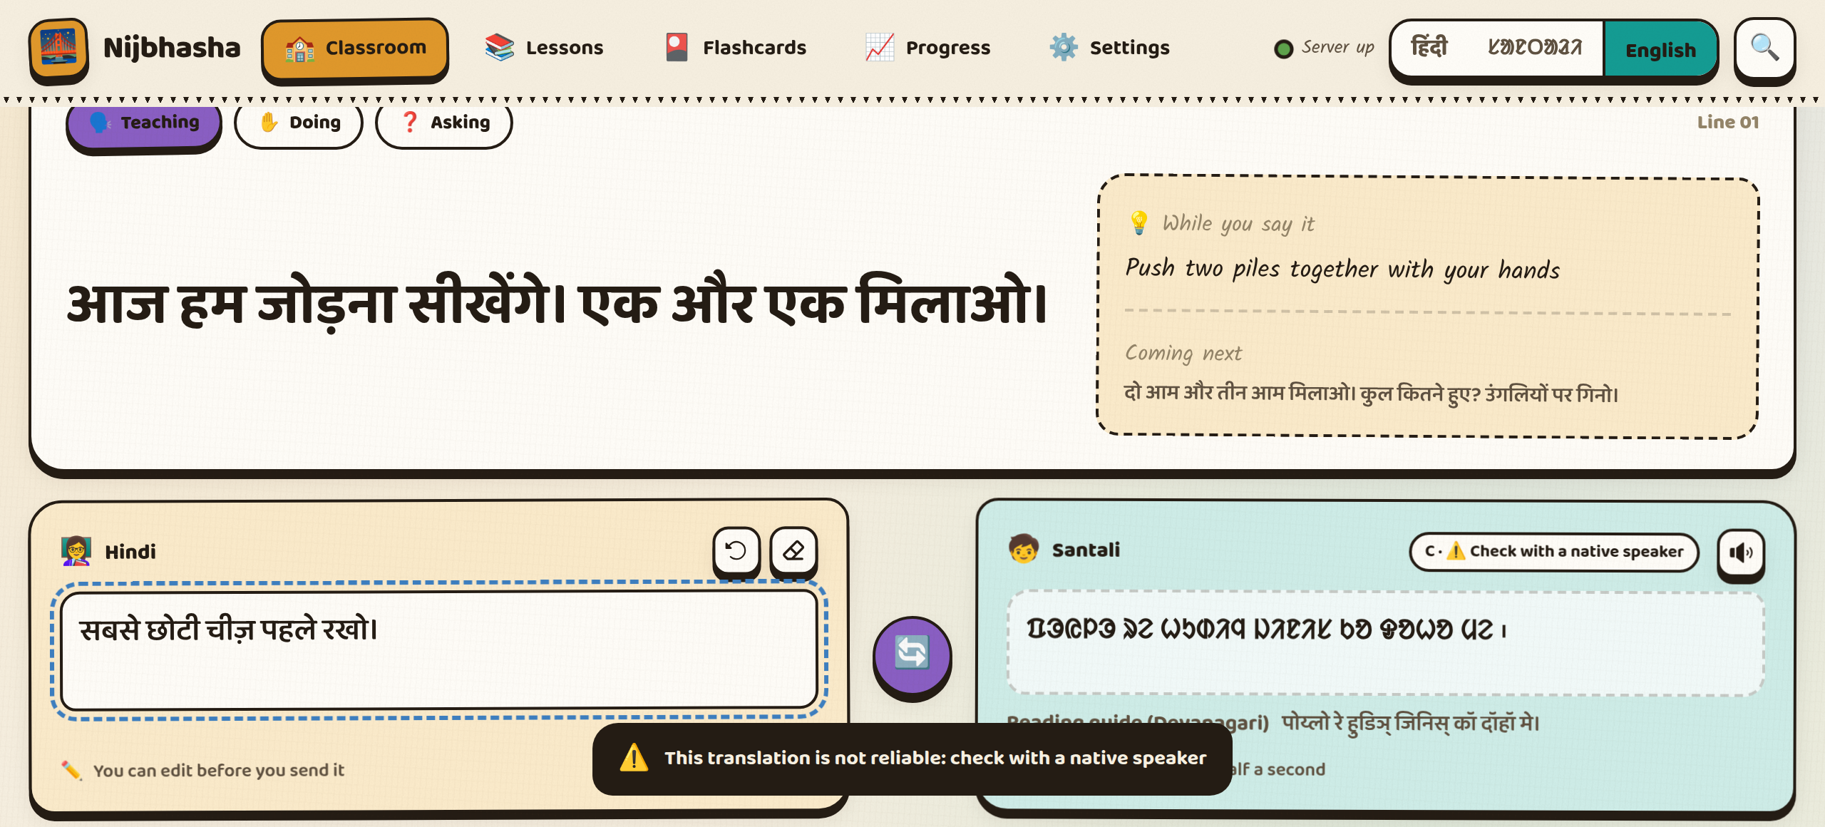
No native speaker yet: so nothing doubtful is played as if it were right
Round-trip check: a caution, not a score
Script guard: catches words in other scripts
Every Santali line on a native-review list
No cloud, no names; reading audio deleted
A flagged line: tier C, a warning, no auto-play, the nearest verified sentence offered.
13 of 119
0.46 / 0.45
lesson lines with Urdu / Meetei letters: now tier C
round-trip flag precision / recall
Nijbhasha · SIH26042 · Team 8-bitPool
Source: eval/results/roundtrip_flag.md; docs/fln_translation_sample.md; docs/native_review.md
10
Notes:
We have no native Santali speaker on the team, and we treat that as a design constraint, not a secret. Human-written sentences come first. Model output is checked three ways: a loop guard, a round-trip check (a weak signal: precision 0.46, recall 0.45, so we call it a caution), and a new script guard. That guard came from auditing our own content pack: 13 of 119 lesson lines had words in Urdu or Meetei Mayek script, and six of them had passed the round-trip check. Flagged lines are tier C: a warning, no auto-play, and the nearest verified sentence. Children's data never leaves the device.
Likely question: So how accurate is it on your lessons? Answer: not measured, because that needs native speakers; it is the first thing we ask a pilot for.

Slide 11
Where we win: the classroom job, not the translation model
 | Nijbhasha | Translate wrapper | Online-only app | Text-only tool | LLM chatbot
Works with no internet | Yes, tablet in airplane mode | No | No | Sometimes | No
Voice to voice | Both ways; 0.70 s on tablet | Some apps | Network-bound | No | Slow, online
Santali in Ol Chiki | Yes; Mundari preview | Santali only | Varies | Varies | Unreliable
NIPUN lessons + worksheets | 18 lessons, every Lakshya | No | Rarely | Sometimes | Ad hoc
Flags doubtful output | Tiers + 3 guards | No | Rarely | Rarely | No
Child data stays local | Yes | Cloud | Cloud | — | Cloud
We do not claim better translation quality than any of these.
Nijbhasha · SIH26042 · Team 8-bitPool
Source: docs/audit_2026-09-28.md §5; Google Translate added Santali in 2024 (docs/sources.md)
11
Notes:
Against the likely alternatives. A translate wrapper or an online app stops without internet, which rules out many target schools, and sends children's voices to the cloud. Text-only tools do not speak. A chatbot needs the internet and can invent. Where we win is the classroom job: offline on the tablet, both directions by voice, Santali in its own script, NIPUN lessons and worksheets, and flags on doubtful output. We deliberately do not claim better raw translation than any of them.
Likely question: Bhashini supports Santali; why not use it? Answer: it is an online service; we need the classroom to work without a network, and we need the lesson loop around the translation.

Slide 12
Built for PALASH scale: 1,041 schools today, 5,000+ in the brief
1,041
5,000+
How it grows
Santali now → Mundari (our LoRA, preview) → Ho once text exists
Same pipeline for other Munda and low-resource languages
Content = signed packs a district can build and send
Proposed first step: a PALASH classroom pilot (not yet agreed)
PALASH schools, 8 of 24 districts
tribal-area schools in the brief
1 tablet
₹0
per classroom; laptop optional
licence or per-use fees
Assumptions: hardware and training costs are not estimated; school counts are PALASH's and the brief's, not our reach.
Nijbhasha · SIH26042 · Team 8-bitPool
Source: JEPC State Project Director to PTI (Jan 2026); SIH26042 brief; languages.json
12
Notes:
Scale. PALASH runs in 1,041 schools across 8 of Jharkhand's 24 districts, according to JEPC in January 2026; the brief names more than 5,000 tribal-area schools. A classroom needs one Android tablet; the laptop hub is optional. There are no licence or per-use fees. Languages grow along one path: Santali now, Mundari as a preview from our own LoRA adapters, Ho once there is text to train on. We propose a PALASH classroom pilot as the first step; nothing is agreed yet, and we do not estimate hardware cost here.
Likely question: What does a tablet cost? Answer: we have not priced it; any Android 9+ tablet the school has, or a low-cost one, and we would size that with the department.

Slide 13
Roadmap: close the known gaps first, then grow with the community
30 days
90 days
180 days
Native review of the 18 lessons
32-bit ARM build; a real 2 GB tablet
Demo video; APK release
Proposed PALASH pilot, 5 classrooms
Children's speech benchmark
Mundari on the tablet
Ho content with native writers
Voice from the community corpus
Resumable pack download
Sustained by: open models and MIT code; lessons as editable JSON; corrections and the voice corpus grow with use.
Nijbhasha · SIH26042 · Team 8-bitPool
Source: docs/audit_2026-09-28.md §7 (checklist)
13
Notes:
Our roadmap starts with the gaps we have told you about. In 30 days: native review of the lessons, a 32-bit build and a real 2 GB tablet, and the demo video. In 90 days, if a pilot is agreed: five classrooms, a children's speech benchmark, and Mundari on the tablet. In 180 days: Ho content written with native speakers, a better Santali voice from the community corpus, and resumable downloads. It sustains itself because the models and code are open, lessons are editable files, and every correction and recording improves it.
Likely question: Who pays for maintenance? Answer: there are no licence fees; the ongoing work is content and review, which fits the existing PALASH teacher-training structure; that is a proposal, not an agreement.

Slide 14

See it run: airplane mode, the timer on screen
1
Tablet in airplane mode: lessons load
2
Teacher says a lesson line → Santali in 0.7 s
3
Reading guide under the Santali
4
A doubtful line: tier C, not played
github.com/barath0512s-rgb/nijbhasha
Demo video: [add link after recording]
5
Worksheet, flashcards, lesson plan print
Our ask: a native Santali reviewer and one PALASH classroom.
Notes:
Here is what the live demo shows, in order: the tablet in airplane mode loading lessons; the teacher speaking a lesson line and the child hearing Santali in about 0.7 seconds, with the timer on screen; the Devanagari reading guide; a doubtful line flagged as tier C and not played; and the worksheet, flashcards and lesson plan. The code, tests and every number are in the repository behind the QR code. Our ask is simple: a native Santali reviewer, and one PALASH classroom to measure it with real children. Thank you.
Likely question: Can we try it now? Answer: yes, the tablet is in airplane mode; say any lesson line.

Slide 15
A1 · Data sources and licences
What | Used for | Licence
AI4Bharat IndicConformer 600M / 120M | Speech recognition (hub / tablet) | MIT
AI4Bharat IndicTrans2 indic-indic 320M | Translation, hub fp32 and tablet int8 | MIT
Piper hi_IN-pratham-medium | Speech (Hindi, and Santali via transliteration) | CC BY-NC-SA 4.0
sherpa-onnx 1.13.8 (with espeak-ng) | On-device speech | Apache-2.0 (espeak-ng GPL-3.0: APK under GPL-3.0)
Meta MMS voices mms-tts-unr / -hoc | Mundari and Ho voices (preview) | CC BY-NC 4.0
MMLoSo 2025 Hindi-Mundari data | Mundari LoRA (18,978 training pairs) | CC BY-SA 4.0
IN22-Gen, IN22-Conv; FLORES-200 | Evaluation only (leakage-guarded) | CC BY 4.0; CC BY-SA 4.0
FLEURS (Hindi), IndicVoices (Santali valid.) | Speech benchmarks, adult | CC BY 4.0
OpenMoji; Noto fonts | Pictures; Devanagari and Ol Chiki type | CC BY-SA 4.0; OFL
Our code | Everything else | MIT
Nijbhasha · SIH26042 · Team 8-bitPool
Source: THIRD_PARTY_LICENSES.md; docs/sources.md; languages.json
15
Notes:
All models and data are public, with licences listed in THIRD_PARTY_LICENSES.md. Test sets are used only for evaluation; a leakage guard stops any training script from seeing them. The default voice is non-commercial, which suits a free government programme; the APK is under GPL-3.0 because of espeak-ng.

Slide 16
A2 · Benchmarks (all offline)
Measure | Setting | Result
Voice to voice, lesson lines | Realme Pad Mini, n = 50 | p50 0.70 · p90 1.20 · p95 1.27 s
Voice to voice, lesson lines | 2 GB Android 9 emulator, n = 50 | p50 0.50 · p90 0.82 · p95 0.93 s
Hindi → Santali, free speech ≤ 17 words | Laptop hub, 3 runs × 32 (FLEURS) | p50 2.04 · p90 2.90 · p95 3.29 s; 8 of 96 > 3 s
Santali → Hindi, upload to reply | Laptop hub, 80 answers per run | p90 2.52–2.60 s
Typed new sentence on the tablet | Realme / 2 GB emulator | p50 1.50 s / 0.60 s
Translation quality hi → sat | IN22-Gen / IN22-Conv / FLORES-200 | chrF++ 31.3 / 32.2 / 27.4
Mundari preview (our LoRA) | Held-out 5 % of MMLoSo, n = 1,021 | chrF++ hi→unr 30.92 · unr→hi 35.97
Speech recognition, WER (normalised) | Hub 600M: Hindi / Santali | 12.5 % / 31.0 %
Peak memory | Lessons / lesson-line voice / typing | 0.30 / 0.75 / 1.30 GB
Nijbhasha · SIH26042 · Team 8-bitPool
Source: bench/results/latency_percentiles.md; eval/results/benchmarks.md; README §6; STATUS.md
16
Notes:
The full numbers, each from a results file. Adult public speech and synthetic lesson lines only; children's speech is not measured.

Slide 17
A3 · How we keep the numbers honest
332 automated tests pass without models; 38 more need the models; CI on every push
A test fails if the README quotes a number with no evidence file
Model choices by rules written before the results (voice, decoding, int8)
Leakage guard: no benchmark sentence can reach training
Same 24-case REST contract tested on the hub and the tablet
Every figure printed by a script: tools/deck_numbers.py, tools/latency_percentiles.py
Nijbhasha · SIH26042 · Team 8-bitPool
Source: tests/; .github/workflows/tests.yml; tests/test_claims.py; docs/voice_rule_finale.md; eval/leakage.py
17
Notes:
If a judge doubts a number, it can be re-derived from a script in the repository. We fixed decision rules before running the comparisons, so we could not pick the winner after seeing the results.

Slide 18
A4 · Security and privacy
No cloud at run time; network sockets blocked in the offline test
Packs signed (Ed25519) and verified on the tablet; a changed pack is refused
Progress reports: no names, no audio
Reading check: consent box; the recording is deleted after scoring
Voice corpus: adults only, consent, no names; export only from the laptop, only with consent to share
Hub over HTTPS with its own local certificate for tablet microphones
Nijbhasha · SIH26042 · Team 8-bitPool
Source: tests/test_offline.py; core/Pack.kt; progress.py; orf.py; corpus.py; tools/make_cert.py
18
Notes:
Children's data never leaves the classroom device. The only recordings we keep are from consenting adults in the voice corpus, and they stay on the laptop.

Slide 19
A5 · Limitations we disclose
No native-speaker review yet of Santali, Mundari or Ho output, or of the voice
Santali voice is a Hindi voice reading a transliteration
No real 2 GB tablet; no 32-bit ARM build
Free-form speech on the laptop only; p95 3.29 s there
Children's speech and classroom noise not measured
Ho: voice only; Mundari: preview on the laptop
NIPUN mapping not reviewed by a teacher
Nijbhasha · SIH26042 · Team 8-bitPool
Source: docs/audit_2026-09-28.md; README §13
19
Notes:
These are the gaps a judge would find; we list them first.

Slide 20
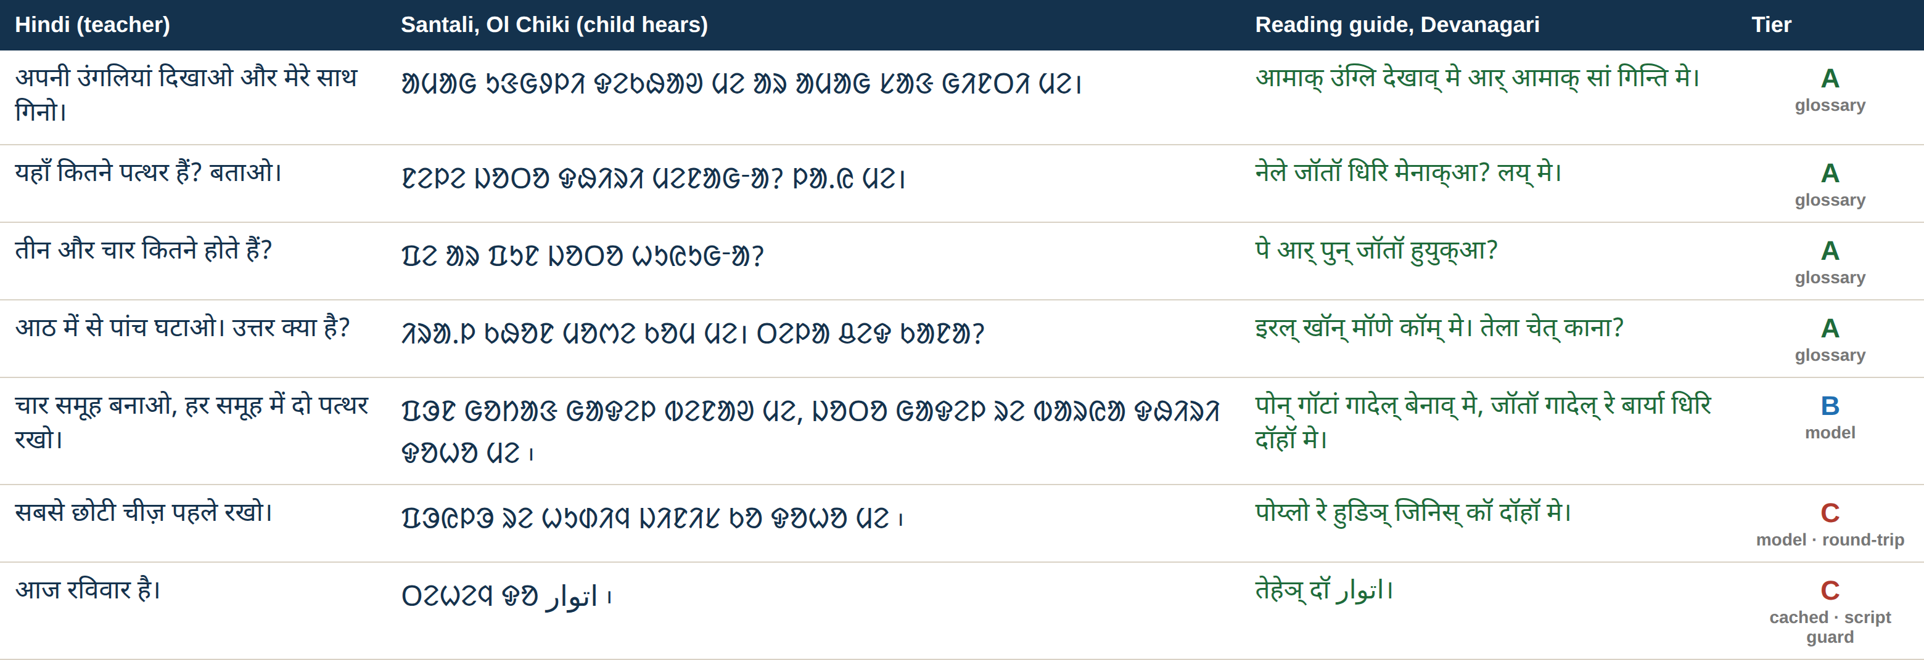
A6 · Real lesson lines, as the app shows them
Hub output from the content pack (26 Sep); not reviewed by a native speaker.
Nijbhasha · SIH26042 · Team 8-bitPool
Source: docs/fln_translation_sample.md
20
Notes:
Seven real lines. The last row is one the new script guard catches: an Urdu word inside the Santali, now tier C.

Slide 21
A7 · Questions we expect
Question | Short answer
Is the Santali correct? | Not measured without native speakers; human-written first, doubtful lines flagged, review list ready
Does it run on 2 GB? | 2 GB Android 9 emulator yes; real 2 GB tablet not yet; typing needs 1.3 GB, loaded on demand
Under 3 s? | Tablet lesson lines p95 1.27 s; laptop free speech p95 3.29 s (8 of 96 over)
Children's voices? | Not measured; first pilot benchmark
Ho and Mundari? | Mundari translation preview (our LoRA); Ho voice only, no licensed text
Why not an LLM? | Needs internet or far more memory; can invent
Cost? | No licence or per-use fees; hardware not estimated
Privacy? | No cloud; no names; reading audio deleted; corpus adults-only with consent
Nijbhasha · SIH26042 · Team 8-bitPool
Source: docs/winning_narrative.md (15 questions in full)
21
Notes:
The full set of fifteen questions and answers is in docs/winning_narrative.md.

