Slide 1
15CSE480
Home Automation using Telegram App
Internet Of Things Project
Alagu Vignesh A – CB.EN.U4CSE16308
Barath B – CB.EN.U4CSE16315
Keerthana S – CB.EN.U4CSE16531

Slide 2
Table of Content
Abstract
Block Diagram
UML Diagram
Hardware Design
Project Description
Hardware
IoT Services
Challenges Addressed
Reference

Slide 3
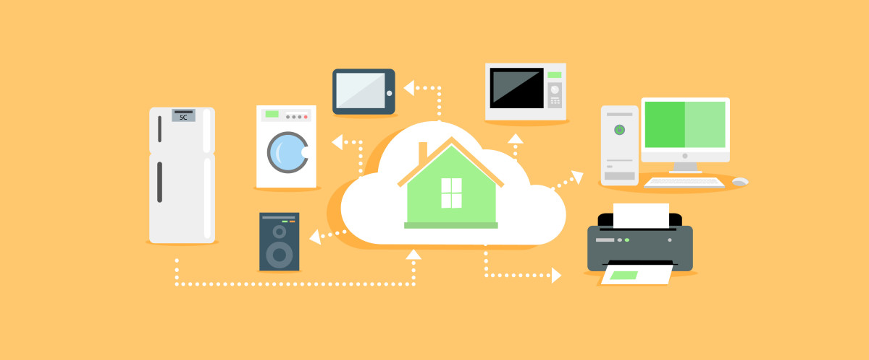



Abstract
Social media is playing a major role in every people’s hand, we are using social media for lots of applications like chatting, video and data sharing. To make life easier we are using social media to make our home into smart home, this is achieved using a system called Raspberry Pi.

Slide 4
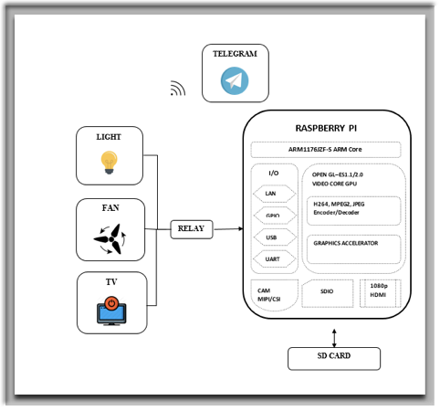
Block Diagram
Raspberry Pi system is connected with the internet to get chat messages from the Telegram app and the appliances which we have to control should be connected to GPIO pins of Raspberry Pi through relay circuit

Slide 5
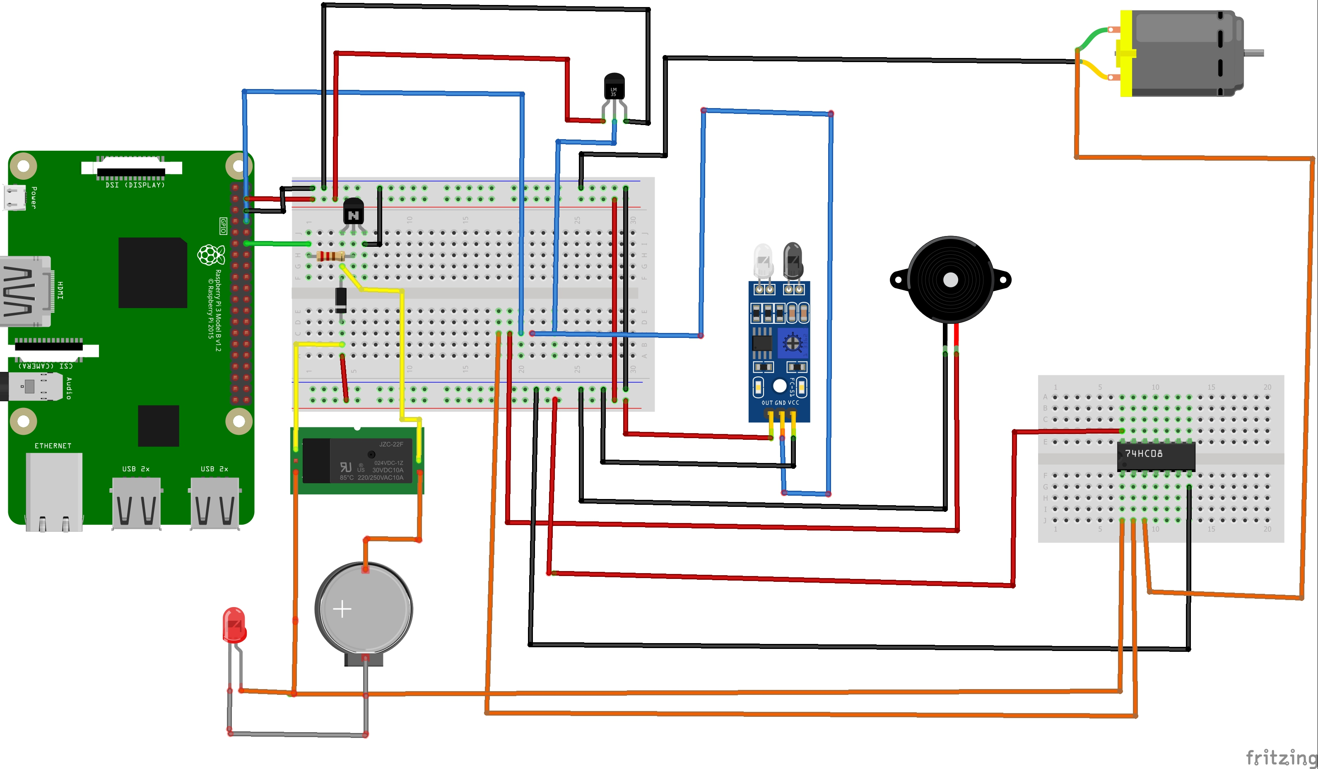
Hardware Design

Slide 6
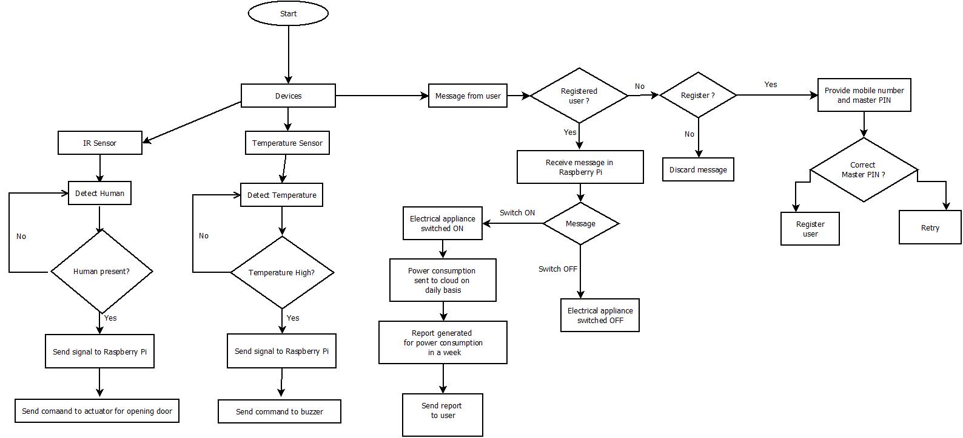
UML Diagram

Slide 7
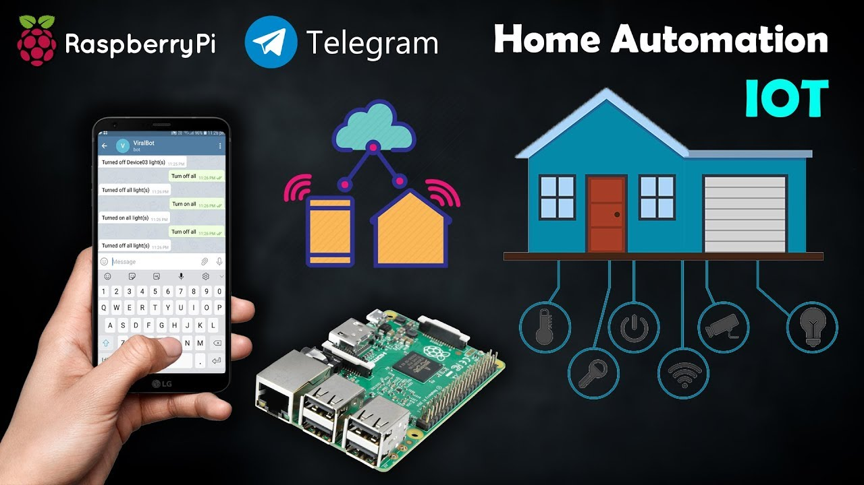
Project Description
Raspberry Pi, which is connected to the Network is programmed to receive chats from telegram application whenever we send messages to the configured bot to control the application based on configured commands sent through chat.

Slide 8
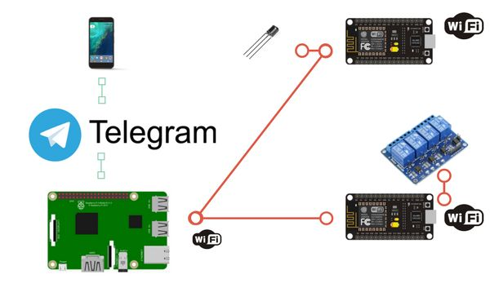
Hardware
Raspberry Pi
Power Source
IR Sensor, Temperature Sensor, Motor(Actuator)
Local Storage (SD Card)
Relay
Appliances
Android Device

Slide 9
IoT Service
Communication Service – HTTPS
Data Identifier – Segregation of data
Identification Service – Device Identification
Edge Analysis – Local Data processing and report generation in cloud.

Slide 10
Challenges Addressed
Controlled Access – Only Registered users will be allowed to control the devices.
Speed of IoT Service – The cloud-based Telegram app enables high speed request and response.

Slide 11
Integration
Python program for controlling the system
OS for Raspberry pi installed
Bot created in telegram as user interface
Door automatically opens the door is unlocked through app and a person comes near the door.
Door automatically closes when it is locked through app.
Lights, fans and ACs are all controlled through telegram app.
Temperature sensor used to detect any smoke or fire and buzzer enabled and notification is sent to user.

Slide 12
Outcome
Home automation enabled through Raspberry pi
Controlled access enabled through Telegram
Secured access provided for the users
Authentication and Identification enabled
Edge analytics performed by mongo db and data stored in cloud.
Log reports generated on user request
Power usage and other details analysed through machine learning techniques.

Slide 13
Literature Survey
Ishan Krishna, K. Lavanya,”Intelligent Home Automation System using BitVoicer”, 11th International Conference on Intelligent Systems and Control, 2017.
Juan Carlos de Oliveira, Danilo Henrique Santos,” Chatting with Arduino Platform through Telegram Bot”, IEEE International Symposium on Consumer Electronics, 2016
Aravindan1, Darshan James “Smart Homes using Internet of Things Vignesh” Volume: 04 Issue: 04 | Apr -2017

Slide 14


