Slide 1
CAN Protocol

Slide 2
Overview
What is CAN?
Who thought this up?
When did it happen?
Where is it used?
Why use CAN?
How does it work?

Slide 3
What is CAN?
Stable International Standard (ISO 11898)
Serial Communications Protocol
  Efficient support of distributed computing
  Bitrates up to 1 Mbit/s

Slide 4
Who and When?
Bosch 1983 – 1985, Stuttgart, Germany
Specification Completed, 1985
First IC (from Intel), 1987

Slide 5
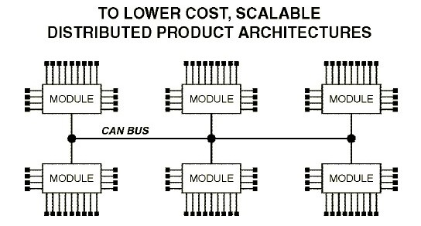
Why?
Vector CANtech Application Note - Intro to CAN.pdf

Slide 6
Other Advantages
Low Cost Components
Lower Wiring Cost
Many CAN-based Products Available
Easy to Configure/Modify
Growing Number of CAN Chips
Automatic Transmission Error handling
Off-the-Shelf Development Tools
  Vector CANoe

Slide 7
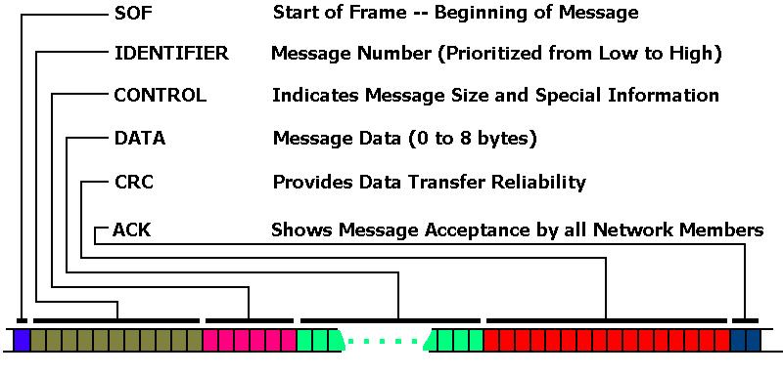
Message Frame
Vector CANtech Application Note - Intro to CAN.pdf

Slide 8
Four CAN Message Types
Remote Frame
Data Frame
Error Frame
Overload Frame

Slide 9
Remote Frame
Contains No Data
Data Length Code does not matter
Identifier contains network address of data home
  Remote Frame and Data Frame Response use the same ID
Not allowed in some industry standards
  SAE J1939 (Heavy Truck/Agriculture)
  NMEA 2000 (Marine)

Slide 10
Data Frame
Most Common
Used for “normal messaging”
Contains signal values in the data area
  Up to 8 bytes of data

Slide 11
Error Frame
Any message may be “killed”
  Violate bit-stuffing
  Destroying Fixed-Form field

Slide 12
Overload Frame
Not commonly used
Causes
  More time needed to process current message before receipt of next frame
  Detection of dominant bit during INTermission field
Interrupt also triggered to CPU
Format identical to Error frame
  Only sent during INTerframe space

Slide 13
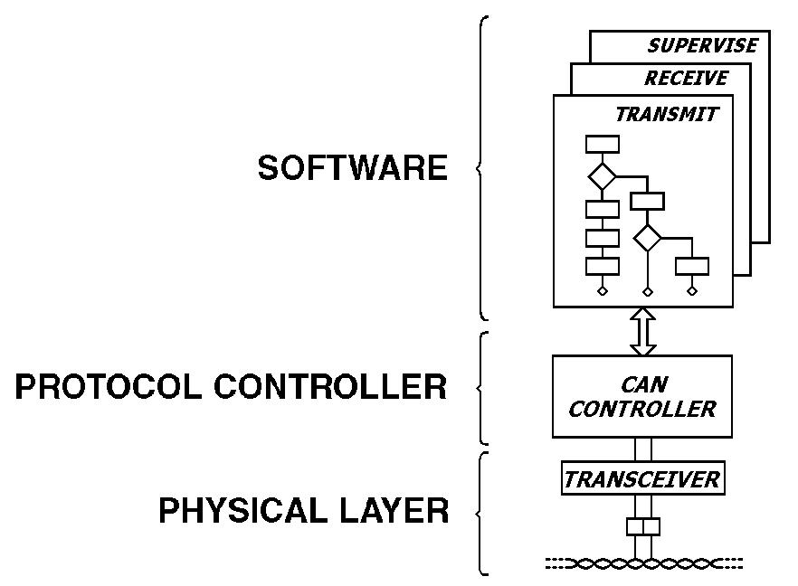
Structure of a CAN Node
Vector CANtech Application Note - Intro to CAN.pdf

Slide 14
The CAN Controller
Arbitration
Bit Stuffing
Errors

Slide 15
Arbitration
Resolves Message Collisions
Prioritizes Messages
Non-Destructive
  Transmitter of Highest Priority message unaware of other transmissions
  Other Transmitters turn off when
  Transmitted Bit ≠ Received Bit

Slide 16
Arbitration Example
Message ID
0x361
0
1
1
0
1
1
0
0
0
0
1
Not
Transmitting
0x363
0
1
1
0
1
1
0
0
0
1
0
Dominant
1
Recessive
0x370
0
1
1
0
1
1
1
0x577
1
Bus
Result
0
1
1
0
1
1
0
0
0
0
1
Vector CANtech Training Manual – CAN PROTOCOL

Slide 17
Bit Stuffing
Purpose
  Create frequent bit edges
Not used in
  CRC
  ACK
  EOF
  Error Frames
Handled by CAN Controller
  No software needed

Slide 18
Bit Stuffing Method
0
0
0
0
0
1
Recessive inserted after 5 dominant bits
1
1
1
1
1
0
Dominant inserted after 5 recessive bits
Example: Node A wants to transmit message with ID 0x7FF
SOF
1
1
1
1
1
1
1
1
1
1
1
Intended Transmission
Stuff Bits inserted by
CAN Controller
SOF
1
1
1
1
1
SB
1
1
1
1
1
SB
1
As seen by Application Layer of Receiving Node
SOF
1
1
1
1
1
1
1
1
1
1
1
Vector CANtech Training Manual – CAN PROTOCOL

Slide 19
Bit Stuffing Method
Example: Node A wants to transmit message with ID 0x7C2
SOF
1
1
1
1
1
0
0
0
0
1
0
Intended Transmission
Stuff Bits inserted by
CAN Controller
SOF
1
1
1
1
1
SB
0
0
0
0
SB
1
0
As seen by Application Layer of Receiving Node
SOF
1
1
1
1
1
0
0
0
0
1
0
Vector CANtech Training Manual – CAN PROTOCOL

Slide 20
Error Types
Bit Error
Bit Stuffing Error
CRC Error
Form Error
Acknowledgement Error

