Slide 1

Suggest Apartment location for Elderly Couple
By:Barath S

Slide 2
Business Problem
Mr. John, 65 years old, has decided to move to a new apartment in Toronto with his wife, to one among the shortlisted Boroughs:
Downtown Toronto
East Toronto
West Toronto
Central Toronto
As with old age, they have some pre-existing medical conditions and they need a location in the close vicinity of Hospitals for their treatment to be continued.
Mr. John is a Heart Patient and his requirement is that the new location should be nearer to heart speciality clinics.
Mrs. John has been visiting Toronto General Hospitals for past few years and she needs atleast one among these hospitals accessible from the new location.
Apart from this condition, they are flexible enough to handle other requirements.
They need our help to suggest them an apt location as near as possible according to above conditions, so that they can move without any hesitation and also continue to take their treatments in this old age without any hassle.

Slide 3
Data
Data used:
The Toronto neighborhood data was extracted from their Wikipedia page
https://en.wikipedia.org/wiki/List_of_postal_codes_of_Canada:_M
Structure:
The above data has three columns – Postal Code, Borough and Neighborhood of Toronto.
We can see many NA values in them, and they need to be handled.
We processed only the cells with an assigned Borough and removed the rows if Borough Column had NA values.
More than one neighbourhood can exist in one postal code area.

Slide 4
Methodology
Data Extraction, Cleaning and Visualization
Map Creation and Plotting
Using Fourswaure API to get the venue data
Analyze each neighborhood by grouping the rows by neighborhood and set the scope
Shortlist venue and plot geolocations of interest
Suggest area nearest to visit places geolocations

Slide 5
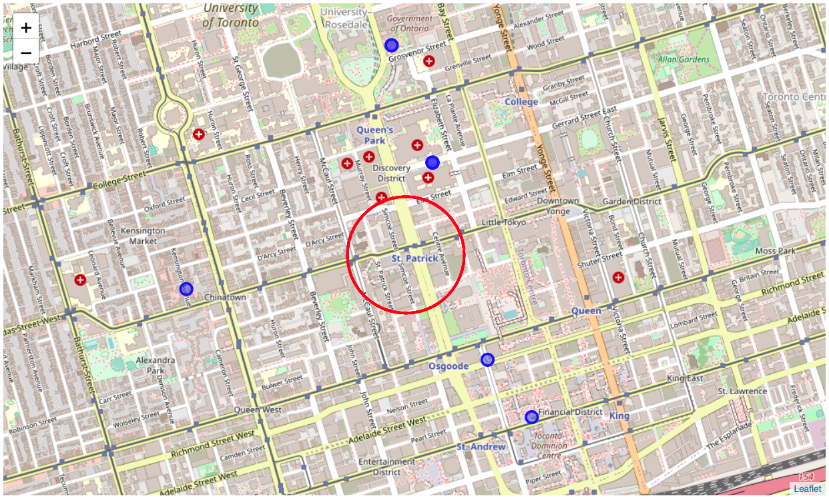
Results
The Geo locations of the neighbourhoods were plotted and nearest area to all these places was shortlisted as one of the solutions to this problem
We can see that St. Patricks near Central Bay area would be a great location from where both Heart Speciality Clinics and Toronto General Hospitals are conveniently accessible.
Mr and Mrs. John would be happy to move to this kind of a place.

Slide 6
Discussion
As our locations in this particular area are not very far from each other, we can roughly consider earth as a plane and estimated the new location by determining the centroid of the surrounding geo location coordinates.
This would be the simple yet effective recommendation.

Slide 7
Conclusion
The use of location data to explore a geographical location is quite a handy and effective tool to solve specific problems like above.

