Slide 1
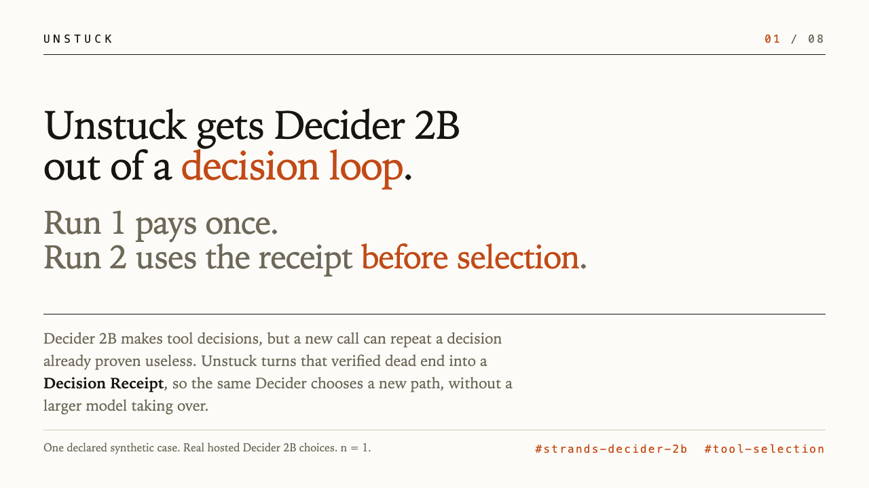
Notes:
Unstuck gets Decider 2B out of a decision loop. Decider 2B makes tool decisions, but a new call can repeat a decision already proven useless. Unstuck turns that verified dead end into a Decision Receipt. Run 1 pays the learning cost once. Run 2 uses the receipt before selection. The memoryless control stays stuck. No larger model takes over.

Slide 2
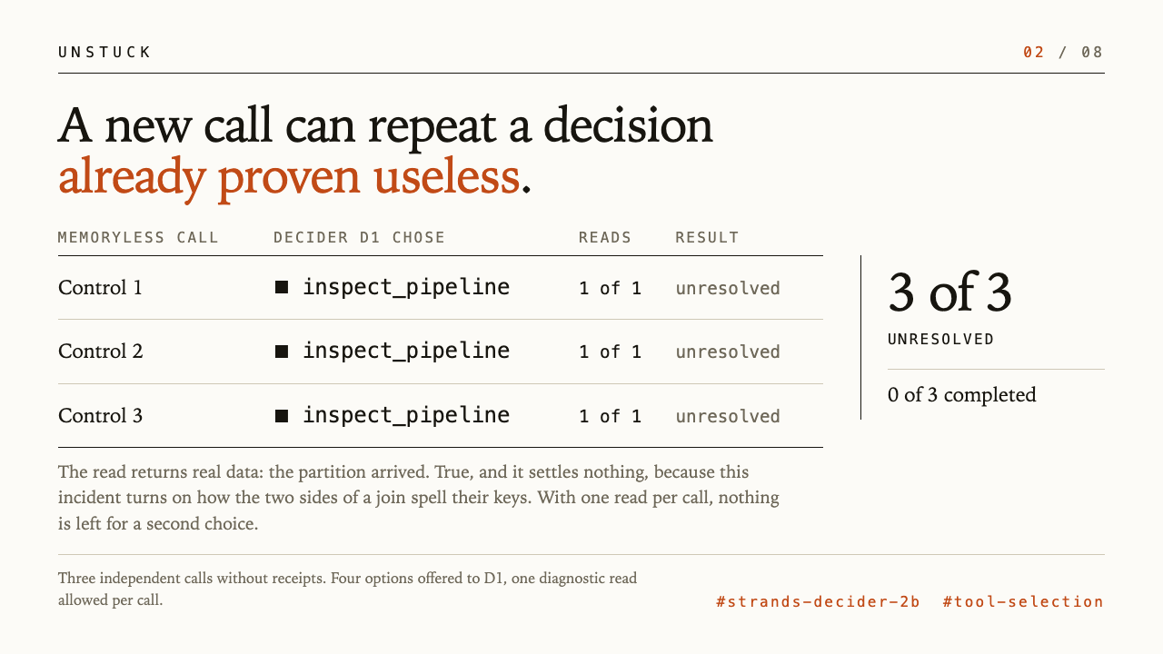
Notes:
Here is the problem. A synthetic report returns zero rows. Decider 2B is offered four read-only diagnostics and picks inspect_pipeline. The read returns real data, the partition arrived, and it settles nothing, because this incident turns on how the two sides of a join spell their keys. Each call may spend one diagnostic read, so the call ends unresolved. Ask again on a new call without receipts and it picks the same tool again. Three memoryless calls, three of three unresolved, zero of three completed.

Slide 3
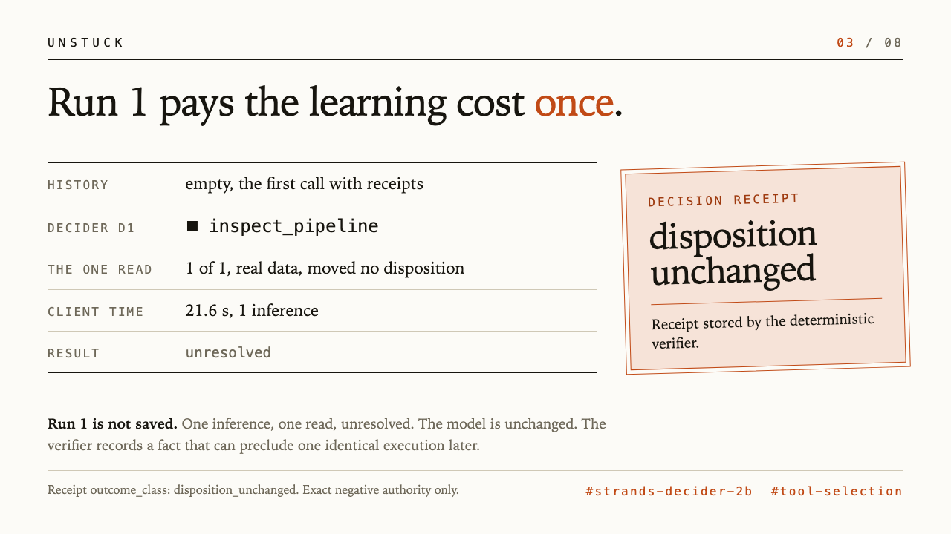
Notes:
Run 1 pays the learning cost once. Empty history, four diagnostics offered, one Decider choice: inspect_pipeline. One inference, 21.6 s client time, one read, unresolved. The deterministic verifier stores a disposition_unchanged Decision Receipt. Run 1 is not saved. The model is unchanged. The system records a verified fact. Source: curated loop-escape proof, Run 1 learning observation.

Slide 4
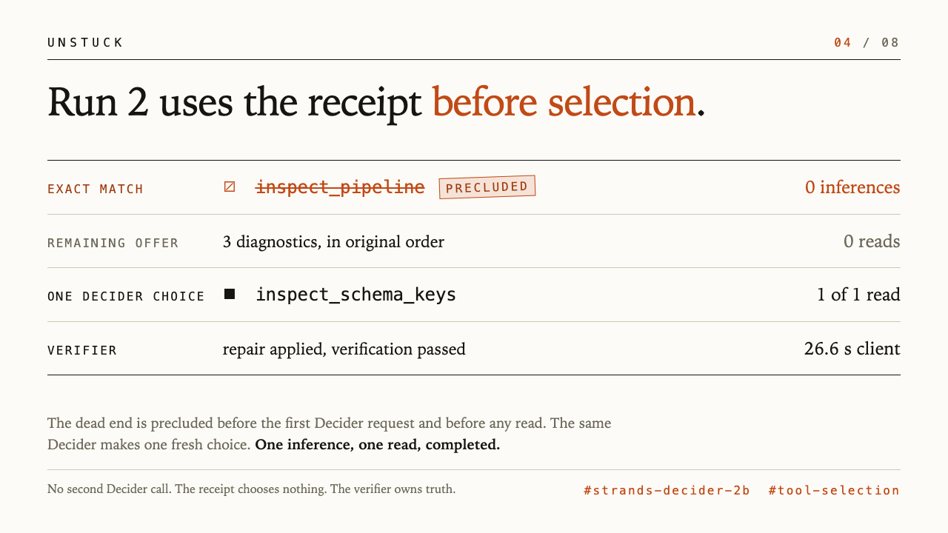
Notes:
Run 2 is a new call about the same incident, and the receipt matches exactly. Before the first Decider request and before any read, the controller precludes only inspect_pipeline. The three remaining diagnostics retain their original order. The same Decider 2B makes one fresh choice, inspect_schema_keys. One inference, one read, a verified repair, completed in 26.6 s client time. No second Decider call. The receipt chooses nothing. The verifier owns truth. Source: curated loop-escape proof, optimized Run 2 observation.

Slide 5
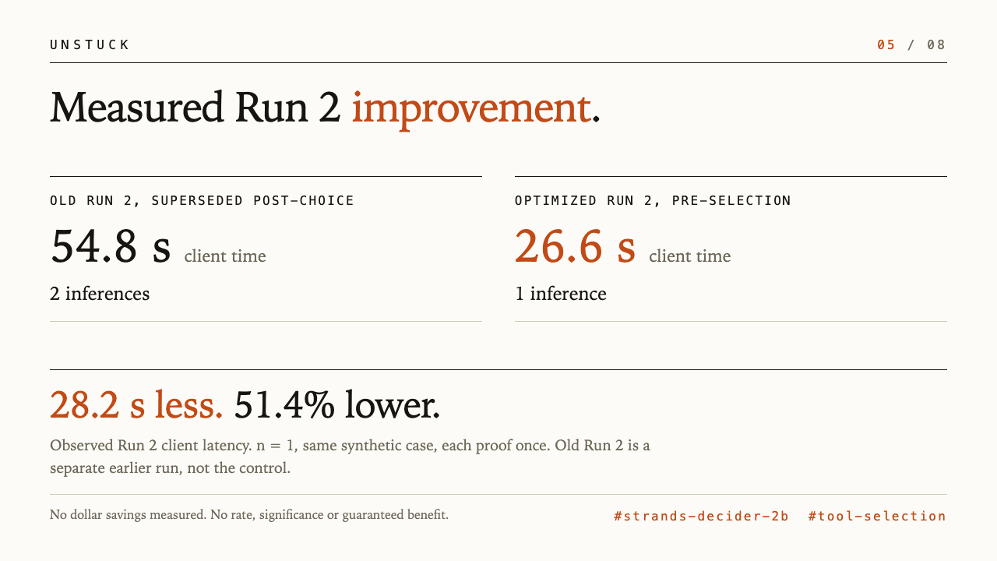
Notes:
Measured Run 2 improvement. The old Run 2 is the superseded post-choice flow, a separate earlier run on the same endpoint, not the memoryless control. Old Run 2: 54.8 s client time and 2 inferences. Optimized Run 2: 26.6 s and 1 inference. Observed Run 2 client latency fell 28.2 s, or 51.4%, with one fewer inference. n = 1, same synthetic case, each proof once. No dollar savings measured. No rate, significance or guaranteed benefit. Source: curated loop-escape proof, AgentCore client time comparison.

Slide 6
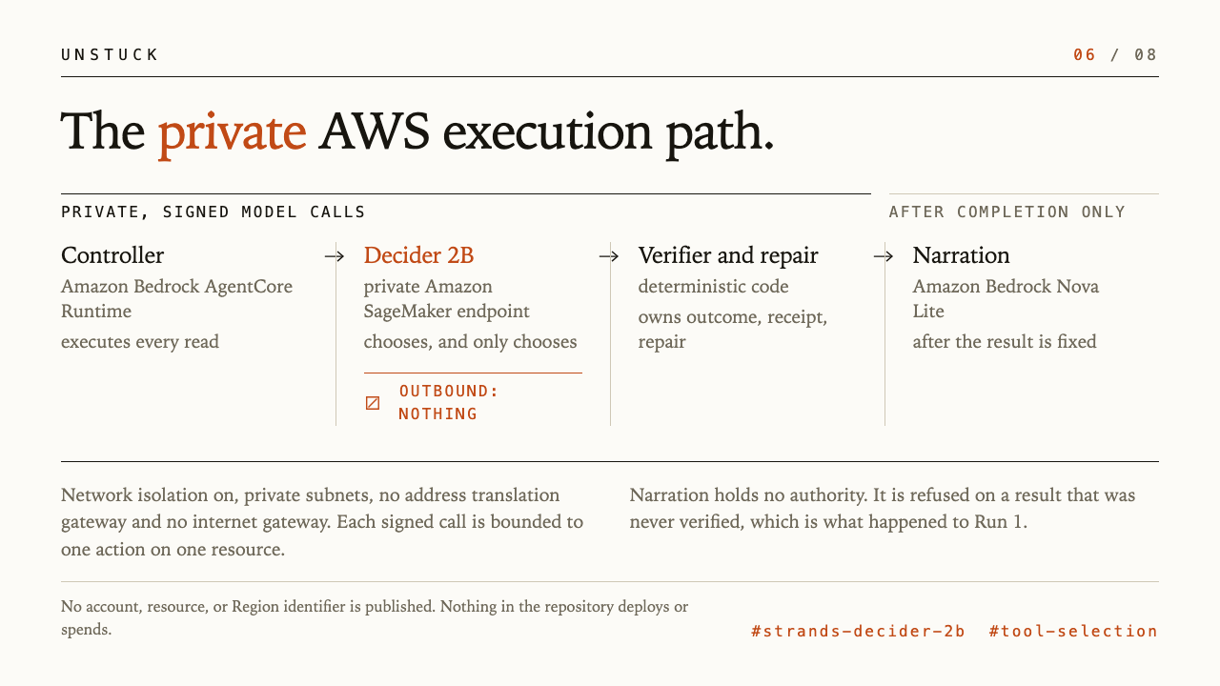
Notes:
The execution path is private. The controller runs on Amazon Bedrock AgentCore Runtime and executes every read. Decider 2B serves from a private Amazon SageMaker endpoint with network isolation and no outbound route. Model calls are signed. The deterministic verifier decides what the read found, writes the receipt, and authorizes the repair. Amazon Bedrock Nova Lite narrates only after the result is complete, holds no authority, and was refused on Run 1 because nothing was verified.

Slide 7
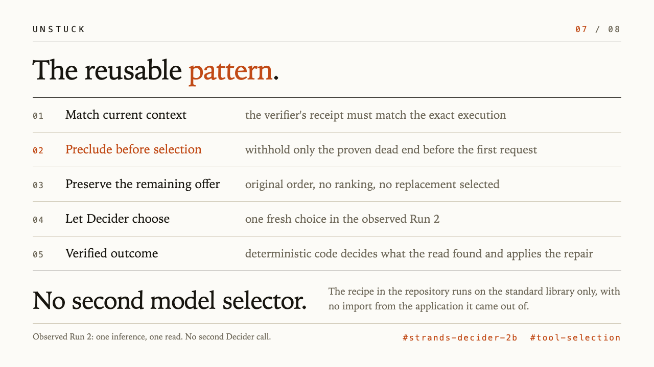
Notes:
The reusable pattern matches current context against the verifier's receipt, precludes only the proven exact execution before selection, preserves the remaining offer in original order, and lets Decider choose. Deterministic code verifies the result. In the observed Run 2 there is one inference, no second Decider call, and no second model selector. The recipe uses the standard library only.

Slide 8
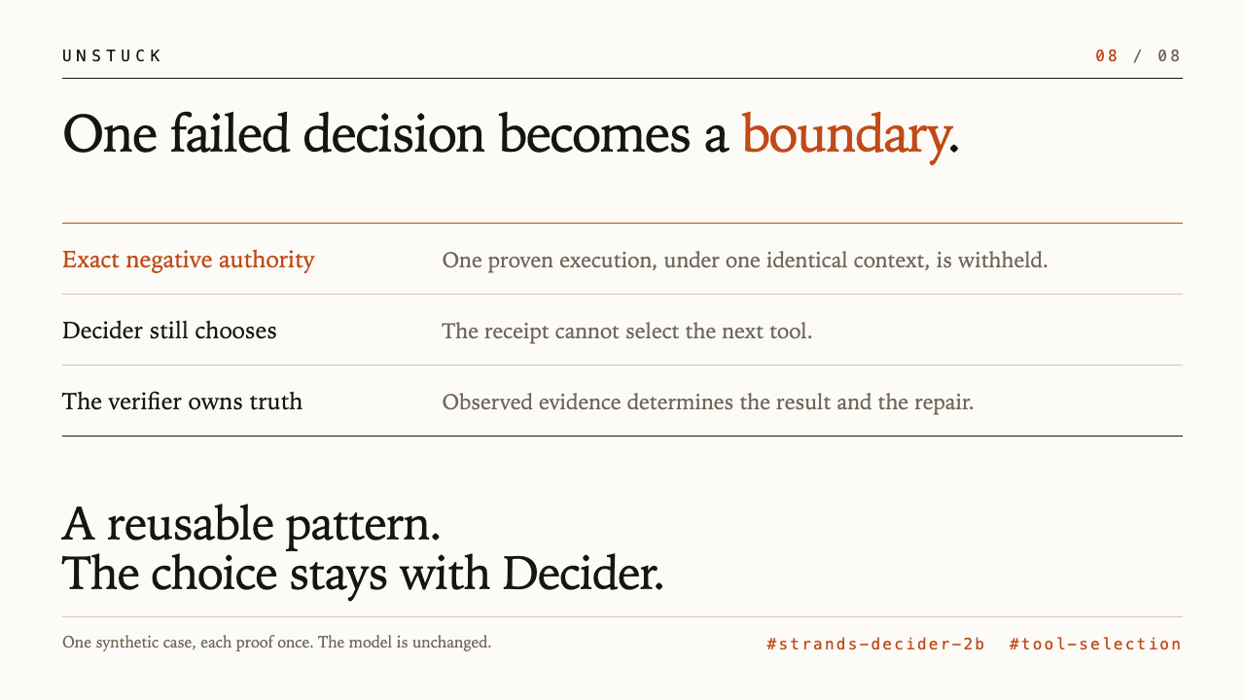
Notes:
One failed decision becomes a boundary. Exact negative authority can withhold one proven execution under one identical context. It cannot select the next tool. Decider still chooses. The verifier owns truth and authorizes repair from evidence. This is a reusable pattern. The model is unchanged. One synthetic case, each proof once.

