Slide 1
🕵️ LeakHunter
The AI profit detective for online sellers
Finds where returns drain your margin, explains why, and shows what fixing it is worth.
Team Lumora · ExaThon India 2026 · Track 02: Customers, Channels & Demand
Notes:
Hi, I'm Barathi from Team Lumora. LeakHunter is a profit detective for online sellers, built on Exasol for Track 2: returns that erode the margin on the sale.

Slide 2
The problem: sellers can't see where profit leaks
Online sellers see what they SOLD, not what they KEEP.
Invisible
Late
Costly
Returns, discounts and refused COD orders quietly eat the margin, hidden inside normal sales numbers.
Nobody notices until month-end accounts, when thousands of rupees are already gone.
Shipping both ways + write-offs + the lost sale. No analyst to dig into it.
Who: small D2C brands and marketplace sellers in India, where refused COD orders (RTO) make it worse.
LeakHunter · Team Lumora · ExaThon India 2026
Notes:
Sellers can see what they sold, but not what they actually kept. Returns, deep discounts and refused cash-on-delivery orders cost shipping both ways plus write-offs, and small sellers have no analyst to notice.

Slide 3
The solution: find it, explain it, price it, fix it
1 Data
2 Exasol
3 LeakHunter
4 Dashboard
Orders, products, returns
(synthetic, seeded)
→
View + SQL profit
+ z-test for leaks
→
Leak, reason,
₹ estimate, action
→
5 tabs, show-SQL,
what-if sliders
Statistically tested: random noise is not flagged as a leak
Every number comes from an Exasol query, with a Show the SQL button to audit it
Savings are clearly labelled as estimates, never verified results
Run it with Docker Compose or three Python commands
LeakHunter · Team Lumora · ExaThon India 2026
Notes:
LeakHunter loads orders, products and returns into Exasol. SQL in Exasol computes profit after returns and tests every category and channel for a statistically real jump in returns. The dashboard then explains why, estimates the loss in rupees, and lets the owner simulate a fix.

Slide 4
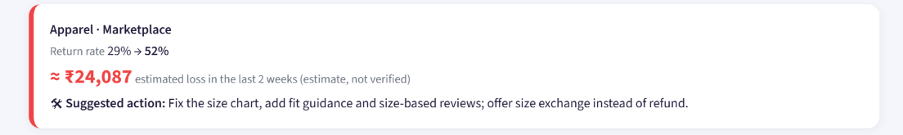
What's leaking
1 leak(s) found. Biggest: Apparel on Marketplace. Return rate rose from 29% to 52% in the last 2 weeks. Main reason: Size issue (41 of 54 returns). Estimated loss: ₹24,087 (estimate, not verified).
WHAT YOU SEE
Biggest leak found: Apparel on Marketplace
Return rate 29% → 52% in 2 weeks
≈ ₹24,087 estimated loss
A suggested action comes with it
How to read it: The red card is one detected leak. The briefing above it is plain language; the numbers are the before/after return rate and the estimated cost of the extra returns.
So what? The owner gets a Monday-morning answer, not a spreadsheet to dig through.
LeakHunter · Team Lumora · ExaThon India 2026
Notes:
This is the main screen. LeakHunter compares the last two weeks with the earlier baseline for every category and channel, and a z-test inside Exasol decides whether the jump is real. It found Apparel on Marketplace and suggests fixing the size chart.

Slide 5
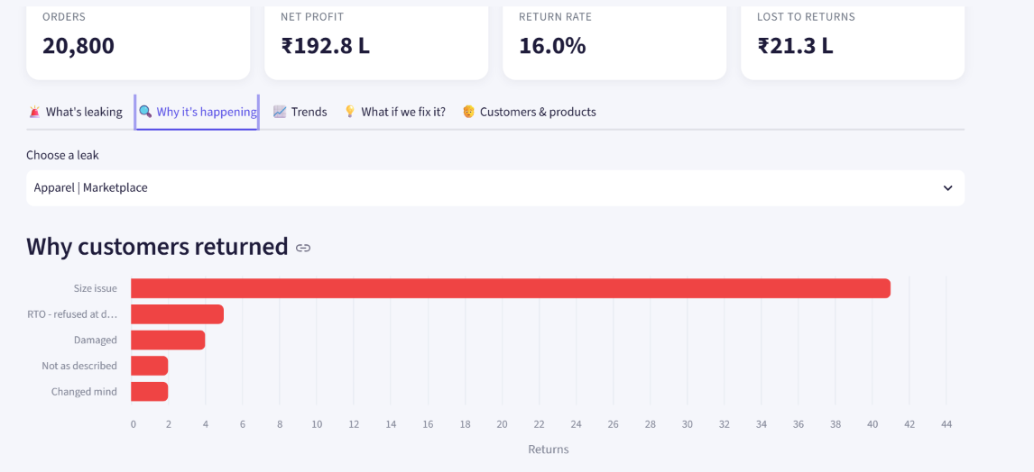
Why it's happening
WHAT YOU SEE
41 of 54 returns are size issues
Refused COD, damage, 'not as described' are minor
Pick any detected leak from the list
So what? Knowing the cause turns 'returns are up' into a fix: the size chart.
How to read it: Each bar is a return reason in the leak window; longer means more returns. The Show the SQL button under it reveals the exact Exasol query.
LeakHunter · Team Lumora · ExaThon India 2026
Notes:
The drill-down explains the leak. Most returns are size issues, so the action is clear. The Show the SQL button lets the owner audit the number, which is how we answer the question of whether you can trust AI analytics.

Slide 6
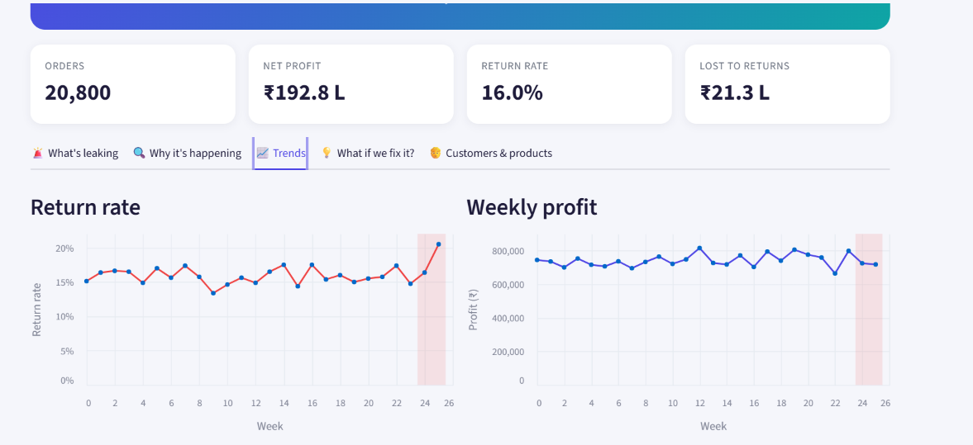
Trends
WHAT YOU SEE
Return rate sits near 15-17% for months
Spikes to ~21% in the final week
Profit dips as the leak starts
So what? The leak is visible but easy to miss in a normal dashboard, which is why detection is automated.
How to read it: The red band is the recent window being compared against the earlier baseline. The left line is return rate, the right is weekly profit.
LeakHunter · Team Lumora · ExaThon India 2026
Notes:
The red band marks the weeks LeakHunter compares against the baseline. The return rate breaks out of its normal range, while profit only wobbles. That is why a human might miss it for weeks.

Slide 7
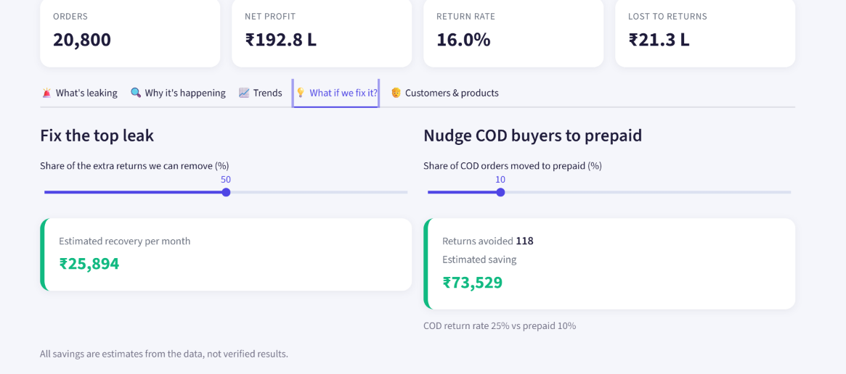
What if we fix it?
WHAT YOU SEE
Remove half the extra returns: ≈ ₹25,894/month
Nudge 10% of COD buyers to prepaid: 118 returns avoided, ≈ ₹73,529
COD returns 25% vs prepaid 10%
So what? Owners can size the prize before spending effort, which is how a finding becomes a decision.
How to read it: Move a slider to change how much of the problem you fix. The green card shows the estimated recovery. Both are estimates from this data, not verified savings.
LeakHunter · Team Lumora · ExaThon India 2026
Notes:
These are what-if sliders. Fixing half the extra returns on the top leak recovers an estimated ₹25,894 a month. Cash-on-delivery orders return at 25% against 10% for prepaid, so shifting 10% of COD buyers avoids about 118 returns. We label these as estimates.

Slide 8
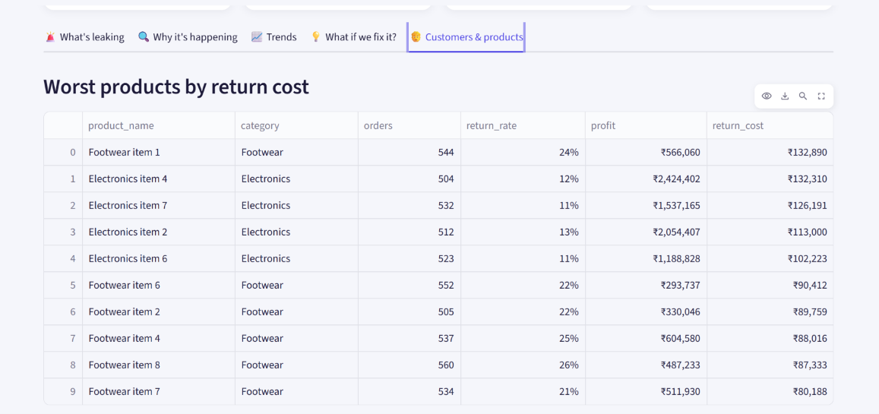
Customers & products
WHAT YOU SEE
Worst products ranked by return cost
Footwear item 1: 24% returned, ₹1.3 L return cost
Same tab: discount bands and serial returners (182 customers ≈ 28% of return cost)
So what? Shows which products and customers to act on first. Customer IDs are synthetic.
How to read it: Rows are products sorted by the money returns cost. Return rate is the share of orders sent back; profit is after returns.
LeakHunter · Team Lumora · ExaThon India 2026
Notes:
This tab adds the customer and product view: the products costing the most in returns, how return rate changes with discount level, and serial returners, a small group of customers behind a large share of the return cost. The customer IDs in the demo are synthetic.

Slide 9
Built for the judging criteria
Criterion | How LeakHunter answers it
Innovation & impact (25%) | Proactive profit detective: finds the leak, explains why, prices it in ₹, suggests the fix
Use of Exasol (25%) | All data in Exasol; V_FACT view, profit maths and the z-test run in SQL; every chart shows its SQL
Technical excellence (20%) | Statistical test avoids false alarms; seeded, reproducible data; logic tested
Design & UX (15%) | 5-tab dashboard, plain-language briefing, what-if sliders, CSV/TXT download
Docs & reproducibility (10%) | README, run guide, Docker Compose, .env example
Open-source quality (5%) | MIT licence, public GitHub repo
LeakHunter · Team Lumora · ExaThon India 2026
Notes:
Each judging criterion maps to something concrete in the project. The strongest point is that Exasol does the real analytical work, and every claim can be audited with the Show the SQL button.

Slide 10
Why it matters, and what we're honest about
Why sellers will pay
Honest by design
A weekly briefing replaces month-end surprises
Fixes are priced in ₹ before any effort
No analyst or data team needed
Subscription for D2C and marketplace sellers
Demo data is synthetic, with one planted leak
Loss and saving figures are estimates
Detection is rule + z-test; no ML model yet
Next: real retailer data, stock-out and churn leaks, AI-written briefings
LeakHunter · Team Lumora · ExaThon India 2026
Notes:
LeakHunter is a CFO-in-a-box for sellers who can't afford an analyst. All demo data is synthetic and savings are estimates. The roadmap is real data, more leak types such as stock-outs and churn, and AI-written briefings.

