Slide 1
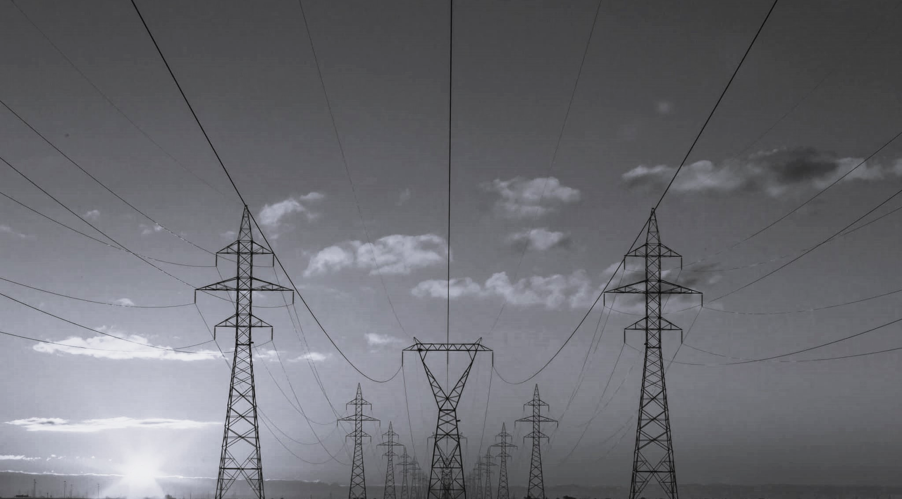
Fraud Detection in Electricity & Gas Consumption Tunisia

Slide 2
Introduction
Fraud Detection in Electricity and Gas Consumption Challenge
by Giulia, Mike, Barbara
The Tunisian Company of Electricity and Gas suffered tremendous losses in the order of 200 million Tunisian Dinars due to fraudulent manipulations of meters by consumers.
Aim: Detection and Recognition of clients involved in fraudulent activities.
Data: 1.048.757 Mio records from 31.601 clients in a time frame of 5 years.
Source: Zini Challenge: Fraud Detection in Tunisia

Slide 3
Information about the data
Generalizations:
Total of clients: 31603
1757 of them are fraud → 5.6%
31449 for electricity → 1756 fraudulent
14512 for gas → 1018 fraudulent
Regions with most fraud cases are 311 , 101 and it's surroundings.

Slide 4
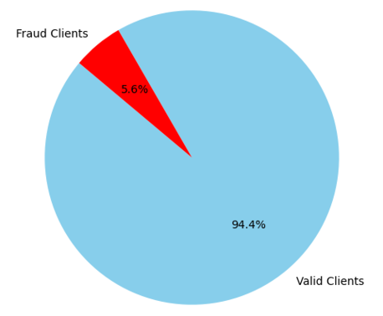
Valid Clients vs Fraud Clients

Slide 5
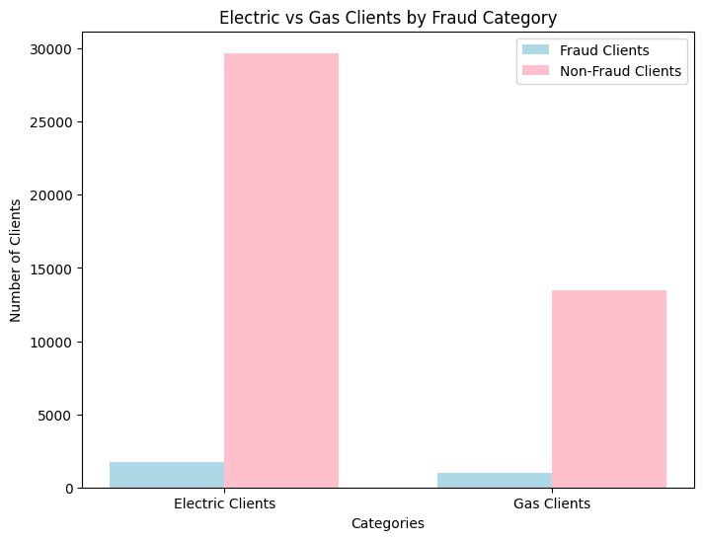
Electric vs Gas Clients by Fraud Category
94.5 %
94.7 %
93.5 %
5.3 %
6.5 %

Slide 6
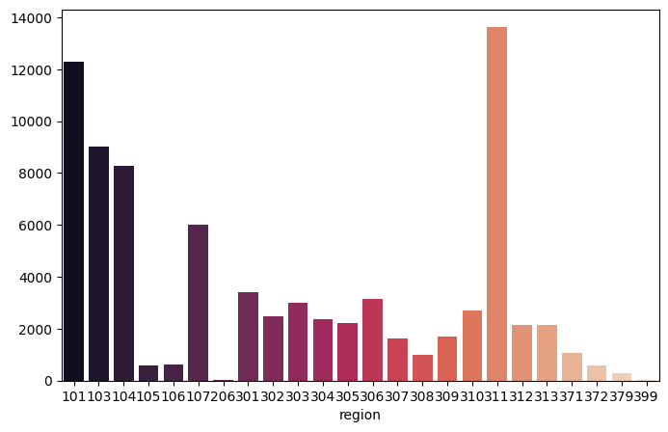
Region with most fraud cases
94.5 %
94.7 %
93.5 %
5.3 %
6.5 %

Slide 7
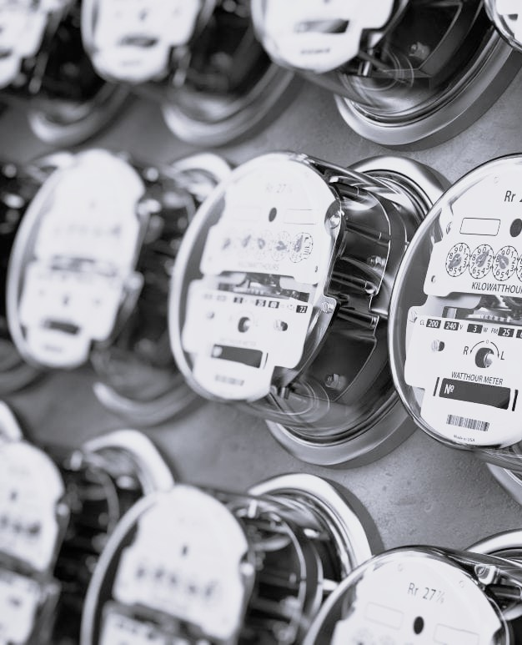
Our system can detect fraud with a 43% accuracy , while this low and results in a lot of false positive results , we can have a good approach
Product
Our system can detect 85% of actual fraud cases, while there is a high level of false positives ,possible solutions:
Priorities these clients during the quarterly remak visits.
Manual vetting process (might add to costs but is justified by the saving per client)

Slide 8
Our system can detect fraud with a 43% accuracy , while this low and results in a lot of false positive results , we can have a good approach
Savings
The returns can be tremounds
For eclectic the official average consumption for fraud per quarter is 767 KW.
This translates to 60 USD per quarter per client.
For gas the official average consumption for fraud per quarter is 170 Cub m per quarter,about 20 USD.

Slide 9
Suggestions
Change the counter remark criteria used in a visit (If the counter shows something wrong, the agent gives a bad score ).
Start new evaluation in the high populated regions: 311, 101 - 109 with a focus on the list our system produces.
focus on eclectic fraud (more cost saving and higher numbers).

Slide 10
Sharing with the class
Insights:
The data set is highly imbalanced no clear correlation.
processing the data per client (on avg there is 30 row per client).
our approach was to convert this data into statistical info.
split the gas and elec set

Slide 11
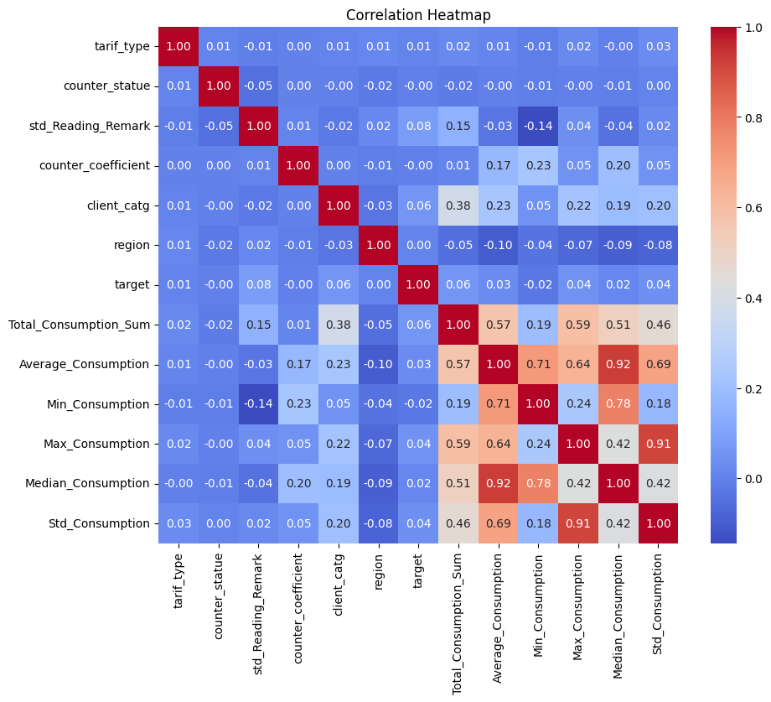

Slide 12
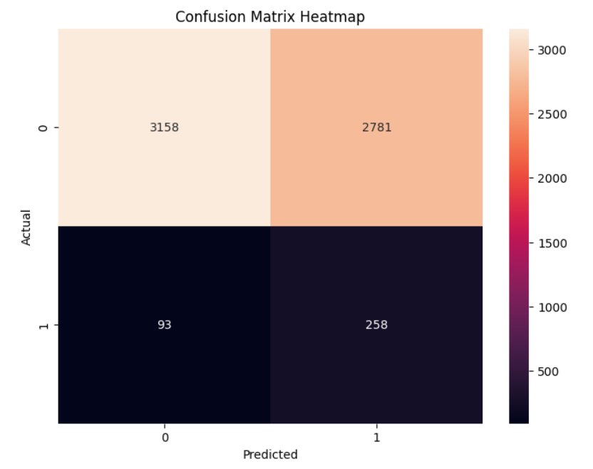
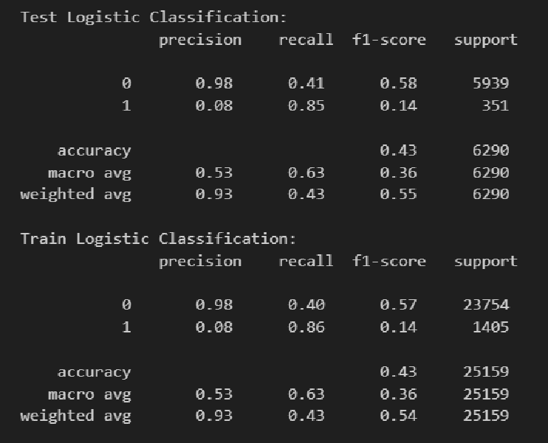
Logistic Regression results

Slide 13
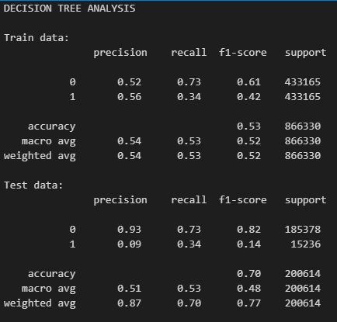
Decision Tree Results

