Slide 1
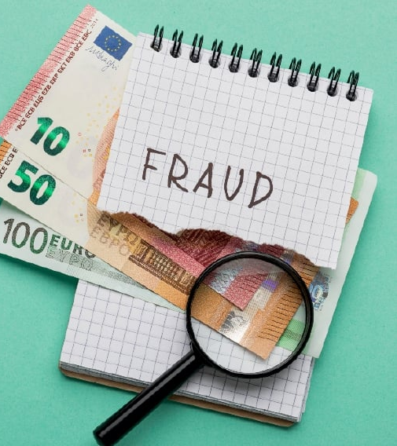
Fraud Detection
Recognizing clients involved in fraudulent activities thought their billing records.

Slide 2
EDA
Generalizations:
Total of clients: 31603
1757 of them are fraud → 5.5%
31449 for electricity → 1756 fraudulent
14512 for gas → 1018 fraudulent
Most Fraudulent Activities are caught in energy bills
regions with most fraud are 311 , 101 and it's surroundings.

Slide 3
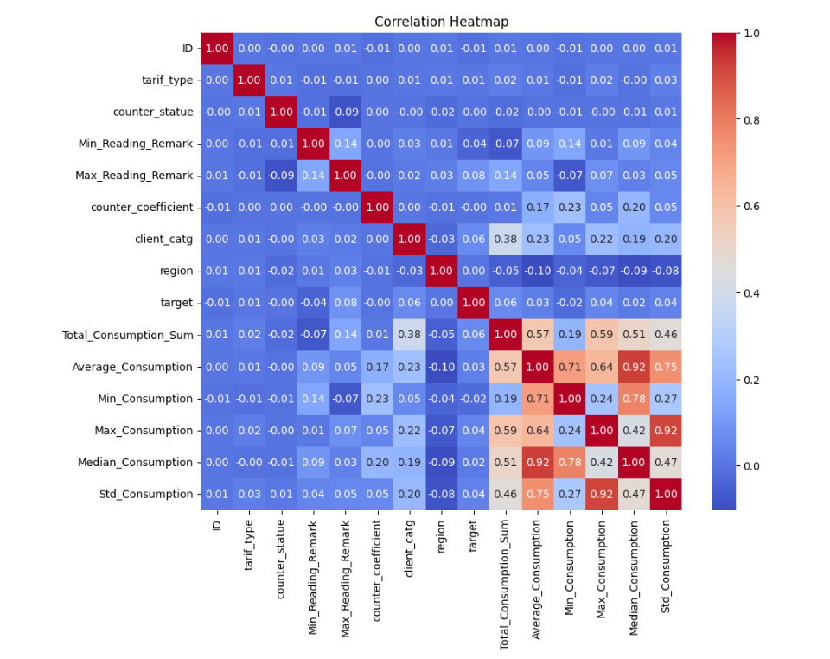

Slide 4
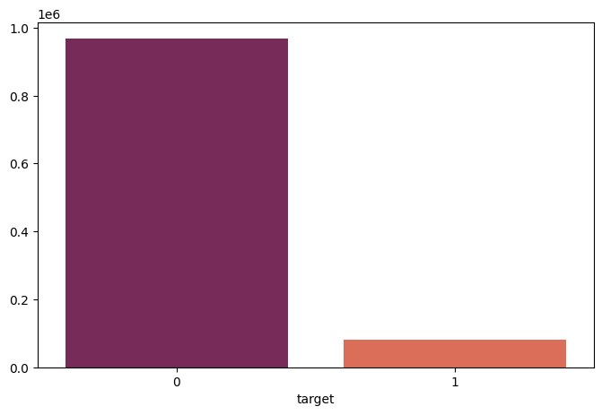
Fraudulent clients vs Paying clients

Slide 5
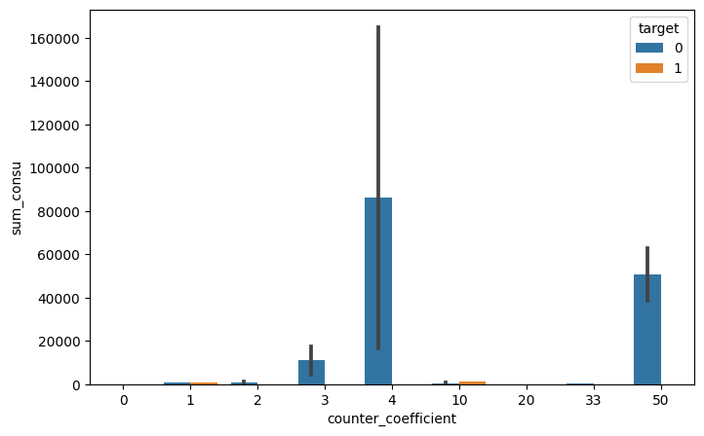
High coefficient for consumption (10,20,33) while the sum of consumption is very low might be a indicator for counter manulatplation

Slide 6
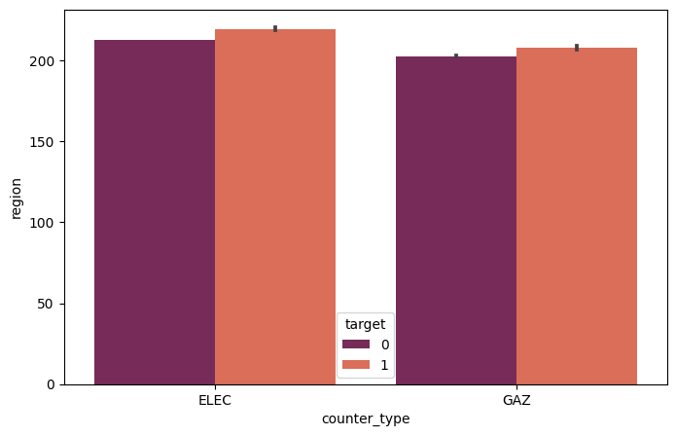

Slide 7
Sugestions
Change the counter remark system.

