Slide 1

Fitbit Data Case Study
Insights on Activity, METs, Weight Change & Heart Rate

Slide 2
Objective
Analyze Fitbit user data to uncover how activity intensities and METs (Metabolic Equivalent of Tasks) relate to weight change and heart rate.
MET = Calories / Weight (kg) x duration (hours)

Slide 3
Data & Methods
• 35 Fitbit users, 2×1-month periods (3/12–4/11 & 4/12–5/12)
Summarized per user: weight change, avg daily METs (Metabolic Equivalent of Tasks), activity (light/fair/very), avg HR, sleep, steps.

Slide 4
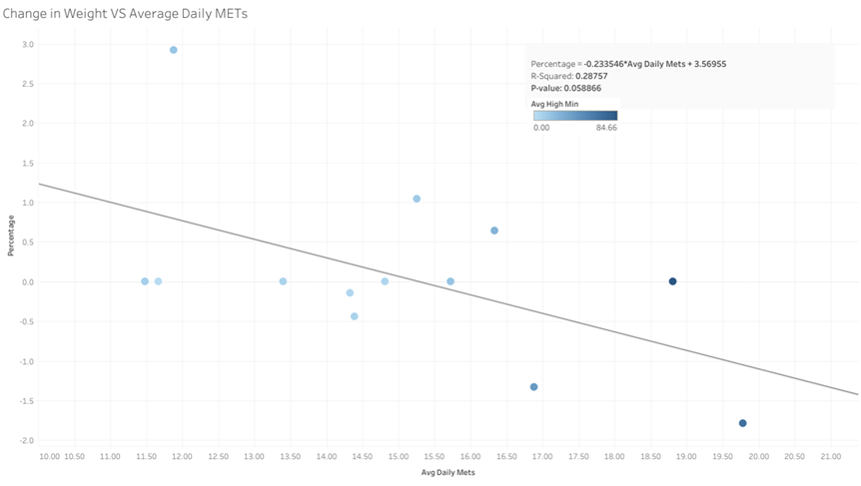
Interpretation: Higher METs link to modest weight loss (borderline significant). • Each +1 MET linked to ~0.23% additional weight loss; • R² = 0.29, p ≈ 0.06 (moderate, borderline)
METs vs. Weight Change

Slide 5
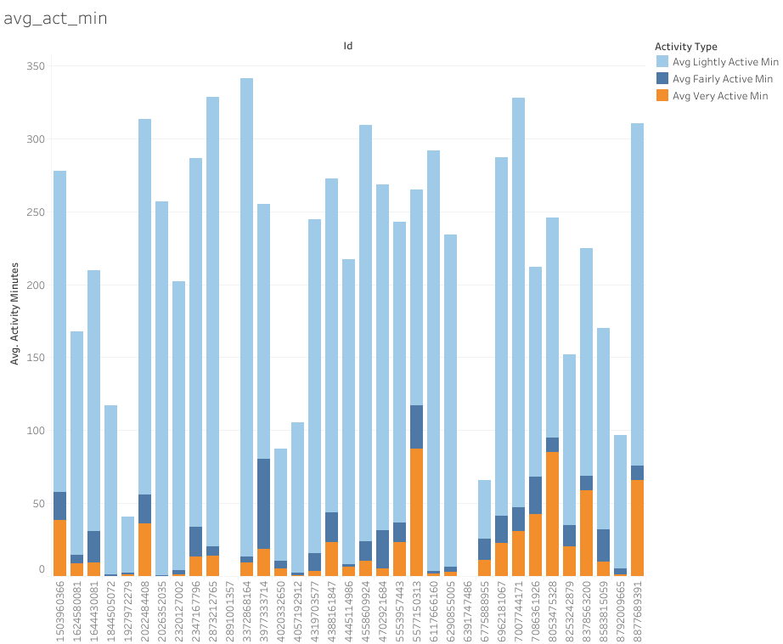
Average Activity per minute

Slide 6
Steps vs Activity Type
Regression results:
Light activity: R²=0.205, p=0.0080
Fair activity : R²=0.239, p=0.0038
Very activity : R²=0.509, p<0.0001
Insights: There is a greater number of steps related with very active minutes on more than a half of times

Slide 7
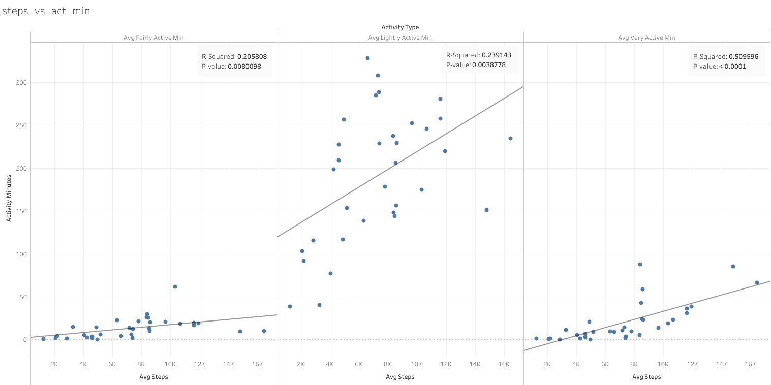
Steps vs Activity Type
Light R²=0.205, p=0.0080; Fair: R²=0.239, p=0.0038; High R²=0.509, p<0.0001
Very active is a good indicator of activity

Slide 8
Activity vs. Resting Heart Rate
Regression Results:
• Light activity: R²=0.015, p=0.68 (ns)
• Fair activity : R²=0.156, p=0.16 (ns)
• Very activity : R²=0.093, p=0.29 (ns)
Insights: No single intensity predicts resting Heart Rate strongly.

Slide 9
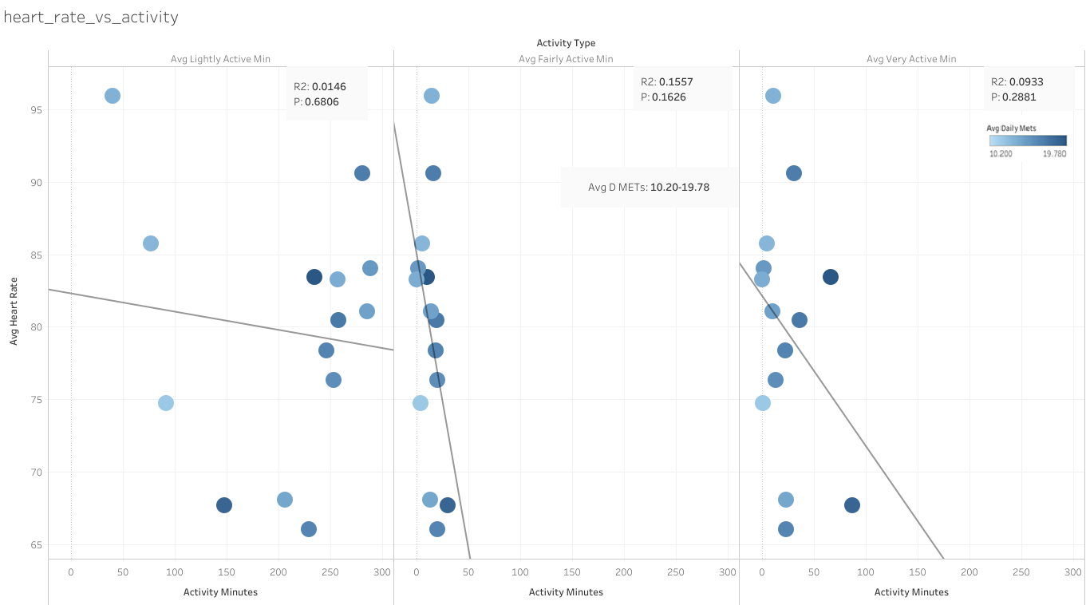
Activity vs. Resting Heart Rate
Light R²=0.015, p=0.68; Fair: R²=0.156, p=0.16 ; High: R²=0.093, p=0.29
No one is a good predictor

Slide 10
Activity Intensity Drives METs
Regression Results:
Light Activity: R² = 0.23, p = 0.004
Fair Activity: R² = 0.12, p = 0.045
Very Activity: R² = 0.60, p < 0.0001
Insight: Very-intensity minutes are by far the strongest driver of total METs.

Slide 11
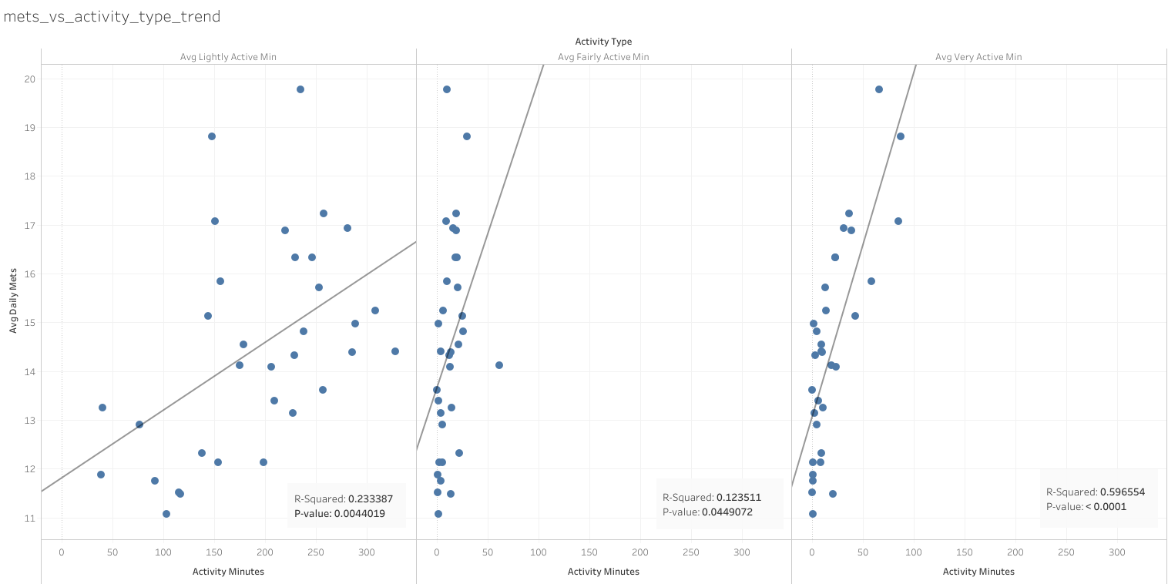
Activity Intensity vs. METs
Light: R²=0.23, p=0.004; Fair: R²=0.12, p=0.045; High: R²=0.60, p<0.0001
High-intensity minutes are strongest MET driver.

Slide 12
Final Summary
Less than a half of people use wearable devices that allow us to capture data and make some insights.
Intensity per hour increases the MET within a statistically significant difference of 90% of cases.
Increase in MET is significant for weight change, but it does not explain all the cases. More parameters to be taken into evaluation in order would address weight lost.
The major activity-driving MET is very active, so people who do lots of steps are more prone to increase the metabolic rate.
Finally, the heart rate poorly relates to the activity and MET itself, which it means new ways have to be explored to identify heart rate patterns for people doing physical activity.

Slide 13
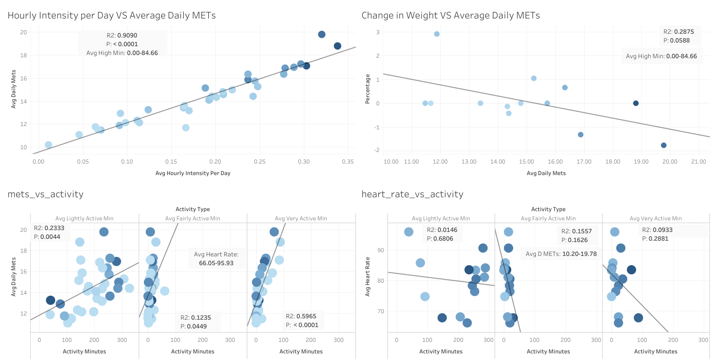
Final Summary

Slide 14
Recommendations
Many people might already have a smartwatch or do not want one.
Leaf would work as an ornament and people might be more prone to use wearable devices.
Feature “Very-Active” Streaks & Rewards Highlight daily/weekly high-intensity minutes
Light-Activity Reminders
Combined Activity Tracking
MET-Based Challenges “Boost your daily METs by 2 points for weight-loss bonus”

