Slide 1
E-commerce product listing page
by Juliette Barbay

Slide 2
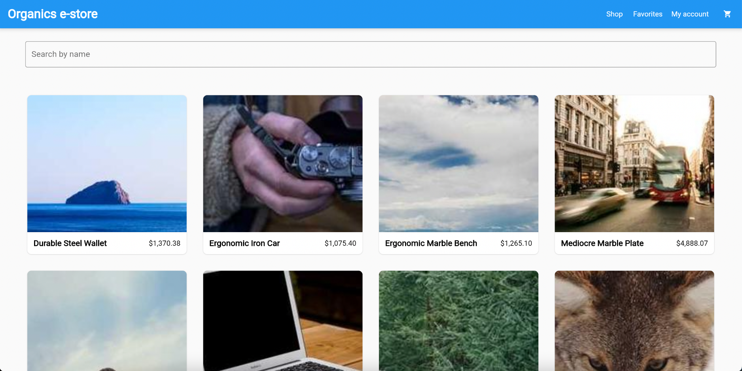
Final result

Slide 3
Content
DB Schema
Backend with Rails
Frontend with Flutter
Filter
Code challenges
Learning points
Coding principles

Slide 4
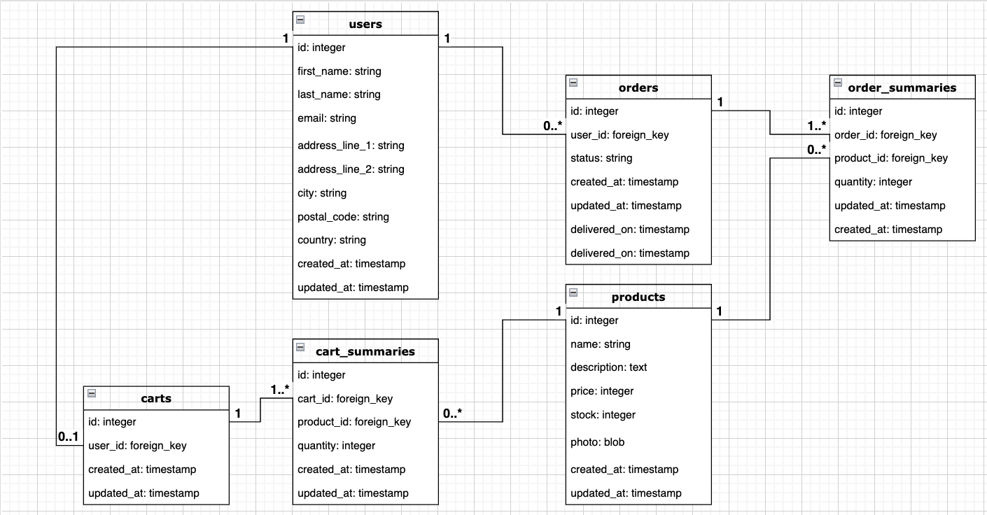
DB Schema

Slide 5
Backend: Ruby On Rails
Rails API
PostgreSQL
ActiveRecord
ActiveStorage for pictures
Test data using Faker gem

Slide 6
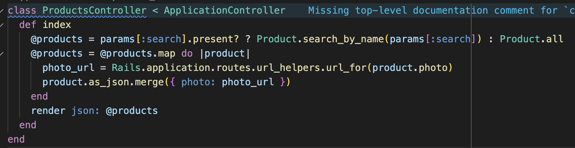
Rails API
Sends the data as JSON

Slide 7
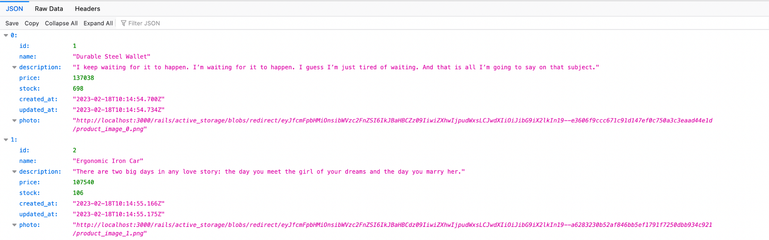
Running the backend
http://localhost:3000/products

Slide 8
Flutter Frontend
Widgets
= Presentation / View layer
Bloc
= Business Logic layer with state management
Repository
= Data / Model layer
Rails Backend

Slide 9
Presentation
Product listing page: Stateful widget
Init called once, when widget first rendered
Blocbuilder: builder called everytime state changes
Search field
Grid
Grid: displayed depending on the state

Slide 10
Cubit (= Bloc)
State
Define the different states for the product listing page
All states inherit from ProductListingState
ProductListingState inherits from Equatable
ProductListingLoaded receives a List of products, to display them.
Cubit
Function to load the products and emit the different states.
If error, we catch it and emit the new state (failure)

Slide 11
Model
Product model:
Create new instances of Product once we receive JSON from backend
Repository:
Function to send http request to backend
Asynchronous function
Transform JSON to List of Product instances
Http package

Slide 12
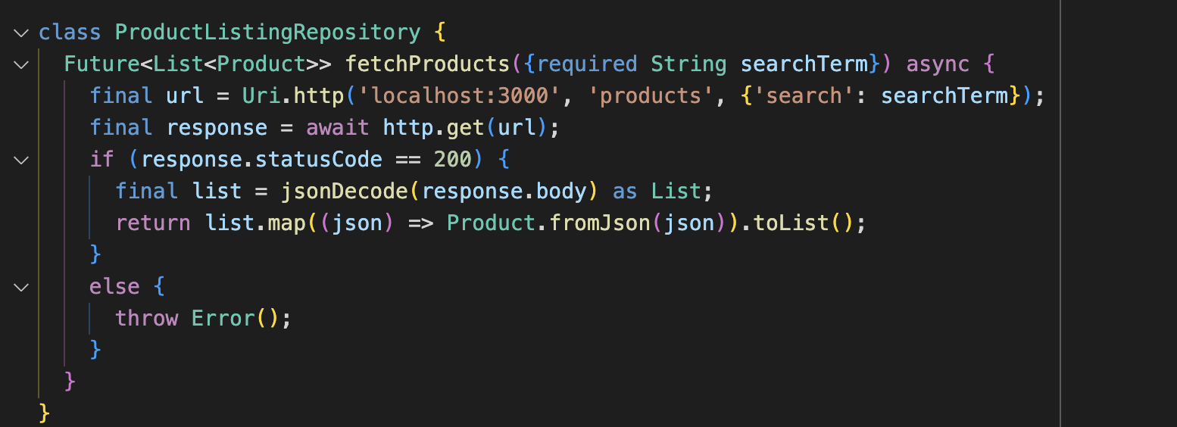
Getting data from backend

Slide 13
Filter
Backend
Using pg_search gem
Search based on name
API sends JSON with all products or filtered products
Frontend
Searchfield
Submit : call function to load products with search term.

Slide 14
Code challenges
CORS:
Configuring CORS to send the data from Rails API. By default, cannot answer a request from another domain.
→ Allow GET requests from frontend

Slide 15
My take away
New language, new framework
Widgets
Statically typed language (vs dynamically typed)
Frontend and backend separately

Slide 16
Some principles used
Single Responsibility Principle
Class has only one responsibility → Format the price in model, not view
Liskov substitution
ProductListingState can be substituted with its child classes
Composition
Build complex widgets with simpler ones

Slide 17
Thank you for listening!
Any questions ?

