Slide 1
Environmental
Considerations in ATM System Design
Rappertour – Lourdes Maurice, FAA, United States
Session Chair – Billy Josefsson, LFV, Sweden
Reviewers also included:
Cesare Bernabei, CEC DG TREN, European Union
Mark Weber, MIT LL, United States

Slide 2



Slide 3
6 Presentations
Environmental Impact of Air Traffic Flow Management Delays – ENVISA/EUROCONTROL - 101
Advanced Noise Abatement Approach Activities at Nottingham East Midlands Airport – Cambridge/GaTech - 119
Flight Demonstration of the Separation Analyses Methodology for Continuous Descent Arrival – GaTech - 178
Determining the Environmental Benefits of Implementing Continuous Descent Approach Procedures – ATAC - 17
AEDT Global NOx Demonstration – CSSI et al. - 16
Quantifying the Relationship Between Air Traffic Management Inefficiency, Fuel Burn and Air Pollutants – CSSI et al. - 65

Slide 4
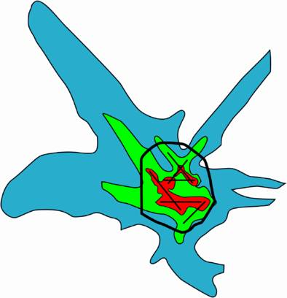
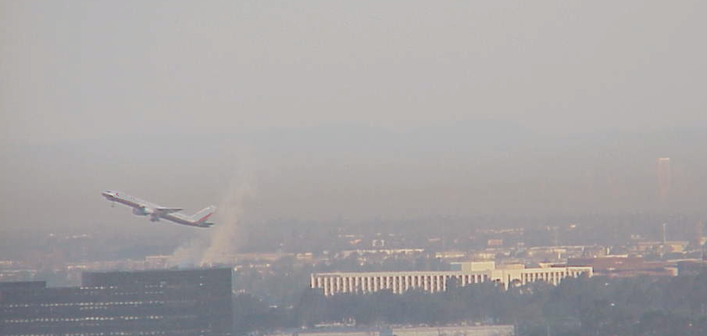

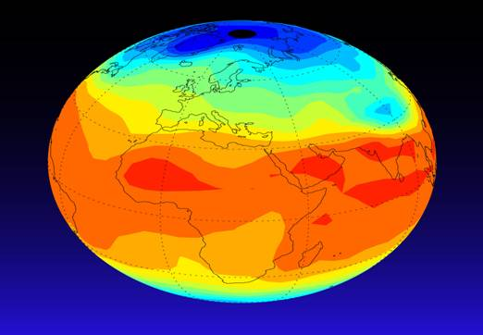
Aviation Environmental
Challenges - 2005
Aviation Environmental Issues
Air Quality
Community Noise Impacts
Water Quality
Global climate

Slide 5


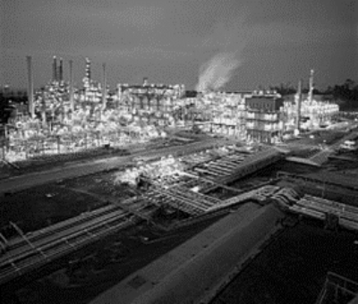

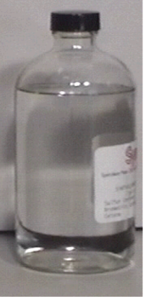

Aviation Environmental
Challenges - 2007
Community Noise Impacts
Air Quality
Energy
Water Quality
Global Climate
Notes:
I think this chart is a better reflect of the challenges ahead- Community noise remains- but it has increasing competition from local air quality issues- and at least in one part of the world- the impact on GHG and climate change- is becoming an issue that could potentially constraint growth.
Going forward, it will be increasingly important to not onloy understand each of these factors- bt to understand their interdpendnencies and influences on one another. For example- do we build an engine that reduces noise or NOx?
.

Slide 6
Key Themes
Environment not confined to environment session – subject of discussion throughout seminar
Everyone is looking for environmental benefits – actors must come together to offer solutions before solutions are imposed from outside
Environmental efficiency is a key driver – ATM and operational improvements can be leveraged to mitigate environmental impacts
We no longer talk about noise, LAQ, global emissions or about local versus regional versus global implications – we must consider all impacts and all implications in an integrated manner
Models making advances in capturing impacts, trades, etc. – integral to decision making process

Slide 7
2005 Next Steps – 2007
Scorecard
Robust analyses of capacity and economic impact of environmental mitigation actions - Yes
Robust treatment of interrelationships - Evolving
International ties between research efforts critical to success – Yes – many excellent examples
Increase ties between science and operations - Evolving
Need to consider alternative sources of energy – Efforts underway – not presented this year

Slide 8




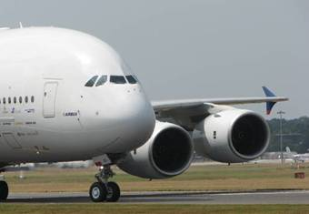
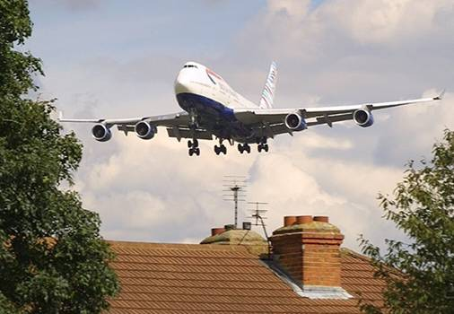
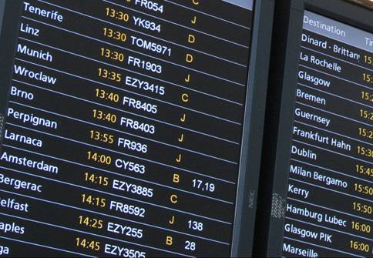

Aviation Integrated Modelling Project Architecture
The Future
Sample policy:
ATC evolution
Global
Environment
Impacts
Sample policy:
Regulation
Aircraft
Movement
Global Climate
Sample policy:
Airport capacity
Airport Activity
Local
Environment
Impacts
Aircraft
Technology & Cost
Local Air Quality & Noise
Sample policy:
Economic instruments
Local/National
Economic
Impacts
Air Transport Demand
Regional Economics
for more information
See www.AIMproject.aero
www.faa.gov/about/office_org/headquarters_offices/aep/models/
www.partner.aero

Slide 9


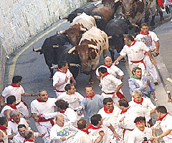
Gracias … next stop Pamplona?

