Slide 1
CEATS
Central European Air Traffic Services

Slide 2
The Context
The En-Route and Airport Strategies for the 1990s
Europe’s ATM2000+ Strategy
The Single European Sky

Slide 3
The CEATS Agreement
Agreement between the EUROCONTROL Organisation and 8 States
EUROCONTROL Organisation entrusted with the provision and the operation of en- route air traffic facilities and services
National Contracting Parties retain their competencies and obligations in respect of aeronautical regulations, rule-making, airspace organisation

Slide 4
Strategic Objectives
Achieve ever-increasing levels of Safety in the CEATS area
Enhancement of the airspace capacity
Optimal integration of the CEATS environment into the European Air Traffic Management System
Improve the economy of flight operations
Support access to the airspace by military users

Slide 5
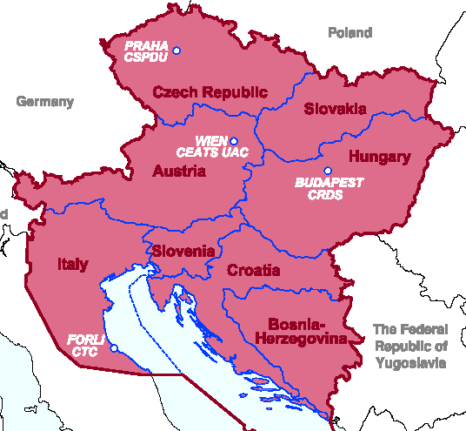
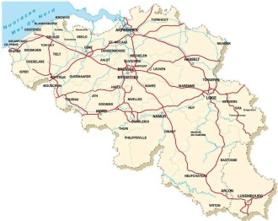
CSPDU
CEATS Strategy Planning and Development Unit
Prague - Nov.1999
CMO
CEATS Project
Management Office
Brussels - Sep.2002
CRDS
CEATS Research, Development & Simulation Centre
Budapest - Jul.2001
CUAC
Upper Area
Control Centre
Vienna - Oct.2007
CTC
CEATS Training Centre
Forlí - 2004-2005

Slide 6
CRDS - Role
1. Simulations
  Validation of operational and technical choices in support of the CEATS project (operational concept, specifications, …).
  Study and simulate the range of available options, identifying the optimum solution path and generating benefits as early as possible to the widest range of stakeholders.
  The CRDS could also act as a relief unit for the EUROCONTROL Experimental Centre.

Slide 7
CRDS - Role
1. Simulations
  Model Based Fast-Time Simulations
  Real-Time Simulations
  Airport simulations (after validation of business opportunity)
  Priorities
    1. For the CEATS project
    2. For the CEATS States (support of harmonisation)
    Planning : up to 2005..2006
    3. For Eurocontrol States
    4. For non Eurocontrol States

Slide 8
CRDS - Role
2. A Centre of Expertise for « FBA »
  Contribute to the development of the appropriate ATM solution
    Direct participation in the CEATS Projects (e.g. HMI, Training, Airspace Planning, ...)
    Assistance to ANSP in their harmonisation projects (SIM, CR ANS Escape, ...)

Slide 9
CRDS - Role
3. The CRDS will be the focal point for ATM R&D in central Europe ….
  Develop own expertise
  Create a “Network of Excellence” in the Region
  Harmonise R&D in the Region (reduce fragmentation)
  Join 6th Framework Programme consortium

Slide 10
CRDS - Role
3. ... ATM R&D in central Europe …
  R&D workshop with universities January 2003
  R&D workshop with industry end 2003 / early 2004
  Participation in R&D workgroups
  Create visibility of own R&D activities (in ARDEP)
  Attract students (Masters & Doctoral)

Slide 11
CRDS - Role
4. Training
  The CRDS will add an additional element to the regional simulation training capability in particular for training and familiarisation with advanced system features.
  Support for the “Training of the Trainers” of the CUAC
  In co-operation with CEATS Training Centre (Forli, Italy), the other ANSP training centres and the Eurocontrol IANS (Luxembourg).
  In co-operation with universities in region (e.g. U.Belgrade)
  Disseminate Eurocontrol expertise
    (presentations of Eurocontrol projects and R&D)
Notes:
The Institute trained a record 3,000 students and was obliged to turn down a further 1,000 requests for training. Their new e-learning unit should go some way to absorbing this shortfall in the future.

Slide 12
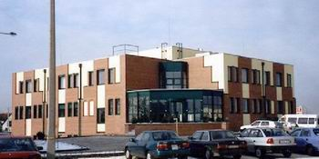
CRDS
Visit of the CRDS and HungaroControl on Thursday, 26 June. Bus at 16:00

