Slide 1
Traffic Flow Optimisation
Rapporteur: Nicolas Durand, CENA
27 June 2003

Slide 2
Thanks
Thanks to the reviewers
  Tom Edwards
  George Donohue
  Heinz Winter
Thanks to the chairmen
  Jean-Marc Pomeret
  Alain Printemps
A special thanks to Christian, Sabrina and Catherine
27 June 2003

Slide 3
9 out of 16 papers accepted
4 papers from Europe
  Eurocontrol (EEC)/Transim/Modis International/Neosys
  Eurocontrol (EEC)/Université Technologique de Compiegne (UTC) (2 papers)
  NLR
4 papers from USA
  Metron Aviation/University of Colorado/University of Maryland
  Boeing ATM
  Metron / FAA
  NASA (ARC)
1 Europe-USA paper: FAA/ISA Software
27 June 2003

Slide 4
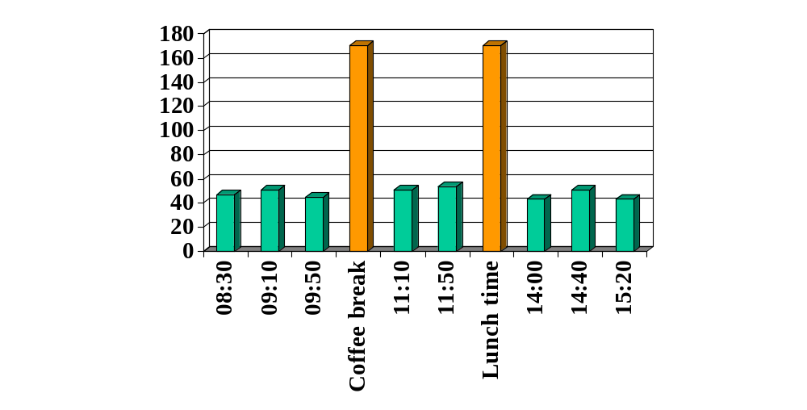
Participation to presentations
27 June 2003

Slide 5
Themes covered
Analysis of the existing system & behaviors
A study of the NAS Behavior (ETMS Scheduled Route Errors)
    higher view of the NAS system (get away from tools)
    debate on the prediction accuracy problem
Comparison between “pilot models” and “humans” in an autonomous aircraft environment.
    Effects of human in the loop (complex conflicts)
    debate on the conditions of the experiments (low participation, toy problems)
27 June 2003

Slide 6
Themes covered
Ground Delay & Equity
    limit inequities rising from exempted flights and mitigate the resulting bias
    questions on uncertainties, acceptation by airlines, extension to holding
Route & flight level assignment
    limit the number of conflicts by optimising the route and flight level. Good modeling and strong algorithm. Connexions with telecom problems
    questions on uncertainties, sector capacity respect, cost criteria, overtaking aircraft
27 June 2003

Slide 7
Themes covered
Airline Schedule Recovery
    Precise modeling of the problem, experiments on a simplified environment & on real data
    Questions on the algorithm used, the complexity, assumptions
Sectorization optimization with constraints
    CSP modeling of the Sector design problem.
    Questions on constraints assumptions, sensitivity to parameters, 3D extension
Conceptual approach of SuperSectors
    A new organization of controllers’ tasks to optimize capacity
    Debate on the role of each layer, efficiency of control by exception
27 June 2003

Slide 8
Themes covered
Trajectory Optimization
Real Time Conflict-Free Trajectory Optimization
    Based on the sparse aispace assumption, perturb the unconstrainted trajectory using a conflict grid.
    Questions on uncertainties on detection & resolution, how often should the optimization be updated
Dynamic Re-routing
    RAMS algorithm on US data, trajectory rerouting when delay is important enough.
    Questions on the OPGEN algorithm, partial information influence on result, uncertainties impacts
27 June 2003

Slide 9
Algorithms used
CSP (Constraint Satisfactory Programming)
Integer Linear Programming
Optimal Control Techniques
Lagrangian Relaxation techniques
Genetic Algorithms (OPGEN)
Modified Voltage Potential methods
...
27 June 2003

Slide 10
Rapporteur’s comments
27 June 2003

Slide 11
Still different environments
USA
  1 constraint/bottleneck at a time (Ground delay & equity)
  Mostly airport & weather problems (Dynamic rerouting, airline schedule recovery)
  En route capacity not crucial (Real time conflict free)
  Equity is already an issue (Ground delay & equity)
Europe
  Several constraints at a time (Route & FL assignment)
  Mostly en-route problems (Route & FL assignment, optimized sectorization)
  High densities (bots/human comparison)
But a better understanding of each others’ problems
27 June 2003

Slide 12
Impact on the optimisation methods
USA
  Easier to separate problems
  Local optimisation methods
  Longer horizon (optimisation of the full trajectory)
Europe
  Global treatment of problems
  Combinatorial optimisation
  Shorter horizons
27 June 2003

Slide 13
Shared concerns (1)
You cannot optimize without a proper description of the context
Quality of the optimization relies on valid assumptions
Difficult to enter the ATM world for “newcomers”
Need for specific community efforts
27 June 2003

Slide 14
Shared concerns (2)
There is a need of accurate prediction (for each presentation questions on uncertainties)
  Trajectory prediction
  Flight information, weather forecast accuracy
Eliminate uncertainties or deal with them?
Stochatic model or exact model ?
Where is the trade-off (uncertainty-time horizon) ?
27 June 2003

Slide 15
Rapporteur’s recommandations
27 June 2003

Slide 16
To authors
Scientific Approach
  need to explain more precisely what is behind algorithms (no progress possible with « proprietary approaches » or « blackboxes »)
  An opinion is not a proof (be careful with conclusions)
Need for details on
  assumptions, parameters
  algorithm complexity, computing time
Bibliography
  improve :-) Some papers still rather poor on bibliography
27 June 2003

Slide 17
Recommandations
To the ATM R&D community:
  Necessary steps towards better collaborations
    Share data, benchmarks or even “toy problems”
    Cross-test results on each-other’s simulators
To the R&D Committee:
  Give more information to the authors when their papers are rejected
  Improve paper allocations to the tracks.
  Encourage more collaboration with Universities
27 June 2003

Slide 18
My conclusions
We move forward (but very slowly ? )
  Some very complete state of the art in papers
  with mixed references of what is done both sides
  The ATM R&D Proceedings are widely used
The evolution since Saclay 97 is important
  As an example: thanks to previous ATM R&D Seminar, we expect to present results of comparisons on Traffic complexity using US & European data with the same tool at the next ATM R&D Seminar
27 June 2003

Slide 19
Back to work !
27 June 2003

