Slide 1
GraphLLM: Boosting Graph Reasoning Ability of Large Language Models
Mohmmadbarbod Amirmazlaghani

Slide 2
Introduction
LLMs' ability to understand diverse types of information (e.g., images, audio)
Gap in LLMs' ability to reason on graph data

Slide 3
Problem Statement
LLMs' underwhelming performance on fundamental graph reasoning tasks
Common practice of converting graphs into natural language descriptions (Graph2Text) as a bottleneck

Slide 4
Graph2Text Strategy Limitations
Inefficiencies in learning graph structures from sequential text
Lengthy context of graph descriptions posing challenges for LLMs
Examples

Slide 5
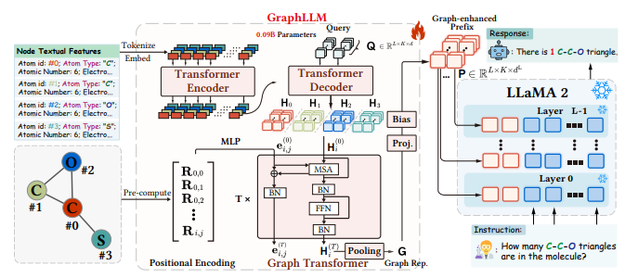
Introduction to GraphLLM
End-to-end approach integrating graph learning models with LLMs
Equips LLMs to interpret and reason on graph data
Superior expressive power of graph learning models

Slide 6
GraphLLM Framework Overview
Collaborative Synergy
Context Condensation
Integrating graph learning models and LLMs
Reducing lengthy graph descriptions

Slide 7
Node Understanding Module
Use of textual transformer encoder-decoder
Extraction of semantic information from node descriptions

Slide 8
Structure Understanding Module
Use of graph transformer
Aggregation of node representations and graph structure

Slide 9
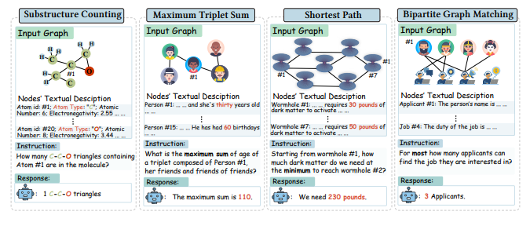
Experimental Setup
Description of graph reasoning tasks
Dataset statistics and task illustrations

Slide 10
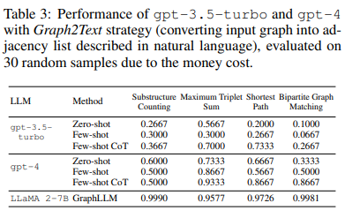
Performance on Graph Reasoning Tasks
Comparison of GraphLLM with Graph2Text-based methods
Performance metrics and improvements

Slide 11
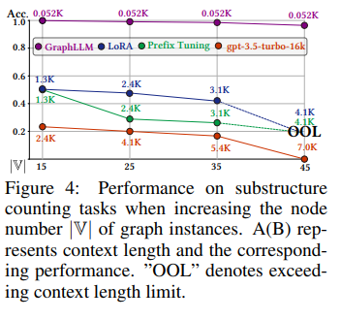
Context Reduction Analysis
Reduction in context length achieved by GraphLLM
Impact on efficiency and effectiveness of LLMs

Slide 12
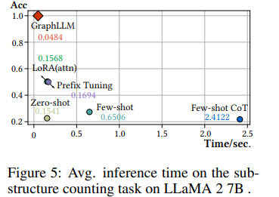
Computational Efficiency
Inference time comparison
Speedup achieved by GraphLLM

Slide 13
Conclusion and Future Work
Summary of GraphLLM's contributions and improvements
Potential directions for future research

