Slide 1
Review of two large models GPT-4, 3D-LLM
MohammadBarbod AmirMazlaghani

Slide 2
Reference
OpenAI. GPT-4 technical report. ArXiv, abs/2303.08774, 2023.
arXiv:2307.12981(NeurIPS 2023)

Slide 3
Outline
Introduction
GPT-4
3D-LLM
Examples & Evaluation

Slide 4
Introduction
LLM-GPT4
3D-LLM

Slide 5

GPT-4

Slide 6
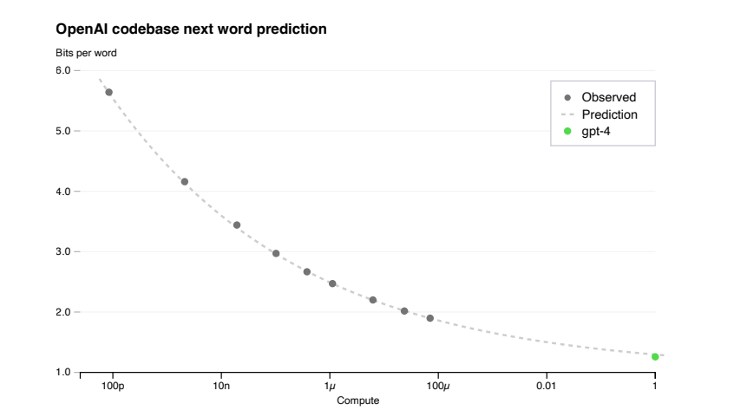
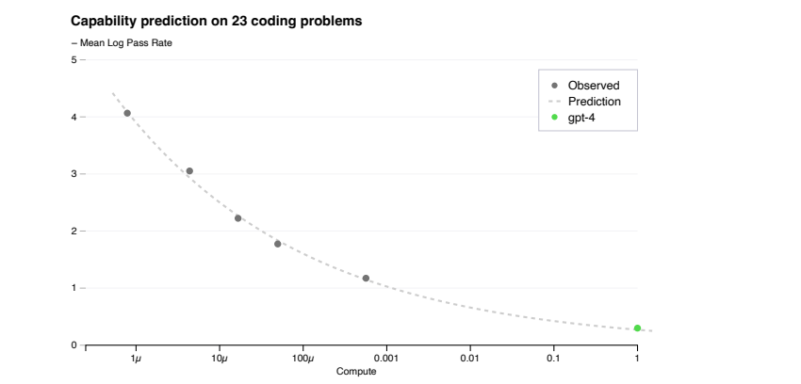
GPT-4
Predictable Scaling
Loss prediction
Scaling of Capabilities on HumanEval

Slide 7
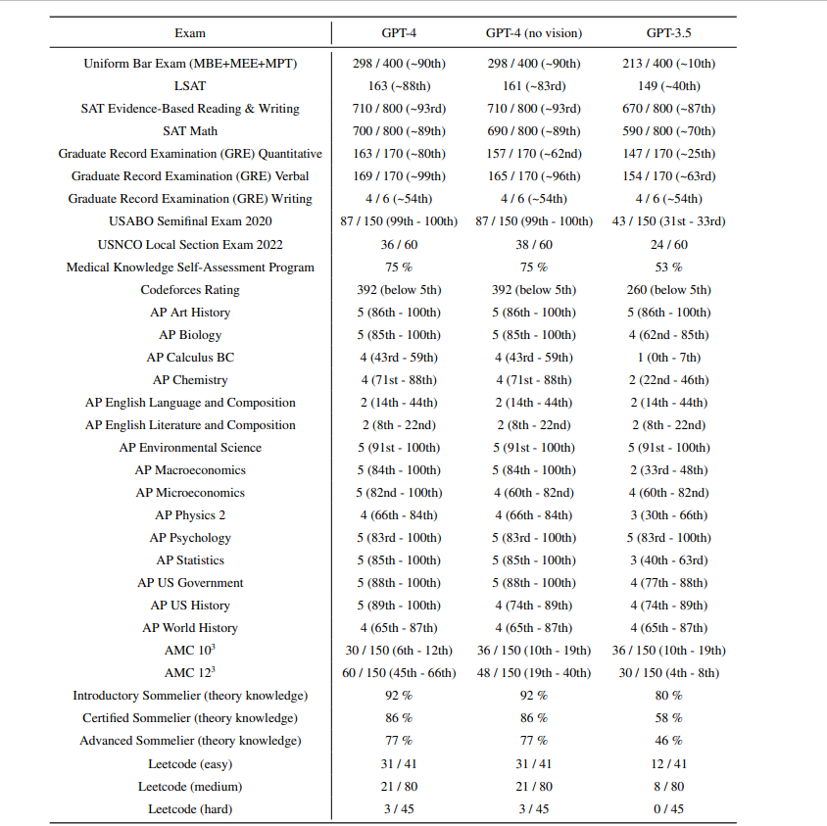
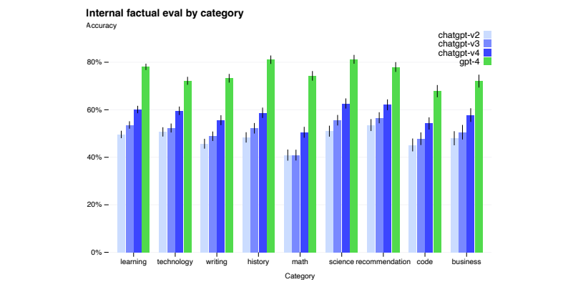
GPT-4
Capabilities & Limitations

Slide 8
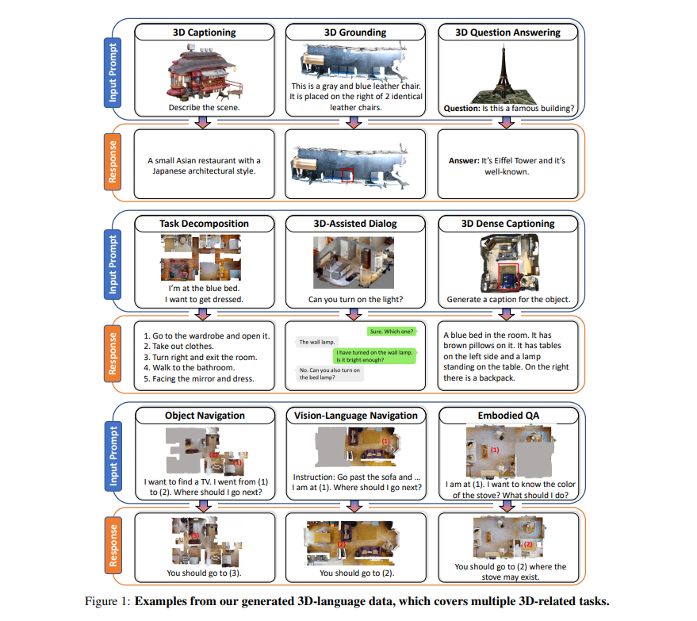
3D-LLM

Slide 9
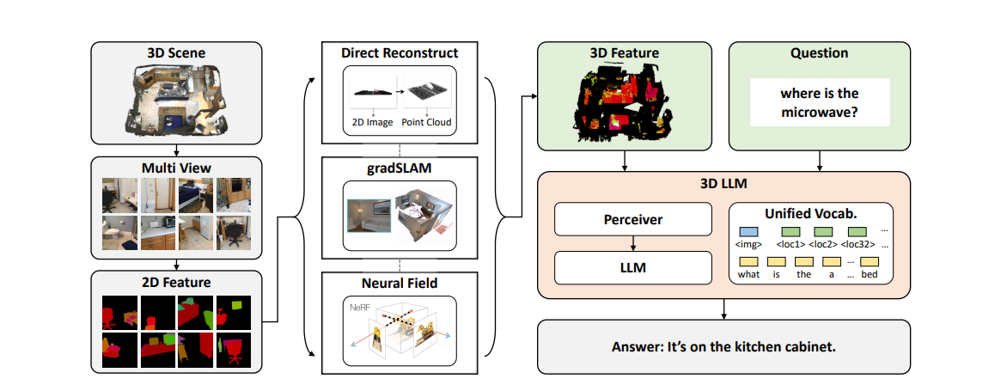
3D-LLM
Feature Extractor
2D VLMs as backbone

Slide 10
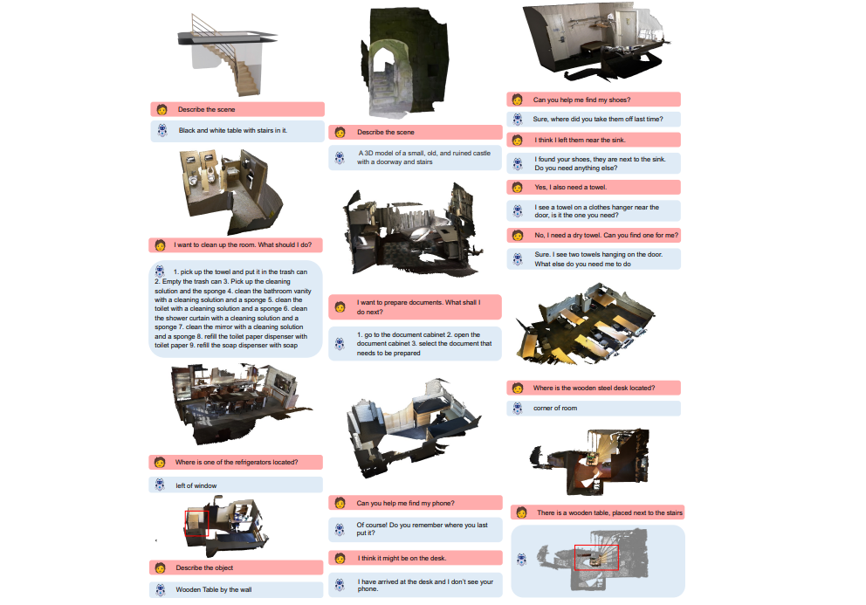
3D-LLM

Slide 11
BYEEEEEEEEEE

