Slide 1
Cholera
As of February 08, 2024

Slide 2
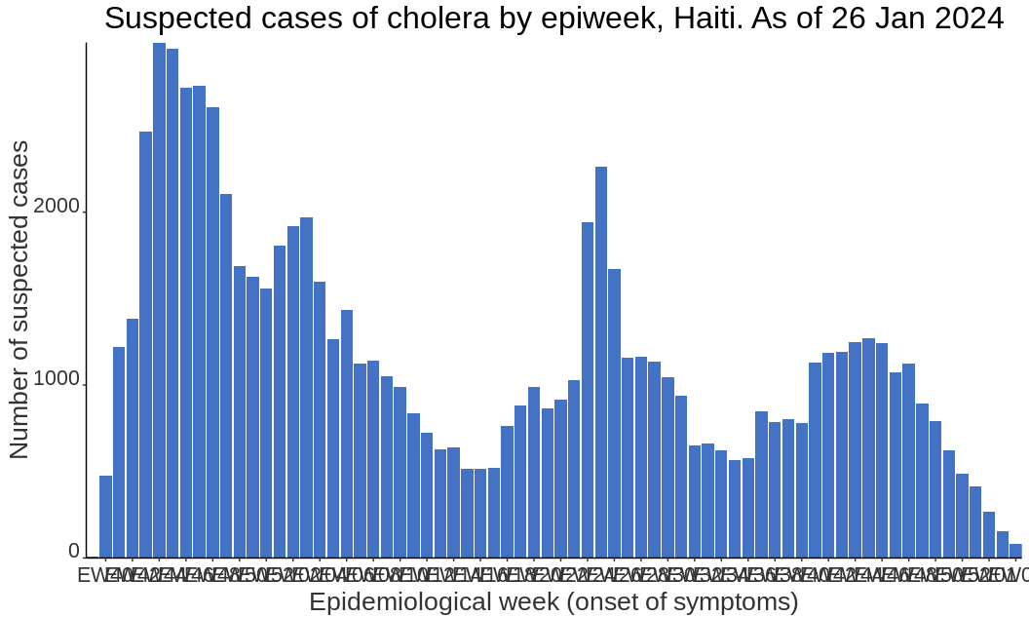
Summary - Situation Report: Cholera in Haiti
Total suspected cases: 79347
increasing: 3.1%
Total confirmed cases: 4608
increasing: 1.8%
Deaths: 1169
increasing: 1.2%
CFR in suspected cases: 1.5%
CFR in hospitalized cases: 1.2%
Demographic information
55% are male
48% <20 years old

Slide 3
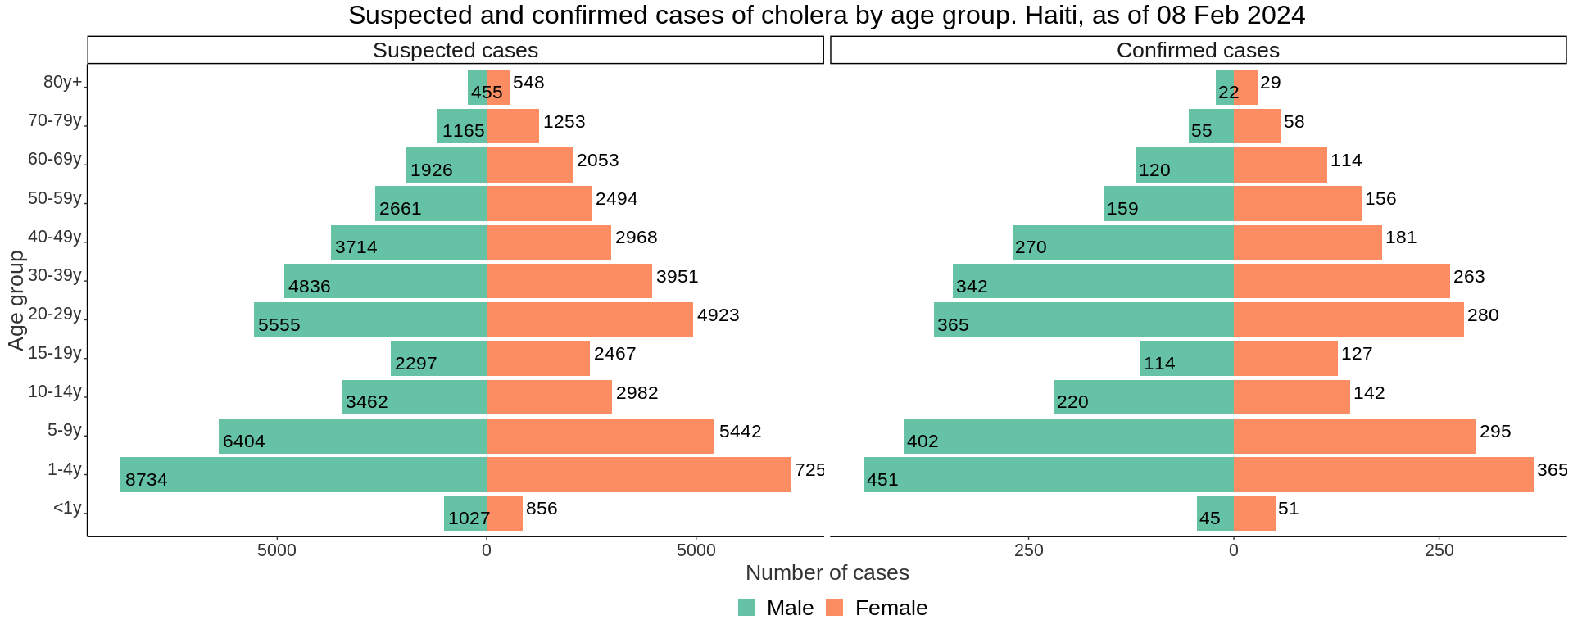
Demographic information

Slide 4
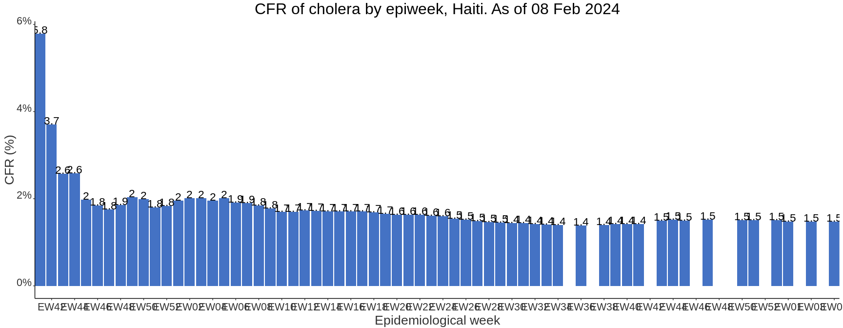
Case fatality rate

Slide 5
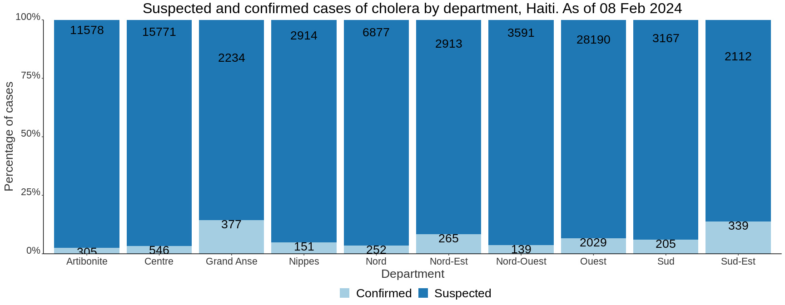
Cholera cases in Haiti by department

