Slide 1
EY Studio+ Health Services & LS Case Studies
File Contacts
Owner: Katie Nolan;
katie.m.nolan@ey.com
Garrett Wexler;
garrett.wexler@ey.com
Brooke Smith
brooke.smith@ey.com
Content Editor: John Motley (john.m.motley@ey.com)

Slide 2


MEDICAL DECISION SUPPORT FOR LEADING PROVIDER SYSTEM
An intuitive, interactive dashboard to display medical data analytics
A major medical system trusted our team with creating an intuitive, interactive dashboard to display data analytics in a way that guided prescription decisions, with the objective of reducing antibiotic overuse in care system providers.
Solution:
Through research and experience design we created a new digital platform that were guided by interviews with both caregivers and pharmacists. This digital product brought together information about individual patients and prescription patterns that had been available previously only through a complicated ecosystem of data platforms and screens with little adoption and impact to end patient.
Services we provide:
Design Research Product Strategy UX Design User testing & validation Experience Design Front-end development
INNOVATION & EXPERIENCE DESIGN
Notes:
Point of Contact: -
Sector: Health Services
Solution: Product
Client: -
#NoName #Health #CX #Product #Experience #Cover

Slide 3
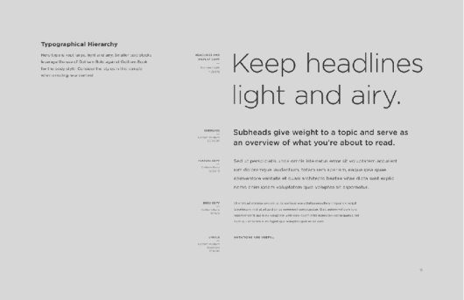
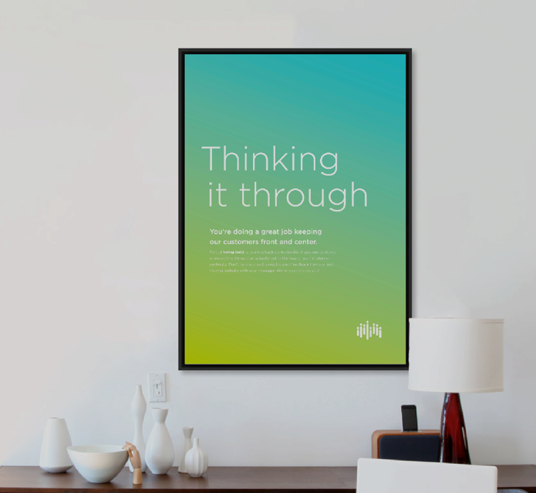
CONSUMER HEALTH ENGAGEMENT
Developing greater brand loyalty
INNOVATION & EXPERIENCE DESIGN
EY worked with a consumer health engagement team to create an identity system in support of their new internal culture initiative. Using stakeholder interviews, we were able to map specific attributes to build a diverse visual system. This allowed us to draw a deeper connection to the emotional trust and enduring loyalty celebrates in their employees. The resulting efforts successfully activated a new confidence all around and helped to activate support from within.
Solution
EY delivered logo system and communications programming and a content strategy playbook that gave guidance and parameters to extend the brand system beyond its initial deployment.
Notes:
Point of Contact: -
Sector: Health Services
Solution: Experience
Client: Cigna
#Health #Experience #CX #Cover
#Cigna

Slide 4

pharmacy chain
Reimagining testing for a pharmacy store chain
Situation
Legacy patient testing services
Low customer and team member satisfaction
Redundancies and siloed processes
Solution
Reimagine the consumer and employee experience
Identify service opportunities across people, processes, technology, data
Focus on outcomes across front and back stages
BU alignment via Service Design workshops
Results
Service and product innovation
Reimagine a connected, collaborative way of working
Faster time-to-market to enable growth
Improved experiences for customers and employees
INNOVATION & EXPERIENCE DESIGN
Notes:
Point of Contact: -
Sector: Health Services
Solution: CX
Client: Walgreens
#Health #CX #Experience #Cover #Walgreens

Slide 5

Healthcare advisory group
Moving from a publisher of healthcare research to a healthcare catalyst
INNOVATION & EXPERIENCE DESIGN
Situation
Legacy value proposition
Evolving customer needs
Move from a research publisher to a healthcare catalyst
Solution
Reimagine how value is delivered
Understand member needs
Clarify the value proposition
Rapid prototyping via Figma
Alignment workshops via MURAL
Results
Differentiated platform and services enabling profitable growth
30 Innovative new services on AEM
Automated, scalable solutions
Open new revenue channels and customer segments
Improve engagement and retention
Notes:
Point of Contact: - Keith VanWarren
Sector: Health Services
Solution: CX, Experience
Client: UHG Americas Health Group
#Health #CX #Experience #Product #Cover #UHGAmericasHealthGroup

Slide 6

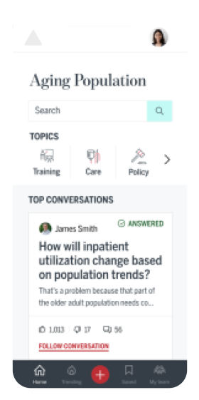


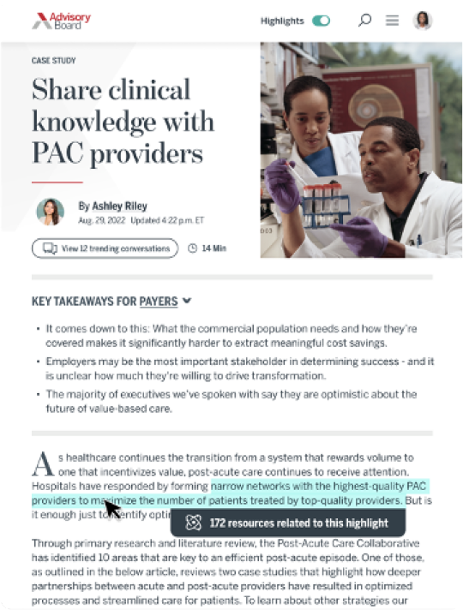
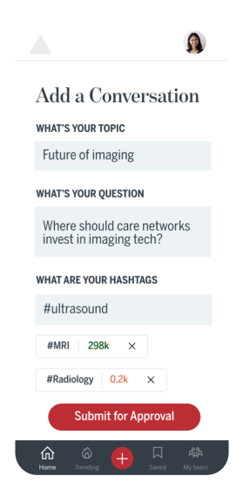
Healthcare Advisory Group
It is about defining a value proposition
Situation
Legacy value proposition
Evolving customer needs
Move from a research publisher to a healthcare catalyst
Solution
Reimagine how value is delivered
Understand member needs
Clarify the value proposition
Rapid prototyping via Figma
Alignment workshops via MURAL
Results
Differentiated platform and services enabling profitable growth
30 Innovative new services
Automated, scalable solutions
Open new revenue channels and customer segments
Improve engagement and retention
INNOVATION & EXPERIENCE DESIGN
Moving from a publisher of healthcare research to a healthcare catalyst
Notes:
#UHGAmericasHealthGroup

Slide 7

GLOBAL MEDICAL DEVICE MANUFACTURER
Building and operating healthcare innovation labs
$27b medical device company sought to establish an innovation culture and capabilities for its innovative digital surgery platform and partner ecosystem.​
​
Designed Digital Innovation Operating Model for the client’s digital surgery platform to enable more patient-centric care, identified capability gaps and partner ecosystem model, and developed data architecture and capability requirements to aggregate/analyze data across its product teams.​
​
Solution
Defined an MVP operating model structure, customer experience and capability road map, and data fabric architecture to enable future state customer experiences.​
INNOVATION & EXPERIENCE DESIGN
Notes:
Point of Contact: -
Sector: Health Services
Solution: CX and Product
Client: -
#NoName #Health #CX #Product #Experience #Cover

Slide 8

Leading med-tech company
Barcoding technologies to reduce preventable harm
$4b medtech company sought to design, pilot and launch an innovation lab/incubator to focus on cross-BU horizontal innovations and align its digital and IT investments. ​
​
Designed Innovation Operating Model and capability road map, including innovation strategy and scope, priority growth platforms, governance and funding model, innovation process, tools and resources.​
​
Solution
Designed proof-of-concept MVP pilot for an end-to-end, medication safety solutions to integrate products, processes, people and data/information from infusion pumps, med dispensing robots and bedside barcoding technologies to reduce preventable harm in hospitals.​​
INNOVATION & EXPERIENCE DESIGN
Notes:
Point of Contact: -
Sector: Health Services
Solution: CX and Product
Client: -
#NoName #Health #CX #Experience #Product #Reinvention #Cover

Slide 9

Leading national payer-provider
Standardizing and securing mobile apps for clinicians and patients
$20b health care payer-provider sought to define and implement an innovation operating model and governance structure to standardize and secure use of mobile applications by clinicians and patients.​
Designed mobility Center of Excellence (CoE) operating model, including governance and funding, process flows, activities, resources, conceptual technology architecture and mobile app certification process to standardize deployment across the organization, created mobile product road map, portfolio and KPIs.​
​
Solution
Aligned business unit mobility strategies, application development platforms, data architecture, cybersecurity and brand standards.​​
INNOVATION & EXPERIENCE DESIGN
Notes:
Point of Contact: -
Sector: Health Services
Solution: CX
Client: -
#NoName #Health #CX #Cover

Slide 10

Cloud-based e-clinical platform
The client wanted to identify opportunities for short-term improvements and a long-term user experience strategy for their clinical data management product.
Solution
Initial UX Assessment: Prior to starting the redesign, the legacy online application was evaluated to identify current problems and prioritize near & long-term enhancements.
Competitive Assessment: Competitive and comparative sites within and outside clinical data management were reviewed to identify opportunities and potential pitfalls
Provide guidance: Point users in the right direction throughout the experience.
Surface critical information: Provide personalized, role-based information immediately.
Clarify the layout and look: Clarify iconography, reduce scrolling, provide easily scannable audit trails.
Maximize efficiency: Reduce user effort completing tasks, increase system speed, design for mobile/tablet.
Short- and long-term enhancements to clinical data management tools
INNOVATION & EXPERIENCE DESIGN
Notes:
Point of Contact: -
Sector: Health Services
Solution: Experience and Product
Client: Mednet
#Mednet #Health #Experience #Product #Cover

Slide 11

National health insurance
Redesigning the customer service model
Develop End-to-End experience mapping to define target customer experiences (with cross-functional walk-the-wall work sessions)​
Identify key cross-functional operational requirements to support customer expectations of cloud-based solution provider​
Refine product roadmap based on customer usage data across experience stages
Solution
Delivered new SaaS pay-by-use models of bundled software​
Developed full cross-functional alignment (e.g. billing, legal, finance, IT) and execution on the highest customer value initiatives (90 day sprints, small dedicated teams)​
Redesigned the role of customer support and tech support to drive customer success, adoption of new value and reduce churn​
Drove executive alignment and decisions on prioritization of initiatives and UX/UI design direction from a shared vision
INNOVATION & EXPERIENCE DESIGN
Notes:
Point of Contact: -
Sector: Health Services
Solution: CX and Product
Client: - UHC?
#UHC #Health #CX #Product #Cover

Slide 12




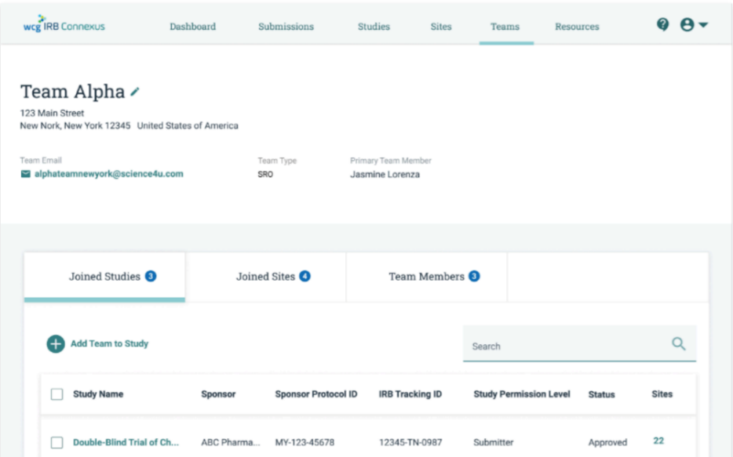
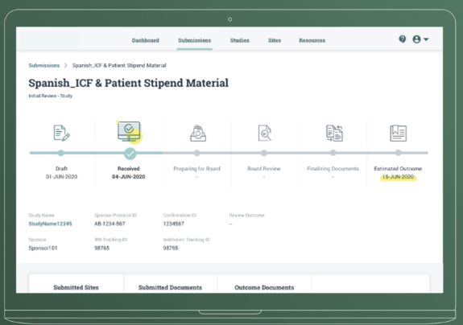
Building new user centric experiences
An end-to-end user-centered redesign of a clinical trials document management & communication platform included contextual field research to define user needs, followed by iterative design and agile development, leading to a successful launch.
Innovating, thinking and designing with users in mind
Situation
A regulatory and ethical services provider engaged us to help them envision a new IRB (institutional review board) submission experience. IRB submission occurs within a complex ecosystem of stakeholders, tools, and processes, resulting in inefficiencies, communication breakdowns, and delays. The client wished to move toward a user-centered process and become a more user-centric organization
Solution By taking a multidisciplinary approach to discovery, we leveraged user, business, and technical insight to define the initial product vision and backlog. The redesign led to an innovative approach in the IRB submission process, resulting in advanced performance, increased user satisfaction, and market differentiation.
INNOVATION & EXPERIENCE DESIGN
“The result? Cut submission times by 50%, and gave complete visibility into the status and timelines of IRB reviews – all in one place”
—Website Comment
Notes:
#WCG #Initium

Slide 13

GLOBAL PHARMACEUTICAL MANUFACTURING
Digital transformation for global pharmaceutical manufacturing
This global pharmaceutical company conducted a digital transformation to better support the safe and efficient formulation and distribution of life-saving pharmaceuticals. Using a human-centered approach, our team worked to uncover and creatively explore opportunities to streamline and connect dozens of digital manufacturing solutions, for a group of users ranging from “the shop floor to the top floor.”
From conducting usability research and testing with 80+ users around the world to creating high-fidelity prototype designs, we are working to create streamlined guided experiences from historically disparate digital solutions.
Services we provided:
Design Research Product Strategy & Ownership User testing & validation Prototyping Digital Strategy
DesignOps
INNOVATION & EXPERIENCE DESIGN
Notes:
Point of Contact: Rob Tannen, Katie Nolan, Greg Picarelli
Sector: Health Services
Solution: CX, Experience
Client: Pfizer
#Pfizer #Health #CX #Experience #Cover

Slide 14

FORTUNE 100 DRUG RETAIL CHAIN
Redesigning customer loyalty through data-driven insights
The client wanted to redesign its loyalty program to drive profitable growth by reducing the cost of the program and driving increased engagement of shopper.
Solution
EY provided benchmark comparison of costs & business benefits; tested hypotheses to streamline costs and drive growth
EY conducted quantitative analysis to test potential program features, and build the business case for redesign
EY built conjoint model with customer preferences to determine best benefit combinations; segmentation model to identify and size opportunity to grow and retain shoppers
EY estimated price elasticities to optimize loyalty program promotional discounts
Developed a more cost-efficient future program while minimizing impact to sales and customer retention
Redesigned program expected to improve margin by over $100M through reduced program costs and acquired customers
INNOVATION & EXPERIENCE DESIGN
Notes:
Point of Contact: Kristen Bishof, Dylan Floyd, Patricia Camden
Sector: Health Services
Solution: CX
Client: Herbalife
#Herbalife #Health #CX #Cover

Slide 15
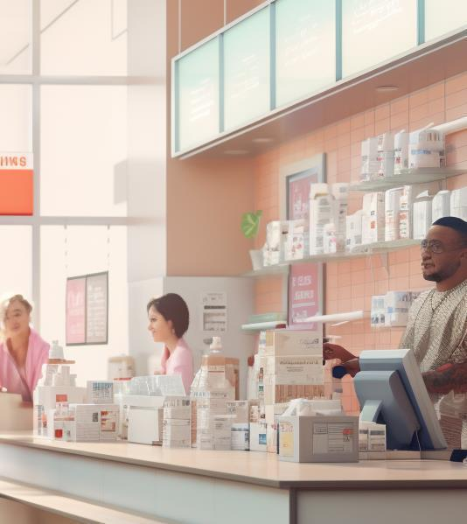
PHARMACY CHAIN
Reimaging the customer and employee experience
The Service Design team at EY partnered with one of the largest pharmacy store chains in the United States to re-imagine the customer and employee experience, illustrating a portfolio of solutions for acute and chronic healthcare services within the pharmacy ecosystem.
Solution
We took a pioneering approach to discovery, using mixed research methods to uncover the core problems. We laid out the end-to-end journey, identified the moments that matter, and built enhanced cohesive experiences across all aspects of the journey.
INNOVATION & EXPERIENCE DESIGN
Notes:
Point of Contact: Michelle Terng, William Scheideler
Sector: Health Services
Solution: CX
Client: Walgreens
#Walgreens #Health #CX #Cover
Source: case studies collection vol1 157-159

Slide 16
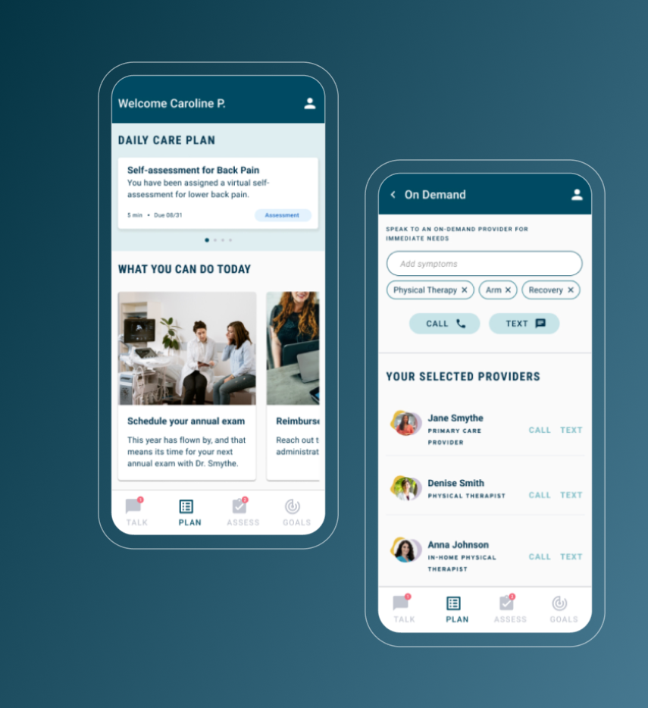
Humanizing virtual care in a time of crisis
Re-imagining patient care under lockdown
Situation
When Covid-19 hit, the need for virtual healthcare solutions was urgent. In response, a national safety-net hospital began piloting potential solutions to humanize remote care delivery.
Our team was engaged to help imagine what the future of remote care could look like for both patients and providers. Motivated by the need, we innovated quickly and empathetically to deliver immediate medical access to patients and proactive support for clinical teams.
Results
To show the hospital what was possible, we prototyped an immersive experience that worked in tandem with a new clinical model, helping the provider rise to the moment and meet the most complex needs for the highest-use clinical tiers. Our ability to concept and refine solutions quickly convinced the client our process could even deliver against unforeseen healthcare challenges.
INNOVATION & EXPERIENCE DESIGN
“We estimated that more than a million additional nurses were required to cover the spike in care demands. We didn’t have an extra million nurses, so we needed a solution that would let the nurses we did have do more.”
A national safety-net hospital responds to a global pandemic with newly demanded customer experiences, bringing enduring value to patient-focused telehealth strategies.
- Vice President of Virtual Care
Notes:
#Metrohealth

Slide 17
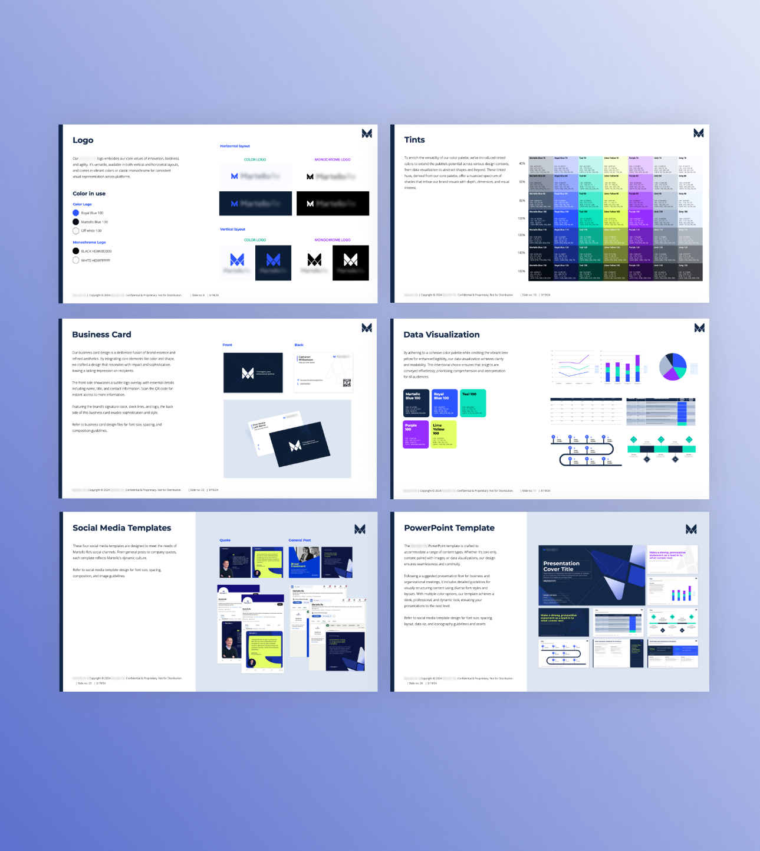
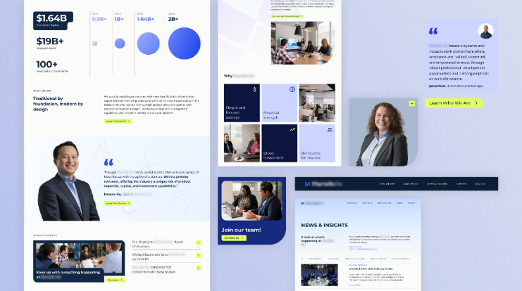
Elevating the brand to match the business
Reflecting the client's values in a bold brand makeover
Situation
With a critical conference on the horizon, a fast-growing reinsurance firm turned to EY to update their brand identity and website to better reflect the company’s leadership position today. To kick off the engagement, our team facilitated a stakeholder workshop to understand the client’s business, customers, key differentiators, and vision for the future-state website. We then synthesized their inputs as brand identity pillars and experience principles, which would guide the design and content of the new site. From there, we worked closely with client stakeholders to craft a bold and modern web experience that conveys a sophisticated financial brand, while guiding the selection and setup of a CMS to bring it to life.
Results
In a tight 12-week timeline, we shepherded the project from discovery to development, delivering a responsive web experience that elevates the firm’s brand identity and better reflects its market leadership, all supported by secondary assets including deck templates, business cards, letterhead, and more. With time to spare before the conference, the client was thrilled to be able to put its best face forward—on the website and beyond.
INNOVATION & EXPERIENCE DESIGN
When a newly minted reinsurance start-up quickly became an industry leader, it knew its brand and website needed a refresh to look the part.

Slide 18

Health insurance platform
Innovating the operating value streams to deliver great constituent experiences
Innovating the constituent experience by redefining value stream operations to drive NPS
Approach
Develop End-to-End experience mapping to define target customer experiences (with cross-functional walk-the-wall work sessions)
Identify key cross-functional operational requirements to support customer expectations of cloud-based solution provider
Refine product roadmap based on customer usage data across experience stages
Outcomes
Delivered new SaaS pay-by-use models of bundled software
Developed full cross-functional alignment (e.g. billing, legal, finance, IT) and execution on the highest customer value initiatives (90 day sprints, small dedicated teams)
Redesigned the role of customer support and tech support to drive customer success, adoption of new value and reduce churn
Drove executive alignment and decisions on prioritization of initiatives and UX/UI design direction from a shared vision
INNOVATION & EXPERIENCE DESIGN
Notes:
Point of Contact: -
Sector: Health Services
Solution: CX
Client: Cisco
#Cisco #Health #CX #Cover

Slide 19

CONSUMER HEALTH ENGAGEMENT
Innovating subscriber experience
EY has worked with this multinational health management company for seven years to innovate and evolve the company’s subscriber experience. EY has conducted expansive user and admin research to identify strategies to engage subscribers and drive healthier, less costly behaviors.
Solution
In fall 2020, EY conducted research on two subscriber states, pre-engagement, in which we explored ways to guide subscriber decisions before they had engaged a physician to address two disease states, and hip replacement. Research into hip replacement experience was meant to better coordinate the digital experience to the end-to-end experience of preparing for, experiencing, and recovering from hip replacement
INNOVATION & EXPERIENCE DESIGN
Notes:
Point of Contact: -
Sector: Health Services
Solution: CX
Client: Cigna
#Cigna #Health #CX #Reinvention #Cover
Source: EYDS-CaseStudies pg 26

