Slide 1
CSS Gradients
By Luis Barboza

Slide 2
CSS Gradients
CSS gradients let you display smooth transitions between two or more specified colors.
CSS defines two types of gradients:
Linear Gradients (goes down/up/left/right/diagonally).
Radial Gradients (defined by their center).

Slide 3
CSS Gradients
CSS Linear Gradients
To create a linear gradient you must define at least two color stops. Color stops are the colors you want to render smooth transitions among. You can also set a starting point and a direction (or an angle) along with the gradient effect.
Syntax
background-image: linear-gradient(direction, color-stop1, color-stop2, ...);

Slide 4
CSS Gradients
#grad { background-image:linear-gradient( red, yellow); }
#grad { background-image: linear-gradient(to right, red , yellow); }

Slide 5
CSS Gradients
#grad { background-image: linear-gradient(to bottom right, rgb(255,255,255), blue); }
#grad { background-image: linear-gradient(-90deg, red, green); }

Slide 6
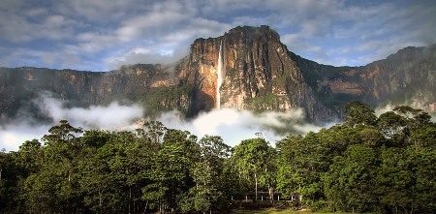
CSS Gradients
#grad { background-image: linear-gradient( yellow, blue, red); }
#grad { background-image: linear-gradient( rgba(0, 128, 0, 0), rgba(0, 128, 0, 1)); }

Slide 7
CSS Gradients
#grad { background-image: linear-gradient(to left, lime 28px, red 77%, cyan); }
#grad { background-image: linear-gradient(to bottom left, green 50%, red 50%); }

Slide 8

CSS Gradients
#grad { background-image:
linear-gradient(217deg, rgba(255,0,0,.8), rgba(255,0,0,0) 70.71%),
linear-gradient(127deg, rgba(0,255,0,.8), rgba(0,255,0,0) 70.71%),
linear-gradient(336deg, rgba(0,0,255,.8), rgba(0,0,255,0) 70.71%); }

Slide 9

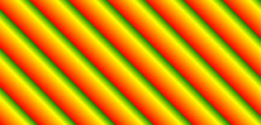
CSS Gradients
#grad { background-image:repeating-linear- gradient(-60deg, black 0 15px, gray 15px 45px); }
#grad { background-image: repeating-linear-gradient(45deg,red,yellow 7%,green 10%); }

Slide 10

CSS Gradients
#grad { background-image:
repeating-linear-gradient(190deg, rgba(255, 0, 0, 0.5) 40px, rgba(255, 153, 0, 0.5) 80px,
rgba(255, 255, 0, 0.5) 120px, rgba(0, 255, 0, 0.5) 160px, rgba(0, 0, 255, 0.5) 200px,
rgba(75, 0, 130, 0.5) 240px, rgba(238, 130, 238, 0.5) 280px, rgba(255, 0, 0, 0.5) 300px),
repeating-linear-gradient(-190deg, rgba(255, 0, 0, 0.5) 30px, rgba(255, 153, 0, 0.5) 60px,
rgba(255, 255, 0, 0.5) 90px, rgba(0, 255, 0, 0.5) 120px, rgba(0, 0, 255, 0.5) 150px,
rgba(75, 0, 130, 0.5) 180px, rgba(238, 130, 238, 0.5) 210px, rgba(255, 0, 0, 0.5) 230px),
repeating-linear-gradient(23deg, red 50px, orange 100px, yellow 150px, green 200px,
blue 250px, indigo 300px, violet 350px, red 370px);}

Slide 11
CSS Gradients
CSS Radial Gradients
A radial gradient is defined by its center.
To create a radial gradient you must also define at least two color stops. By default, shape is ellipse, size is farthest-corner, and position is center.
Syntax
background-image: radial-gradient(shape size at position,
start-color, ..., last-color);

Slide 12


CSS Gradients
#grad { background-image: radial-gradient(red, blue); }
#grad { background-image:radial-gradient (rgb(255, 0, 0) 10px, yellow 30%, #1e90ff 50%); }

Slide 13


CSS Gradients
#grad { background-image:radial-gradient (circle closest-side, red, yellow, rgb(20,20,20)); }
#grad { background-image:radial-gradient(at 0% 30%, red 10px, yellow 30%, #1e90ff 50%); }

Slide 14


CSS Gradients
#grad { background-image:radial-gradient (closest-side at 60% 55%, red, yellow, black); }
#grad { background-image:radial-gradient (ellipse farthest-corner at 90% 90%,
red, yellow 10%, #1e90ff 50%, beige); }

Slide 15
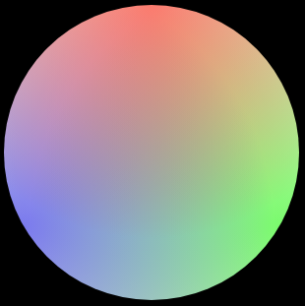
CSS Gradients
#grad { background:
radial-gradient(circle at 50% 0, rgba(255,0,0,.5), rgba(255,0,0,0) 70.71%),
radial-gradient(circle at 6.7% 75%, rgba(0,0,255,.5), rgba(0,0,255,0) 70.71%),
radial-gradient(circle at 93.3% 75%, rgba(0,255,0,.5), rgba(0,255,0,0) 70.71%)
beige;
border-radius: 50%; }

Slide 16
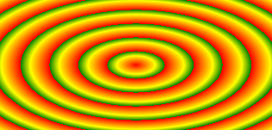

CSS Gradients
#grad { background-image:repeating-radial-gradient(red, yellow 10%, green 15%); }
#grad { background-image:repeating-radial-gradient(circle, black, black 5px, white 5px, white 10px);
}

Slide 17

CSS Gradients
#grad { background:
repeating-radial-gradient(ellipse at 80% 50%,rgba(0,0,0,0.5),
rgba(0,0,0,0.5) 15px, rgba(255,255,255,0.5) 15px,
rgba(255,255,255,0.5) 30px) top left no-repeat,
repeating-radial-gradient(ellipse at 20% 50%,rgba(0,0,0,0.5),
rgba(0,0,0,0.5) 10px, rgba(255,255,255,0.5) 10px,
rgba(255,255,255,0.5) 20px) top left no-repeat yellow;
background-size: 200px 200px, 150px 150px; }

