Slide 1
Champ
Cloud Pak for Apps Learning Journey
Barbara Schramm
@barbaras
Content Architect for ICPA
09/27/19

Slide 2
Assumptions
Learning journey contains the product documentation and other content
Phases considered at this time are Discover, Try, Deploy (includes Buy)
Many IBM touchpoints host the content
Open Source sites are required, due to the OSS included in ICPA.
Focus will be on the strategic IBM properties for technical content, as determined by the Technical Content Initiative.

Slide 3
Product Documentation Plan
Installation will be handled on the 3 websites that host product docs:
https://kabanero.io/docs/– for installing the open source version
https://www.ibm.com/support/knowledgecenter/SSCSJL/welcome.html – for installing ICPA airgap
https://cloud.ibm.com/docs/cloud-pak-applications?topic=cloud-pak-applications-getting-started for installing ICPA on IBM Public Cloud (TBD - decide where to provide installation steps for other clouds such as AWS and Azure)
All procedural, conceptual, and architectural info will be contained in Guides, using the OpenLiberty Guide format. Docs and Reference topics will also be produced.
Completed Guides are currently displayed on https://kabanero.io/guides/
For on-prem (airgap) and on-cloud, Guides and Docs are installed as embedded user assistance with the product and will be a selection on the landing page.
Issues with embedded content: How to translate?; It will be updated only when the software is released; Guides become available at post-install; Not searchable by Google.

Slide 4
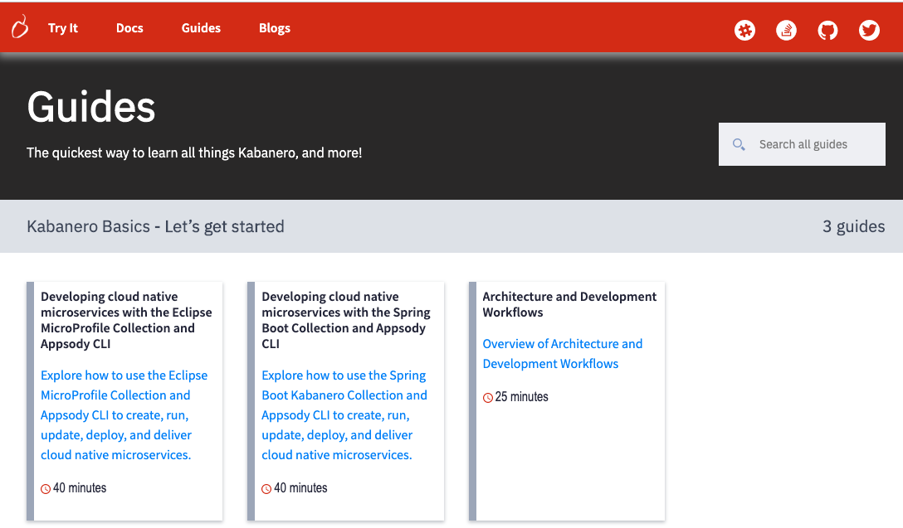
Kabanero.io/guides Page Guides are published first for Kabanero.

Slide 5
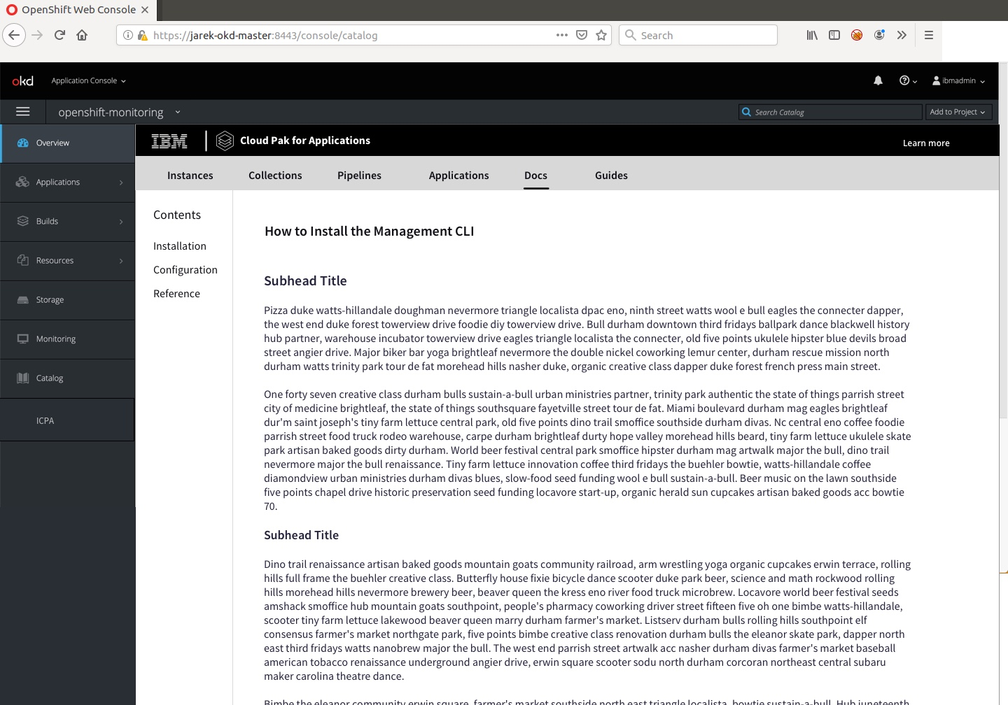
ICPA Landing Page Guides are installed and accessible from top nav bar on OpenShift console. Guides are agnostic across footprints, except for entitled Collections.

Slide 6
Champ Learning Journey Goals and Content Overview
Describes the intent for each phase and the possible content types that are useful.
Champ Discovers ICPA
Requests time with expert, or performs self-service trial
Modernize/refactor applications
Gradually move to Cloud Native development
Leverage benefits of Open Source software
Understand containers and Kubernetes (OpenShift)
Evaluate/choose the right solution
Intent
Google search results
Events
Social Media
Blogs
Demos (Videos)
Whitepapers
Field Guides
Arch and Workflow Guide
Product overviews
Product datasheet
Product website
InfoGraphics
Content
Champ Tries ICPA
Champ Buys and Deploys ICPA
Buy
Production
Assess product features for fit
Understand typical use cases
Completes Try and Learn badge
Install product and start working
Refactor and deploy using TA artifacts
Develop new cloud native apps
Deploy to production
Intent
Intent
Getting Started/Try it
Self-service end-to-end tutorials
Trial product on Cloud
Interactive Guides
DTE Demos and Labs
IBM Garage engagement
Accurate installation docs
End-to-end tutorial for App Mod using TA and ICPA
Product documentation (Guides and KC)
Advanced use cases using code patterns, recipes, labs, videos
Forums, Stack Overflow, and Customer Support
Content
Content
Challenges:
Multiple opensource projects, no single starting point, many touchpoints.
Notes:
This slide describes Champ’s intentions during 3 phases of the learning journey and the types of content that will support her. Included are the green lights to a the next phase. The Discover phase is a research phase in which Champ learns how CP4Apps can help reach the company's goals for rapid development of cloud native apps, relieving developers of DevOps tasks, and modernizing apps while maintaining existing investment. The Try phase is when Champ creates a POC and determines if ICPA is the correct solution. Try can be done independently or with the help of an IBM expert The Buy and Deploy phase is the implementation phase of a production deployment.

Slide 7
Sample needs-based path
As a solutions architect, I need to stay well-informed of technologies that will increase productivity but protect investments.
As a solutions architect, I need to oversee the delivery of the solution into production.
As a solutions architect, I need to evaluate technologies and conduct trials to choose the best solution.
Discover
Attends BOF session
Watches demo video
Try
Completes locally installed Quickstart
Completes AppMod trial
Deploy
Todd installs product
Completes App Mod process
Reads Blogs
Schedules time with expert
Reads Field Guide
Generates collections and notifies developers

Slide 8
Content formats and locations for Discover Phase
Content | Format | Location (Current, Proposed)
Google search | Internet | (P) Improve SEO for technical content
Events | Trade Show demos, presentations, meetups | (C) Various geo-locations
Social Media | Tweets | (C) Twitter
Blogs | Technical and Business blog posts | (C) https://kabanero.io/blog/ (C) https://developer.ibm.com/blogs/ (C) https://www.ibm.com/cloud/blog/ https://www.ibm.com/blogs/cloud-computing (C) https://medium.com/appsody (P) Blog index
Video demos – best for overviews | Light Board videos Explainer videos Screen shot videos | (C) Various (On https://mediacenter.ibm.com/ they are translated) (P) YouTube Channel
Whitepapers | PDF | (C)https://www.ibm.com/downloads/cas/QWB9X1GE (P) Replace by shorter form datasheets
Field Guides | PDF | (C) https://www.ibm.com/cloud/garage
Arch and Workflow Guide | Guide | (C) kabanero.io/guides (P) Knowledge Center and Cloud docs
Product overviews | PDF | C- https://www.ibm.com/cloud/cloud-pak-for-applications
Product datasheet | PDF | C- https://www.ibm.com/cloud/cloud-pak-for-applications
Product website | HTML | C-https://www.ibm.com/cloud/cloud-pak-for-applications

Slide 9
Content formats and locations for Try Phase
Content | Format | Location (Current, Proposed)
Quickstart/Try it | HTML | C- Persona-based Try it on Kabanero.io P – Redesigned Quickstart needs to be published Quickstart for ICPA needed
E2E Tutorials | HTML | C - https://ibm-cloud-architecture.github.io/Learning-Kabanero-101 P – host on kabanero.io site
Trial product | Download or on-cloud | C -https://www.ibm.com/software/lt/info/trials/ https://www.ibm.com/cloud/garage/tutorials/install-ibm-transformation-advisor-local P – ICPA-lite on cloud.ibm.com
DTE Demos | Videos | C - https://www.ibm.com/demos/
Labs | Videos or interactive demos | C – https://www.ibm.com/demos/ P- Functional lab environment (similar to https://www.katacoda.com/)
Interactive Guides | See https://openliberty.io/guides/?search=Interactive&key=tag | C – Guides but no interactive guides yet P – Hosted on kabanero.io and embedded in product
Videos | Step-by-step screens | C- Various P- Youtube channel

Slide 10
Content formats and locations for Deploy Phase
Content | Format | Location (Current, Proposed)
Installation | HTML | C - https://kabanero.io/docs/– for installing the open source version https://www.ibm.com/support/knowledgecenter/SSCSJL/welcome.html – for installing ICPA airgap https://cloud.ibm.com/docs/cloud-pak-applications?topic=cloud-pak-applications-getting-started - cloud
E2E tutorial, incl TA | Guide | C- Guides do not include the TA process P- Guide for E2E
Guides | Guide | C- See kabanero.io/guides P – More Guides are in the works; will be embedded in ICPA
Code patterns, recipes | HTML | C - https://developer.ibm.com/components/cloud-pak-for-applications/
Badge sequence for IBM Cloud digital credentials | HTML | https://www.ibm.com/developerworks/community/groups/service/html/communitystart?communityUuid=2f20f62a-eec3-465b-acb6-6df8685a065c
Forums | Chat | https://www.ibm.com/community/
Stack Overflow | Chat | C – No stack overflow posts P – Active stack overflow discussion
Customer Support | Support ticket | C- ibm.com/mysupport
Troubleshooting | Guide, Forums, Support | C – No troubleshooting info yet P – Knowledge Base for use by Support

Slide 11
Open Source sites ICPA contains several OpenSource projects. The strategy will be to document the necessary steps required to work with the OpenSource projects and then provide a link to the OpenSource documentation for additional information. It is not feasible to duplicate the OpenSource documentation.
https://appsody.dev/)
https://www.eclipse.org/codewind/)
https://tekton.dev/)
https://razee.io/)
https://istio.io/)
https://knative.dev/)

Slide 12
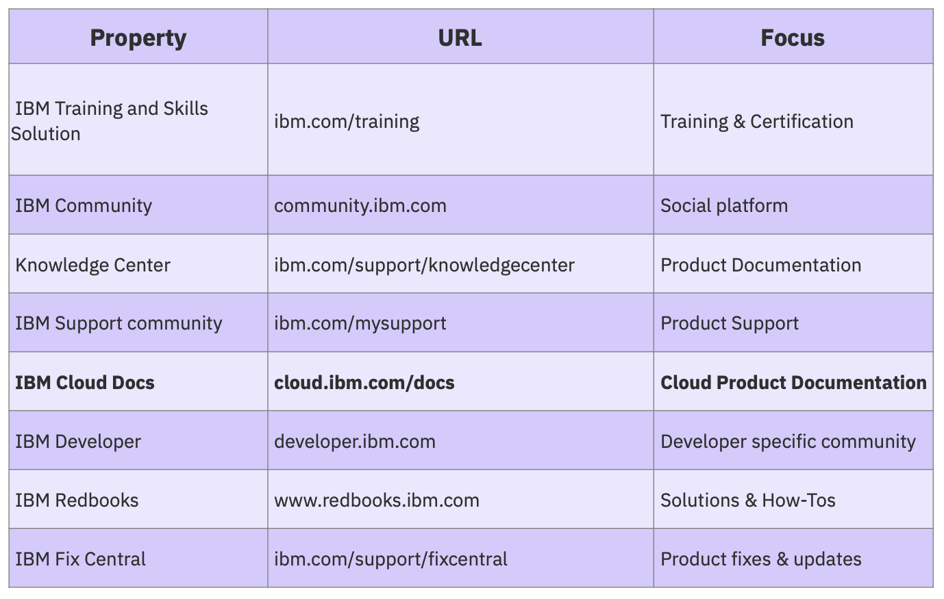
Locations – proposed Focus on IBM strategic sites from the Technical Content Initiative group

Slide 13
Summary of proposals
Improve SEO for technical content
Blog index or syndication (RSS feed?)
YouTube Channel – use Cloud or SupportTV channel
Whitepapers - Replace by shorter form datasheets
Arch and Workflow Guide - Knowledge Center and Cloud docs
Quickstart - Redesigned Quickstart needs to be published; Quickstart for ICPA needed
Trial product - ICPA-lite on cloud.ibm.com
Labs - Functional lab environment (similar to https://www.katacoda.com/)
Interactive guides - Hosted on kabanero.io and embedded in product
Guide for E2E including TA
More Guides are in the works; will be embedded in ICPA
Forums, Active stack overflow discussion
Knowledge Base for use by Support
Hire at least one fulltime ID person for the project

Slide 14
Other improvements
Discussion is to move the TA documentation onto https://cloud.ibm.com/docs/home/alldocs It won’t be in the catalog, but will be listed on the All docs index.
Copyright symbol needs to be added to all IBM content and product names in the OpenSource documentation. ©2019 IBM

Slide 15
Moving forward
Jane and Todd Learning Journeys
Add Mobile Foundation
Develop strategy for Blogs – re-blog or feedly.com-type app
YouTube Channel
Continual updates to Learning Journey
Work with cloud-docs-next and Technical Content Initiative teams
Explore adding more content to Knowledge Center and Cloud docs to leverage the translation services and SEO capabilities.
How do third party integrators access the correct content?

Slide 16
Discussion
Questions?
Thoughts?
Jokes?
Need to move from this: To this:

