Slide 1
Jane (Enterprise Developer)
Cloud Pak for Apps Learning Journey
Barbara Schramm
@barbaras
Content Architect for ICPA
11/01/19

Slide 2
Problem statement
Content created by many people, often in “content silos”. Developers receive inconsistent messaging for product. Product itself can be confusing as it contains many open source projects, so unified messaging is important.
Goal: Unified content strategy
Move from this: To this:

Slide 3
Strategy: Curate content and publish to developer.ibm.com
Definition: Curated content is content that has been reviewed and deemed accurate, high-quality, and consistent with CP4Apps product messaging.
Why should we curate the content?
-Consistency -Maintenance
-Accuracy -Control customer experience
-Coverage
Style Guide will be published containing standards to ensure consistency. Examples:
Videos requirements: https://ibm.ent.box.com/folder/91142995359
Glossary of terminology: https://ibm.box.com/s/6sjkud4gje8g5xuv35da3bl9x0b3fmk2
Content will be reviewed and published to definitive location on developer.ibm.com, following posting instructions for developer.ibm.com: https://w3.ibm.com/developer/docs/content/
Maintenance schedule will be established (for example, ”update next release”)
We control the customer experience and the message about CP4Apps.
Content will provide clarity to support adoption of the product.
Customers will have confidence in our content.
Notes:
definti

Slide 4
Assumptions
Learning journey incorporates the following types of content:
Product documentation and Guides
Tutorials
Overview videos
Tutorial videos
Blogs
Code patterns
Trial application
Social media
Forums
Events
Industry news
Phases considered are Discover, Try, Buy and Deploy. These correspond to Explore, Evaluate and Embrace phases of the 5E approach (Explore, Evaluate, Embrace, Extend, Expand)
Goal is to consolidate and curate content as much as possible in order to control content for consistency and quality. For this purpose, as much content as possible will be hosted on developer.ibm.com.
Open source sites are considered “stand alone” and outside this journey, unless user is working with the Open Source code in Cloud Pak for Apps. The Open Source sites include: https://appsody.dev/ and https://medium.com/appsody https://www.eclipse.org/codewind/ and https://medium.com/codewind
Notes:
https://medium.com/codewindOpen Source sites are required, due to the OSS included in ICPA.
Focus will be on the strategic IBM properties for technical content, as determined by the Technical Content Initiative.

Slide 5
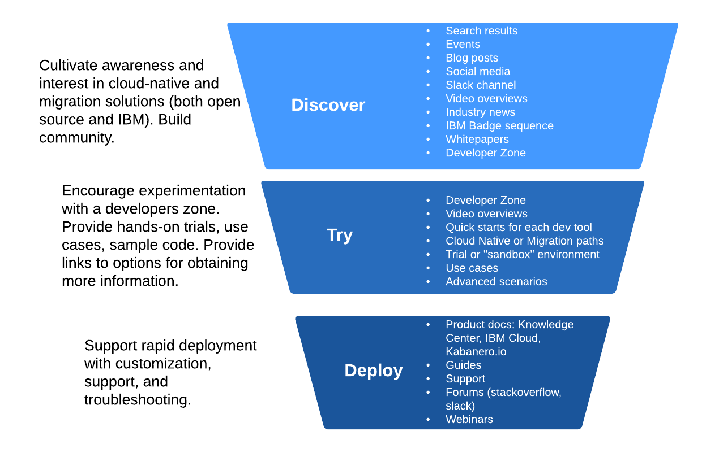
Jane Learning Journey Content Funnel

Slide 6
Discover Steps
Casual interest
Serious interest
Further interest
Reads tweets
Performs internet search
Watches overview video
Reads blogs
Reads blogs
Attends events
Reads industry news
Community: Word of mouth, forums, tweets
Looks at readmes on GitHub
Reads whitepaper
Considers IBM badge
Attends events
Accesses the Developer Zone
Overview
Details
Ready to try
We need consistent messaging and engaging content for every step to hold developers’ interest.

Slide 7
Content plan for Discover Phase
Content | Format | Location
Google Search | Search results | SEO – all content follows SEO tagging to ensure searchabili
Events | Trade Show demos, presentations, meetups | Various geo-locations
Social Media | Tweets | Twitter https://twitter.com/search?q=%23IBMDeveloper&src=hashtag_click @IBMDeveloper
Blogs | Technical and Business blog posts | https://developer.ibm.com/blogs/ is primary location for CP4Apps blogs Open Source sites also contain blogs
Video demos – best for overviews | Light Board videos Overview videos | https://www.youtube.com/user/developerworks https://developer.ibm.com/videos/
Industry news | Articles; O’Reilly books | Various
Community | Stack Overflow Slack Channels Community.ibm.com | (need list of Slack Channels)
Whitepaper
GitHub Readmes | Readme.md | Open Source GitHub locations
IBM Badge | Contributor badge | https://www.youracclaim.com/org/ibm/badge/kabanero-contributor
Developer Zone | webpages | TBD – suggest on developer.ibm.com

Slide 8
Try Steps
Lurking
Want to learn more
“Hello World”
Entice lurkers with list of benefits and overview videos
Provide path for cloud-native and migration
Quickstarts for each developer tool
Run in a preconfigured sandbox environment
Links to additional info
Code samples, use cases, and advanced features
Overview
Quickstarts
Advanced use
Showcase the product with tested quickstarts and examples.

Slide 9
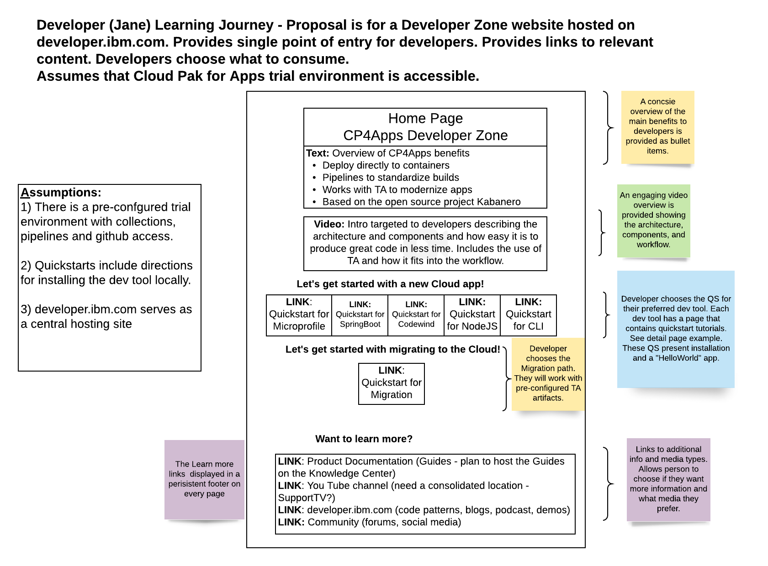
Developer Zone web pages for Try phase (also includes Discover elements)

Slide 10
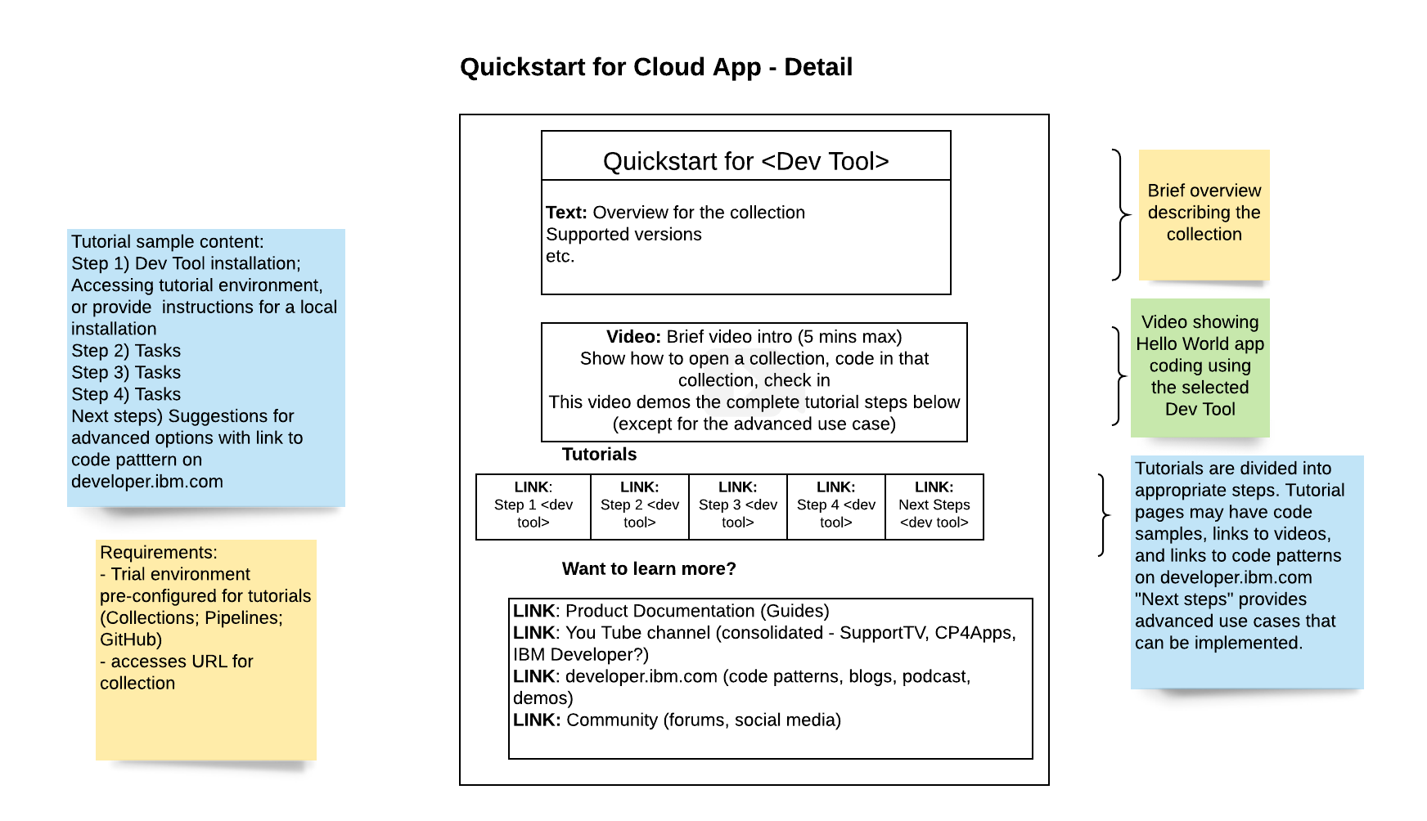
Try – Developer Tool Quickstart Detail

Slide 11
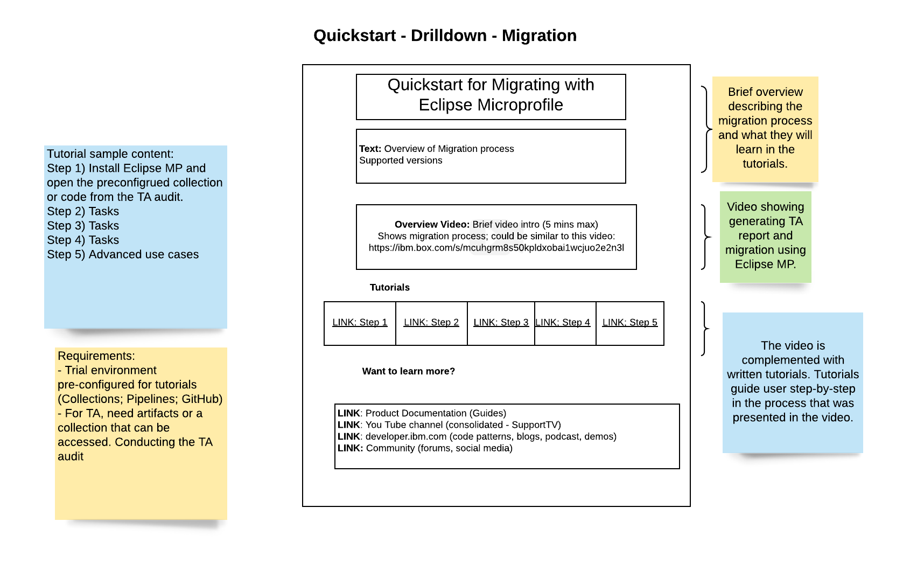
Try – Migration Quickstart Detail

Slide 12
Advantages of the Developer Zone
Includes a preconfigured trial environment
Provides brief overviews for product to understand the benefits quickly (<1 minute time to read)
Video overview is brief as well (5 mins max) and provides a technical and feature overview.
Provides Quickstarts for each developer tool so developer can choose their preferred tool.
QS experience is controlled to ensure success.
An advanced option is offered, as well as a “Hello world” experience.
Links are provided for further info, so the touchpoint is also controlled.

Slide 13
Inventory of content for the Dev Zone
Overview videos – 5 min max
Overview of the CP4Apps solution from a developer POV
Overview for each Quickstart showing the process
Detail videos
Each quickstart step may also have a short video for the step
Text
Bulleted list of benefits for the home page
Step-by-step tutorials
Advanced tutorials

Slide 14
Content formats and locations for Try Phase
Content | Format | Location (Current, Proposed)
Quickstarts | HTML | Developer Zone on https://developer.ibm.com/components/cloud-pak-for-applications/
Overview videos | Video | Hosted on developer.ibm.com
Links to: Product docs | HTML | https://kabanero.io/docs https://www.ibm.com/support/knowledgecenter/SSCSJL/welcome.html https://cloud.ibm.com/docs/cloud-pak-applications
Links to: Youtube Channel or /videos on developer.ibm.com | Video | https://www.youtube.com/user/developerworks https://developer.ibm.com/videos/
Links to:Developer.ibm.com | Various | https://developer.ibm.com/components/cloud-pak-for-applications/
Links to:Community | Forums Social media | https://twitter.com/search?q=%23IBMDeveloper&src=hashtag_click @IBMDeveloper https://stackoverflow.com/questions/tagged/kabanero

Slide 15
Links for additional Discovery
On the Developer Zone pages are links for further reading if the customer wants to learn more:
LINK: Product Documentation (Installation, Docs and Guides): links to a page with following options
https://kabanero.io/docs/– for installing the open source version
https://www.ibm.com/support/knowledgecenter/SSCSJL/welcome.html – for installing ICPA airgap
https://cloud.ibm.com/docs/cloud-pak-applications?topic=cloud-pak-applications-getting-started for installing ICPA on IBM Public Cloud
LINK: You Tube channel or video site: central location for videos (IBM Developer Channel on YouTube: https://www.youtube.com/user/developerworks or https://www.youtube.com/user/developerworks
LINK: Code patterns, blogs, podcast, demos all on developer.ibm.com
LINK: Community: https://twitter.com/KabaneroIO, https: stackoverflow.com (need someone to monitor and answer the questions); community.ibm.com
Notes:
T-

Slide 16
Deploy Steps
Installs and Configures
Continued use
First Steps
Installation docs
Installation videos
Troubleshooting
Simple scenario from Guides to activate deployment
Advanced scenarios
Code patterns
https://www.ibm.com/garage?gc_2019
Installation
Get started
Use cases
We need accurate and complete docs to ensure customer success.

Slide 17
Content formats and locations for Deploy Phase
Content | Format | Location (Current, Proposed)
Installation | HTML | https://www.ibm.com/support/knowledgecenter/SSCSJL/welcome.html – for installing ICPA airgap https://cloud.ibm.com/docs/cloud-pak-applications?topic=cloud-pak-applications-getting-started - cloud
Guides | Guide | See kabanero.io/guides Installed with CP4Apps Published on KC and Cloud docs site
Code patterns, recipes, videos | HTML | https://developer.ibm.com/components/cloud-pak-for-applications/
Badge sequence for IBM Cloud digital credentials | HTML | https://www.ibm.com/developerworks/community/groups/service/html/communitystart?communityUuid=2f20f62a-eec3-465b-acb6-6df8685a065c
Forums | Chat | https://www.ibm.com/community/ Slack channels Stack Overflow
Customer Support | Support ticket | ibm.com/mysupport
Troubleshooting | Documentation, Forums, Support | Support Knowledge Base Knowledge Center Stack Overflow Slack channels

Slide 18
Summary of proposals
Content will be curated and posted primarily on developer.ibm.com
A Style Guide will be created to help standardize the content.
Content will be tagged with a maintenance schedule to ensure it is kept up to date.
Developer Zone provides Quickstarts for Try phase

