Slide 1
Sourcing Hub
Procurement and strategic sourcing, from request to award.
Product walkthrough · version 0.3 · November 2026
Notes:
Sourcing Hub is a Windows desktop app for the procurement team. This walkthrough shows every step and every screen, using the built-in demo data.

Slide 2



One app for the three kinds of sourcing work
Competitive Sourcing
Sole Source / Incumbent
Sourcing Support
RFI, RFQ and RFP events with several suppliers: invite, compare offers, score, negotiate and award.
Negotiate with one supplier. A written justification and a manager approval are mandatory.
Advice for the business: market analysis, benchmarks and estimates, with time and benefit tracked.
Around them: a dashboard with KPIs, configurable workflows, five roles, supplier records, documents, ten reports with Excel/PDF/CSV export, branding and a full audit trail.
Notes:
Every project belongs to one of three scopes. Each scope has its own workflow and its own tabs in the project workspace.

Slide 3
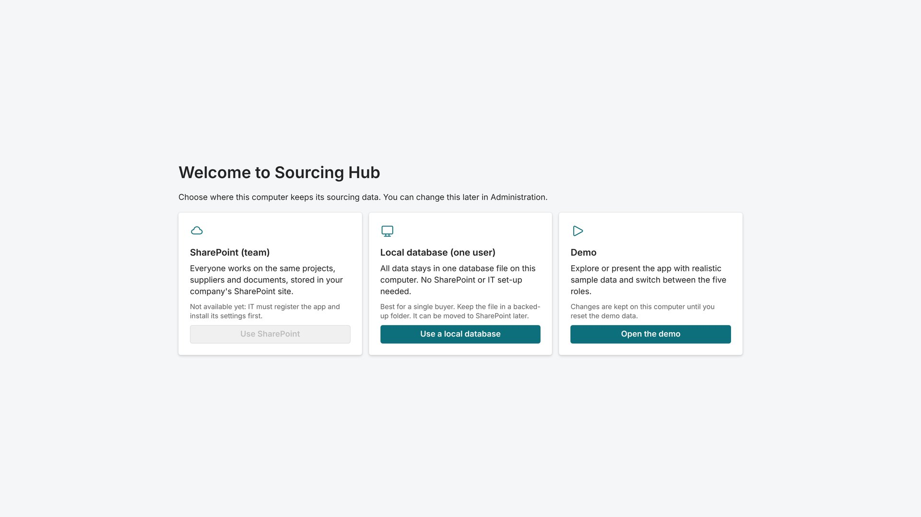



Choose where the data lives
SharePoint (team)
Shared projects and documents in a company SharePoint site. Microsoft sign-in.
Local database (one user)
One file on this computer, backed up daily. No IT set-up.
Demo
Sample data and all five roles, for training and presentations.
The choice appears on first start and can be changed later in Administration.
Notes:
On first start the app asks where to keep data. SharePoint needs IT to register the app; until then that option is greyed out. The local database is the quickest way to start for a single buyer. The demo is what this walkthrough uses.

Slide 4





Five roles, each seeing only what it needs
System Administrator
Procurement Manager
Procurement Specialist
Internal Stakeholder
Client Viewer
Users, workflows, currencies, branding, storage and audit log.
Sees every project, approves stage gates and sole-source requests.
Runs assigned projects end to end: suppliers, scores, negotiations.
Follows the projects they are part of. No confidential data.
Read-only portal with only what was published to the client.
In the demo, "Viewing as" (top right) switches role to show the difference.
Notes:
Roles come from Microsoft Entra groups in SharePoint mode. In the local database mode the single user is administrator. Confidential tabs (evaluation, negotiation) are hidden from stakeholders and clients.

Slide 5
The process: every project moves through fixed stages
Competitive
Creation
Initial assessment
Sourcing strategy
RFx execution
Evaluation
Recommendation
Approval
Closed
Sole Source
Creation
Justification
Negotiation strategy
Negotiation
Recommendation
Approval
Closed
Sourcing Support
Request
Triage
In progress
Recommendation
Closed
Approval gate: a Procurement Manager must approve before the project moves on. Gates and required fields are set per stage in Administration → Workflows.
Notes:
Stages, approval gates and required fields are configurable. A project cannot move past a gate without an approval, and every move is written to the audit log.

Slide 6
Everyday work
Dashboard, project list and creating a new project

Slide 7
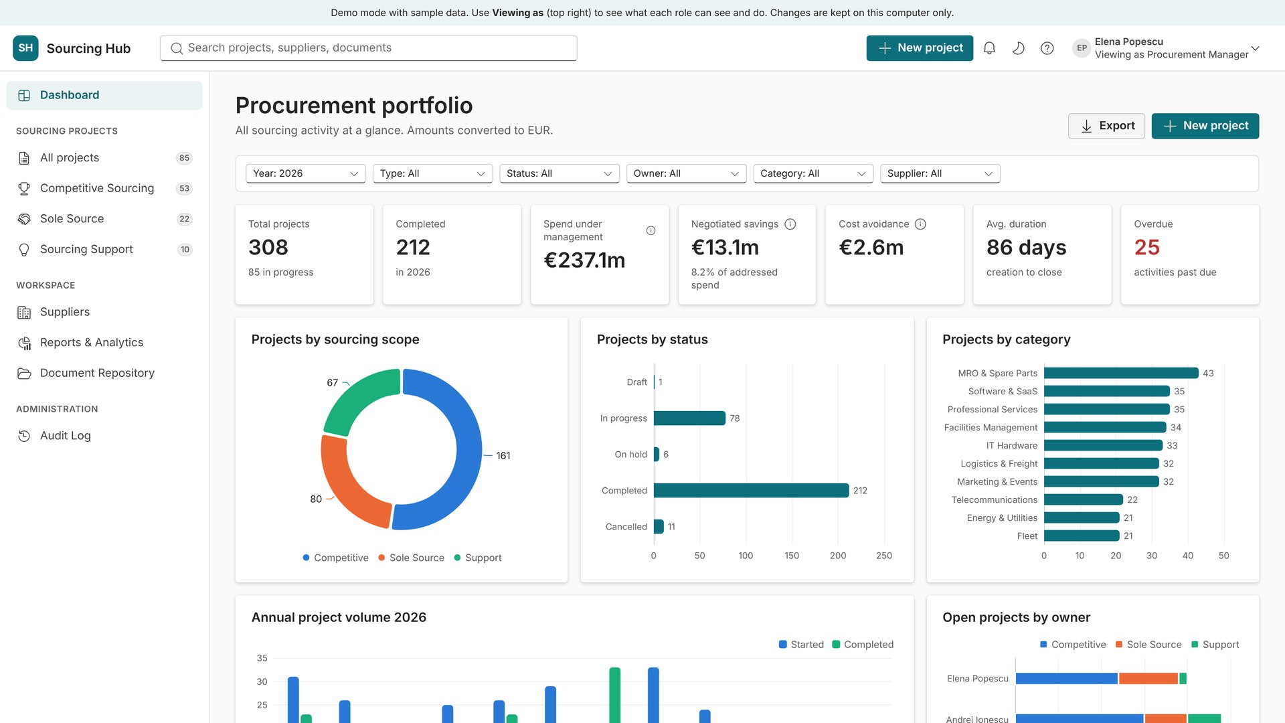
Dashboard: the whole portfolio at a glance
1
Start here every morning.
KPIs: projects, spend under management, savings, cost avoidance, cycle time and overdue items
Filter by year, type, status, owner, category or supplier
Overdue activities and upcoming deadlines link straight to the project
Notes:
All amounts are converted to EUR for totals. Click any chart bar or table row to drill into the projects behind it.

Slide 8
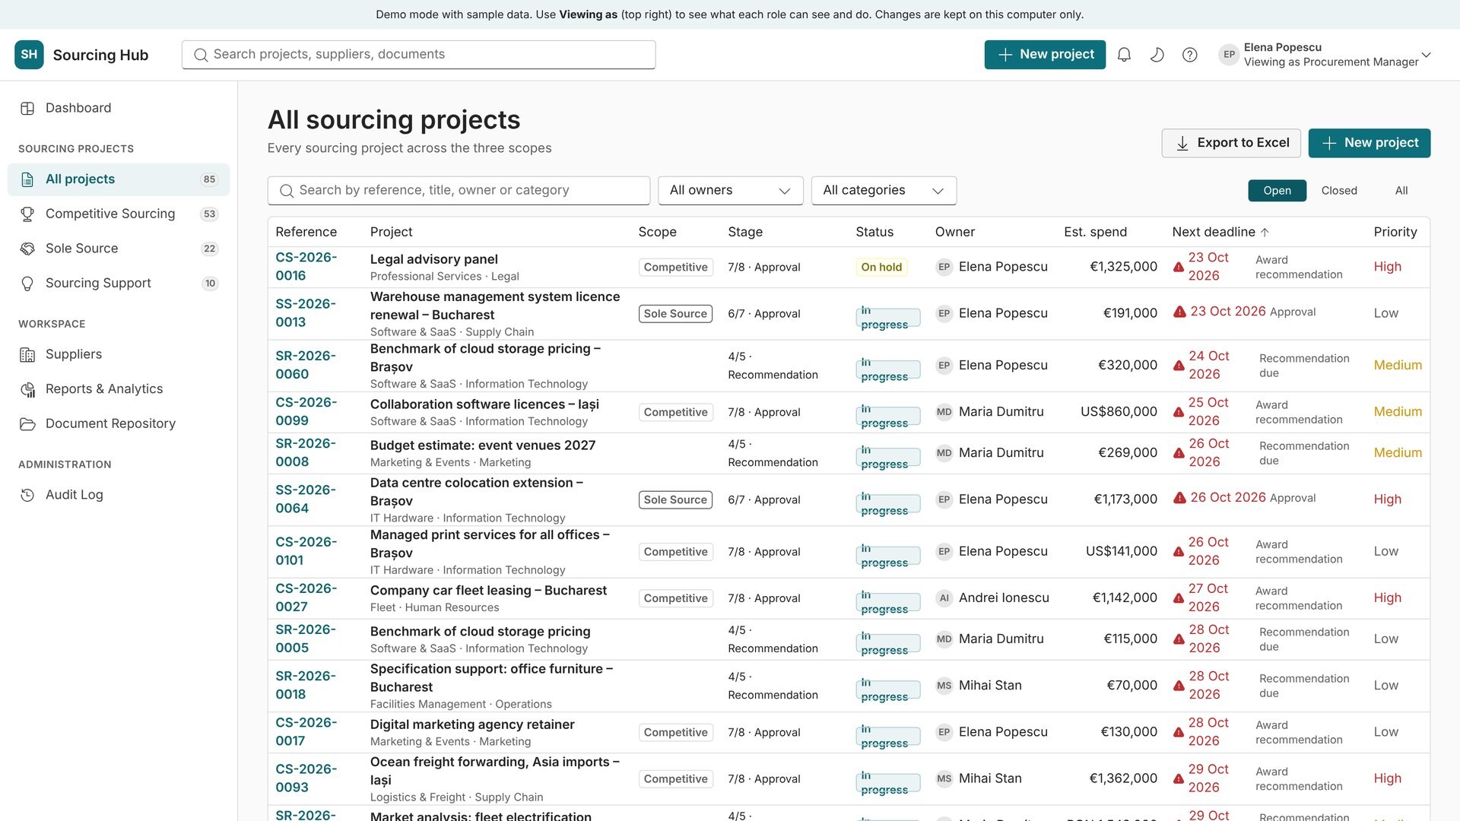
Project list: find any project fast
2
Search, filter and sort all projects.
Search by reference, title, owner or category
Open, closed or all projects; sort by deadline, spend or status
Late deadlines are flagged in red
Export the list to Excel
Notes:
The left menu also opens the list filtered to one scope: Competitive, Sole Source or Sourcing Support.

Slide 9
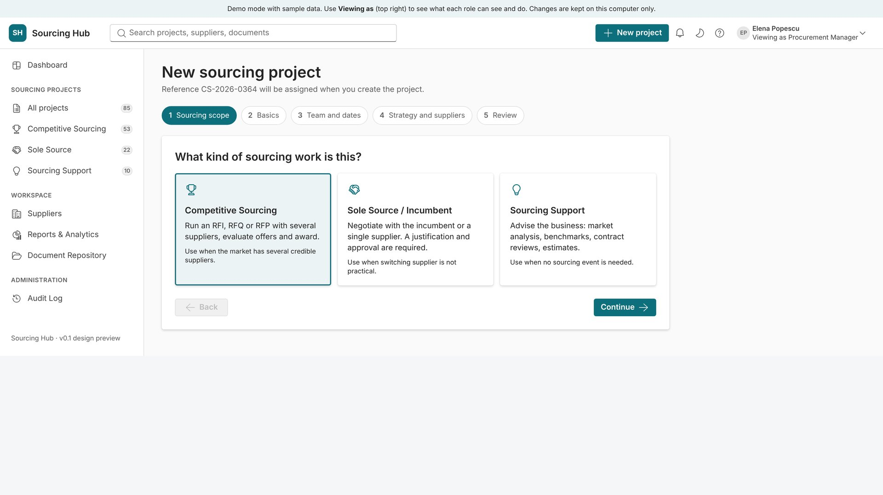
New project, step 1: choose the type of sourcing
3
A five-step wizard creates every project.
Pick Competitive, Sole Source or Sourcing Support
The choice sets the workflow, the tabs and the reference (CS-, SS-, SR-)
The reference number is assigned automatically
Notes:
Steps: sourcing scope, basics, team and dates, strategy and suppliers, review.

Slide 10
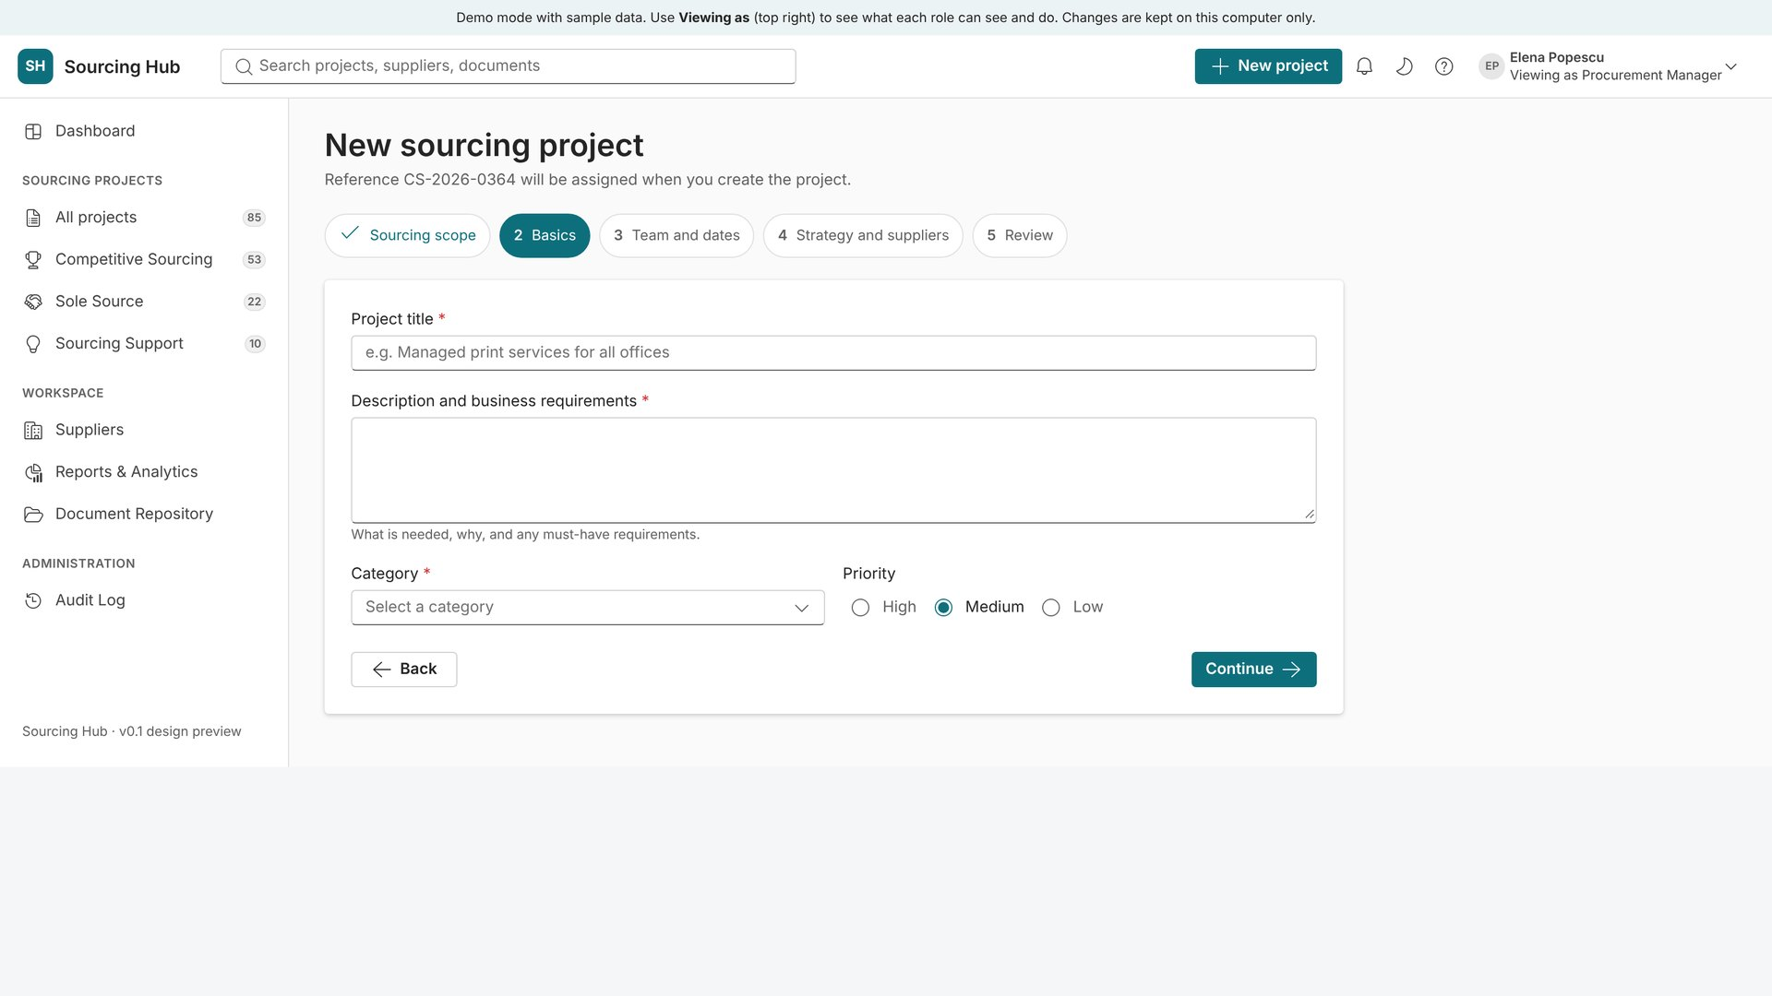
New project, step 2: the basics
4
Describe the need once.
Title, description and business requirements
Category, department and priority
Estimated spend in the project currency (EUR, USD, GBP, CHF, RON, PLN and more)
Next steps add the team, dates, strategy and suppliers
Notes:
Required fields are marked. On Review, Create saves the project, creates its document folder and logs the event.

Slide 11
Competitive Sourcing
Example: "Managed print services for all offices", a two-step RFP worth €640,000

Slide 12
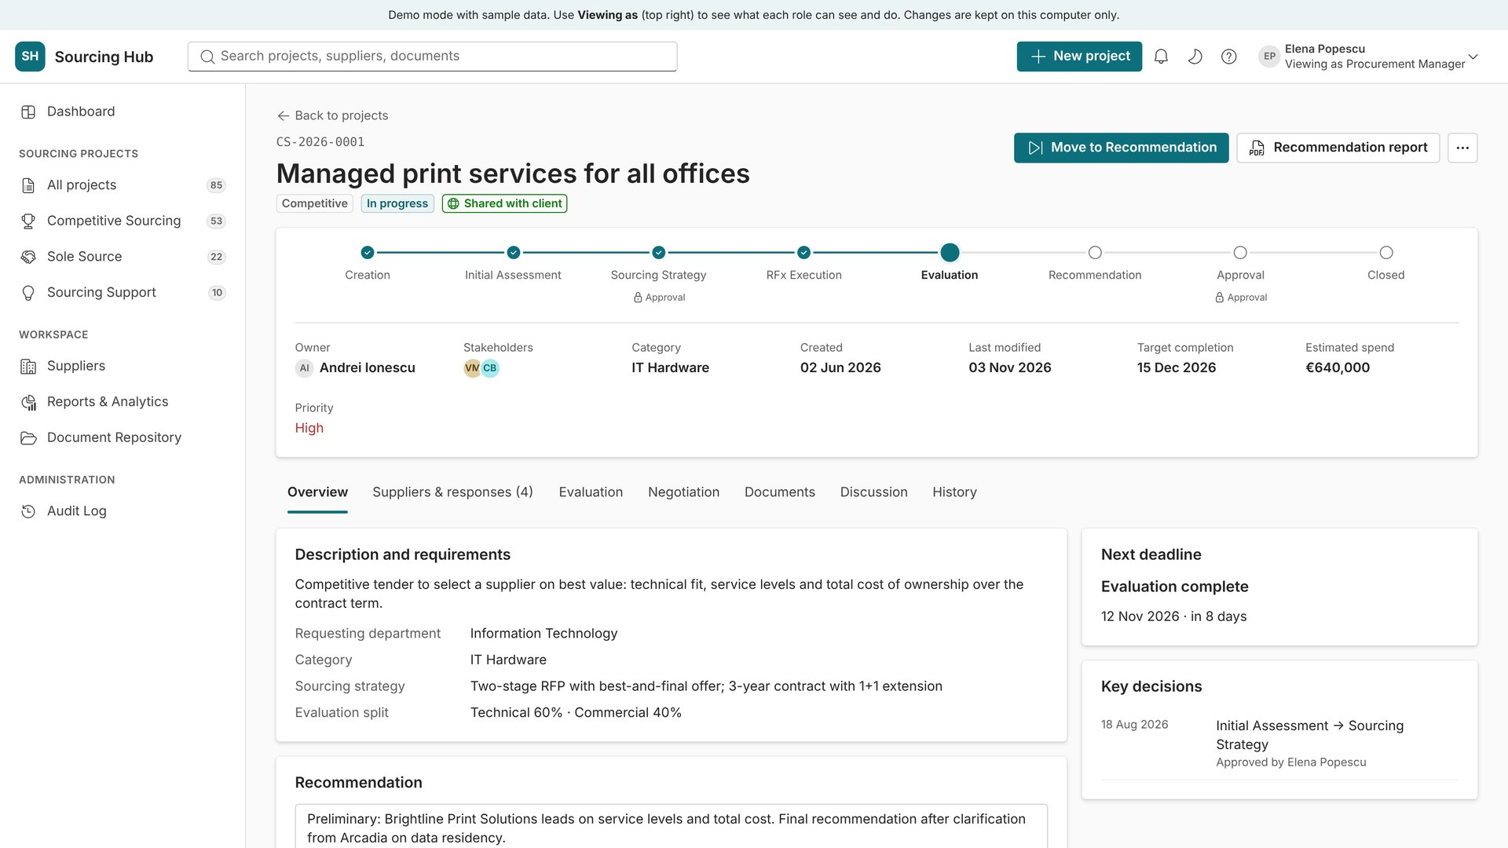
Project workspace: overview
5
Everything about one project on one page.
Stage tracker shows where the project is and which stages need approval
Owner, stakeholders, dates and estimated spend
The main button moves the project to its next stage
Recommendation report is generated from the project data
Notes:
The tabs change with the scope. Evaluation and Negotiation carry a lock: they are confidential and hidden from stakeholders and clients.

Slide 13
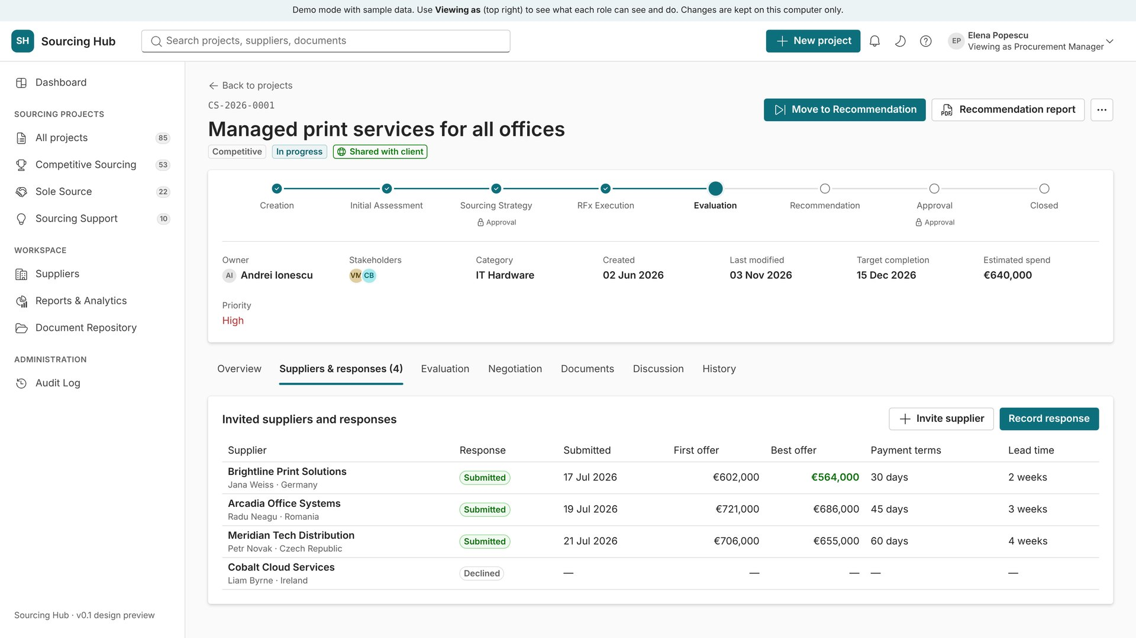
Suppliers & responses
6
Invite suppliers and record their offers.
Invite suppliers from the supplier records
Record each response: first offer, best offer, payment terms, lead time
Declined suppliers stay on record for reporting
Notes:
Best offers are highlighted. Participation feeds the supplier history and the Supplier participation report.

Slide 14
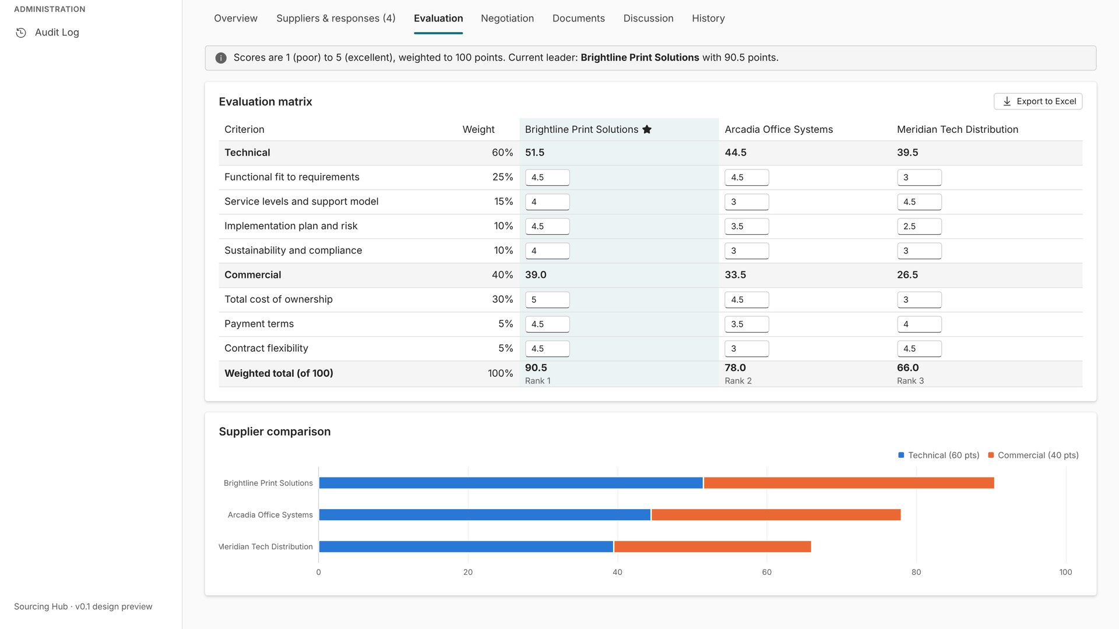
Evaluation matrix
7
Score suppliers against weighted criteria.
Technical and commercial criteria with weights (here 60/40)
Scores from 1 to 5 become a weighted total out of 100
The current leader is marked; the chart compares suppliers
Export the matrix to Excel
Notes:
Confidential tab. Criteria and weights are set per project.

Slide 15
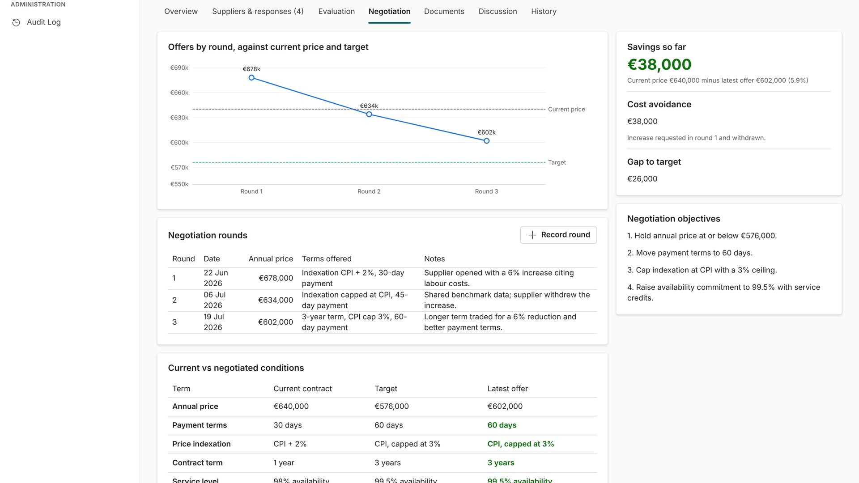
Negotiation
8
Track every round against the target.
Chart of offers by round against current price and target
Savings, cost avoidance and gap to target calculated automatically
Rounds, objectives and negotiated conditions in one place
Notes:
Savings = current price minus the latest offer. Cost avoidance records price increases that were requested and withdrawn.

Slide 16
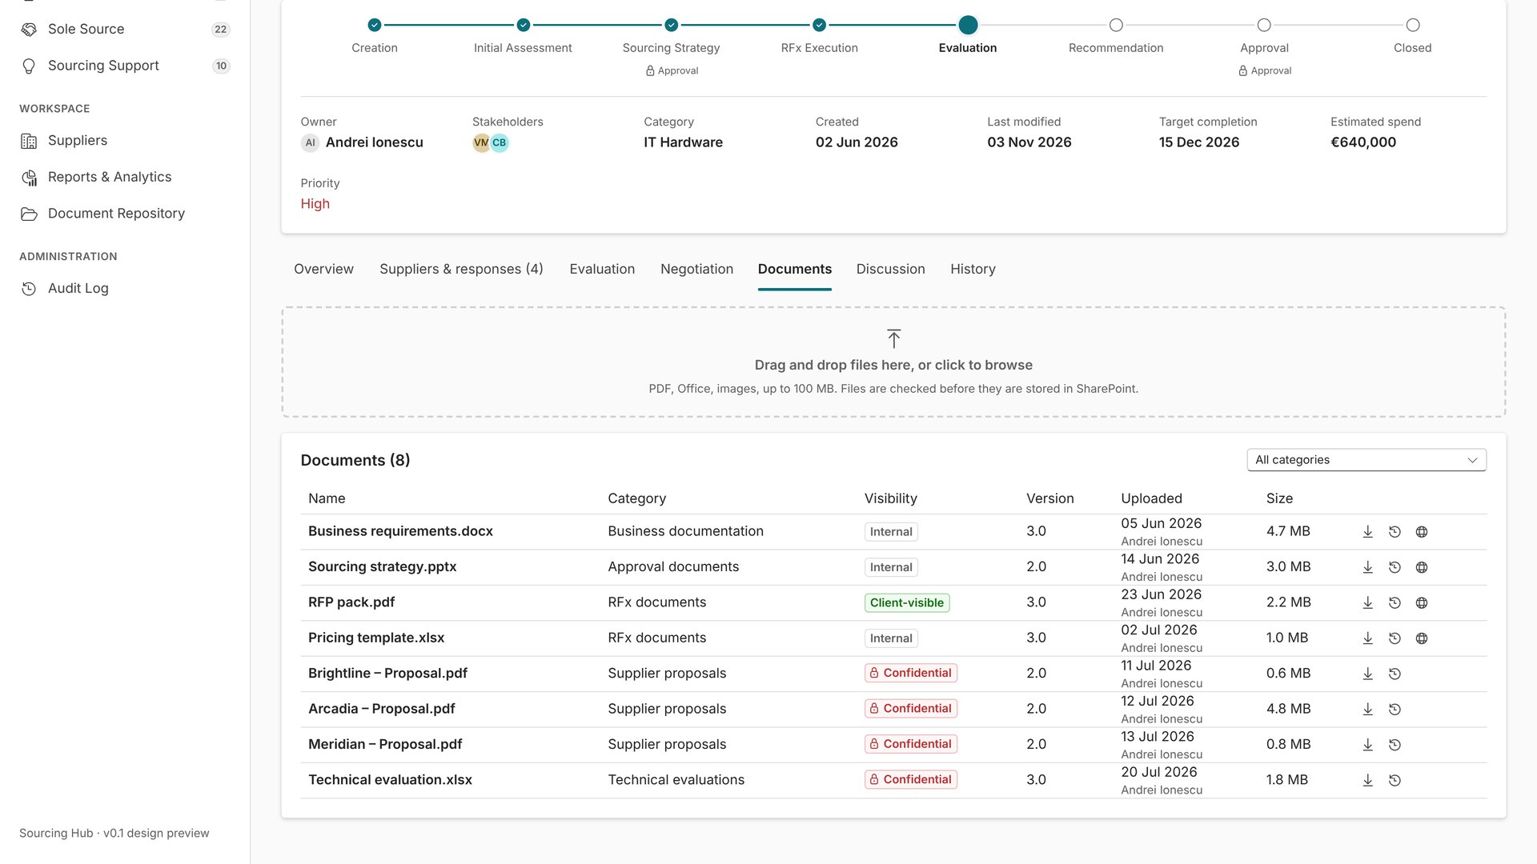
Documents
9
All project files in one folder.
Drag and drop to upload (PDF, Office, images; up to 100 MB)
Each file has a category, version and visibility
Supplier proposals are confidential; client-visible files are marked
Notes:
In SharePoint mode files are stored in the project folder of the document library, with SharePoint version history.

Slide 17
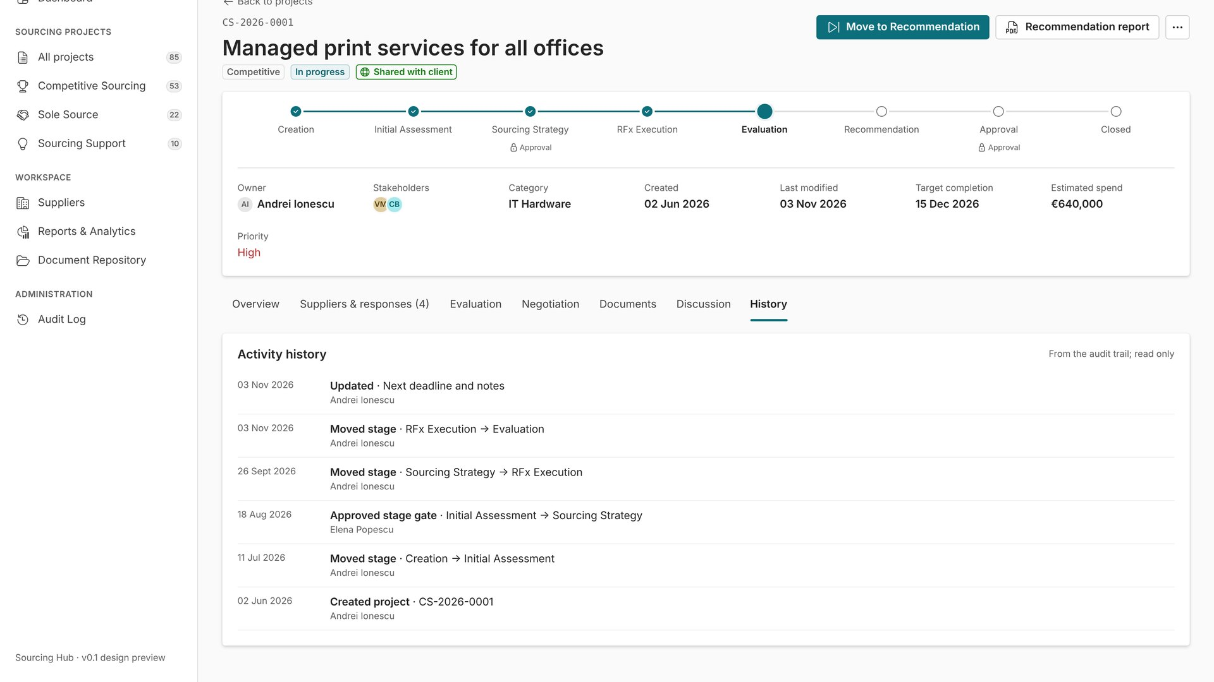
History
10
Who did what, and when.
Every stage move, approval and update with date and user
Read-only, taken from the audit trail
Useful for audits and handovers
Notes:
The full audit log for all projects is under Administration → Audit Log.

Slide 18
Sole Source / Incumbent negotiation
Example: renewal of a warehouse management system licence

Slide 19
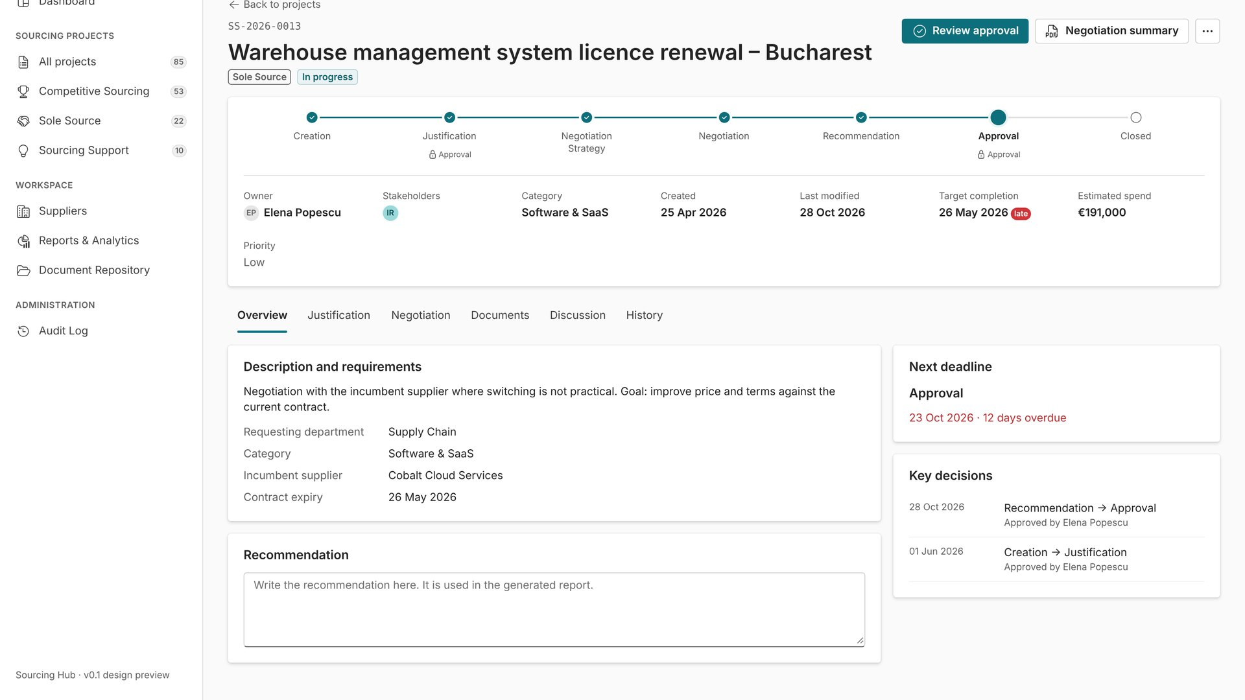
Sole-source project overview
11
One supplier, with an approval trail.
Workflow: Creation, Justification, Negotiation strategy, Negotiation, Recommendation, Approval
Overdue deadlines are flagged on the project
Key decisions list each approval and who gave it
Notes:
The project cannot leave the Justification stage until a Procurement Manager approves it.

Slide 20
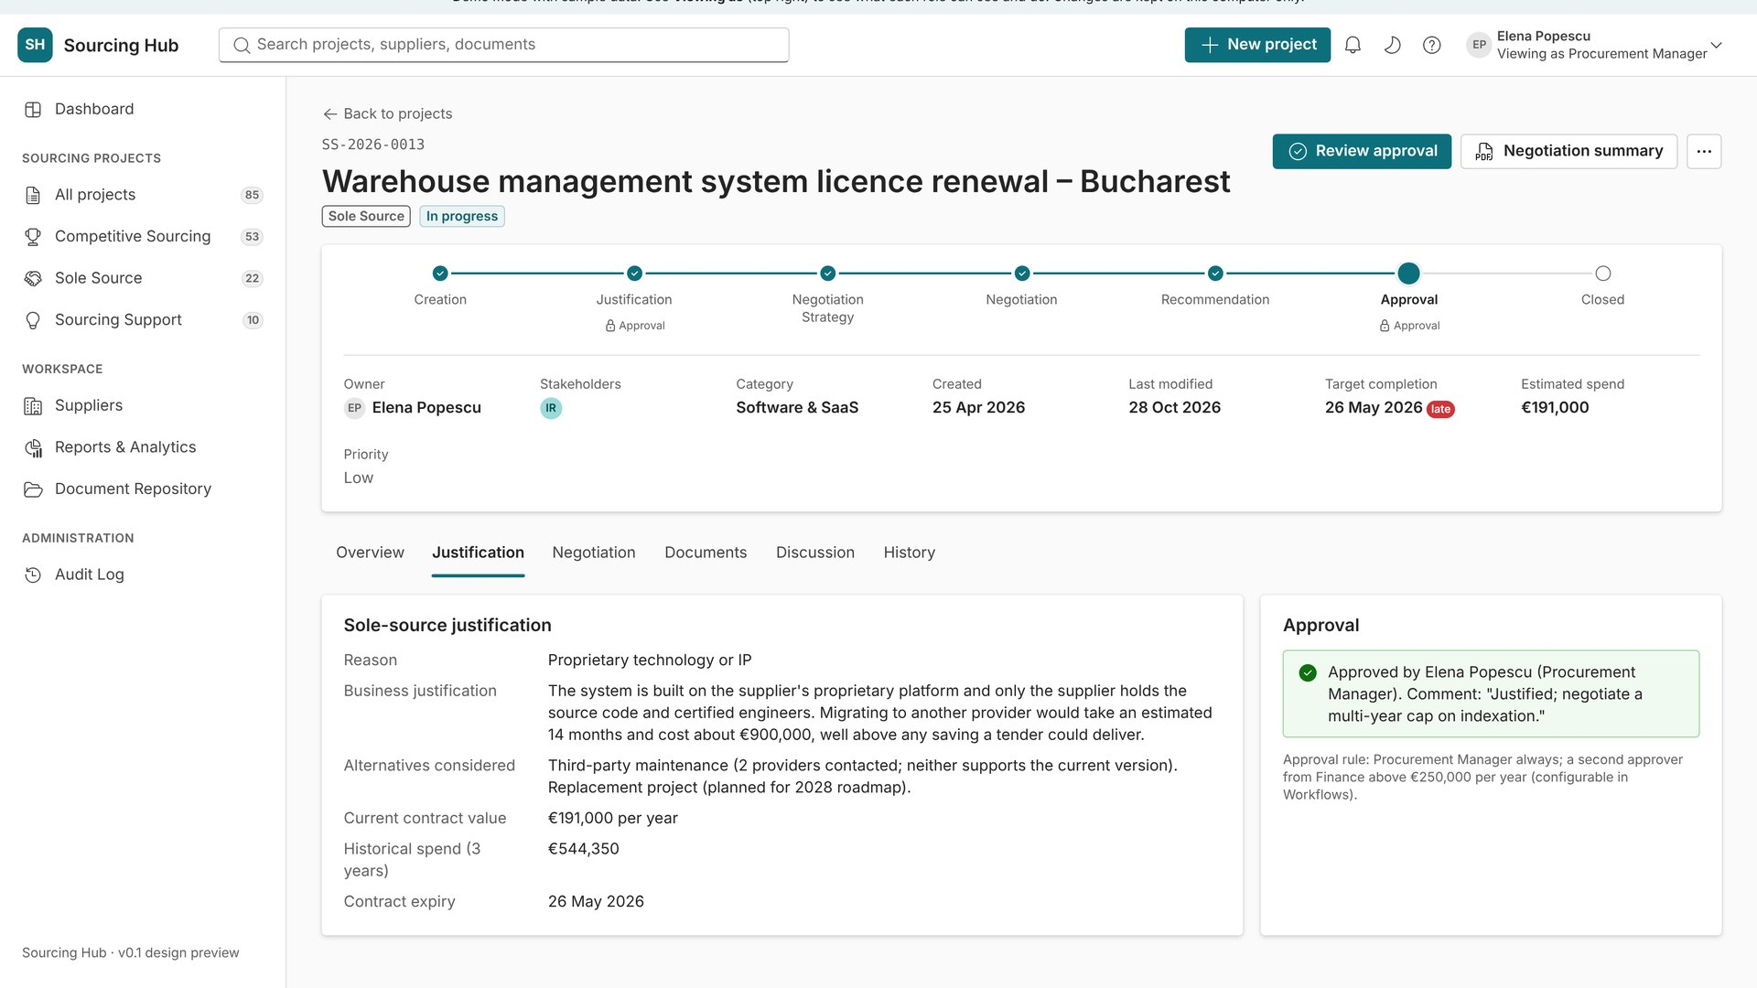
Justification and approval
12
Why only this supplier?
Reason code, business justification and alternatives considered
Contract value, spend history and expiry
Approval box shows who approved, when and with which comment
Above a value threshold a second approver is required
Notes:
Justification fields are mandatory. Thresholds are set in Administration → Workflows.

Slide 21
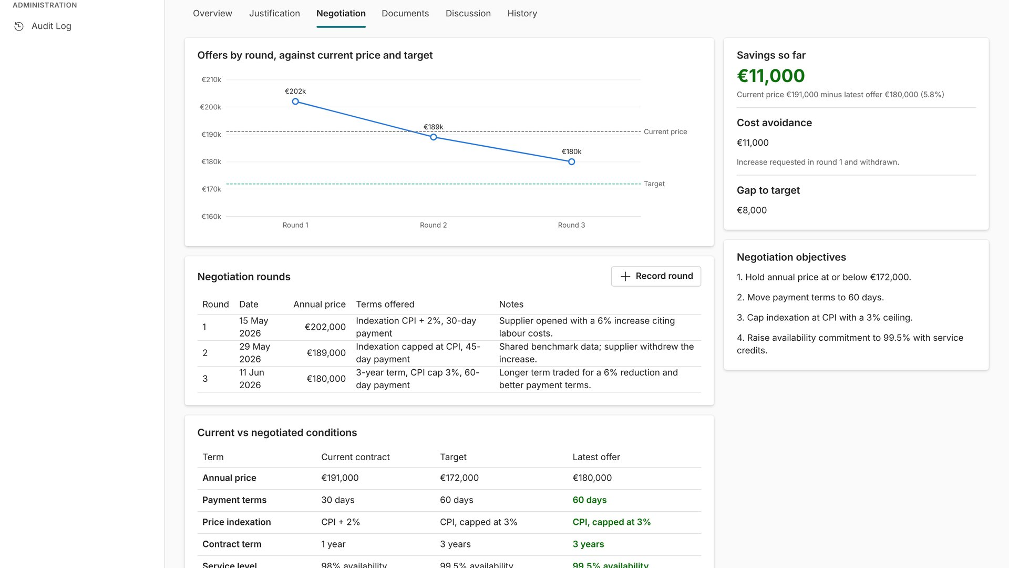
Negotiation with the incumbent
13
Same negotiation tools, one supplier.
Rounds with price and terms offered
Current contract vs target vs latest offer, term by term
Savings and gap to target update with each round
Notes:
Confidential tab, hidden from stakeholders and clients.

Slide 22
Sourcing Support
Example: a benchmark of cloud storage pricing for the IT department

Slide 23
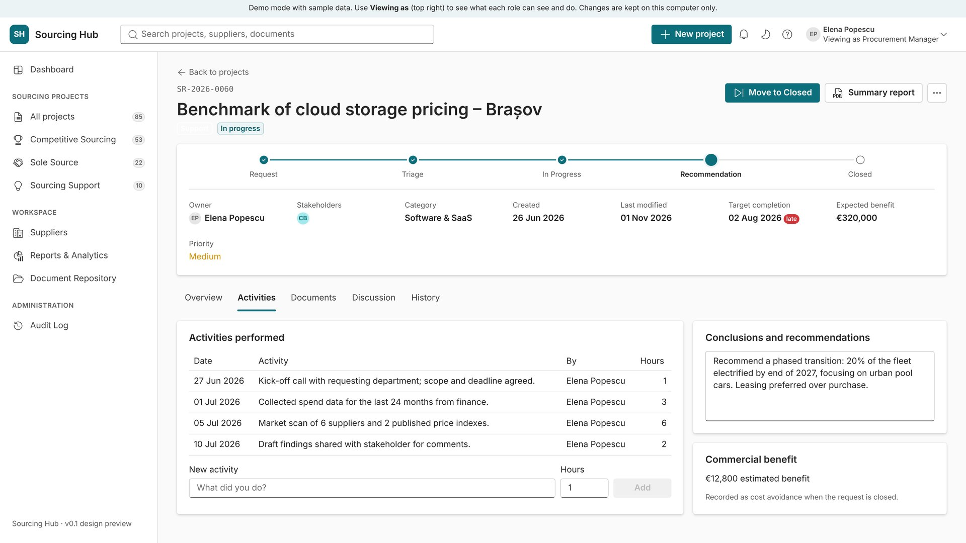
Activities, conclusions and benefit
14
Advice work, recorded and measurable.
Log each activity with date and hours
Write conclusions and recommendations for the requester
Record the commercial benefit, counted as cost avoidance when closed
Notes:
Workflow: Request, Triage, In progress, Recommendation, Closed. The summary report goes to the requesting department.

Slide 24
Suppliers, reports and documents
Shared records used across all projects

Slide 25
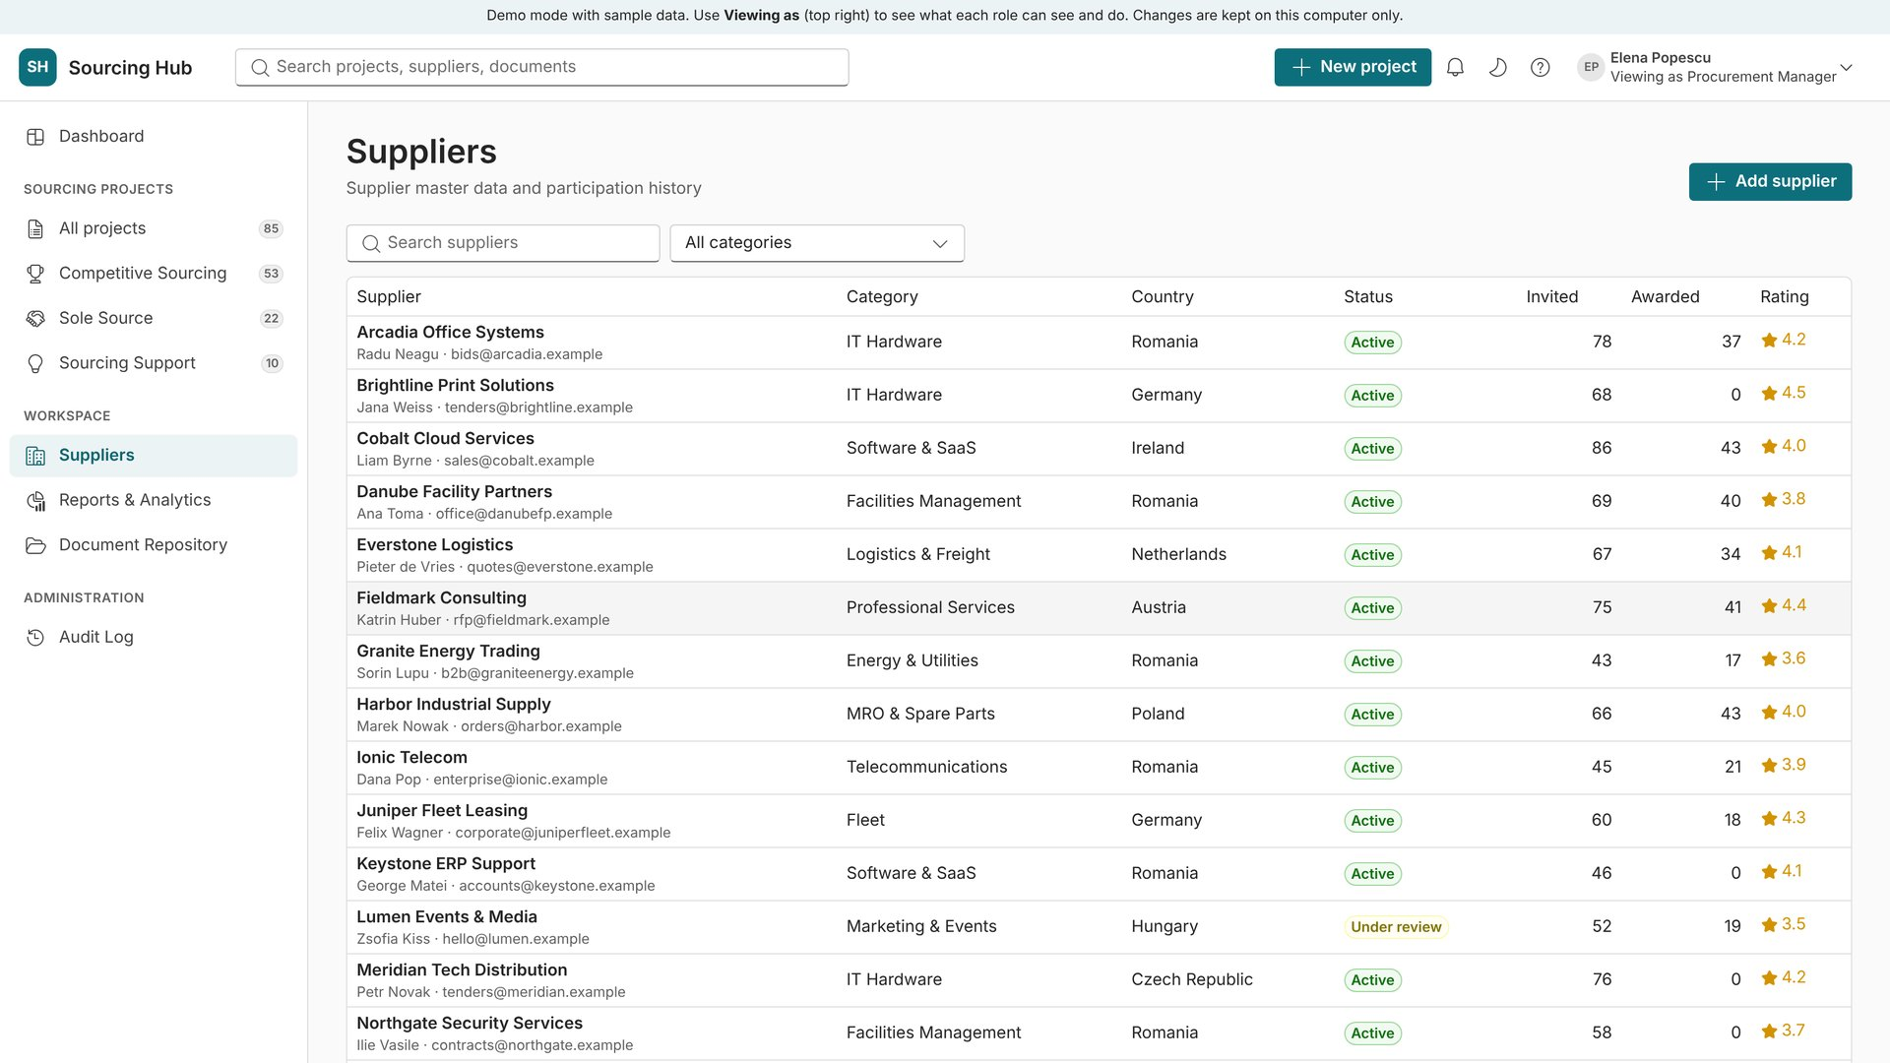
Suppliers
15
One supplier master list.
Category, country, status and rating
How often each supplier was invited and awarded
Search and filter by category
Notes:
Suppliers under review are flagged. Adding a supplier is limited to procurement roles.

Slide 26
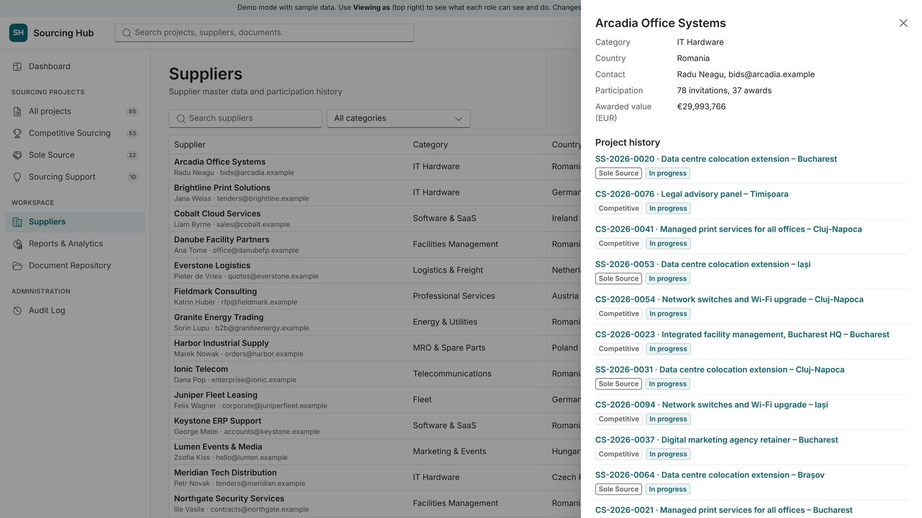
Supplier details
16
Full history in one click.
Contact details and participation
Awarded value, converted to EUR
Every project the supplier took part in, with the outcome
Notes:
Click a project in the history to open its workspace.

Slide 27
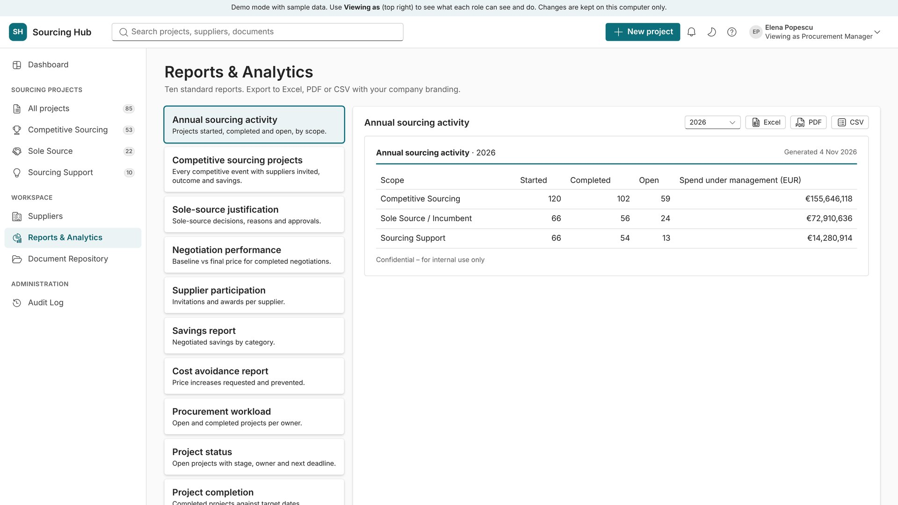
Reports & Analytics
17
Ten standard reports, ready to export.
Sourcing activity, competitive projects, sole-source justification, negotiation performance
Supplier participation, savings, cost avoidance, workload, status, completion
Export to Excel, PDF or CSV with your branding
Notes:
Choose a report on the left and the year at the top. Totals are in EUR; individual rows keep the project currency.

Slide 28
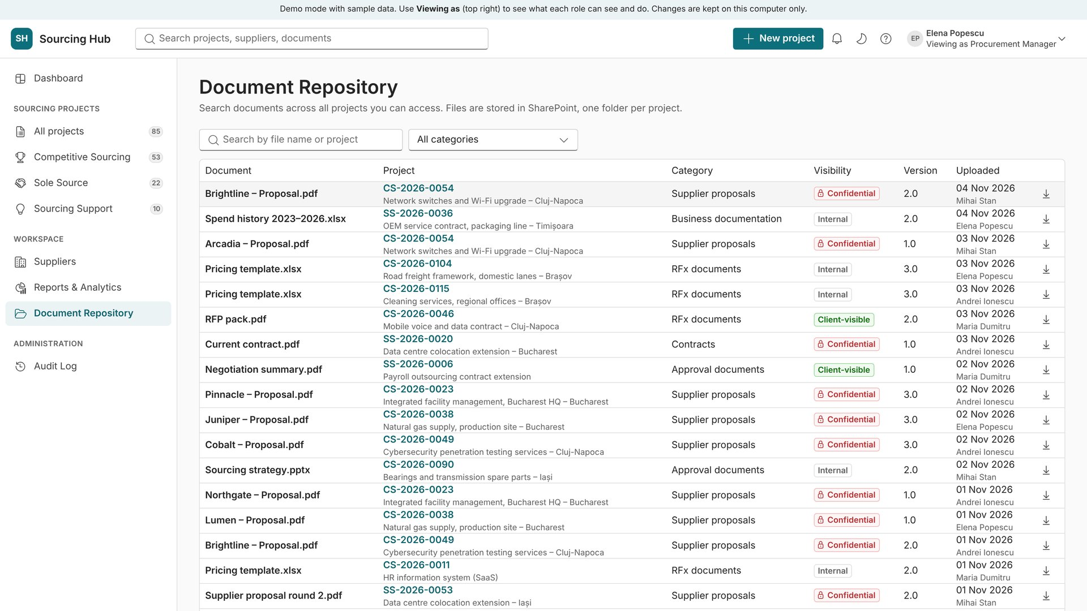
Document Repository
18
Search every document across projects.
Filter by category or search by name or project
Visibility shown on every file: internal, confidential or client
Opens the document or its project
Notes:
Confidential documents are only listed for procurement roles.

Slide 29
Stakeholders and clients
What people outside procurement see

Slide 30
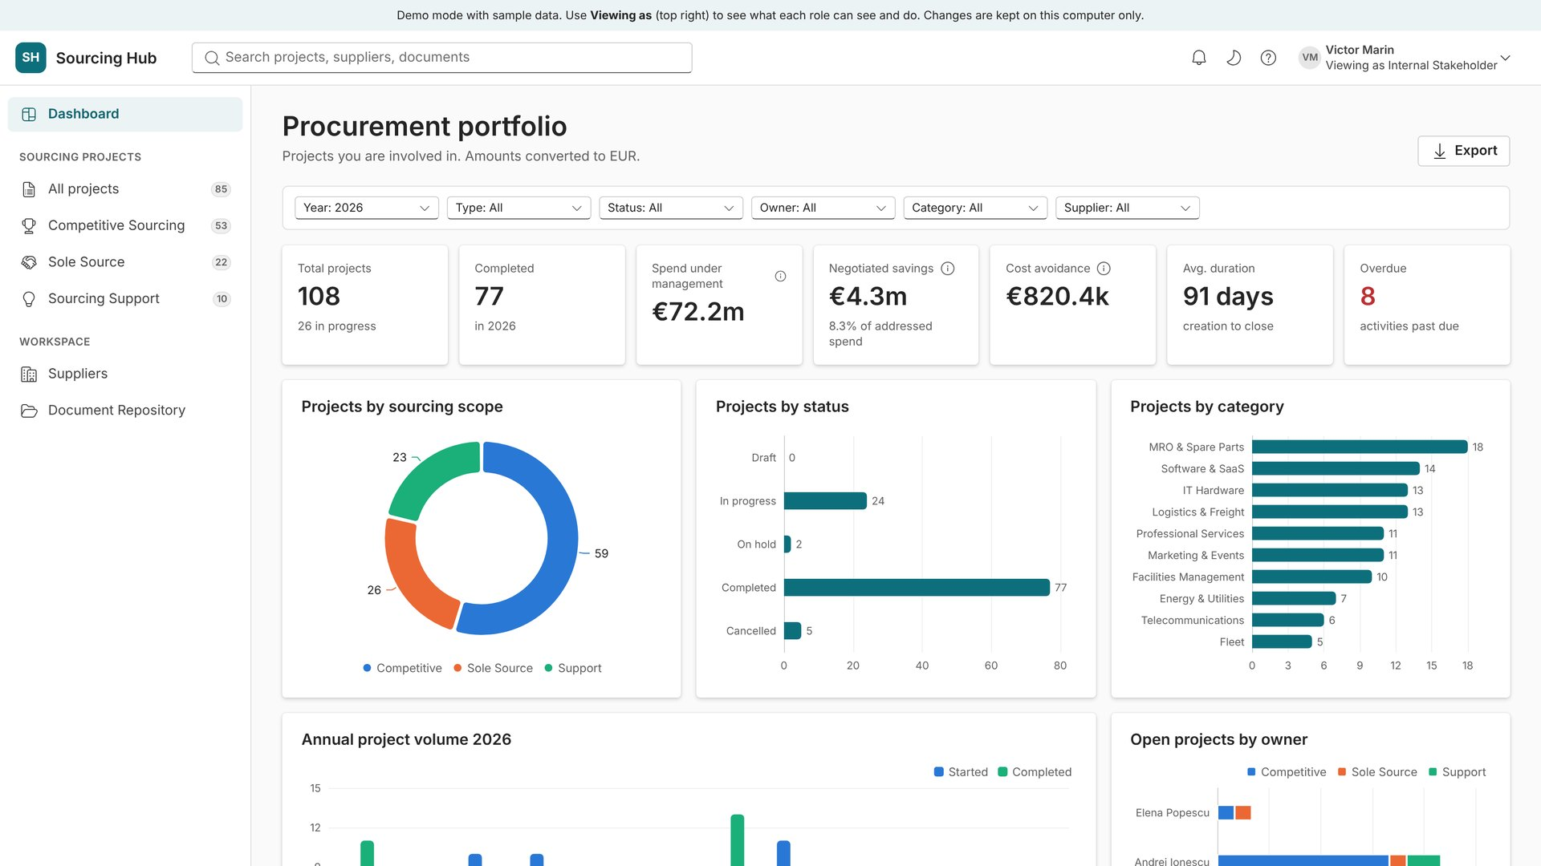
Internal stakeholder view
19
Only their own projects, no confidential data.
Dashboard limited to projects they are part of
No evaluation scores, target prices or negotiation strategy
They can comment in the project discussion
Notes:
Switch "Viewing as" to Internal Stakeholder in the demo to show this.

Slide 31
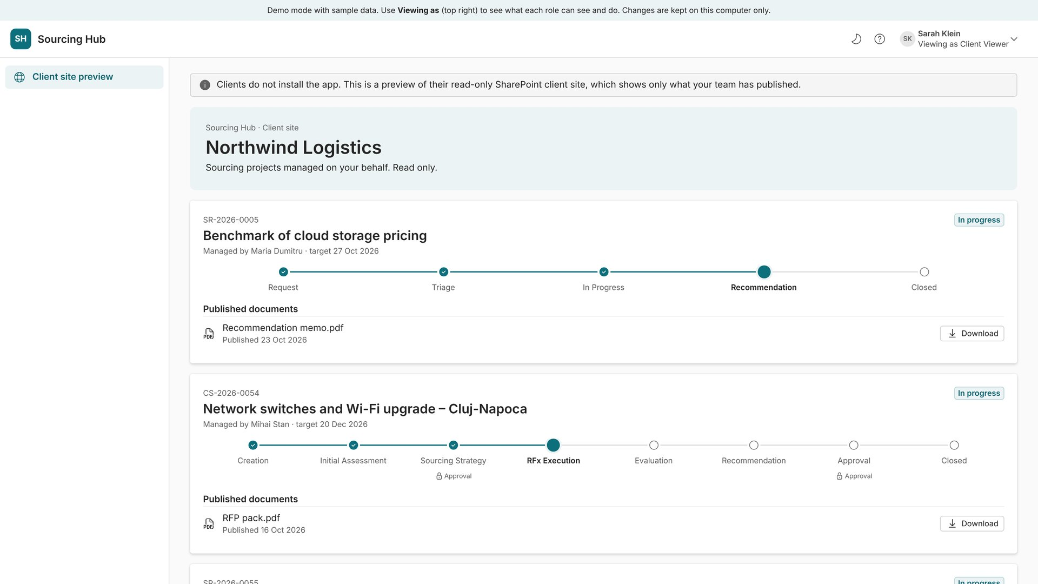
Client portal (read-only)
20
Clients see only what was published.
Project progress and published documents
Read-only, opened in a browser as a guest
Nothing confidential is ever shown
Notes:
In SharePoint mode clients use a separate read-only SharePoint site per client.

Slide 32
Administration
Set up once, adjust any time (System Administrator only)

Slide 33
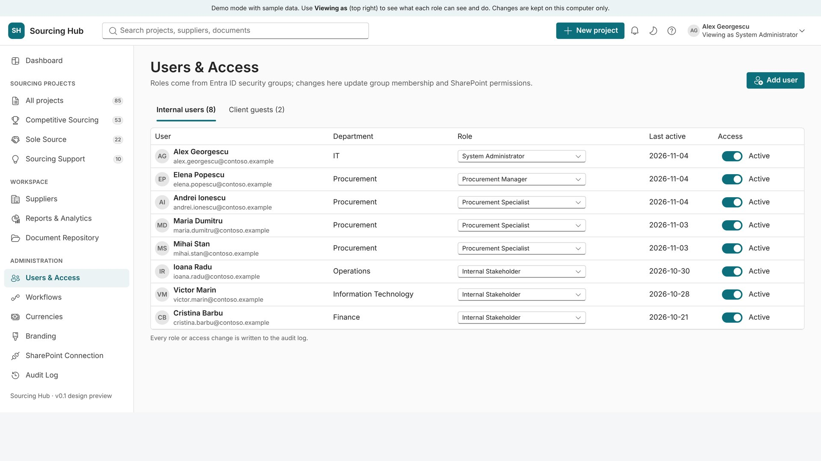
Users & Access
21
Who can do what.
Internal users and client guests in separate tabs
Change a role or disable a user in one click
In SharePoint mode, roles map to Microsoft Entra groups
Notes:
Role changes are written to the audit log.

Slide 34
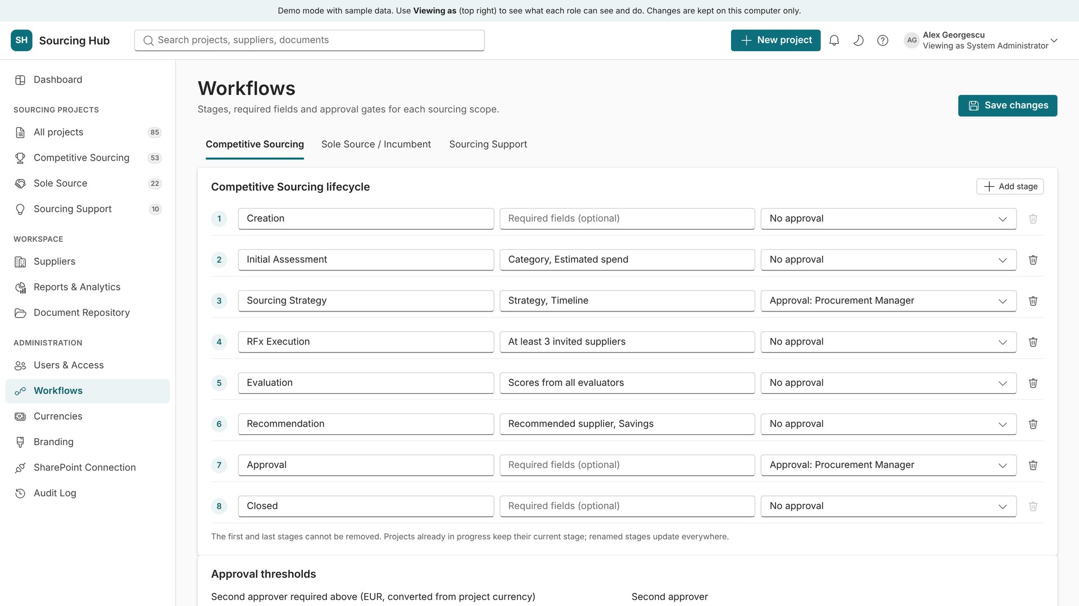
Workflows
22
Stages, required fields and approvals.
One workflow per scope
Mark which stages need approval and by whom
Approval thresholds in EUR, converted from the project currency
Notes:
Changes apply to new stage moves; existing history is kept.

Slide 35
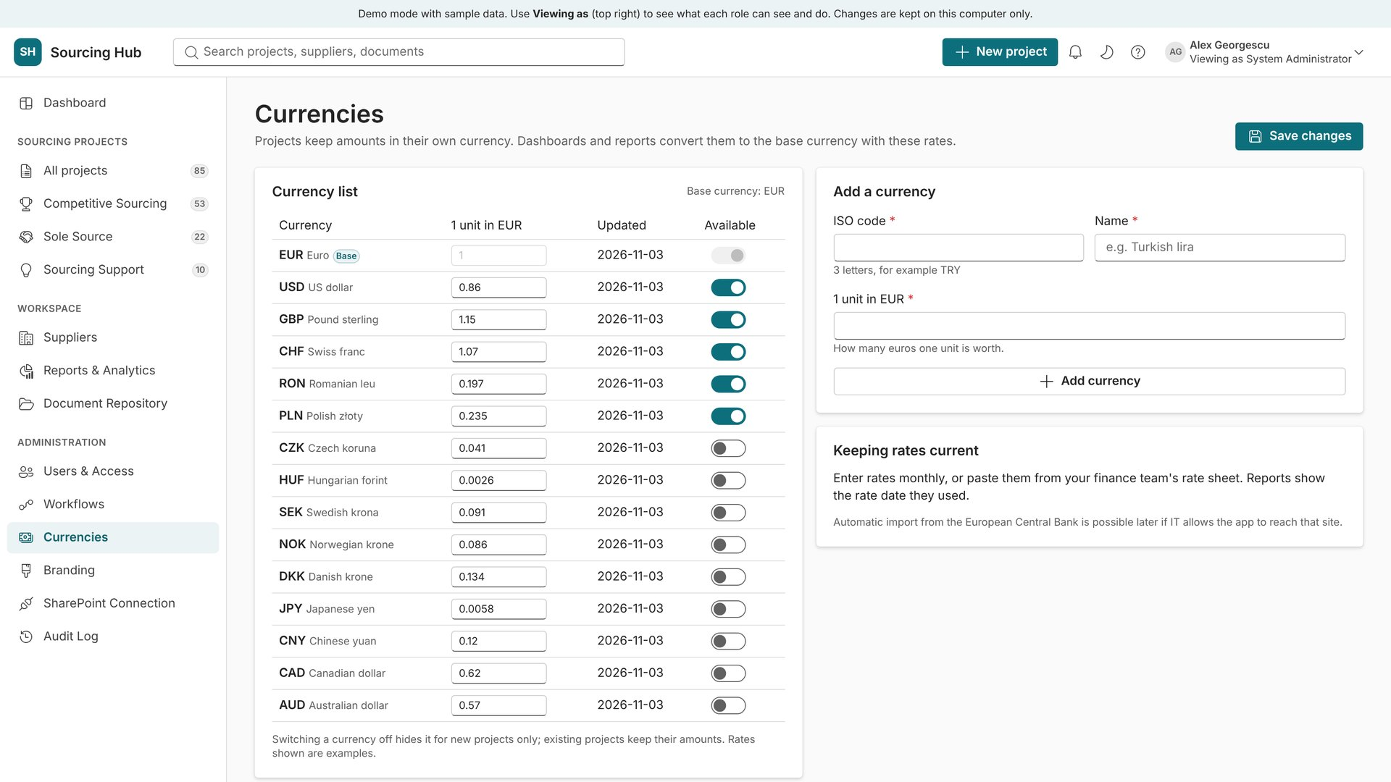
Currencies
23
EUR base, with the common currencies.
EUR, USD, GBP, CHF, RON and PLN active; nine more ready to switch on
Edit the rate and date for each currency
Add any ISO currency with its rate
Notes:
Projects keep their own currency. Dashboards and reports convert totals to EUR with these rates.

Slide 36
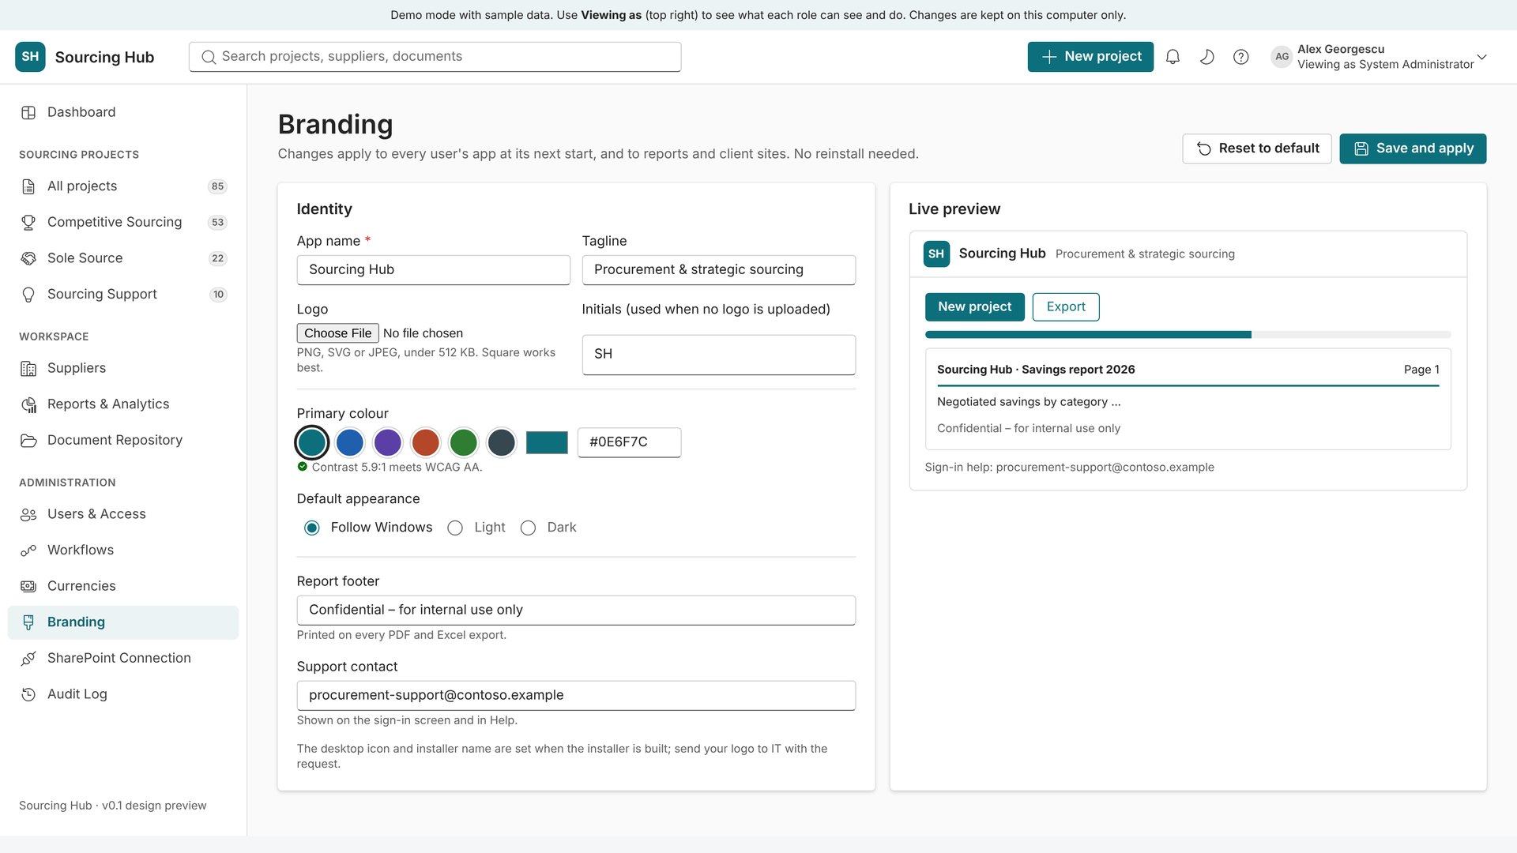
Branding
24
Make it look like your company.
App name, logo and tagline
Primary colour with an automatic contrast check
Light, dark or system mode, and the report footer text
Notes:
The live preview shows the result before saving.

Slide 37
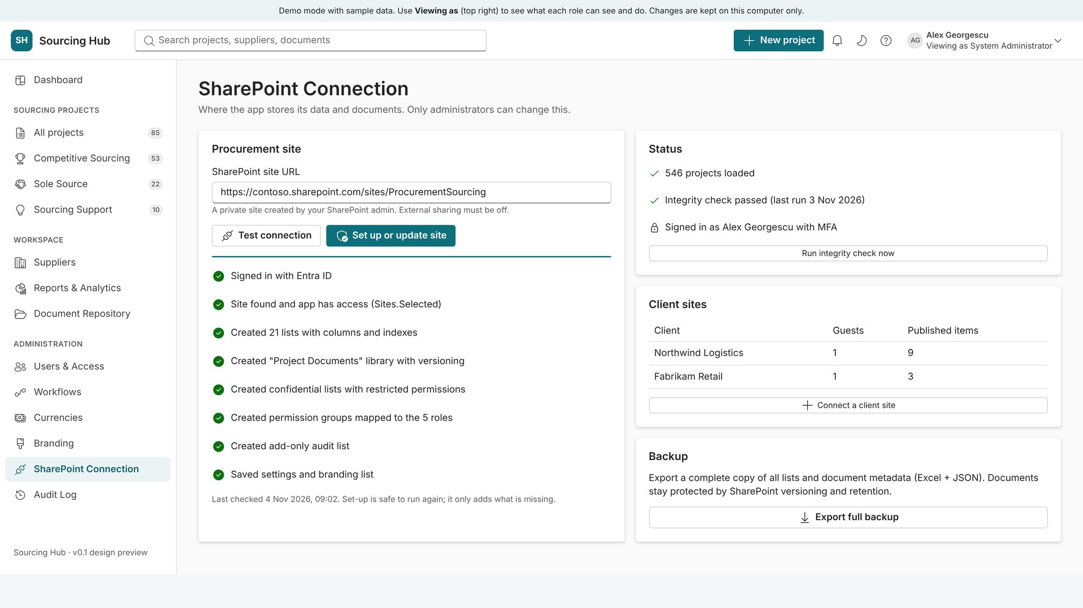
Data storage and SharePoint connection
25
Where the data lives.
SharePoint: enter the site, test the connection, run set-up
Set-up creates every list and the document library, and is safe to run again
Local database: shows the file, size, last save and backups
Notes:
Set-up only adds what is missing and never deletes data.

Slide 38
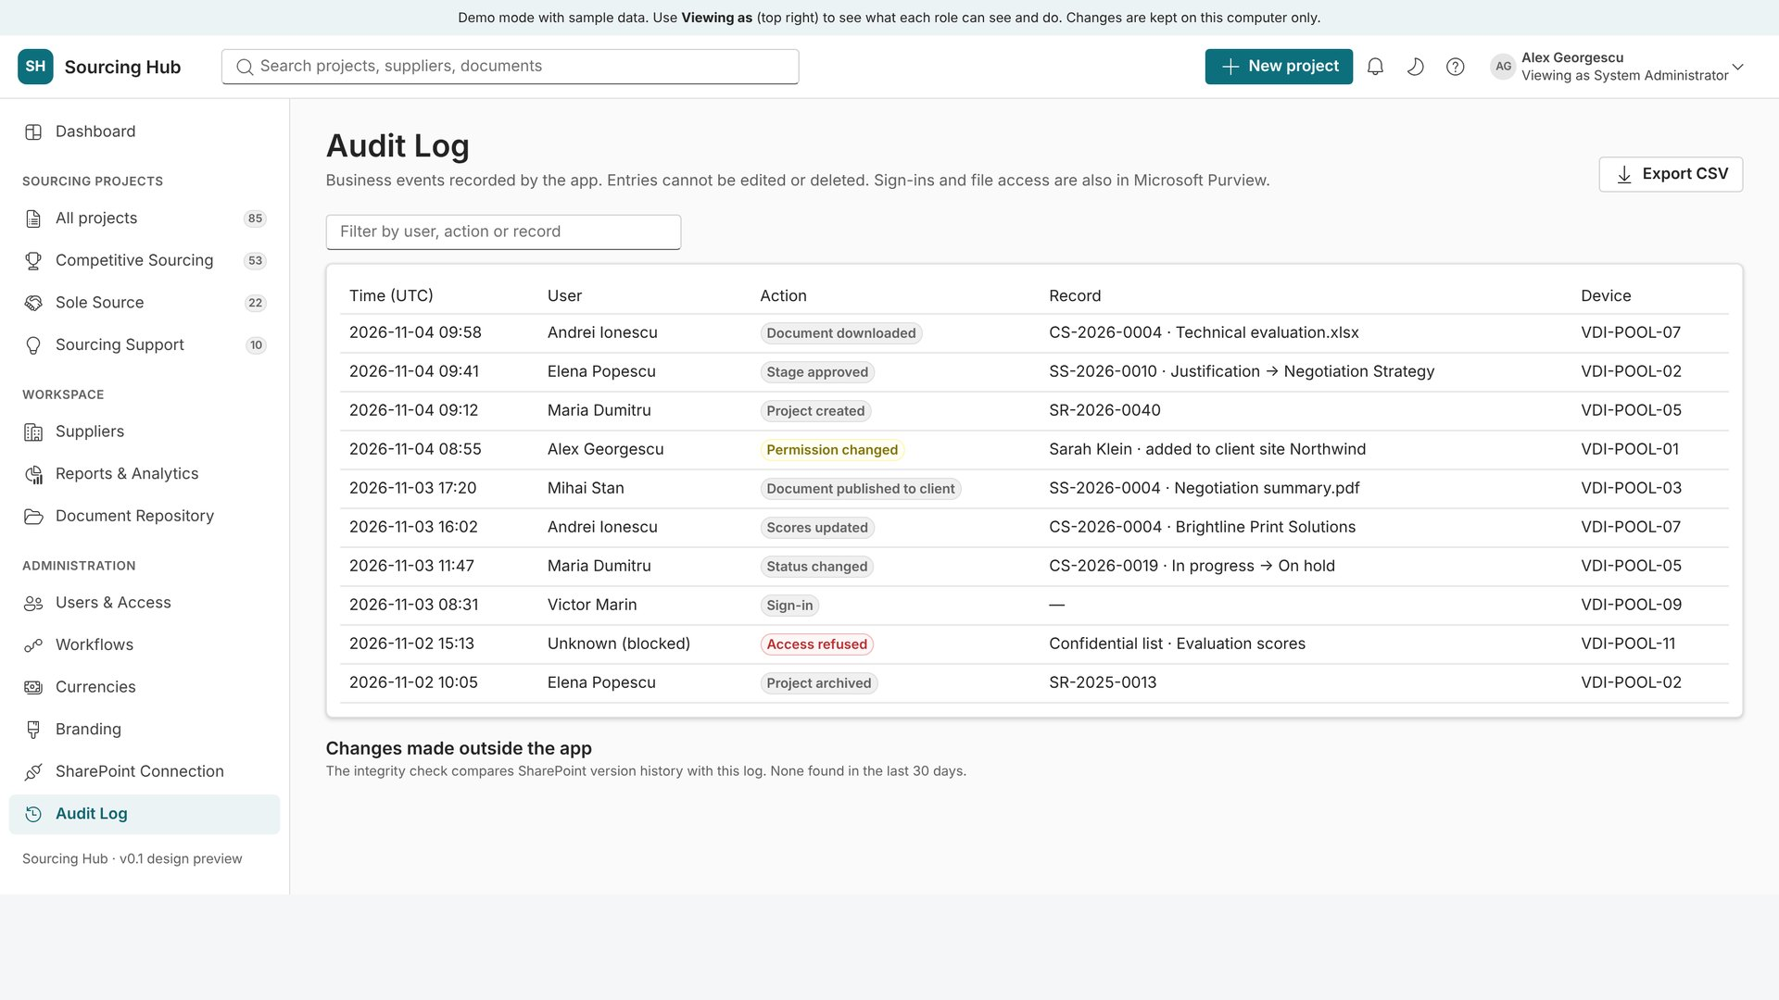
Audit Log
26
Every business event, add-only.
Time, user, action and record for every change
Search and export to CSV
Flags changes made outside the app
Notes:
Visible to administrators and Procurement Managers.

Slide 39

Where the build stands
Done
Architecture, screen designs, desktop app with installer, Microsoft sign-in, SharePoint set-up, local database and demo mode
Next
Connect projects, suppliers and workflows to the real data store (SharePoint or local)
Then
Competitive Sourcing, Sole Source and Sourcing Support modules on real data
Then
Documents and client publishing; dashboard, reports and branding on real data
Finally
Testing, security review, training guide for procurement agents and this deck updated
Notes:
Each module ships with an installer built automatically on GitHub.

Slide 40
Try it yourself
Install Sourcing Hub, choose "Demo" on first start,
and switch roles with "Viewing as".

