Slide 1
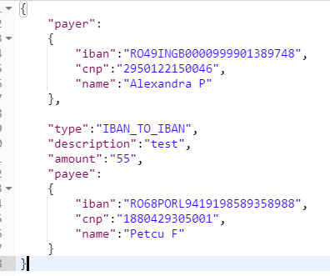
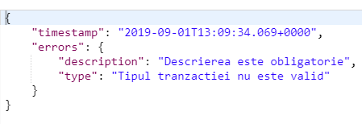
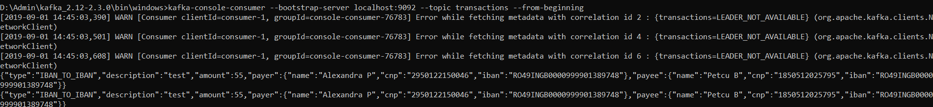
Client
REST: POST /createTransaction
Validation Service
Validation Bean is passed ? (see annotation from model package + validators package)
No
Produce kafka Message
See TransactionSender.java
Respond with BAD_REQUEST status. If data is not valided, MethodArgumentNotValidException is thrown by Bean Validation and it is handled by Exception Handler (see RestExceptionHandler.java)
Integration tests made: ValidationApplicationTests.java
YES
Persistence service
Consumes messages from Kafka message bus (message as Transaction json) -> TransactionListener.java
Send deserialized object to DataService and persist using @Repository class
Expose GET /getReport/{cnp} to retrieve the report from db (see next slide)
ToDo: is needed a producer in this microservice to send in another topic the messages which failed to write in database (eg db errors, db constraints, etc) + some metadata to describe the error
Kafka message bus
Consumes

Slide 2
Report for GET /getReport/ 2950122150046
{"name":"Alexandra P","cnp":"2950122150046","iban":"RO49INGB0000999901389748","transactions":[{"type":"IBAN_TO_IBAN","count":"2 tranzactii","total":"110 RON","details":[{"description":"test","amount":55,"payeeName":"Alexandra P","payeeCnp":"2950122150046","payeeIban":"RO49INGB0000999901389748"},{"description":"test","amount":55,"payeeName":"Alexandra P","payeeCnp":"2950122150046","payeeIban":"RO49INGB0000999901389748"}]},{"type":"IBAN_TO_WALLET","count":"1 tranzactie","total":"55 RON","details":[{"description":"test","amount":55,"payeeName":"Alexandra P","payeeCnp":"2950122150046","payeeIban":"RO49INGB0000999901389748"}]},{"type":"WALLET_TO_IBAN","count":"1 tranzactie","total":"55 RON","details":[{"description":"test","amount":55,"payeeName":"Alexandra P","payeeCnp":"2950122150046","payeeIban":"RO49INGB0000999901389748"}]},{"type":"WALLET_TO_WALLET","count":"fara tranzactii"}]}

