Slide 1

A short tutorial on this version control system

Slide 2
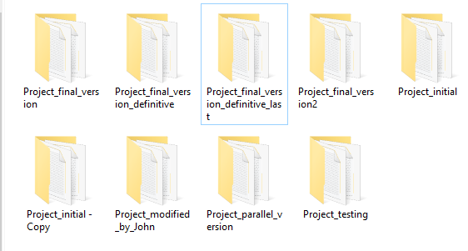
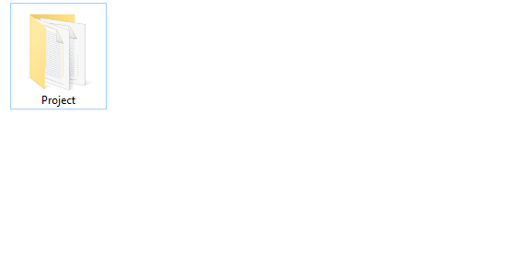
What is Version Control?
It’s what lets you move from this…
… to this.
While having access to this:
Initial version
Improved algorithm
Added Tests
Fixed bug
Final version
Changes by John

Slide 3


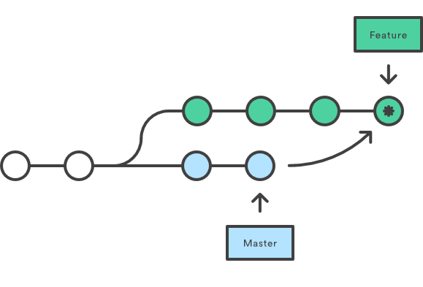
What is Git?
Created in 2005 by Linus Torvalds to help coordinating the development of Linux kernel
A distributed version control system:
Made for multiple people working on the same project
Each person has the full history of the project
They can work offline
Synchronize only when needed
It can also be useful for personal projects
Note: many other version control systems exist, but git is probably the most widely used and “easiest” to adopt

Slide 4
How does it work?
The history is composed by a sequence of “snapshots”
Initial version
Improved algorithm
Added Tests
A user can decide when to create a new snapshot
Initial version
Improved algorithm
Added Tests
Fixed bug
Each snapshot doesn’t contain all the data, but only the differences from the previous one
Fixed bug
Initial version
Improved algorithm
Added Tests
Changed “x+1” to “x-1” in main_loop.c, line 234
Deleted line 235 in main_loop.c
Note: this makes it good for text files (source code), but not so much for encoded data (images, compressed folders…)

Slide 5
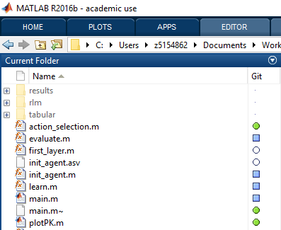
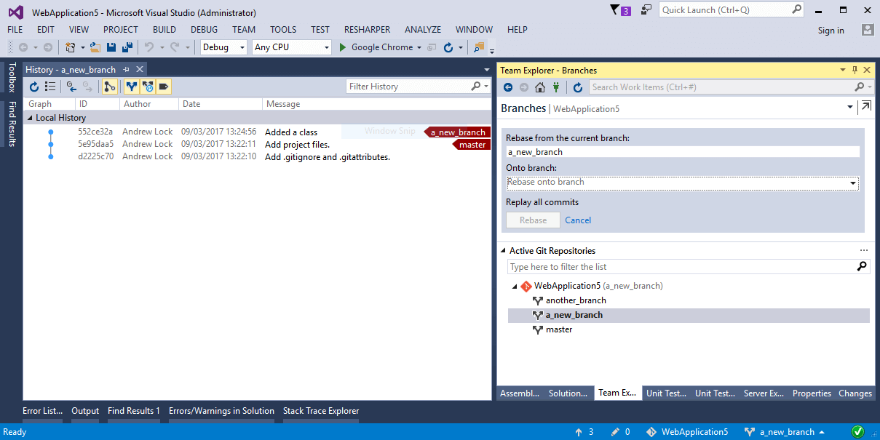
Let’s start the practice!
I’m going to show you some examples of how to work with git
If you want you can follow the examples with your pc, if you don’t have it yet just download git from git-scm.com
I will be using mostly command line instructions in this tutorial, but many different guis exist for git, and most IDEs have built-in git integration

Slide 6
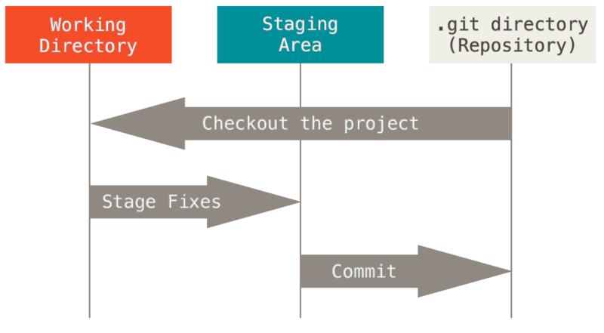
Part 1: git on my pc
We will learn to:
Create a repository
Add some files
Commit changes
Check the state
Check the history
Travel in time
Undo a commit

Slide 7
Step 1: create a repository
A repository is the data structure describing the history of a git project
To start, we can create an empty repository with:
git init
Or we can “clone” a repository available online (more on this later) with:
git clone https://addressoftherepository
Create a new folder and run the “git init” command. This will create a new .git/ hidden subfolder: here git stores all of its history data.
Note: the git project folder can simply be copied to another pc, and git will work from there without a problem!

Slide 8
Step 2: add some files
By default git won’t keep track of any file until we tell it to do so
The command to add a file to the “staging area” is:
git add FILENAME
We can add all files in the current folder with:
git add .
Create a new text file and add it to the staged files. Note: you are adding the current version of the file, if you modify it you will have to add it again.

Slide 9
Step 3: commit
A commit is the action that creates a snapshot of your staged files
Each commit should have a message describing the changes it contains, for future reference
git commit –m “Write here your commit message”
This is probably the most important step to have a tidy and useful history: you should do a commit whenever you have a working set of changes with a single purpose (e.g. added a new functionality, fixed a bug), and always document it with a proper message!
Try to commit your changes, then modify your file or create a new one, add it to the staged files and do another commit. We will see how to check your work in the next step
Note: “commit” can be used as a verb, git has a lot of slang… Now commit your changes, push them to my repo and request a pull!

Slide 10
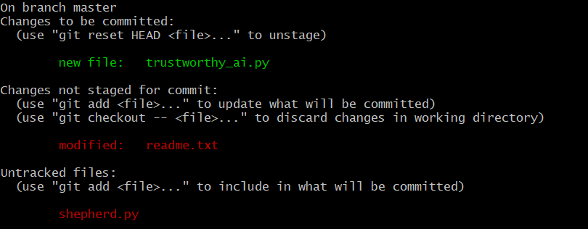
Step 4: check the state
Ok, I did some changes, now let’s add them to git… they were in this file… that file… and… was there something else? Have I already added this one? I need a way to check what’s happening!
git status
This file is new and has been staged
Here are some helpful hints
This file has been modified and needs to be staged
This file is new and needs to be staged
Try to do some changes, adds and commits, and check the status after each command to see what happens

Slide 11
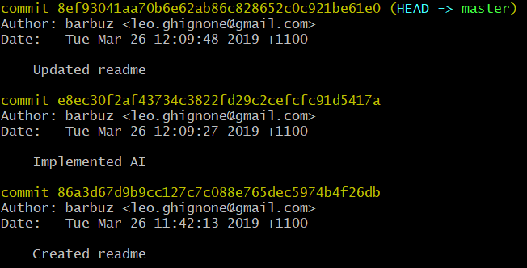
Step 5: check the history
Of course, it is also possible to see the history of all previous commits:
git log
This is the hash of the commit, we’ll need it in the next step
If your history is long you could prefer a more compact list:
git log --pretty=oneline

Slide 12
Extra: travel in time
The history is not just for show, we can jump to any step in the history, and our files will revert to how they were in that moment
git checkout COMMIT_HASH
Checkout to a previous version of your files and check your files and git’s log
The log will show only commits preceding the one that was checked out. If you want to see all of them you can use:
git log --all
Then you can jump back to the last version by checking out to its hash or:
git checkout master
Pro tip: as long as they are unique, the first few characters of the hash (at least 4) can be used instead of the full hash

Slide 13
Step 6: undo a commit
With checkout we can just see previous versions, but what if we decide that our last commit was actually garbage and we want to get rid of it?
git reset --hard COMMIT_HASH
This command will reset everything to the state it was at the moment of the given commit
BE CAREFUL! When you do a hard reset, anyything you delete is gone forever!
Try undoing your last commit (by resetting to the second-last one), then do a different change and commit it (you haven’t forgotten how to do that, have you?)

Slide 14
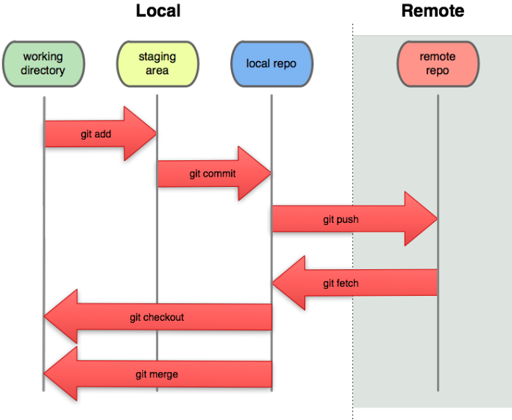
Part 2: git for shared projects
We will learn to:
Host a repository online
Download changes
Upload changes
Solving conflicts

Slide 15


GitHub
In order to work with other people it’s useful to have a server where to store a synchronized copy of the repository
Each person will do their work offline and then synchronize their repository with the one online
The easiest way to store git repositories online is using GitHub

Slide 16
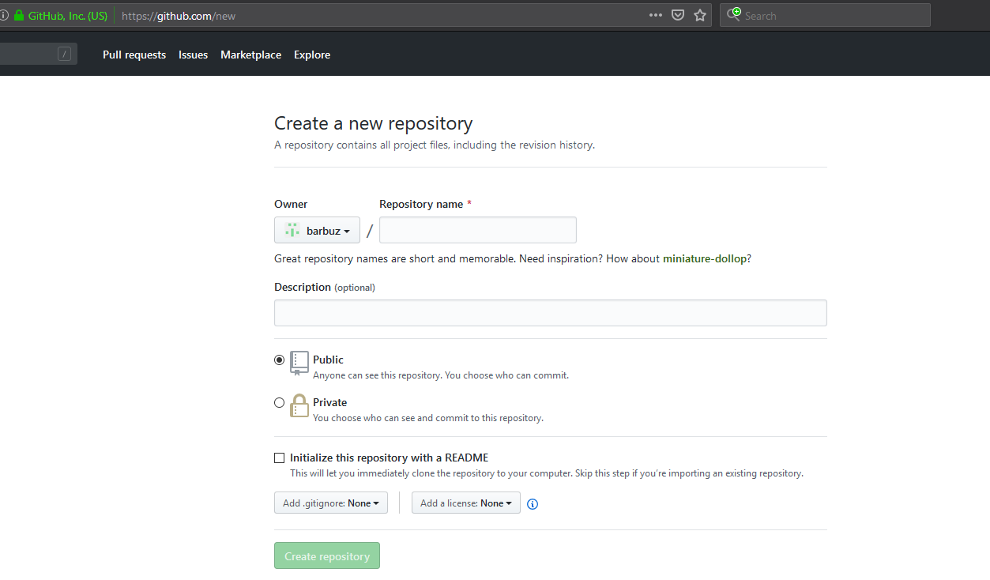
GitHub
Once you have a GitHub account, you can create a repository there:
Then, everyone* will be able to clone this repository on their own pc
I have created a repository for you, try to clone it (in a new folder) with:
git clone https://github.com/barbuz/git-tutorial.git
* A GitHub repository can also be created as “private”, allowing us to manage who can see it

Slide 17
Pulling new changes
Once you have cloned a repository, you can keep it updated with:
git pull
This will download and apply all the changes that were uploaded to the remote repository since your last pull
Pull now, then wait for me to do some changes and pull again. Don’t make changes to your files yet, we’ll see how to combine changes from multiple people in a short while.

Slide 18
Pushing your work
The opposite action to pull is, of course, push
git push
With push, all your commits up to the most recent one get uploaded to the remote repository, so any other collaborator can pull those changes
You need permission from the owner of a repository before being able to push into it; for this tutorial you won’t be able to actually push your changes, so we won’t have to fix conflicts created by 10 people pushing at the same time
And now, let’s get to the fun part! *
* The fun part is, more precisely, the hard part. But it’s also the most useful!

Slide 19
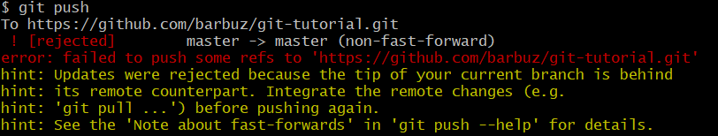
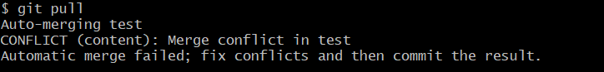
Conflicts
When someone else is working on the same project as you, you may happen to change a file that was already being changed by someone else. Then this would happen:
Ok, this means my local repository is not up-to-date with the remote one. Let’s pull before pushing:
A conflict arose! We need to solve it

Slide 20
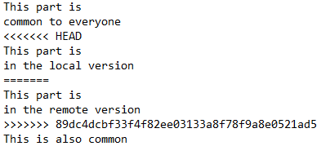
Conflicts
If you open the conflicting file, you will see something like this:
The section between “<<<<<<< HEAD” and “>>>>>>> hash” is the conflict: to solve it it is enough to replace it with the desired version (taking into consideration both people’s changes)
But… is there no easier way to do it?

Slide 21
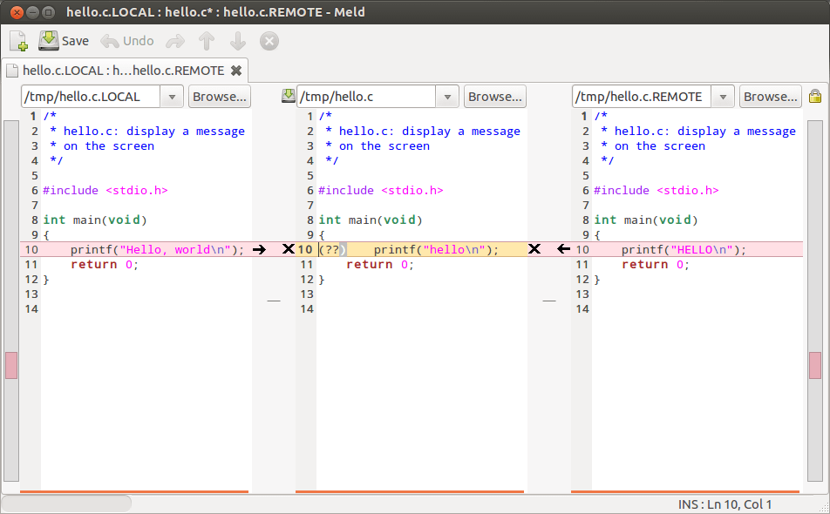
Mergetool
Of course there is!
A useful git command for these situations is:
git mergetool
This will open a specialized conflict-solving program, where you will be able to see both changes and the original version side-by-side, and choose how to combine the changes
Unfortunately, the default program used by git is often something even scarier than doing it by hand (like vimdiff)
My advice is to download Meld, for a nice graphical interface to solve conflicts
You can get it from meldmerge.org

Slide 22
Resolving the conflict
After fixing the conflict either by hand or by using some tools, you just have to commit the resulting file (preferably with a message mentioning the conflict), and then you can push safely!
Last exercise: Do some changes in your local files and commit them. I will do the same on the remote copy. Then try to pull and solve any conflict that arises.
Congratulations! You are now a git expert!

Slide 23
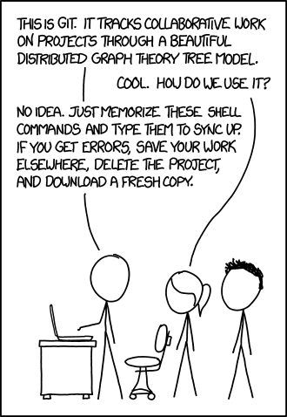
(this is a git expert)
From xkcd.com. But you already knew it.

Slide 24
Extra
Configure name and email address
git config --global user.name “Your Name”
git config --global user.email “your_email@address.bah”
Remove extra files generated by mergetool
git clean

