Slide 1

SAN FRANCISCO INTERNATIONAL AIRPORT
Airline Passenger
✈
Demand Analysis
& Forecasting
Barbara Mangiri
Mentor: Mr. Uzoma Ewurum
24 Yrs
1999–2023
Monthly
5 Models
Data Span
Period
Granularity
Forecasting
SFO · 1999 – 2023 · Monthly Traffic · Forecasting Models

Slide 2



SLIDE 02 | PROJECT OVERVIEW
Project Overview
What this analysis covers and how it is structured?
01
02
03
Background
Exploratory Data Analysis
Key Performance Indicators
San Francisco International Airport (SFO) monthly passenger data spanning
July 1999 – September 2023.
24 years of records sourced from Data.gov
consisting various airline traffic types.
Data source: https://catalog.data.gov/dataset/air-traffic-passenger-statistics
Exploratory analysis and data preparation for this project involved:
Understanding the structure of the dataset
Identifying multiple airline records per month
Aggregation of passenger counts across airlines to obtain total monthly demand
Confirming data quality (no missing / duplicates)
Identification of trends and seasonality
Core metrics derived from the dataset to understand passenger demand patterns and support operational planning:
Average Monthly Passenger Demand
Peak Travel Months
Year on Year Growth Rate
Forecasted Passenger Demand
Seasonal Demand Trend
Airline Passenger Demand Analysis & Forecast | Barbara Mangiri
02 / 12

Slide 3


SLIDE 03 | INTRODUCTION
Introduction & Dataset
Setting the context for the airline passenger demand analysis
About the Dataset
Business Context
Airports and airlines require accurate demand insight to plan terminal capacity, staffing levels, gate allocation, and supply chain logistics efficiently.
Records:
Monthly Passenger Counts
Period:
July 1999 – September 2023
Purpose of Analysis
Source:
Data.gov (Open Government Data)
Identify seasonal demand patterns, analyze passenger growth trends, and generate reliable forecasts to support data-driven airport planning.
Key Variables:
Total Passengers per Month
Granularity:
Monthly
Why Forecasting?
A validated demand forecast enables proactive workforce scheduling, smarter procurement cycles, and evidence-based infrastructure planning.
Data Quality:
Clean — no duplicates or missing values within the observed period
Airline Passenger Demand Analysis & Forecast | Barbara Mangiri
03 / 12

Slide 4

SLIDE 04 | PROBLEM STATEMENT & OBJECTIVES
Problem Statement & Objectives
Problem Statement
01
Analyse Demand Patterns
Identify seasonal trends, peak periods, and monthly variations in passenger traffic
Airlines and airport operators require clear visibility into passenger demand patterns to support efficient planning and resource allocation. Without this, they face:
Difficulty identifying peak and low-demand travel periods
Inefficient staffing and scheduling decisions
Limited insight into seasonal passenger trends
Poor alignment between demand patterns and operational planning
Lack of data-driven support for strategic decision-making
02
Assess Demand Trends Over Time
Examine year-on-year growth patterns and major fluctuations in passenger volume
03
Apply Forecasting Techniques
Evaluate forecasting methods and identify the most suitable model for short-term prediction
04
Support Operational Decision-Making
Provide data-driven insights for staffing, scheduling, and resource planning
Airline Passenger Demand Analysis & Forecast | Barbara Mangiri
04 / 12

Slide 5
SLIDE 05 | EXPLORATORY DATA ANALYSIS
Exploratory Data Analysis (EDA)
Structure, quality, and key statistics of the dataset
24
291
0
0
12
Years of Data
Monthly Records
Missing Values
Duplicates
Months / Year
Key Data Fields
▸ Activity Period Start Date
▸ Passenger Count
Airline Passenger Demand Analysis & Forecast | Barbara Mangiri
05 / 12

Slide 6
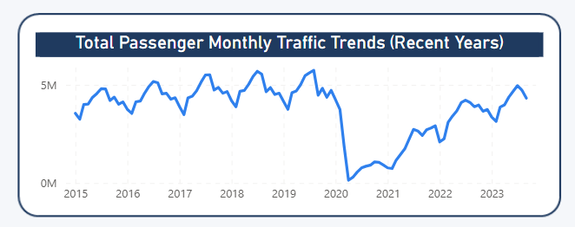
SLIDE 06 | DEMAND PATTERNS
Seasonal Demand Patterns
Monthly passenger traffic reveals strong and consistent seasonality across 24 years
Peak Months
Passenger demand follows a clear seasonal pattern
Demand rises steadily from May to August
August and July represent peak travel months
August ≈ 3.92M passengers (Monthly Avg.)
July ≈ 3.91M passengers (Monthly Avg.)
Trough Months
February and November show the lowest demand.
Airline Passenger Demand Analysis & Forecast | Barbara Mangiri
06 / 12

Slide 7
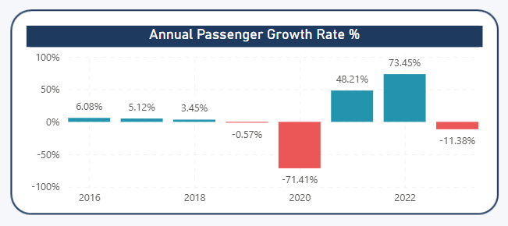
SLIDE 07 | GROWTH ANALYSIS
Year-on-Year Growth Analysis
Demand trajectory from 1999 to 2023 including the COVID-19 shock and recovery
+6.08%
+5.12%
+3.45%
–71.41%
Recovery
2016 Growth
2017 Growth
2018 Growth
2020 COVID Shock
2021–2022
Continued recovery observed in 2022, followed by a slight decline in 2023
Note: 2023 growth is based on partial-year data
(Jan–Sep) and may not fully reflect annual performance.
Airline Passenger Demand Analysis & Forecast | Barbara Mangiri
07 / 12

Slide 8
SLIDE 08 | MODEL COMPARISON
Model Comparison & Results
5 models evaluated — Naïve Approach achieves the highest short-term accuracy
Model | Accuracy | MAE | Interpretation
Naïve Approach | 87.0% | 274,701 | ✔ Lowest MAE — best for short-term forecasting
Exponential Smoothing | 85% | 287,493 | Low MAE — smooths noise but slightly less responsive than Naïve
3-Month Moving Average | 77.93% | 392,656 | Good for smoothing noise
6-Month Moving Average | 70.70% | 491,545 | Lags behind trend shifts
Simple Linear Regression | 60.0% | 601,276 | Affected by sharp demand changes (e.g. 2020)
Linear Forecast | 59.0% | 673,970 | Assumes steady trend — less accurate when demand changes abruptly
Airline Passenger Demand Analysis & Forecast | Barbara Mangiri
09 / 12

Slide 9

SLIDE 09 | FORECAST RESULT
Forecast Result — Naïve Approach
Short-term passenger demand forecast based on the highest-accuracy model
Short-Term Demand Insight
Passenger demand is expected to remain relatively stable in the immediate next period.
FORECAST
4,325,689
Model Context
The Naïve Approach produced the lowest Mean Absolute Error (MAE), making it the most reliable model for short-term forecasting.
Passengers (Next Period)
Practical Interpretation
Model: Naïve Approach · Accuracy: 87%
The forecast reflects recent demand levels and is best used for short-term operational planning.
Airline Passenger Demand Analysis & Forecast | Barbara Mangiri
10 / 12

Slide 10
SLIDE 10 | RECOMMENDATIONS
Strategic Recommendations
Data-driven actions for operational planning and decision-making
1. Staffing & Capacity Planning
3. Short-Term Forecasting Use
Increase staffing and operational capacity during peak months (May – August)
Use the Naïve model for rolling monthly forecasts to support operational decisions
2. Seasonal Planning
4. Continuous Monitoring
Align scheduling and resource allocation with observed seasonal demand patterns
Regularly compare actual vs forecasted demand to improve accuracy over time
Airline Passenger Demand Analysis & Forecast | Barbara Mangiri
11 / 12

Slide 11
CONCLUSIONS & SUMMARY
Key Takeaways
01
Strong Seasonality — Passenger demand shows clear and consistent seasonal patterns, with peak travel during mid-year (July–August) and lower demand in February and November.
02
Demand Disruptions Exist — Passenger trends are generally stable but can experience sharp disruptions (e.g. 2020), which impact forecasting accuracy
Barbara Mangiri
Airline Passenger Demand
Analysis & Forecast
03
Naïve Model Performs Best (Short-Term) — The Naïve Approach (87% accuracy) outperforms all other models tested for short-term forecasting
Forecast Indicates Stable Demand — A forecast of 4,325,689 passengers for the next period supports stable near-term demand.
July 1999 – September 2023
24 Years · Naïve Approach· 87% Accuracy
04
05
Data-driven planning — Using demand patterns and short-term forecasts can support better staffing, scheduling, and operational planning.
Thank You
Airline Passenger Demand Analysis & Forecast | Barbara Mangiri
12 / 12

