Slide 1
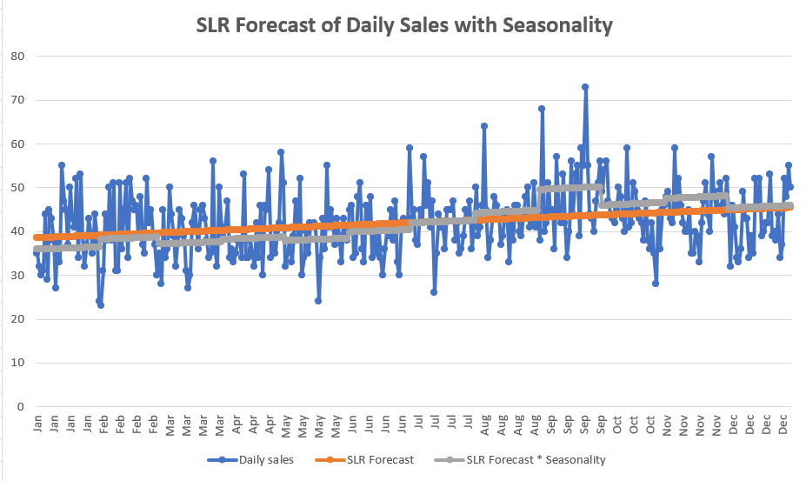
📌 NovaTech Store Sales Forecasting Analysis
👩🏽By: Barbara Mangiri
Here’s how I confirmed the best forecasting technique for the sales at NovaTech Store
👉 Swipe through to explore more visuals comparing forecasting techniques used for the NovaTech Store

Slide 2
Business Problem: NovaTech Store needs accurate Forecasts to manage demand
The Goal?
Find out which technique provides the most accurate prediction:
🔹 Naïve Approach
🔹 Moving Averages
🔹 Exponential Smoothing
🔹 SLR
🔹 Linear Forecast

Slide 3
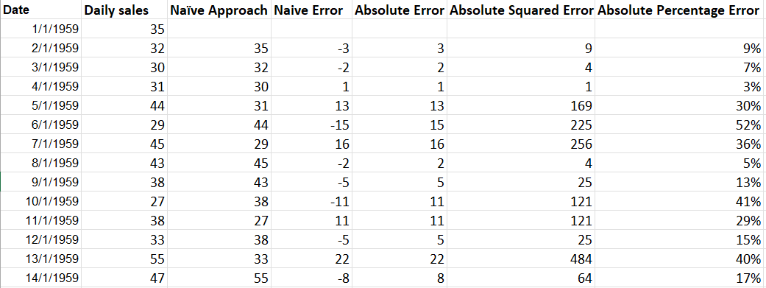
365 days of historical sales data Daily Lenovo product sales
Variables used:
🔹 Independent variable: Date
🔹 Dependent variable: Daily Sales

Slide 4
Forecasting Methods Tested
Forecasting methods used for comparisons:
🔹 Naïve Forecast
🔹 3-day Moving Average
🔹 7-day Moving Average
🔹 Exponential Smoothing (damping = 0.8)
🔹 Simple Linear Regression (SLR)
🔹 Linear Forecast
🔹 SLR + Seasonality

Slide 5
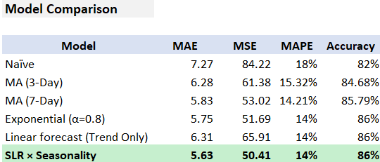
Forecast Comparisons
Which forecast method is best for this business?
🔹 The sales show minimal long-term trend but clear seasonal patterns.
🔹 Models that incorporate seasonality produce the most accurate forecasts.
🔹SLR × Seasonality wins here because it has the lower Mean Squared Error (MSE) value.

Slide 6
Recommendation
Recommended model: SLR × Seasonality
🔹 Lowest forecasting error
🔹 Captures seasonal behavior
🔹 More reliable for daily sales forecasting

Slide 7
Project Repository
Access project on GitHub:
https://github.com/barbzyqueen/novatech_sales_forecasting_project.git
Files/details included:
🔹 Excel forecasting workbook
🔹 PowerPoint presentation
🔹 Project documentation
Thank you for reading and following along!

