Slide 1
OASYS-Shadow4-Hybrid
Xianbo Shi

Slide 2
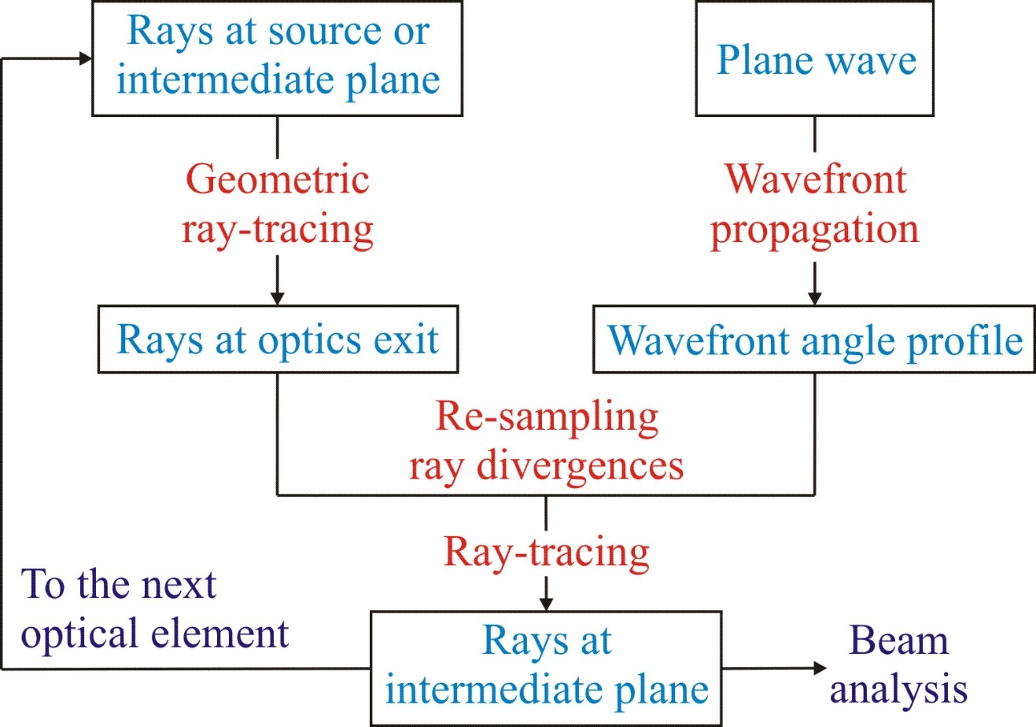
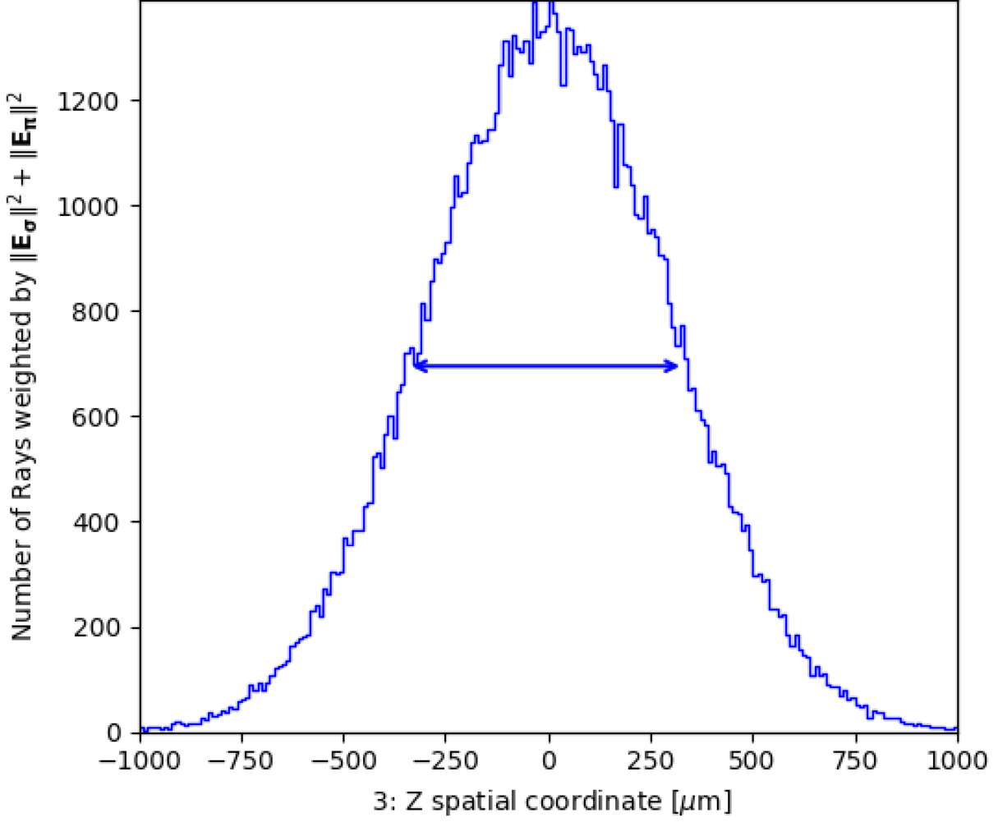
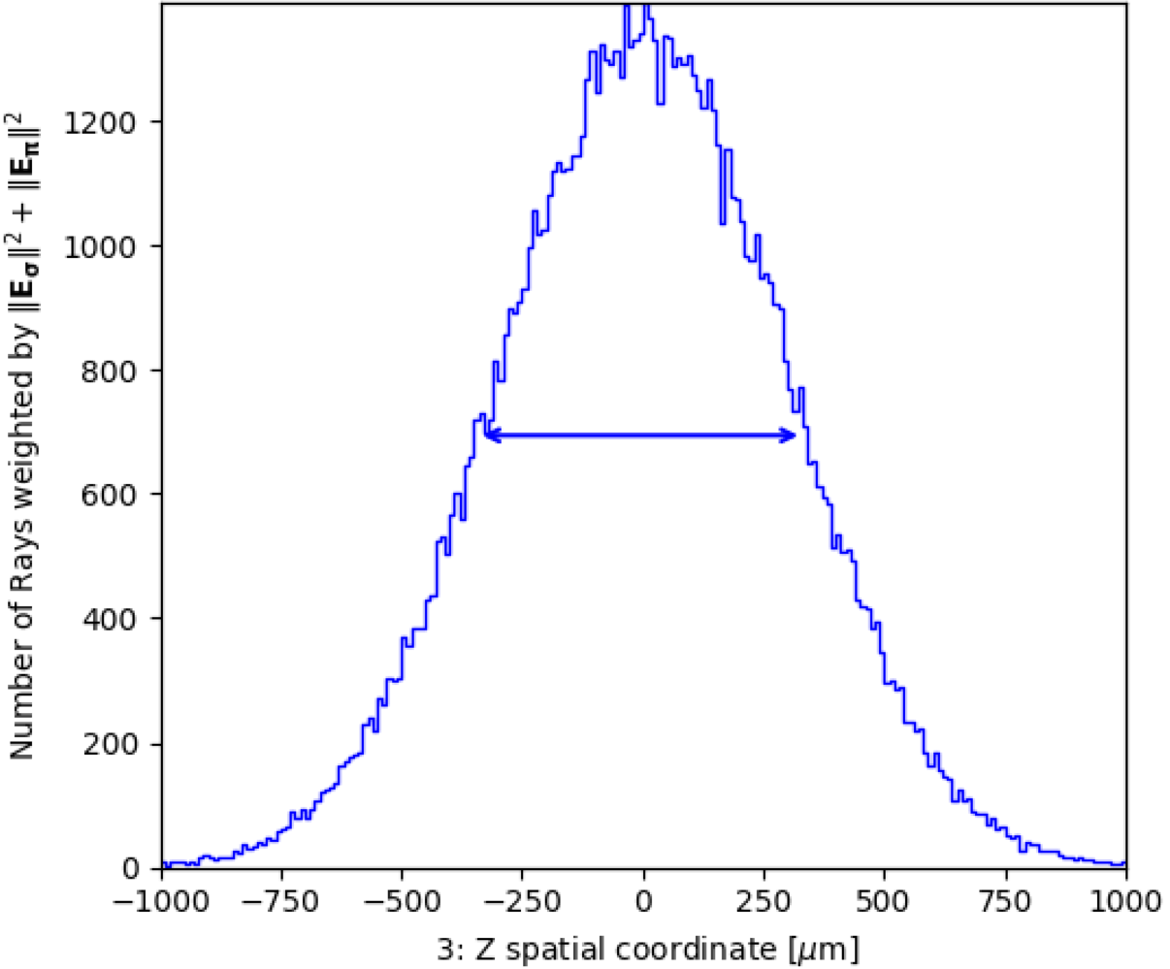
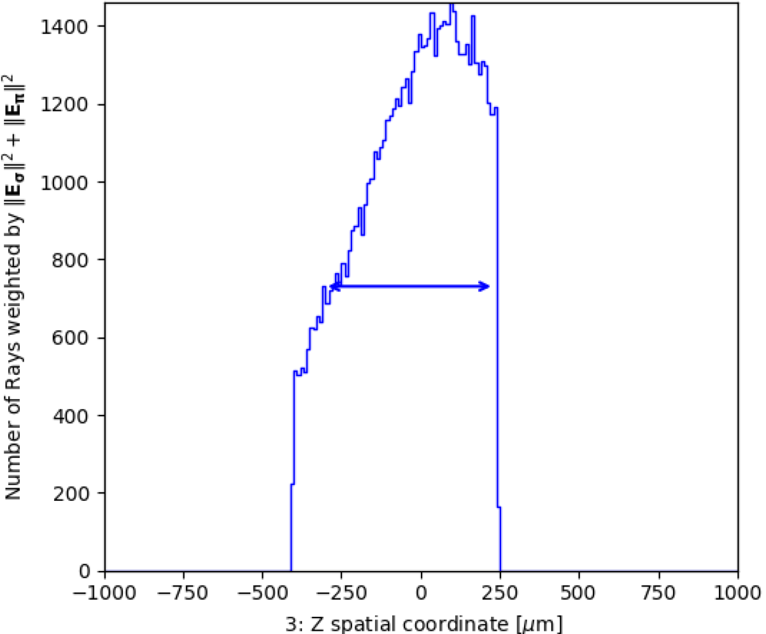
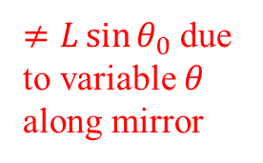
Hybrid method: combining ray-tracing and wavefront propagation
Ideal lens
Far-field, propagable
Entrance plane
Exit plane
Focusing mirror
$≠L\sin{θ_{0}}$ due to variable $θ$ along mirror
X. Shi, et al., J. Synchrotron Rad. 21, 669 (2014).

Slide 3
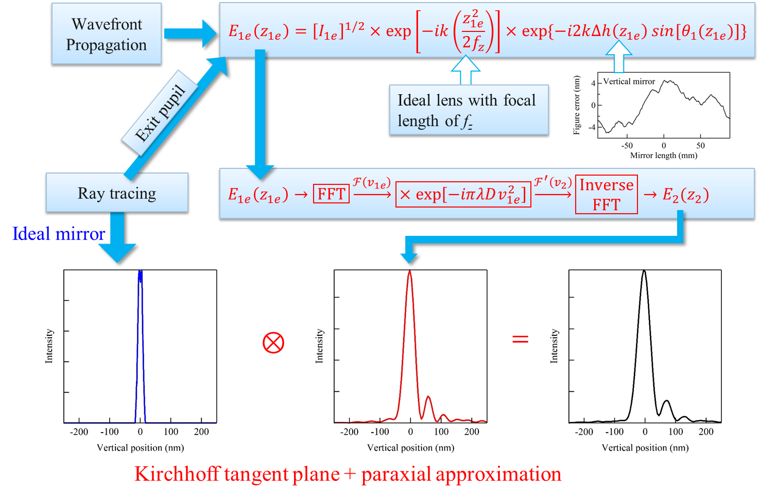
Hybrid method: combining ray-tracing and wavefront propagation
Near-field,
end-of-line
designed focal length
focus at observation plane at D
Propagate to D

Slide 4
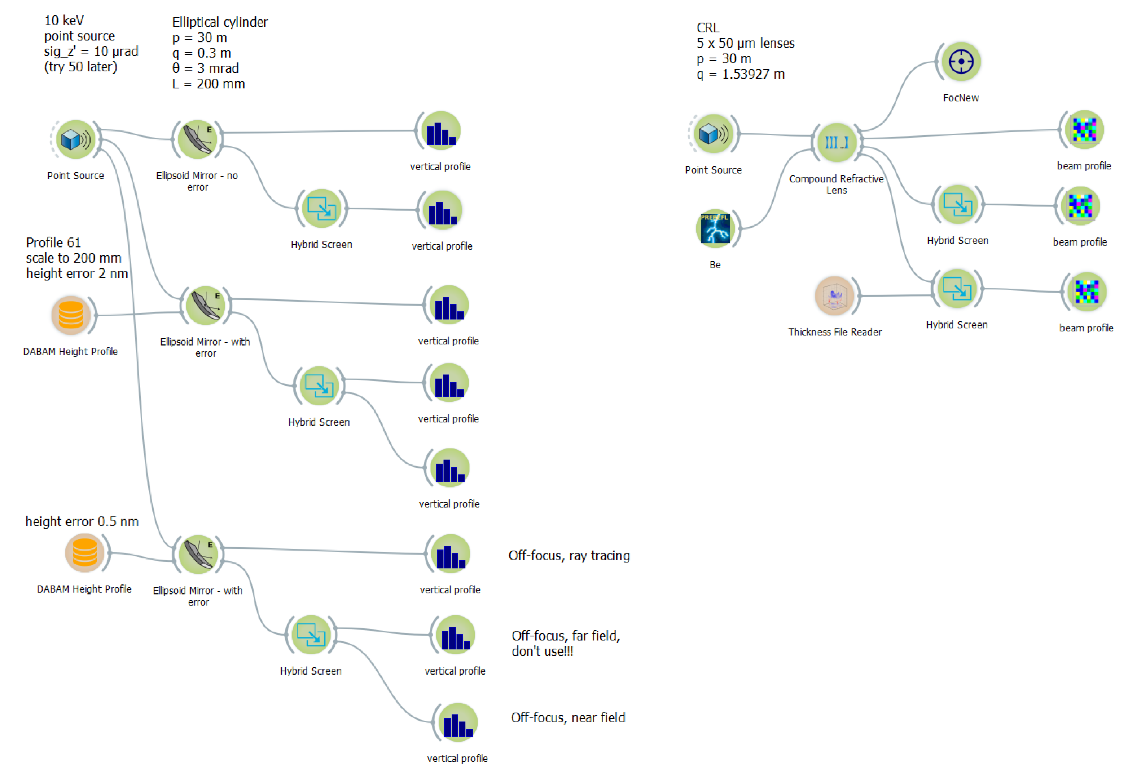
Example 1 (Mirror)
Example 2 (CRL)

