Slide 1

Phase Shifters and Polarizers
Manuel Sanchez del Rio
srio@esrf.eu
Advanced Analysis & Precision Unit, MEG/ISDD, ESRF

Slide 2
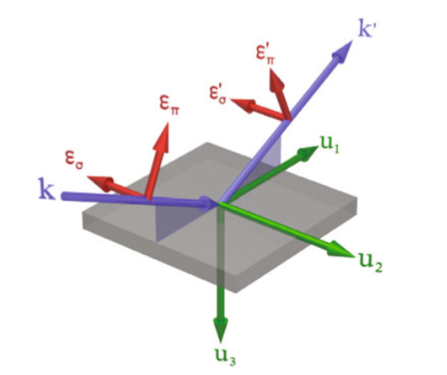


Polarized Light http://dx.doi.org/10.1140/epjst/e2012-01630-3

Slide 3
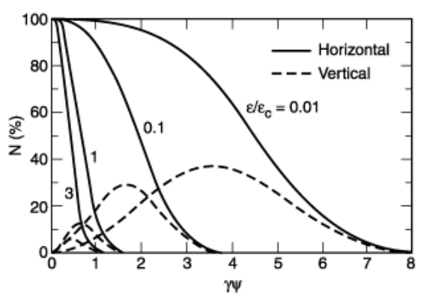
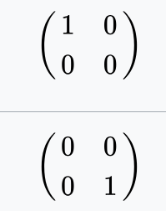

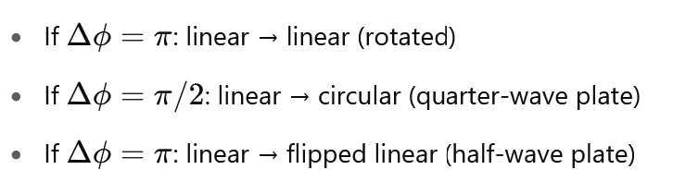
SR Polarized light
Creation:
SR (from BM, or vertical B) is “naturally” polarized
undulators with non-flat trajectory (elliptical, helical, cross, delta, apple…)
Manipulation:
Polarizers: Kill one component (convert light into linear polarized)
Phase-shifters: change the phases in a different way (change circular – linear state)

Slide 4
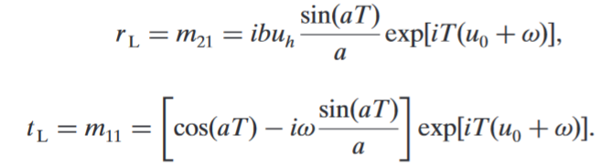
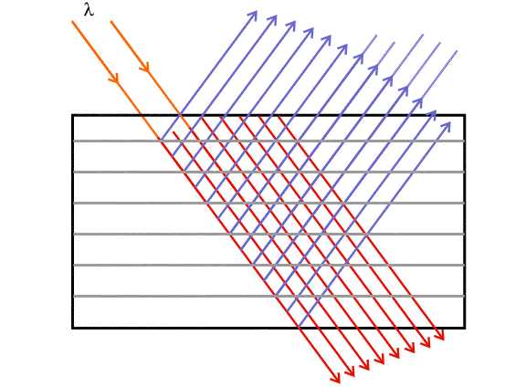
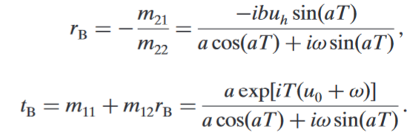

For perfect crystals: https://doi.org/10.1107/S160057752400924X
Amplitudes Intensities

Slide 5
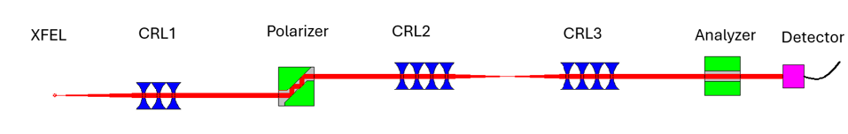
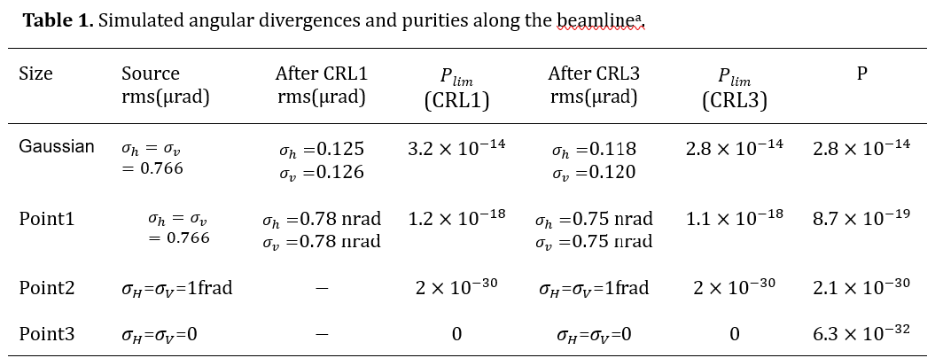
Xiaojiang Yu et al. (Proc. SRI2024, in press)
The vacuum can be polarized by the intense laser X-ray collision, transforming it into a quantum electrodynamics (QED) medium or birefringent material. In this scenario, the vacuum exhibits two distinct refractive indices, determined by the polarization directions of the incoming XFEL photons.

Slide 6
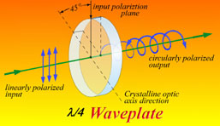
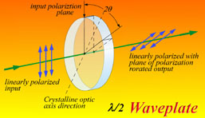
Crystal phase retarders
R
R
BRAGG
T
LAUE
T
Perfect crystals are birefringent elements: R_{σ} ≠ R_{π}
They introduce a phase change Φ that alter the polarization of the beam

Slide 7
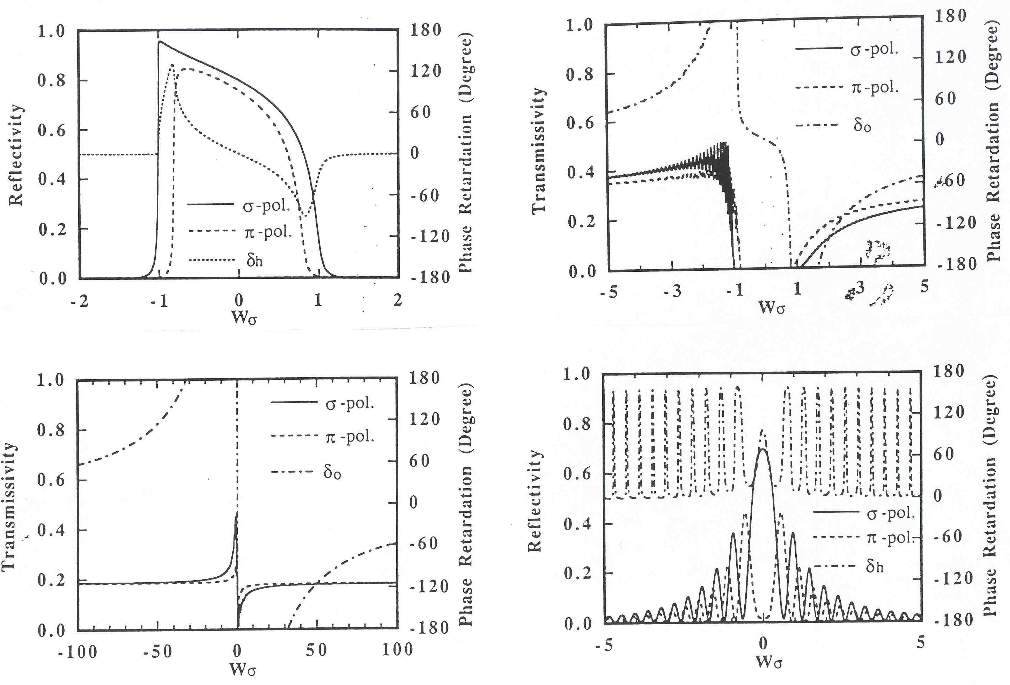
Change of phase
Hirano et al., NIM A336 (1993) 343
4XGe220
50μm Si220
BRAGG
LAUE
22 μm C* 220
22 μm C* 220

Slide 8
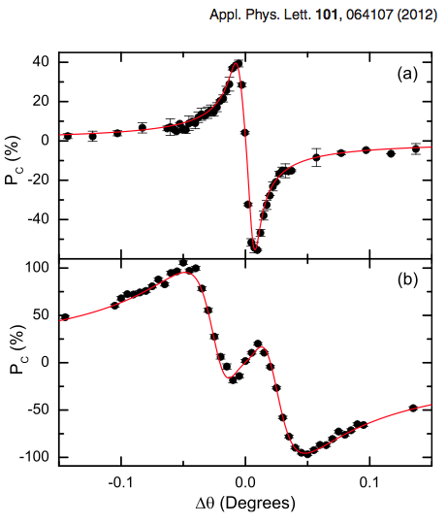
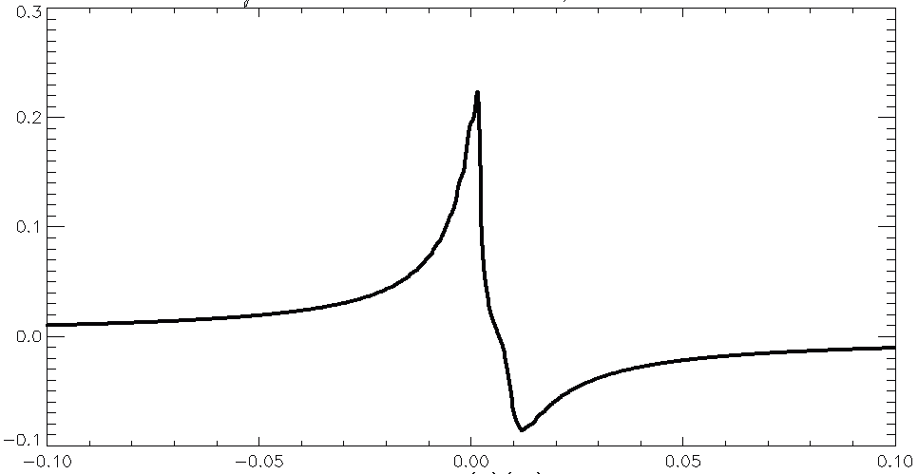
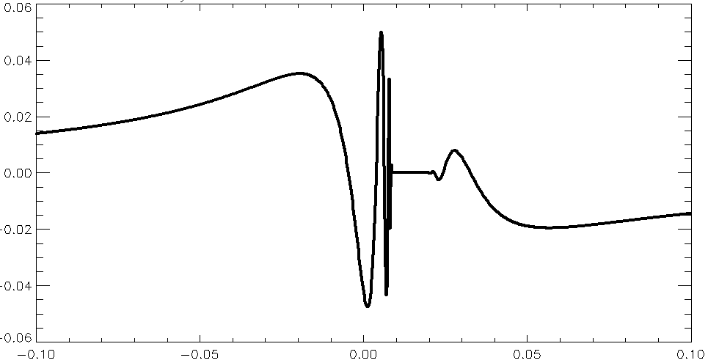
Circular polarization
Bouchenoire, Morris, Hase
Pc = r_{s} r_{p} sin (φ_{p} - φ_{s})
XOP
Si111 5μm
C*111 128μm
E=3.174 keV

Slide 9
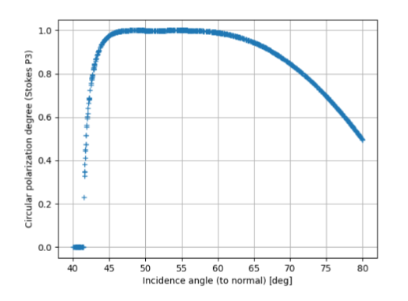
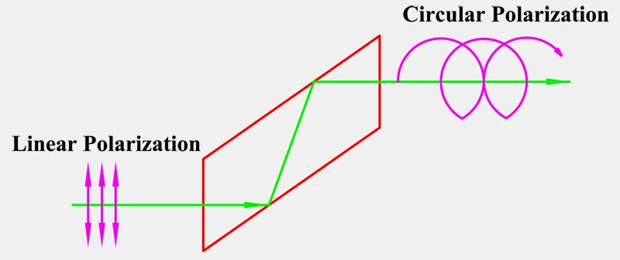
Project 1 X-ray Transmission Crystals and crystal Phase Shifters in SHADOW4
With visible light: Fresnel Rhomb

Slide 10
Project 2
Crystal phase plates (transmission) in crystals

Slide 11
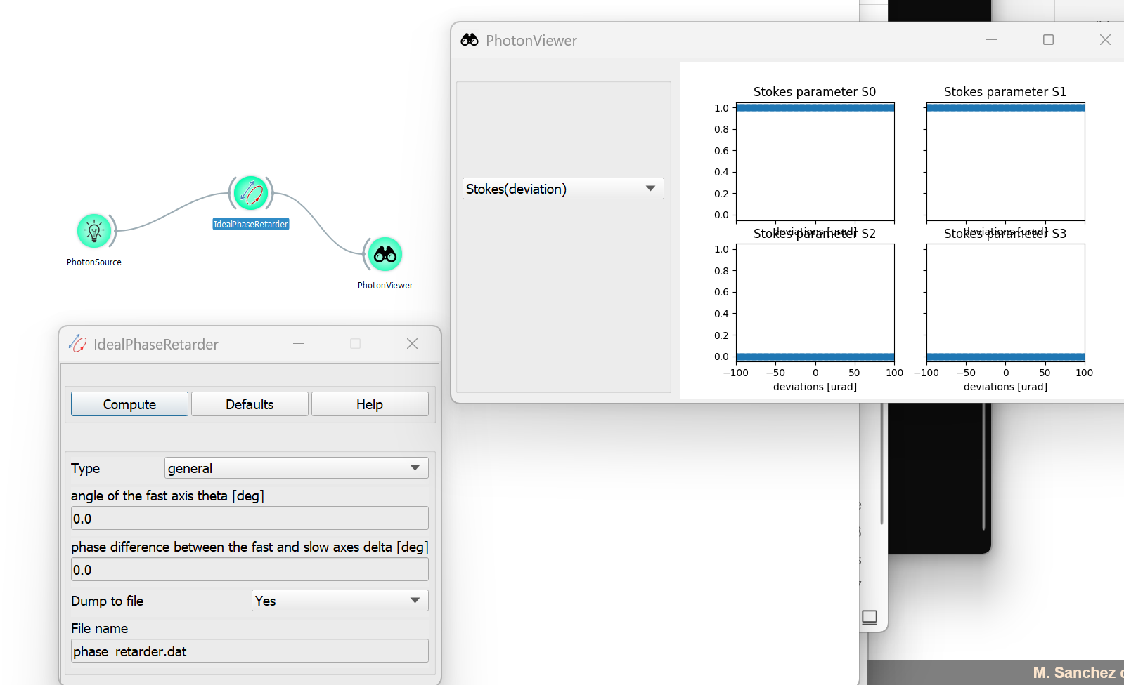
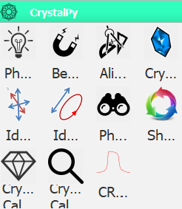
Project 3 Jones and Muller Polarization calculus

