Slide 1


SR source related calculations with SRW
Luca Rebuffi
lrebuffi@anl.gov
Optics Group, Advanced Photon Source
Rafael Celestre
rafael.celestre@gmail.com
Groupe Optique, Division Expériences, Synchrotron SOLEIL

Slide 2
SR source related calculations with SRW
Outline:
What do we want from source related calculations?
Which elements constitute the source in SRW?
How is it done?
Live demo using OASYS

Slide 3

What do we want from source related calculations?
Spectral properties:
“on axis” or “through slit” photon flux (and tuning curves for undulators);
spectral brightness;
coherent flux and fraction;
spectral & cumulated power (“total” or “through slit”)…
Spatial properties:
beam profile or angular distribution (intensity and phase);
coherent mode decomposition, cross spectral density, mutual intensity…
power density…
Spectral distribution of spatial properties and spatial distribution of spectral properties (3D data sets)…

Slide 4
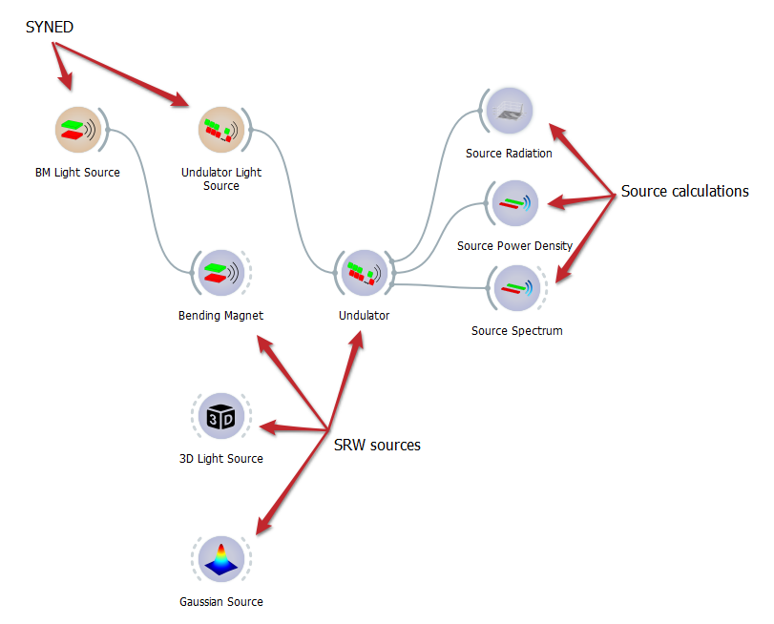
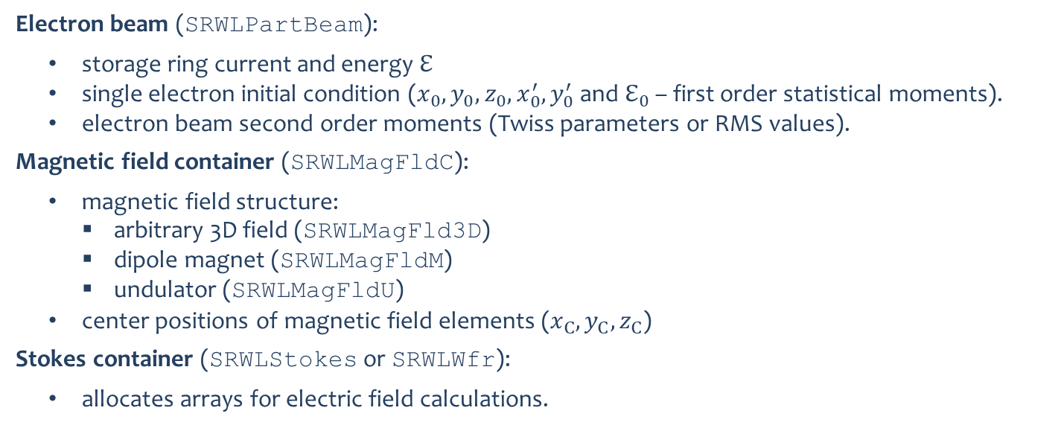
Which elements constitute the source in SRW?
Electron beam (SRWLPartBeam):
storage ring current and energy $ℇ$
single electron initial condition ($x_{0}, y_{0}, z_{0}, x_{0}^{′}, y_{0}^{′}$ and $ℇ_{0}$ – first order statistical moments).
electron beam second order moments (Twiss parameters or RMS values).
Magnetic field container (SRWLMagFldC):
magnetic field structure:
arbitrary 3D field (SRWLMagFld3D)
dipole magnet (SRWLMagFldM)
undulator (SRWLMagFldU)
center positions of magnetic field elements ($x_{C}, y_{C}, z_{C}$)
Stokes container (SRWLStokes or SRWLWfr):
allocates arrays for electric field calculations.

Slide 5
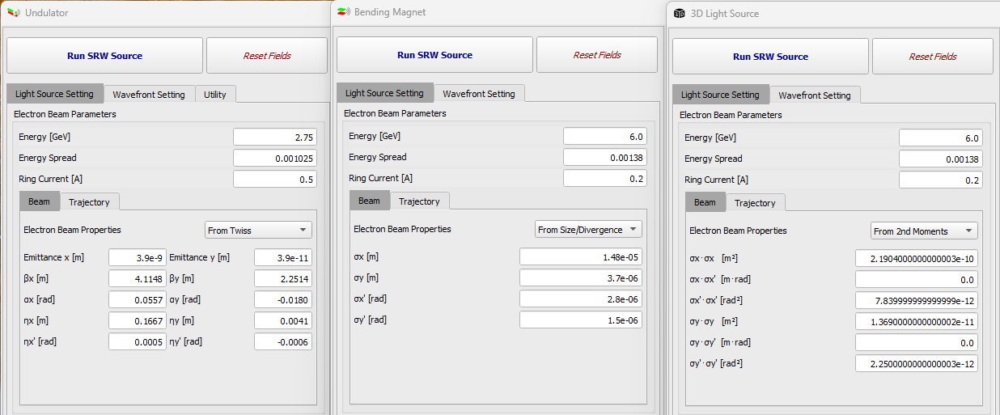
Which elements constitute the source in SRW?
Electron beam (SRWLPartBeam):

Slide 6
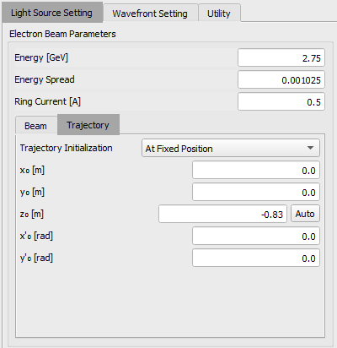
Which elements constitute the source in SRW?
Electron beam (SRWLPartBeam):

Slide 7
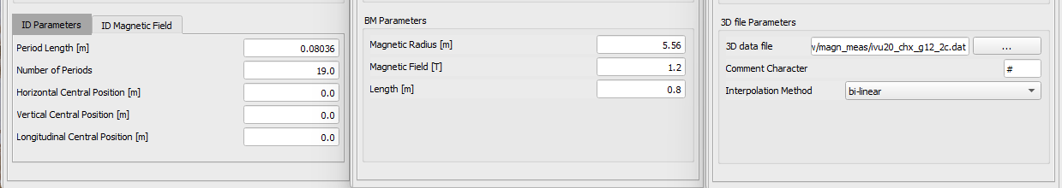
Which elements constitute the source in SRW?
Magnetic field container (SRWLMagFldC):

Slide 8
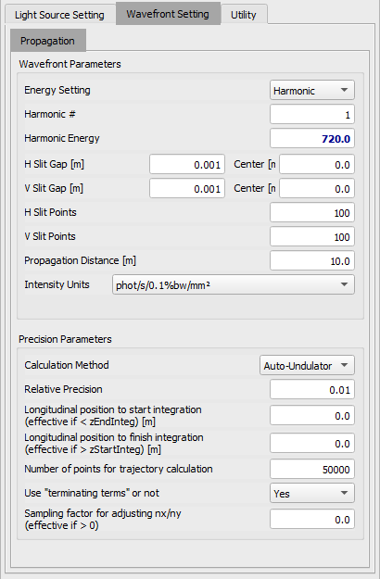
Which elements constitute the source in SRW?
Stokes container (SRWLStokes or SRWLWfr):

Slide 9
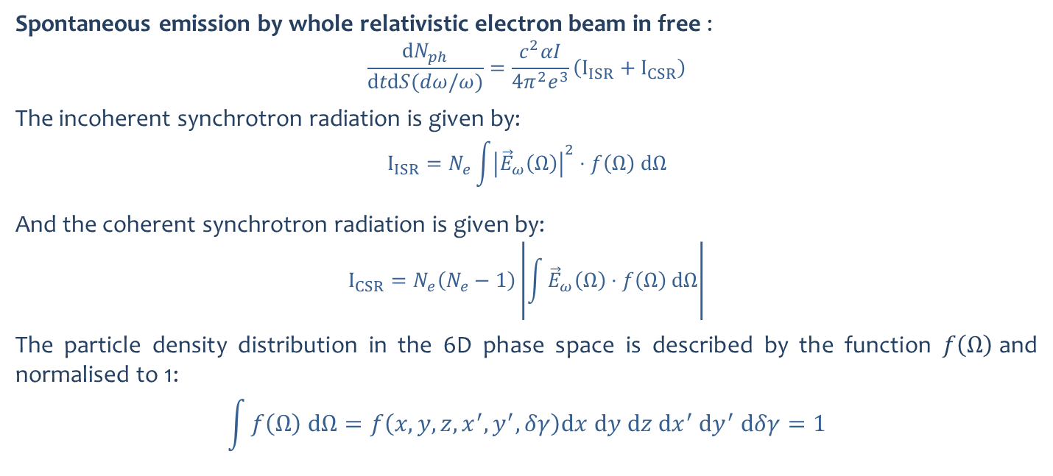
How is it done?
Spontaneous emission by whole relativistic electron beam in free :
$$\frac{dN_{ph}}{dtdS(dω/ω)}=\frac{c^{2}αI}{4π^{2}e^{3}}\left(I_{ISR}+I_{CSR}\right)$$
The incoherent synchrotron radiation is given by:
$$I_{ISR}=N_{e}\int{{\left|{\vec{E}}_{ω}\left(Ω\right)\right|}^{2}⋅f\left(Ω\right) dΩ}$$
And the coherent synchrotron radiation is given by:
$$I_{CSR}=N_{e}\left(N_{e}−1\right)\left|\int{{\vec{E}}_{ω}\left(Ω\right)⋅f\left(Ω\right) dΩ}\right|$$
The particle density distribution in the 6D phase space is described by the function $f\left(Ω\right)$and normalised to 1:
$$\int{f\left(Ω\right) dΩ}=f\left(x,y,z,x^{′},y^{′},δγ\right){dx dy dz dx}^{′} {dy}^{′} dδγ=1$$
Chubar, Review of Scientific Instruments 66(2), 1872–1874 (1995)
Chubar, Infrared Physics & Technology 49(1–2), 96–103 (2006)

Slide 10
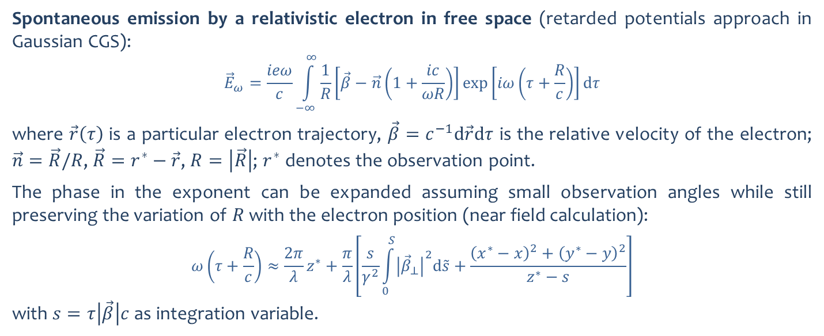
How is it done?
Spontaneous emission by a relativistic electron in free space (retarded potentials approach in Gaussian CGS):
$${\vec{E}}_{ω}=\frac{ieω}{c}\int_{−∞}^{∞}{\frac{1}{R}\left[\vec{β}−\vec{n}\left(1+\frac{ic}{ωR}\right)\right]\exp\left[iω\left(τ+\frac{R}{c}\right)\right]dτ}$$
where $\vec{r}\left(τ\right)$ is a particular electron trajectory, $\vec{β}=c^{−1}d\vec{r}dτ$ is the relative velocity of the electron; $\vec{n}=$ $\vec{R}/R$, $\vec{R}=r^{∗}−\vec{r}$, $R=\left|\vec{R}\right|$; $r^{∗}$ denotes the observation point.
The phase in the exponent can be expanded assuming small observation angles while still preserving the variation of $R$ with the electron position (near field calculation):
$$ω\left(τ+\frac{R}{c}\right)≈\frac{2π}{λ}z^{∗}+\frac{π}{λ}\left[\frac{s}{γ^{2}}\int_{0}^{S}{{\left|{\vec{β}}_{⊥}\right|}^{2}d\tilde{s}}+\frac{{\left(x^{∗}−x\right)}^{2}+{\left(y^{∗}−y\right)}^{2}}{z^{∗}−s}\right]$$
with $s=τ\left|\vec{β}\right|c$ as integration variable.
Chubar, Review of Scientific Instruments 66(2), 1872–1874 (1995)
Chubar, Infrared Physics & Technology 49(1–2), 96–103 (2006)

Slide 11
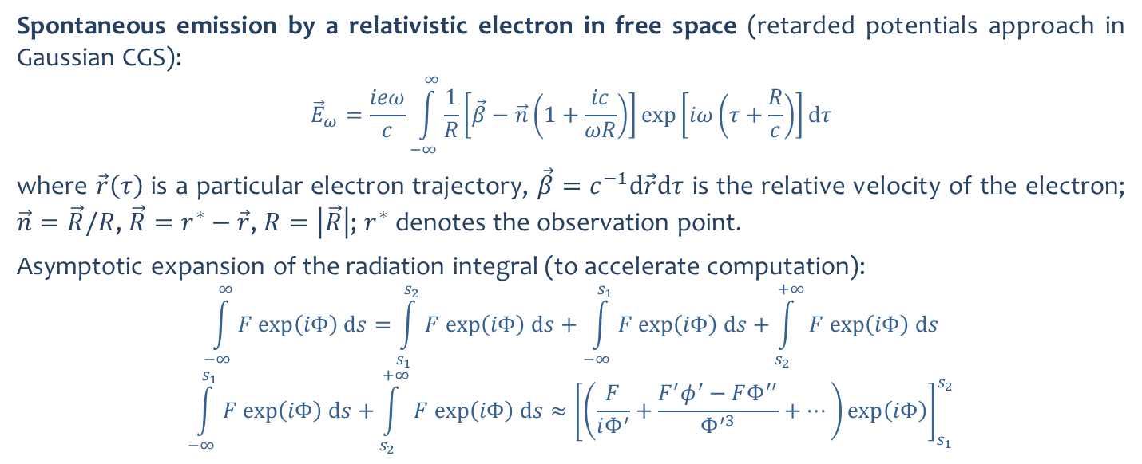
How is it done?
Spontaneous emission by a relativistic electron in free space (retarded potentials approach in Gaussian CGS):
$${\vec{E}}_{ω}=\frac{ieω}{c}\int_{−∞}^{∞}{\frac{1}{R}\left[\vec{β}−\vec{n}\left(1+\frac{ic}{ωR}\right)\right]\exp\left[iω\left(τ+\frac{R}{c}\right)\right]dτ}$$
where $\vec{r}\left(τ\right)$ is a particular electron trajectory, $\vec{β}=c^{−1}d\vec{r}dτ$ is the relative velocity of the electron; $\vec{n}=$ $\vec{R}/R$, $\vec{R}=r^{∗}−\vec{r}$, $R=\left|\vec{R}\right|$; $r^{∗}$ denotes the observation point.
Asymptotic expansion of the radiation integral (to accelerate computation):
$$\int_{−∞}^{∞}{F exp\left(iΦ\right) ds=}\int_{s_{1}}^{s_{2}}{F exp\left(iΦ\right) ds+\int_{−∞}^{s_{1}}{F exp\left(iΦ\right) ds+}\int_{s_{2}}^{+∞}{F exp\left(iΦ\right) ds}}$$
$$\int_{−∞}^{s_{1}}{F exp\left(iΦ\right) ds+}\int_{s_{2}}^{+∞}{F exp\left(iΦ\right) ds}≈{\left[\left(\frac{F}{iΦ^{′}}+\frac{F^{′}φ^{′}−FΦ^{′′}}{Φ^{′3}}+…\right)exp\left(iΦ\right)\right]}_{s_{1}}^{s_{2}}$$
Chubar, Review of Scientific Instruments 66(2), 1872–1874 (1995)
Chubar, Infrared Physics & Technology 49(1–2), 96–103 (2006)

Slide 12
Examples
Live demo using OASYS…

Slide 13
Thank you!

