Slide 1

Advances in Soft X-Ray beamlines design
-
-
Software for Optical Simulations WORKSHOP Trieste October 3-7, 2016
-
-
-
Ruben Reininger
X ray Science Division / Advanced Photon Source Argonne National Laboratory
This version has been edited and adapted by Manuel Sanchez del Rio for: Beamline Optics Design and Simulation Workshop, DESY, Hamburg 19-22 May 2025

Slide 2
Outlook
Toroidal Grating Optical Path Length Formulas
Formulas SGM
Vertical collimated PGM
Follath collimated PGM FVLS PGM
R. Follath and F. Senf, NIM A 390, 388 (1997)
https://doi.org/10.1016/S0168-9002(97)00401-4
-

Slide 3
Outlook
Toroidal Grating Optical Path Length Formulas
Formulas SGM
Vertical collimated PGM
SORRY
Follath collimated PGM FVLS PGM
R. Follath and F. Senf, NIM A 390, 388 (1997)
https://doi.org/10.1016/S0168-9002(97)00401-4
-

Slide 4
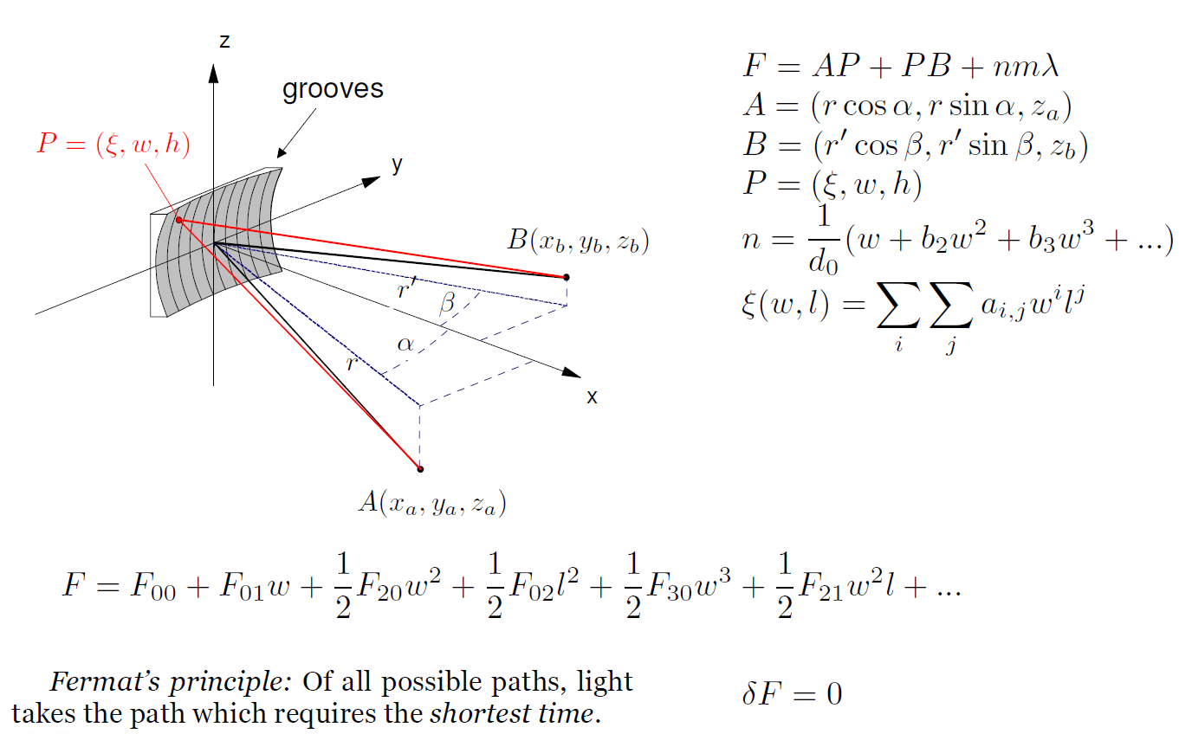
Toroidal Grating Optical Path Length
1 ₂ 1 ₂ 1 ₃ 1 ₂
F = F₀₀ + F₀₁w + ₂ F₂₀w + ₂ F₀₂l + ₂ F₃₀w + ₂ F₂₁w l + ...
Fermat’s principle: Of all possible paths, light
takes the path which requires the shortest time. ^{δF = 0}
-

Slide 5
Toroidal Grating Optical Path Length
1 ₂ 1 ₂ 1 ₃ 1 ₂
F = F₀₀ + F₀₁w + ₂ F₂₀w + ₂ F₀₂l + ₂ F₃₀w + ₂ F₂₁w l + ...
Fermat’s principle: Of all possible paths, light
takes the path which requires the shortest time. ^{δF = 0}
-

Slide 6
Toroidal Grating Optical Path Length
1 ₂ 1 ₂ 1 ₃ 1 ₂
F = F₀₀ + F₀₁w + ₂ F₂₀w + ₂ F₀₂l + ₂ F₃₀w + ₂ F₂₁w l + ...
Fermat’s principle: Of all possible paths, light
takes the path which requires the shortest time. ^{δF = 0}
-

Slide 7
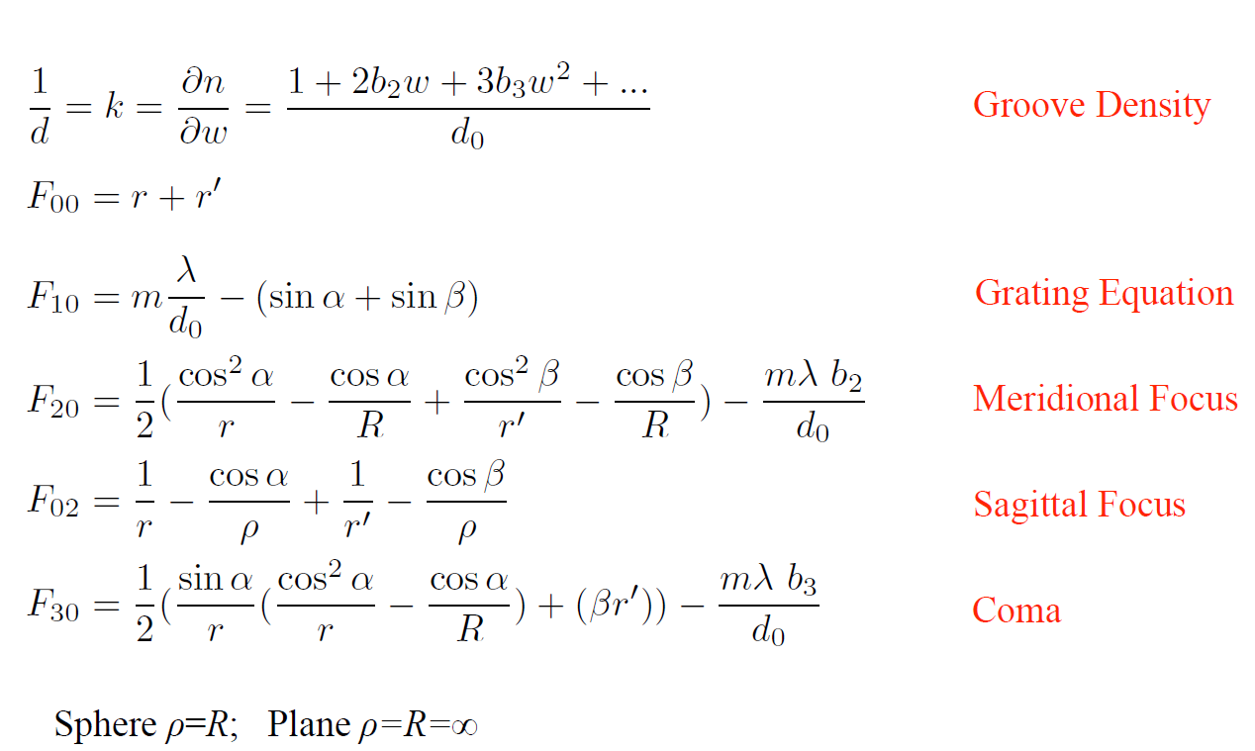
Toroidal Grating Optical Path Length
1 ₂ 1 ₂ 1 ₃ 1 ₂
F = F₀₀ + F₀₁w + ₂ F₂₀w + ₂ F₀₂l + ₂ F₃₀w + ₂ F₂₁w l + ...
Fermat’s principle: Of all possible paths, light
takes the path which requires the shortest time. ^{δF = 0}
-

Slide 8
Toroidal Grating Optical Path Length
1 ₂ 1 ₂ 1 ₃ 1 ₂
F = F₀₀ + F₀₁w + ₂ F₂₀w + ₂ F₀₂l + ₂ F₃₀w + ₂ F₂₁w l + ...
Fermat’s principle: Of all possible paths, light
takes the path which requires the shortest time. ^{δF = 0}
-

Slide 9
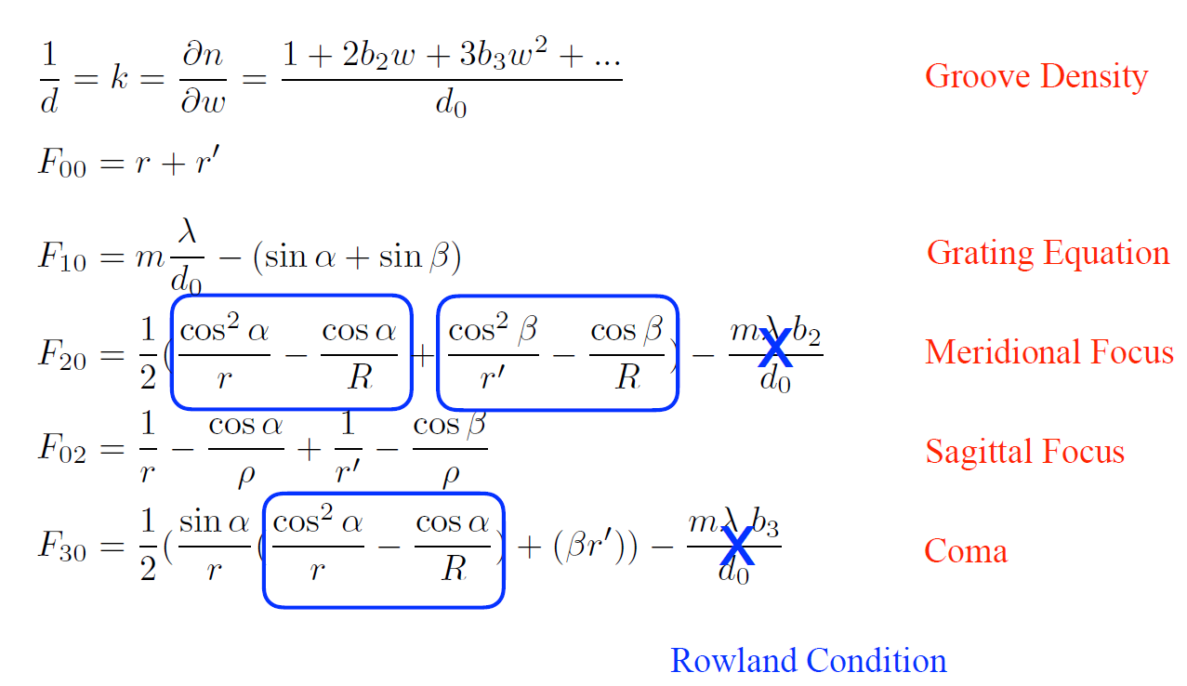
Toroidal Grating Optical Path Length
-

Slide 10
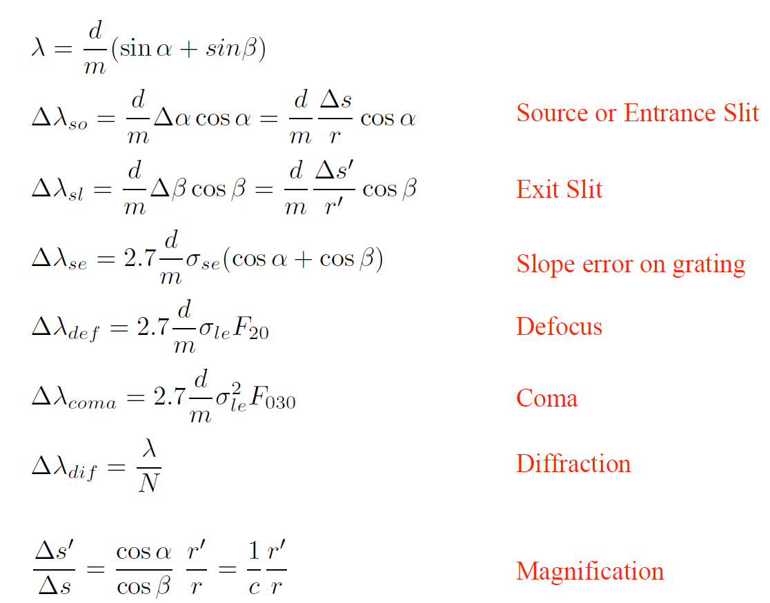
Resolution Terms and Magnification
-

Slide 11
Resolution Terms and Magnification
-

Slide 12
Resolution Terms and Magnification
-

Slide 13
Resolution Terms and Magnification
-

Slide 14
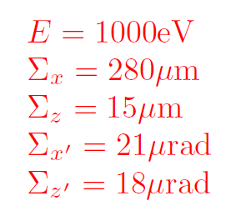
Source: present APS, 2 m ID
Unless specified, all examples use as source
-

Slide 15
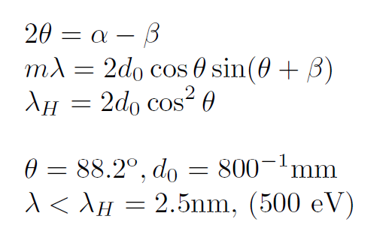
Spherical Grating Monochromator SGM
2θ
α
β
m=-1 (SHADOW 1)
-

Slide 16
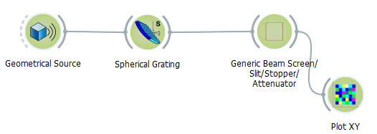
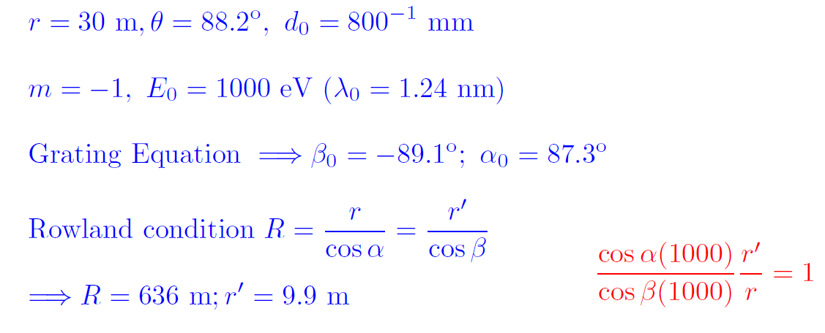
Slitless SGM
01_SGM_1000eV.ows
≈
30 m
9.9 m
α=87.3°, β=89.1°
-

Slide 17
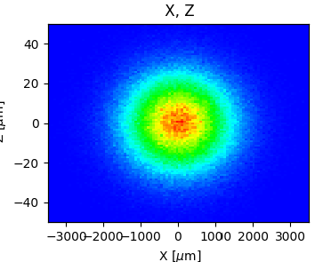

SGM Ray Tracing at 1000 eV
01_SGM_1000eV.ows

Slide 18
SGM Ray Tracing at 1000 eV
01_SGM_1000eV.ows
d FWHM
∆λ =
m
_{r}0
cos β
λ
RP =
= 18000
∆λ

Slide 19
SGM Ray Tracing at 1000 eV
01_SGM_1000eV.ows
cos α(1000) r'
2.35Σ_{z} (1000) _{cos β(1000) r} = 36 µm
Sanity Check!
_{r’}
2.35 Σ_{x}(1000) _{r} = 217 µm

Slide 20
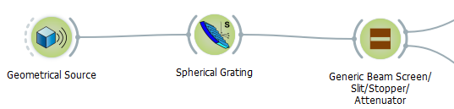
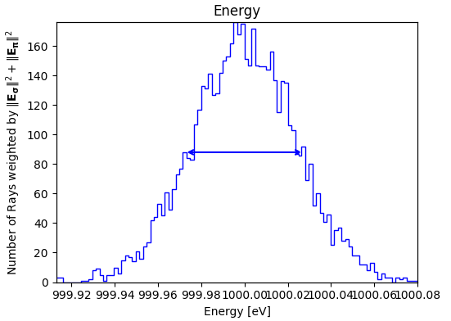

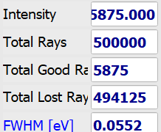
SGM Ray Tracings Resolution
01_SGM_1000eV.ows
Source
999.8 < E < 1000.2 eV
At 1000 eV
55 meV
3 µm
-

Slide 21
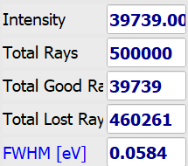
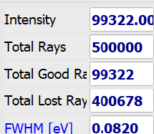
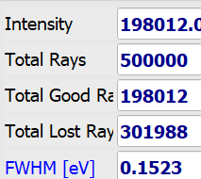
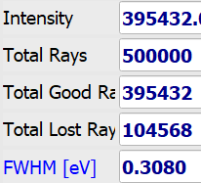
SGM Ray Tracings Resolution
01_SGM_1000eV.ows
Source
999.8 < E < 1000.2 eV
At 1000 eV
55 meV
3 µm
20 µm
50 µm
100 µm
200 µm
Source limited
Slit limited
-

Slide 22
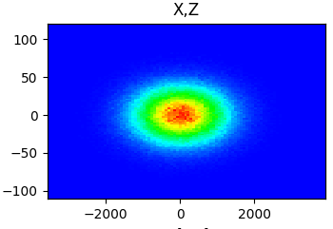

SGM Ray Tracing at 1600 eV
02_SGM_1600eV.ows
Source
E = 1600 eV
Σ_{x} = 280 µm
Σ_{z} = 154 µm
Source
Σ_{x’} = 18 µrad
Σ_{z’} = 14 µrad
β = —88.77º
α = 87.63º
-

Slide 23
SGM Ray Tracing at 1600 eV
02_SGM_1600eV.ows
Source
E = 1600 eV
Σ_{x} = 280 µm
Σ_{z} = 154 µm
Source
Σ_{x’} = 18 µrad
Σ_{z’} = 14 µrad
✖
β = —88.77º
α = 87.63º
Sanity Check!
cos α(1600) r'
2.35Σ_{z} (1600) _{cos β(1600) r} = 20 µm
Not at focus
✖
Not at focus
-

Slide 24
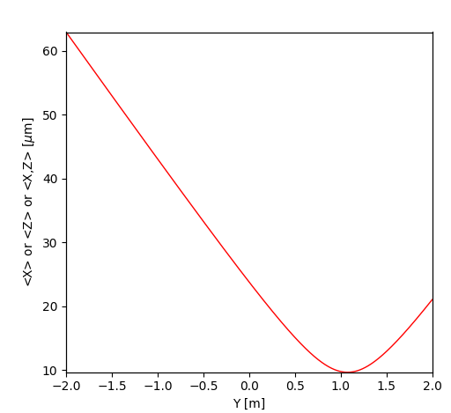


SGM Ray Tracing at 1600 eV
02_SGM_1600eV.ows
Source
E = 1600 eV
Σ_{x} = 280 µm
Σ_{z} = 154 µm
Source
Σ_{x’} = 18 µrad
Σ_{z’} = 14 µrad
✖
β = —88.77º
α = 87.63º
Sanity Check!
cos α(1600) r'
2.35Σ_{z} (1600) _{cos β(1600) r} = 20 µm
Not at focus
✖
Not at focus
Second Sanity Check!
-

Slide 25


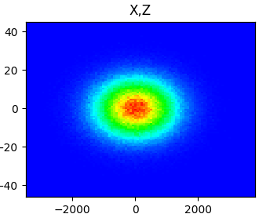
SGM Ray Tracing at 1600 eV, slit moved, corrected
02_SGM_1600eV.ows
Sanity Check!
cos α(1600) r'
2.35Σ_{z} (1600) _{cos β(1600) r} = 22 µm
F₂₀(1600eV)=0 r' = 11046 mm
In the SGM:
Exit slit need to move to keep focus (does not correct coma aberration)
-

Slide 26
Plane Grating
Plane grating (without VLS) does not focus
Focus independent of grating ➠ Fixed focal plane
Grating magnification c⁻¹ can be changed with plane mirror
cos β
c =
cos α
Grating Equation:
mλ
(1 — sin² β
2
( — sin β) = 1 —
d
_{c}2
)
-

Slide 27
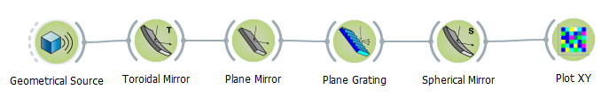
Collimated PGM, vertical plane; c=2
03_CollimatedPGM1000eVc2_Vertical.ows
≈
28 m 2 m 1 m
≈
9 m
Toroidal Mirror:
Collimates beam in meridional direction (vertically) Focuses in sagittal direction at slit (horizontally)
Plane Mirror + Plane grating
Controls grating magnification, c⁻¹ and wavelength
Cylindrical Mirror
Focuses the collimated beam onto the fixed exit slit Reflectivities in SXR not optimal due to many electronic transition in this range
-

Slide 28
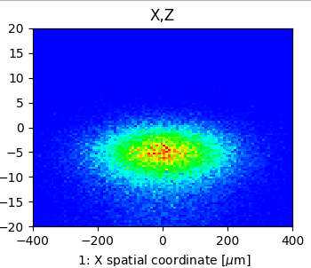
Collimated PGM, vertical plane; c=2
03_CollimatedPGM1000eVc2_Vertical.ows
≈
28 m 2 m 1 m
≈
9 m
88.5°
up
87.8°
down
α=88.5°, β=87.1°
up
88.5°
down
-

Slide 29

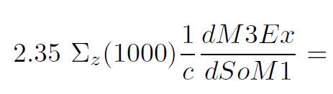
Collimated PGM, vertical plane; c=2
03_CollimatedPGM1000eVc2_Vertical.ows
≈
28 m 2 m 1 m
≈
9 m
88.5°
up
87.8°
down
α=88.5°, β=87.1°
up
88.5°
down
Coma
5.8 µm
-

Slide 30
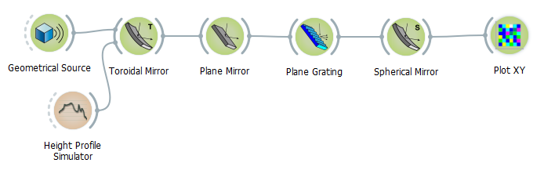
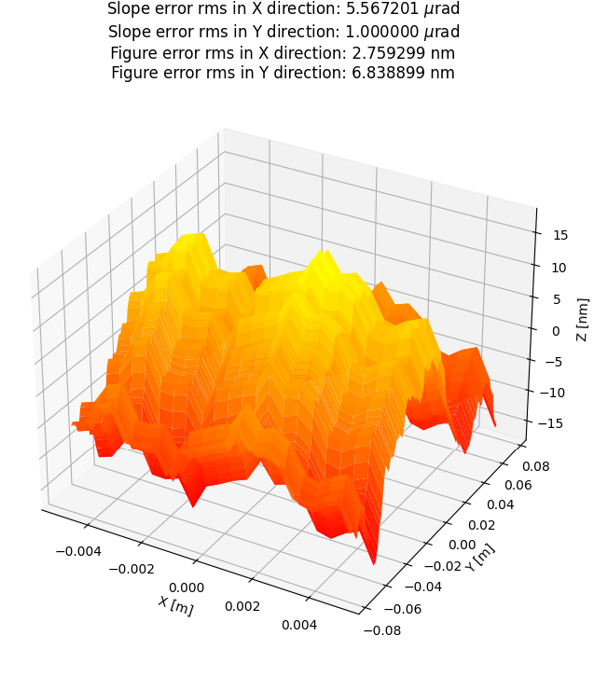
Collimated PGM, vertical plane; c=2
03_CollimatedPGM1000eVc2_Vertical.ows
-

Slide 31
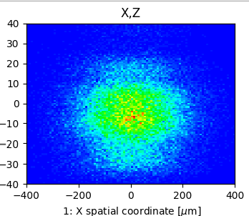

Collimated PGM, vertical plane; c=2
03_CollimatedPGM1000eVc2_Vertical.ows
With SE on Toroid
-

Slide 32
Collimated PGM, vertical plane; c=2
03_CollimatedPGM1000eVc2_Vertical.ows
With SE on Toroid
Without SE on Toroid
-

Slide 33
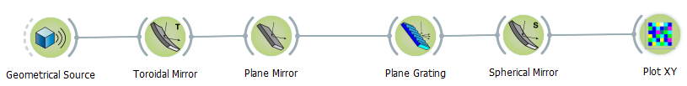
Follath Collimated PGM, TM, CM: hor plane; c=2
04_CollimatedPGM1000eVc2.ows
≈
28 m 2 m 1 m
≈
9 m
88.5°
left
87.8°
down
α=88.5°, β=87.1°
up
88.5°
left
-

Slide 34
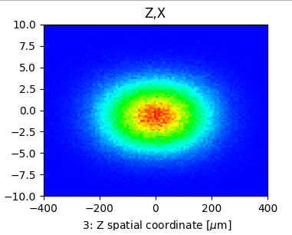

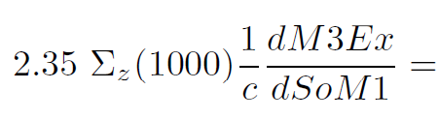
Follath Collimated PGM, TM, CM: hor plane; c=2
04_CollimatedPGM1000eVc2.ows
≈
28 m 2 m 1 m
≈
9 m
88.5°
left
87.8°
down
α=88.5°, β=87.1°
up
88.5°
left
No Coma
5.8 µm
Mirror rotation relative to grating x↔z
-

Slide 35
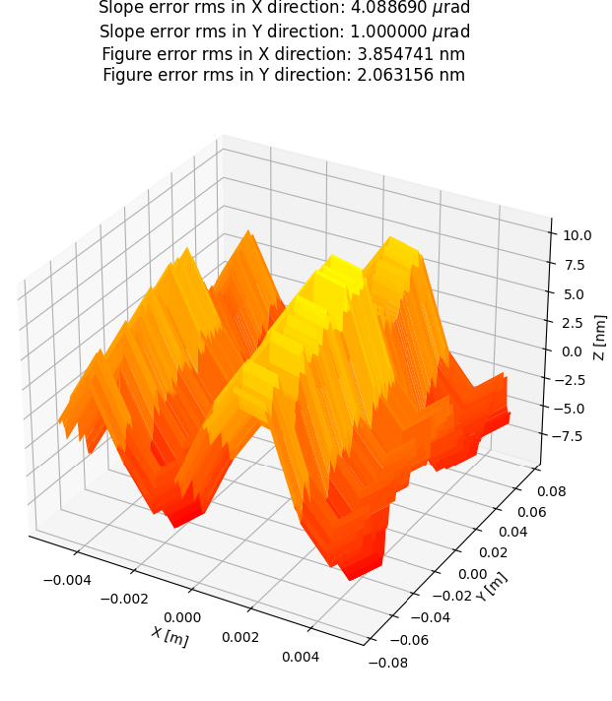
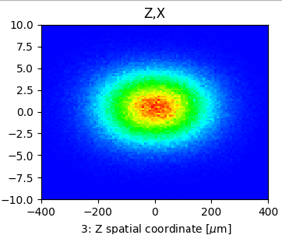

Follath Collimated PGM, TM, CM: hor plane; c=2
04_CollimatedPGM1000eVc2.ows
≈
28 m 2 m 1 m
≈
9 m
With SE
Forgiveness Factor: ×θ
No SE
-

Slide 36
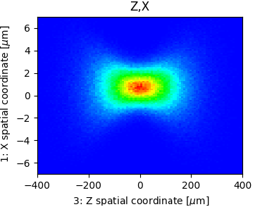



Collimated PGM, TM, CM: horizontal plane; c=5
05_CollimatedPGM1000eVc5.ows
α=89.5°, β=87.4°
With slope errors
Without slope errors
5.8/(5/2)=2.32
Astigmatic Coma
-

Slide 37
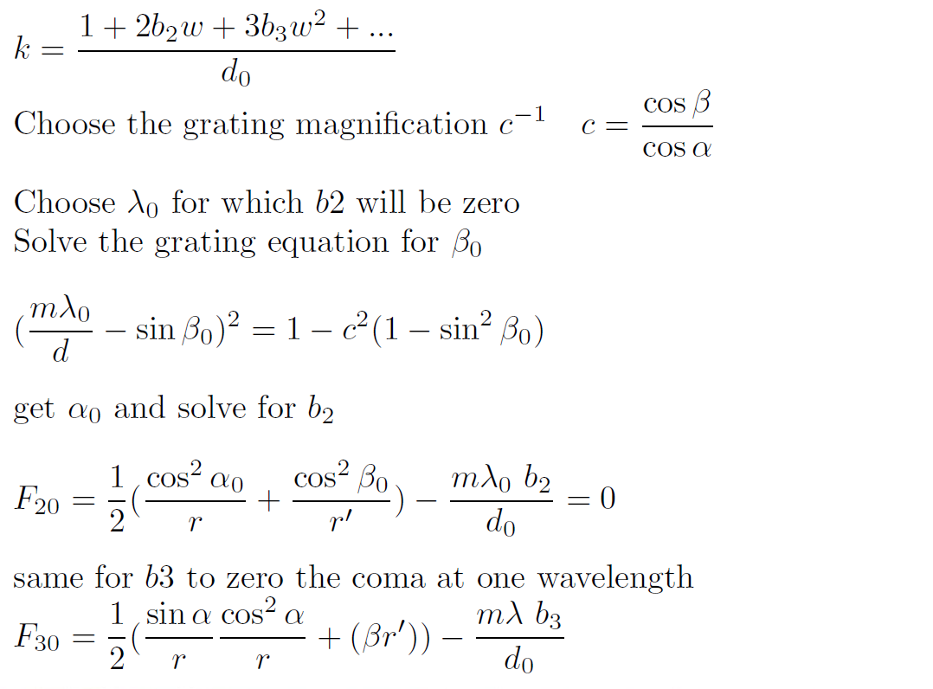
FVLSPGM
Focusing Variable Line Spacing Plane Grating Monochromator
-

Slide 38
FVLSPGM
The defocus equation can be solved for all wavelengths by illuminating the grating at the correct angle of incidence.
c is not a free parameter.
https://doi.org/10.1016/j.nima.2004.09.007 R. R & A. R. B. C, NIM A 538, 760 (2005)
c=2 at 600 eV ⇒ b2=1.44×10⁻⁴ mm⁻¹
Solving coma at one wavelength enough Coma zero at 600 eV ⇒ b3=1.3×10⁻⁸ mm⁻²
-

Slide 39
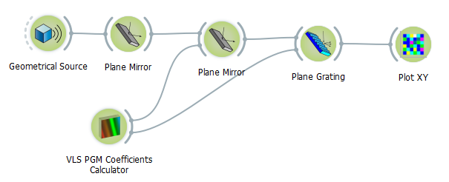
FVLSPGM
≈
28 m
2 m
0.3 m
≈
10 m
Slit plane
Heat Absorber
88.5°
left
87.8°
down
α=88.5°, β=87.1°
up
Horizontal focus after slit
-

Slide 40
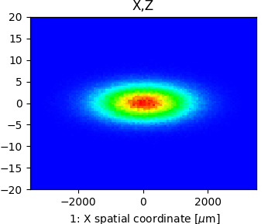

FVLSPGM
≈
28 m
2 m
0.3 m
≈
10 m
Slit plane
88.5°
left
87.8°
down
α=88.5°, β=87.1°
up
Horizontal focus after slit
-

Slide 41
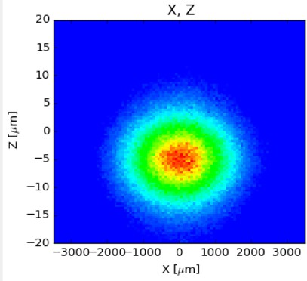
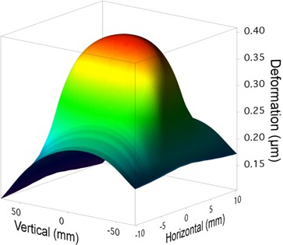


FVLSPGM with Heat Load
Slit plane
Without
With
-

Slide 42

Deformation: Heat load absorbed on PM, c=2
Total Absorbed Power 35 W
0.40
15
Deformation (µm)
0.35
10
Slope (µrad)
0.30
5
0.25
0
R=-30 Km
0.20
-5
-10
0.15
-15
-60 -40 -20 0 20
Mirror Length (mm)
40
60
Virtual Source at 28.52 m
-

Slide 43

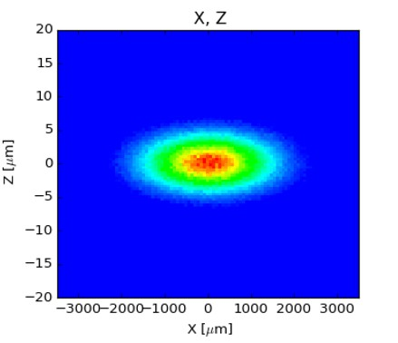
FVLSPGM with Heat Load and Corrected
Without
With
α=88.52843° β=87.05389°
-

Slide 44

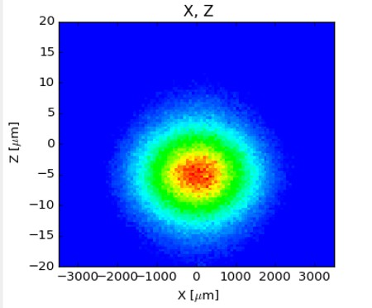
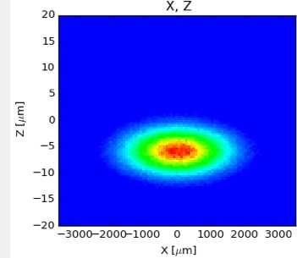
FVLSPGM with Heat Load and Corrected
Without
With
With Corrected
α=88.52843° β=87.05389°
α=88.53789° β=87.0586°
R.R, NIM A 649, 139 (2010)
-

Slide 45
Summary
SGM requires a movable exit slit
Collimated PGM can be used with fixed magnification or following grating efficiency
The slope errors in the mirrors impair the resolution in vertical PGM mirror.
The heat induced deformations in Follath collimated PGM impair the resolution. Could be solved by moving slit.
Focusing VLS PGM
Can correct heat induced deformation Cannot change the magnification
Formulas for all monochromator types are included in Oasys
-

