Slide 1

1 year evaluation
Carlo brunelli

Slide 2
Objectives
Q1 | q2 | Q3 | Q4
Code testing | Add code functionalities | Verify parallel efficiency | Explore Gridap parallel code

Slide 3
Code testing
- VMS tested with 2D orthogonal meshes and unstructured (cylinder shedding)
- Verified Matrix dimension for linear case

Slide 4
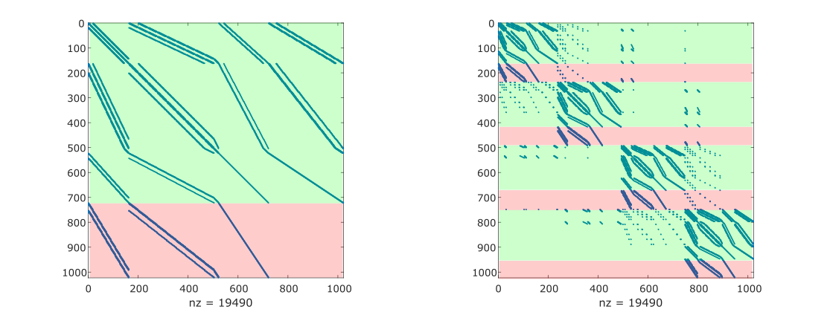
Add code functionalities
- theta method support theta = 1 for pressure and theta = 0.5 for speed. Tested with taylor green. In testing with lid driven it needs ramping
- Segregated and coupled formulations implemented (just in serial, many functionalities are not available)
- In PETSc you can now split the 2 fields, GAMG works better
Stokes linear test matrix, in serial (on the left), in parallel over 4 procs (on the right); split in velocity and pressure degree of freedom. Pressure problem has a saddle point (no elements on the diagonal)

Slide 5
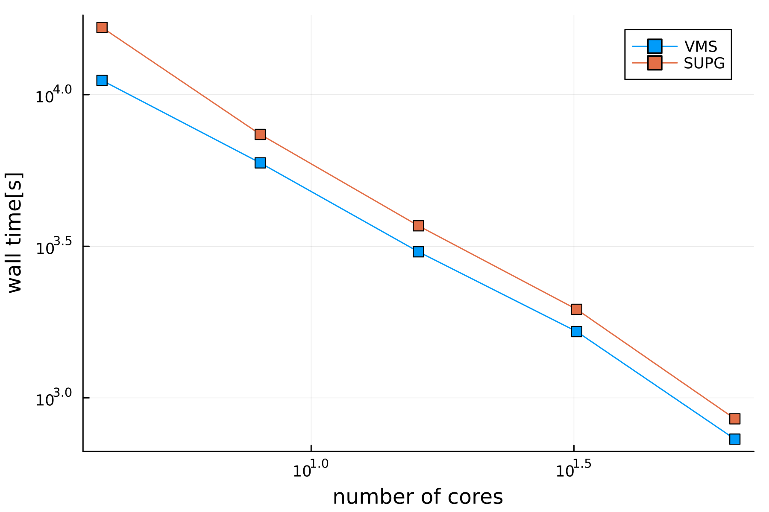
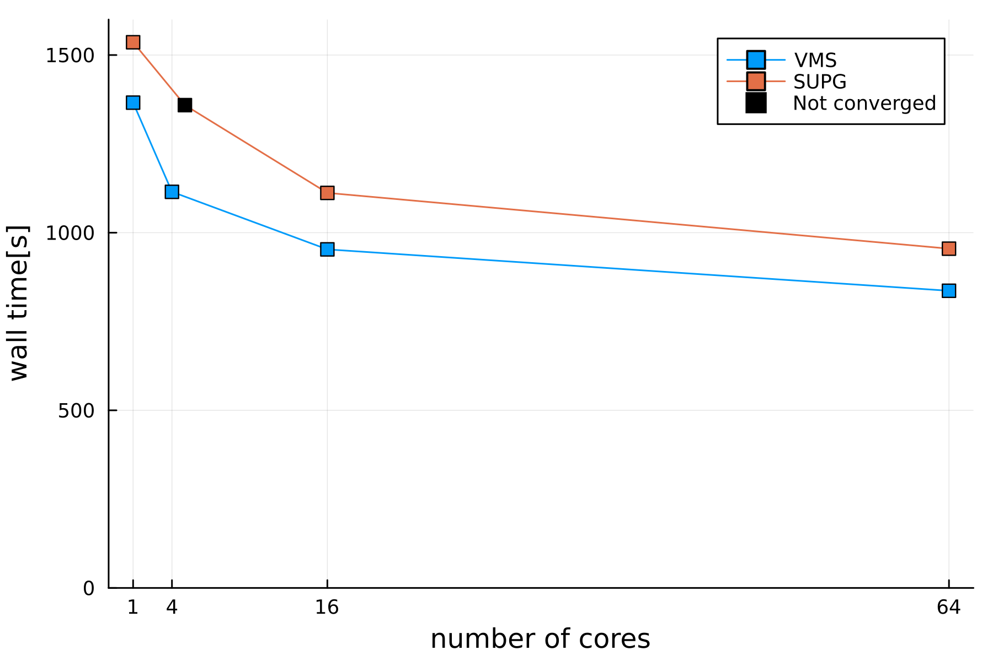
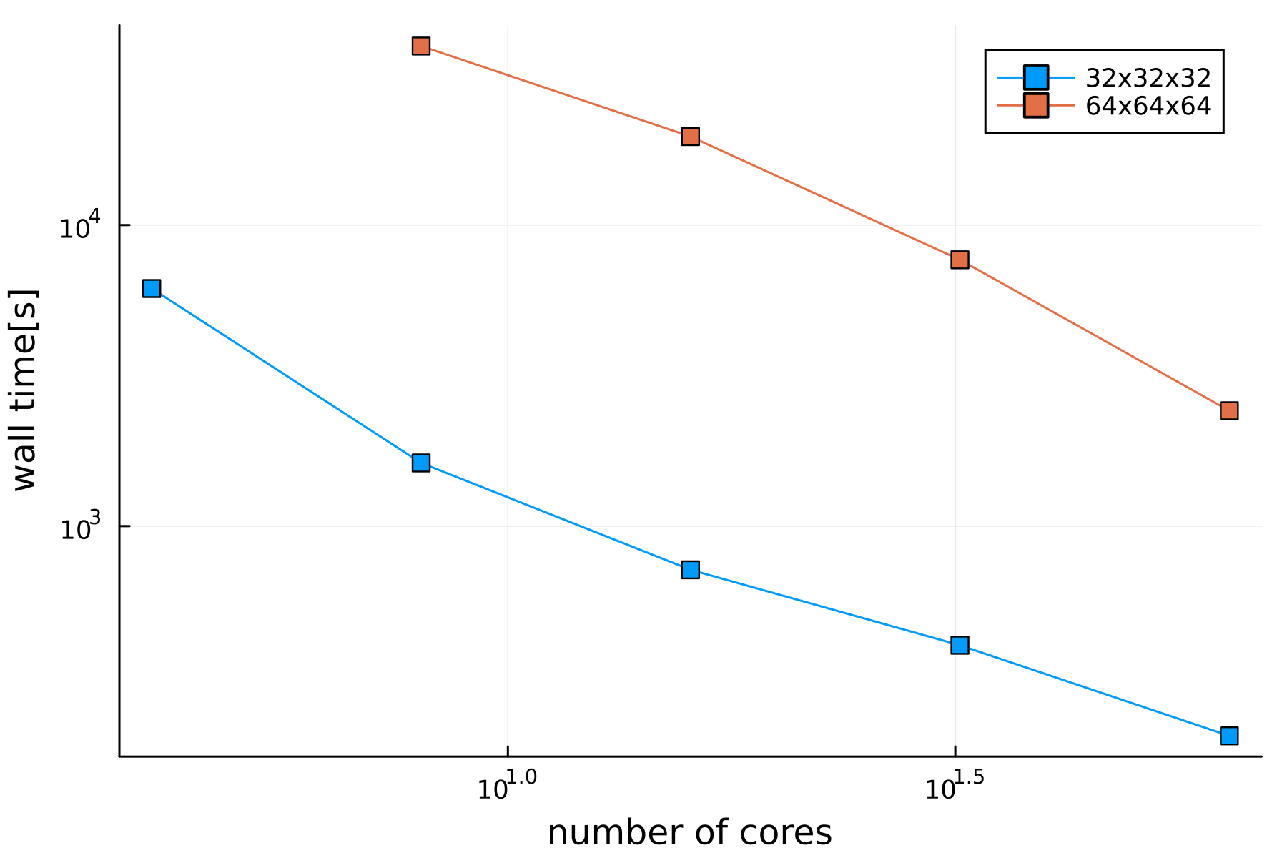
Verify Parallel Efficiency-Scalability
2D Taylor Green, strong scalability (on the left), weak scalability (on the right)
Channel 3D, strong scalability

Slide 6
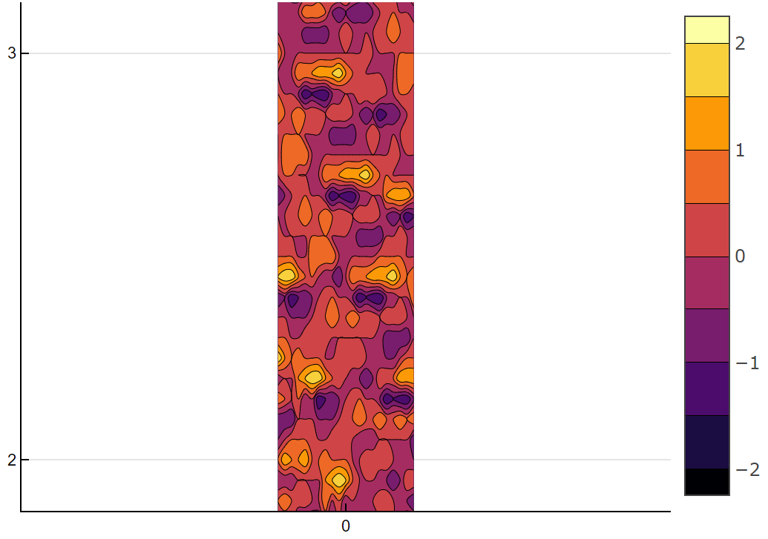
Other activities
- Study and implementation of SEM for creating coherent inlet eddies
Velocity magnitude in x direction over the XY plane, for Z = 0

Slide 7
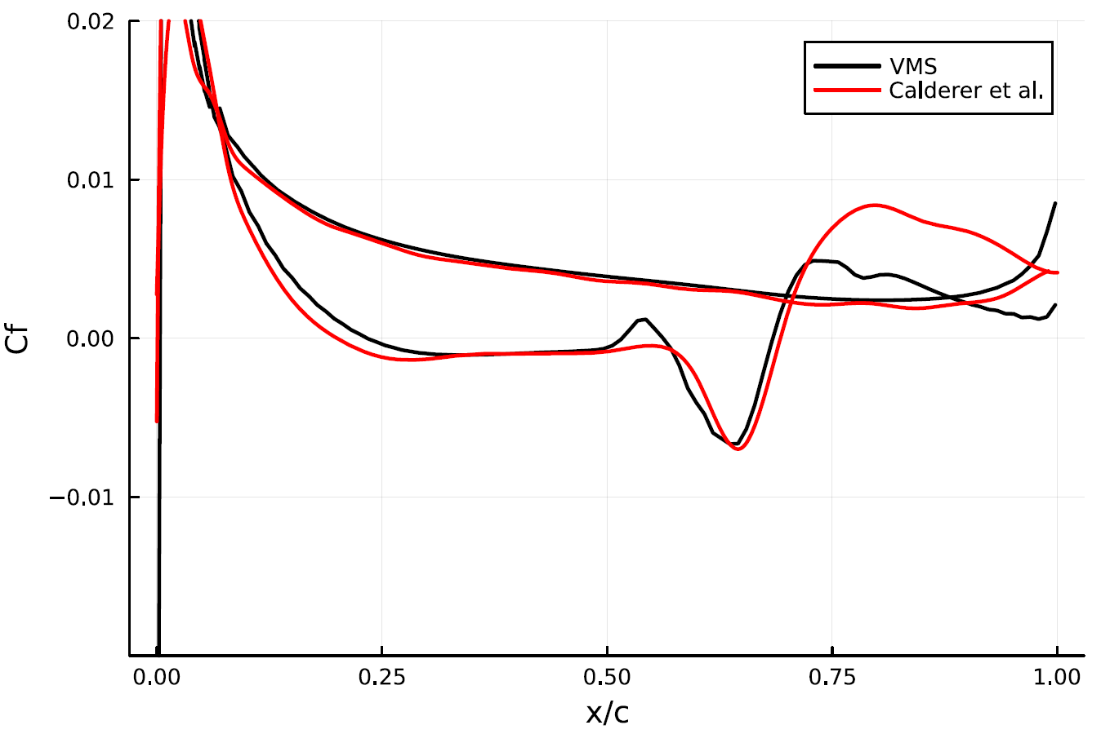
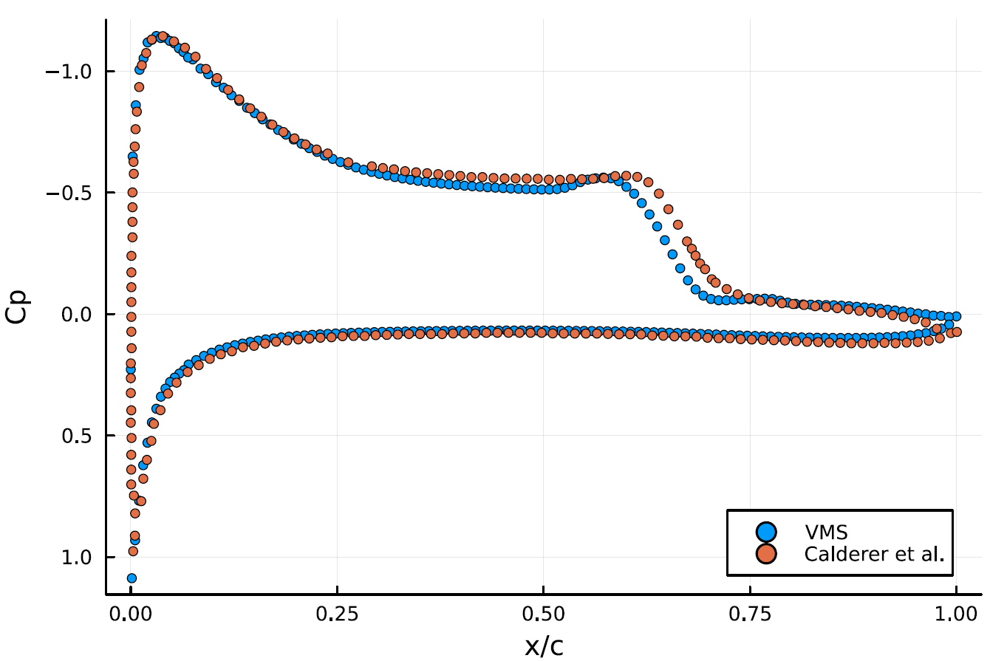
2D Profile Analysis
sd7003 Re=60 000, AoA = 4deg

Slide 8
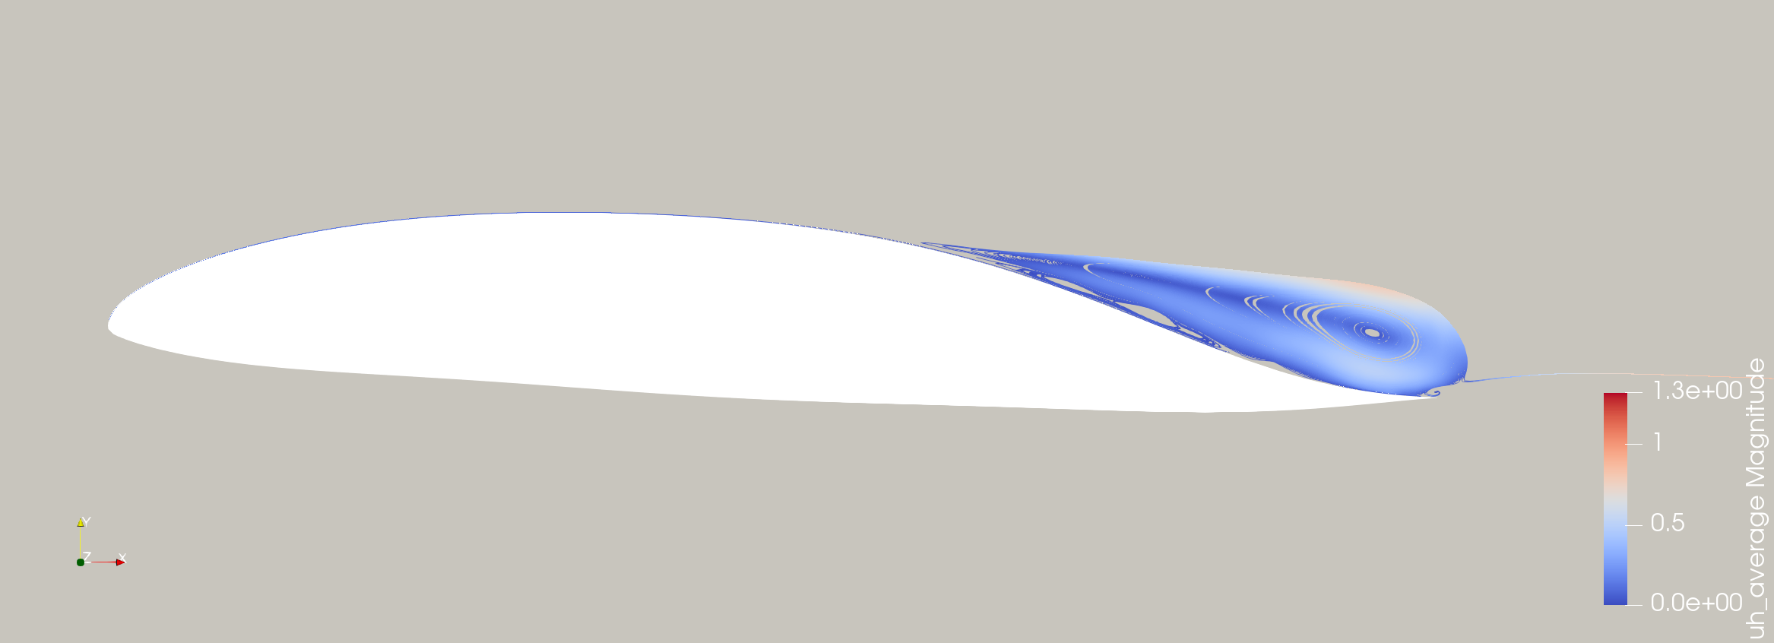
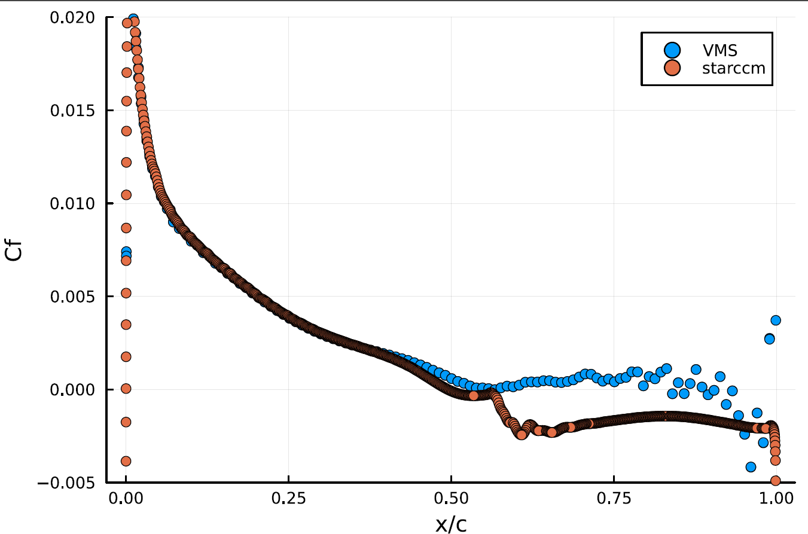
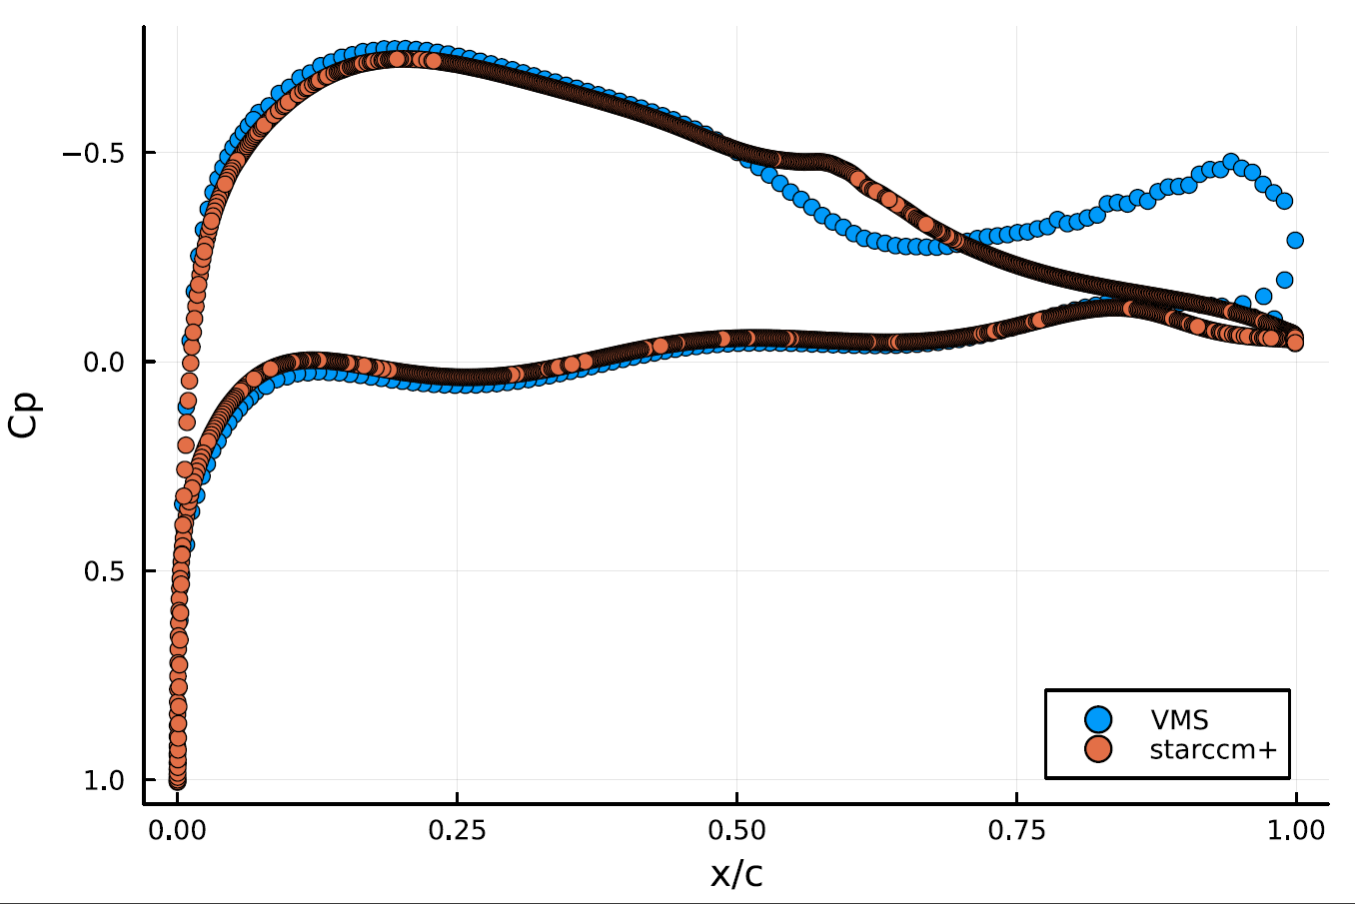
2D Profile Analysis
DU89 Re=250 000, AoA = 3deg

Slide 9
Current critical points
Turbulence in the Channel: too far from the final conditions, the fluid is still evolving. At least we are getting the tubrulence.
3D meshes, dense airfoil meshes, high order elements too heavy to be solved.

Slide 10
Overall of 1 Year
- The VMS (and the SUPG) has been implemented fully in parallel and tested on 2D time depended, fully coupled easy cases.
- The segregated/linearized version works but only in serial
- For the 2D taylor green case the scalability has been proven

