Slide 1

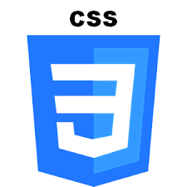







executeBuild
executeTest
HTML, CSS, jQuery responsive UI
getPlatforms
getPlatform
getTutorial
Rest API exposed via Node.js
Development Tooling
Content & data stored in mongoDB

