Slide 1

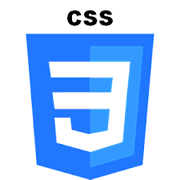











Development & Infrastructure
HTML, CSS, jQuery responsive UI
Rest API exposed via Node.js
Content & data stored in mongoDB

