Slide 2
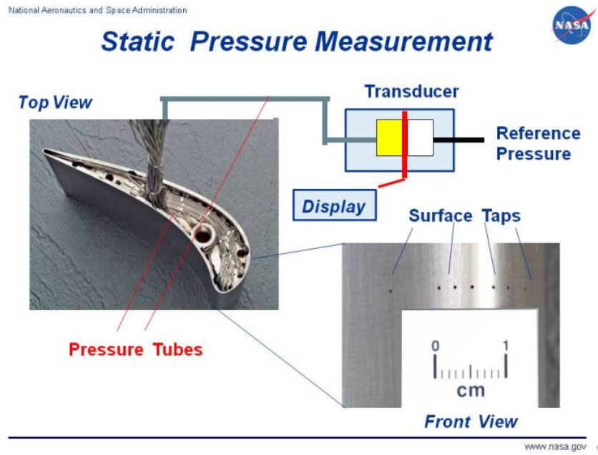
https://www.grc.nasa.gov/www/k-12/airplane/tunpsm.html

Slide 3
Pressure transducer
L
P₀
2r
V P

Slide 4
P (absolute)
Positive gage pressure
Atmospheric pressure
Negative gage pressure
Zero absolute pressure
0

