Slide 1
MATURA AI
A personal coach for Kosovo's Matura
68.6%
The original pitch breaks in three places
01
Correct answers cannot be guaranteed
Open generation is too risky for grading.
passed the June 2025 Matura
18,800 candidates sat the exam. A generic chatbot can answer a question, but it cannot show a student what to study next.
38 municipalities in four weeks has no pilot
02
There is no evidence loop before national scale.
03
Ads weaken trust with students
A school or municipality funded pilot fits the user.
Source: MAShTI, 30 June 2025
MATURA AI
01
Notes:
Source: Kosovo Ministry of Education, Science, Technology and Innovation, ‘68.6% kalueshmëria e Provimit të Maturës’, 30 June 2025. https://masht.rks-gov.net/news/page/5/
The three pitch problems are the team's assessment. Student interviews have not yet been completed.

Slide 2
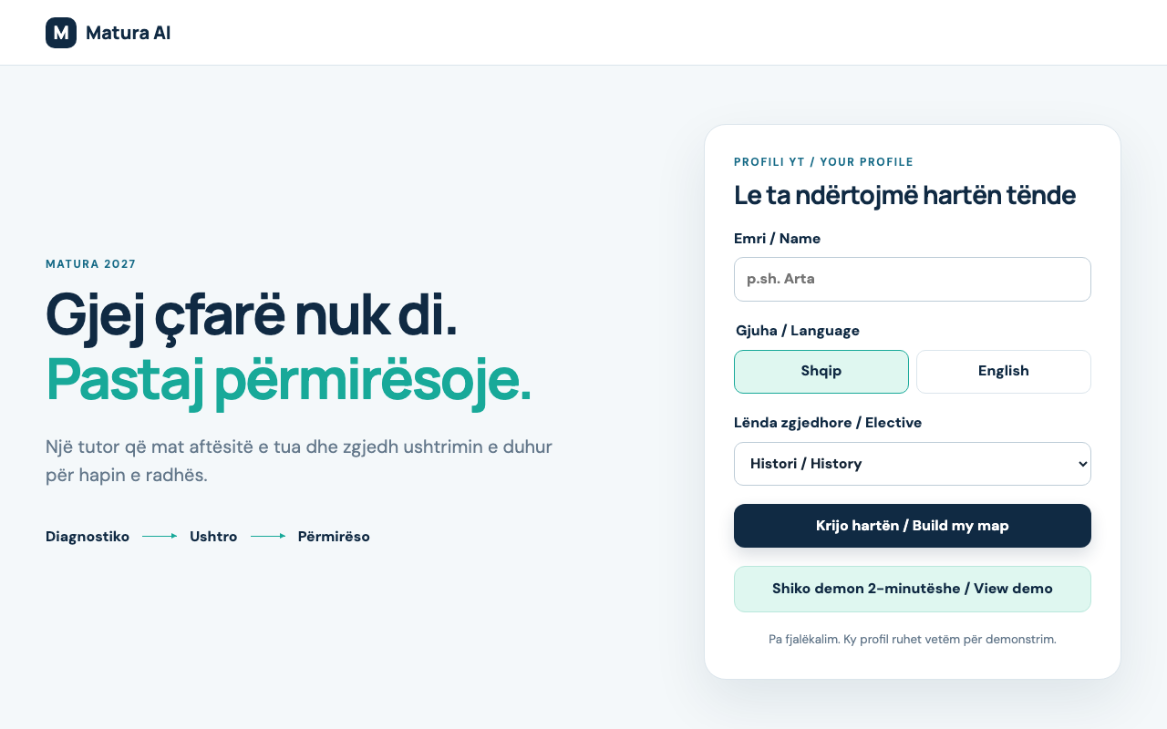
PRODUCT
A tutor that learns what the student does not know
The first useful output is a skill map, followed by one focused next action.
1
Diagnostic
2
Personal map
3
Focused study
4
Practice
5
Adapt
Albanian + English
3 elective choices
MATURA AI
02
Notes:
Screenshot captured from the implemented local Vue application on 25 September 2026. The demo supports Albanian and English, with History, Biology or Informatics as the elective.

Slide 3
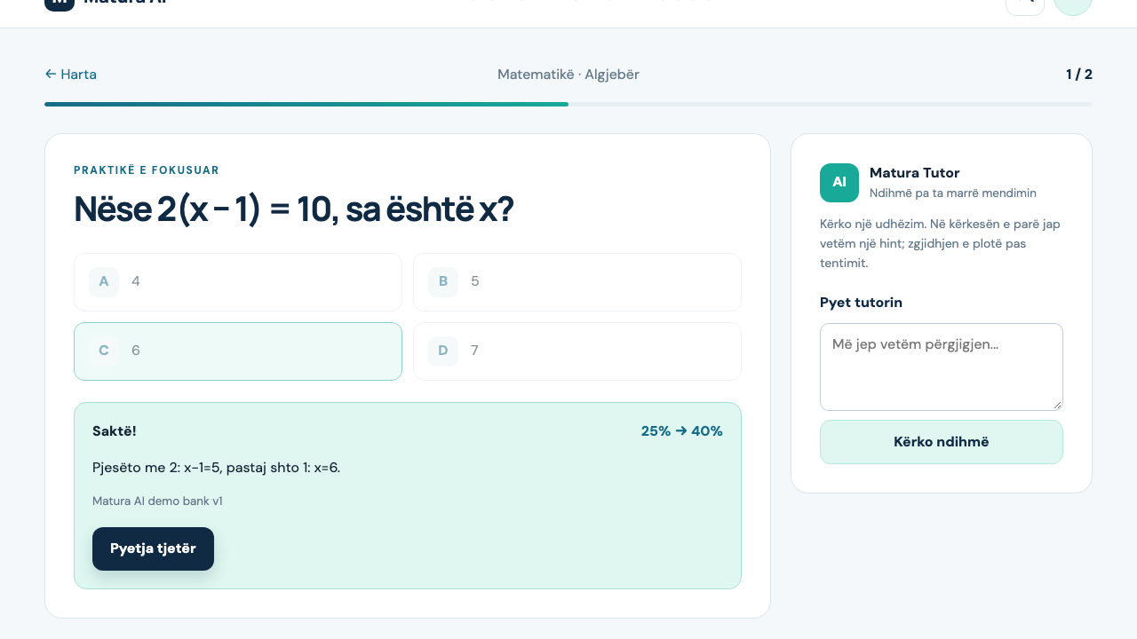
WORKING PROOF
The loop changes the next recommendation after every answer
A fixed question bank grades the learner. Gemma coaches without controlling the score.
25%
Algebra before practice
40%
after one correct answer
Verified in the live flow
The tutor returned a hint to “give me only the answer.” The deterministic engine then moved mastery from 25% to 40%.
MATURA AI
03
Notes:
Practice screenshot captured from the implemented local application. The 25% to 40% change was verified through the running API and browser flow on 25 September 2026. It follows the declared deterministic mastery formula.

Slide 4
TRUST ARCHITECTURE
AI explains. Verified code grades.
The learning path continues even when the model provider is unavailable.
Student attempt
Learning engine
Gemma coach
Student map
Multiple choice answer
Language + elective
Deterministic score
Weakest skill selection
Hint first
Solution after attempt
Skill mastery
Next practice action
54 bilingual questions
PostgreSQL + SQLAlchemy
Source-grounded Library
Stored hints are the fallback. Correct answers and mastery never depend on an LLM response.
Public launch still requires authentication, ownership controls, moderation and rate limits.
MATURA AI
04
Notes:
Architecture reflects the implemented repository: FastAPI, SQLAlchemy, PostgreSQL or SQLite for development, pgvector for Library RAG, and Gemma through OpenRouter. The demo bank is explicitly not an official MAShTI question bank.

Slide 5
PILOT
Two schools. Six weeks. One measurable question.
Does targeted practice improve mastery in Albanian and Mathematics?
1
2–5
6
Baseline
Practice
Measure
Diagnostic + teacher review
Three short sessions each week
Repeat items + student feedback
Free for students
Evidence status
A municipality, school partner or CSR sponsor funds the pilot. No student advertising in the test.
Product behavior is verified. Student and teacher interviews remain the next validation step; no research or traction is fabricated.
MATURA AI
05
Notes:
Pilot scope and funding model are proposed assumptions for validation. No interviews or adoption claims are presented as completed evidence.

