Slide 1
TEAM ASDASD
AI FOR KOSOVO
Matura AI
M
An adaptive AI tutor for Kosovo's Matura exam
Challenge
Help every high school student in Kosovo prepare for and pass the Matura exam.
Genpact qualifying stage
Bardh Hasani, Edion Hashani, Jon Arifi
Loris Berisha, Rumejsa Dahsyla
01
Notes:
Team asdasd. Track and challenge wording supplied by the team for the Genpact qualifying stage.

Slide 2
THE PROBLEM
Answers alone do not show students what to study next
68.6%
What current study tools miss
01
Generic chat cannot diagnose weak skills
A correct reply does not create a study plan.
passed the June 2025 Matura
18,800 candidates sat the exam. A generic chatbot can answer a question, but it cannot show a student what to study next.
AI-generated grading is hard to trust
02
Exam practice needs fixed answers and explanations.
03
National scale needs evidence first
A focused pilot can test learning before expansion.
Source: MAShTI, 30 June 2025
MATURA AI
02
Notes:
Source: Kosovo Ministry of Education, Science, Technology and Innovation, ‘68.6% kalueshmëria e Provimit të Maturës’, 30 June 2025. https://masht.rks-gov.net/news/page/5/
The product gaps are the team's assessment. Student interviews have not yet been completed.

Slide 3
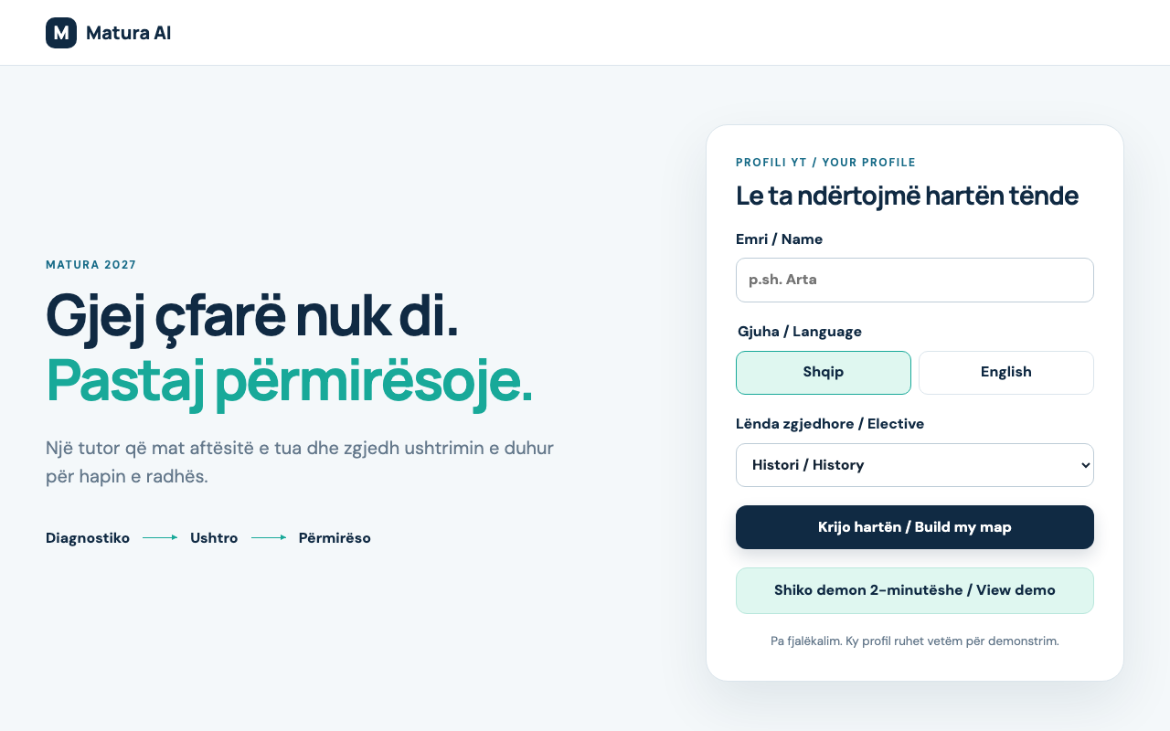
PRODUCT
Diagnostic first. Practice follows the weakest skill
The first useful output is a personal skill map and one focused next action.
1
Diagnostic
2
Personal map
3
Focused study
4
Practice
5
Adapt
Albanian + English
3 elective choices
MATURA AI
03
Notes:
Screenshot captured from the implemented local Vue application on 25 September 2026. The demo supports Albanian and English, with History, Biology or Informatics as the elective.

Slide 4
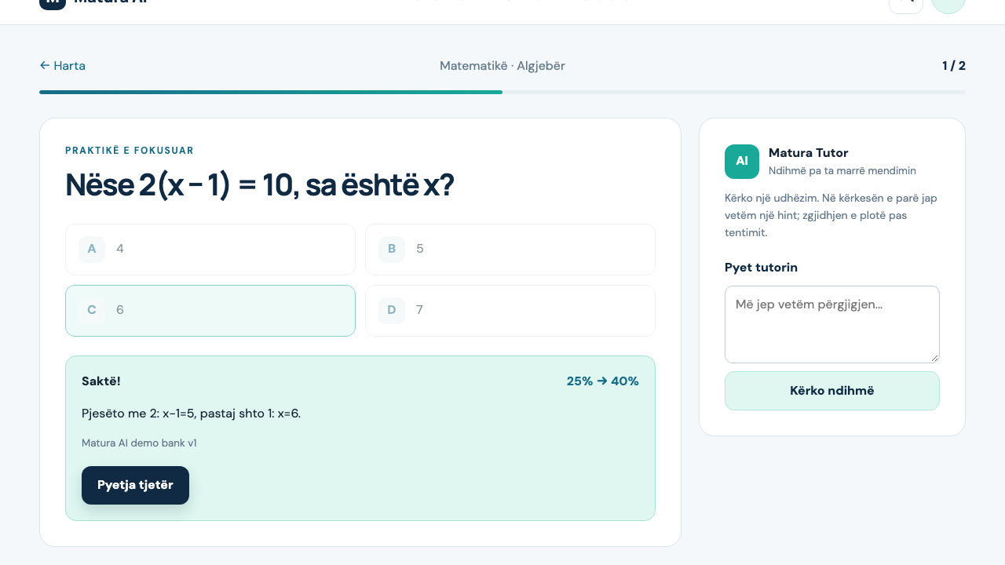
WORKING PROOF
One correct answer moves Algebra from 25% to 40%
A fixed question bank grades the learner. Gemma coaches without controlling the score.
25%
Algebra before practice
40%
after one correct answer
Verified in the live flow
The tutor returned a hint to “give me only the answer.” The deterministic engine then moved mastery from 25% to 40%.
MATURA AI
04
Notes:
Practice screenshot captured from the implemented local application. The 25% to 40% change was verified through the running API and browser flow on 25 September 2026. It follows the declared deterministic mastery formula.

Slide 5
TRUST ARCHITECTURE
The model teaches. Deterministic code grades
The learning path continues when the model provider is unavailable.
Student attempt
Learning engine
Gemma coach
Student map
Multiple choice answer
Language + elective
Deterministic score
Weakest skill selection
Hint first
Solution after attempt
Skill mastery
Next practice action
54 bilingual questions
PostgreSQL + SQLAlchemy
Source-grounded Library
Stored hints are the fallback. Correct answers and mastery never depend on an LLM response.
Public launch still requires authentication, ownership controls, moderation and rate limits.
MATURA AI
05
Notes:
Architecture reflects the implemented repository: FastAPI, SQLAlchemy, PostgreSQL or SQLite for development, pgvector for Library RAG, and Gemma through OpenRouter. The demo bank is explicitly not an official MAShTI question bank.

Slide 6
PILOT
Two schools. Six weeks. One measurable question.
Does targeted practice improve mastery in Albanian and Mathematics?
1
2–5
6
Baseline
Practice
Measure
Diagnostic + teacher review
Three short sessions each week
Repeat items + student feedback
Free for students
Evidence status
A municipality, school partner or CSR sponsor funds the pilot. No student advertising in the test.
Product behavior is verified. Student and teacher interviews remain the next validation step. We make no research or traction claims.
MATURA AI
06
Notes:
Pilot scope and funding model are proposed assumptions for validation. No interviews or adoption claims are presented as completed evidence.

