Slide 1

Adapting to Change: Robust Counterfactual Explanations in Dynamic Data Landscapes
Bardh Prenkaj, Mario Villaizán-Vallelado, Tobias Leeman, and Gjergji Kasneci
Technical University of Munich
TUM School of Social Sciences and Technology
Chair of Responsible Data Science
1
2,3
4
1 Sapienza University of Rome
2 Artificial Intelligence Laboratory (AI-LAB), Telefónica I+D
3 University of Valladolid
4 University of Tuebingen

Slide 2
Part One
Problem Introduction

Slide 3
Importance of Explainability in ML
Explainability is a critical aspect for ML models
Transparency and robustness, and regulatory perspectives
The EU‘s GDPR and proposed AI-Act [1] demand for well-performing and interpretable models
Counterfactual explainability [2] as means for human-centered way of meeting regulatory demands

Slide 4
Counterfactual example
We have an automatic loan-approval decision system X
Alice inserts their personal data including net monthly salary and credit score
X rejects Alice‘s loan
A counterfactual explanation on Alice‘s loan rejection would be:
„If Alice had €2500 as her net monthly salary,
then her loan would be approved“

Slide 5
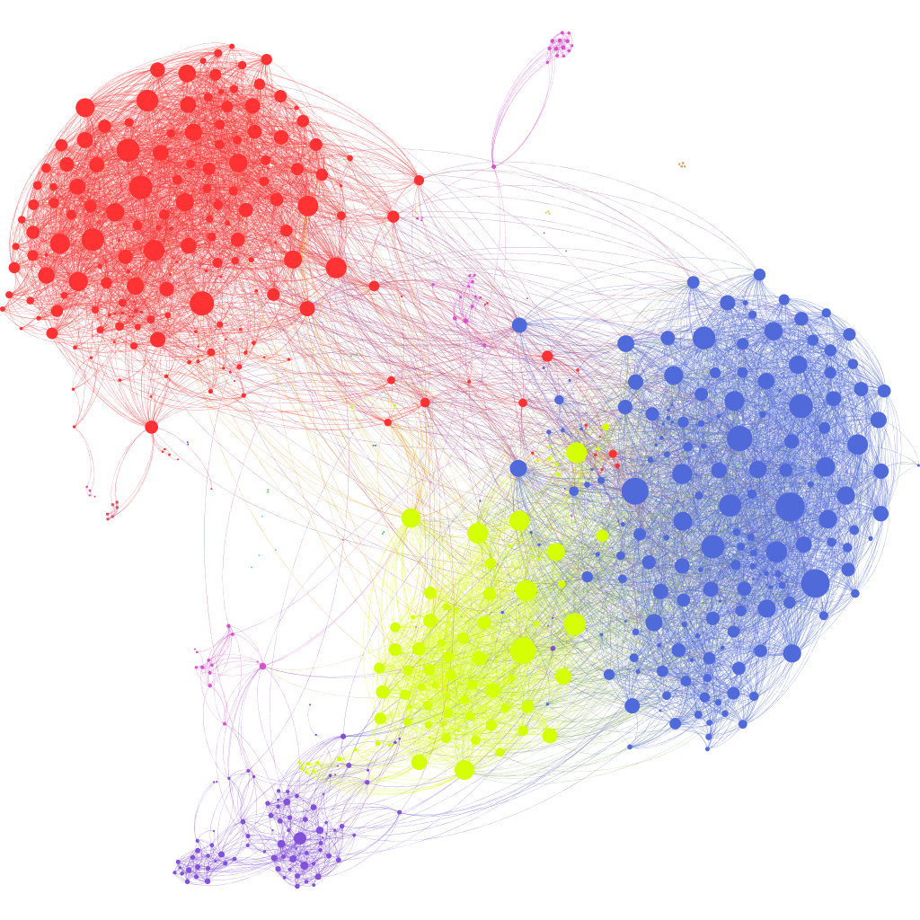
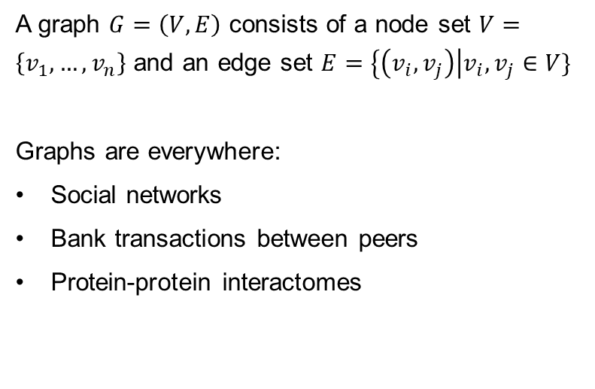
What‘s a graph?
A graph $G=\left(V,E\right)$ consists of a node set $V=\left\{v_{1},…,v_{n}\right\}$ and an edge set $E=\left\{\left(v_{i},v_{j}\right)\right|v_{i},v_{j}∈V\}$
Graphs are everywhere:
Social networks
Bank transactions between peers
Protein-protein interactomes

Slide 6

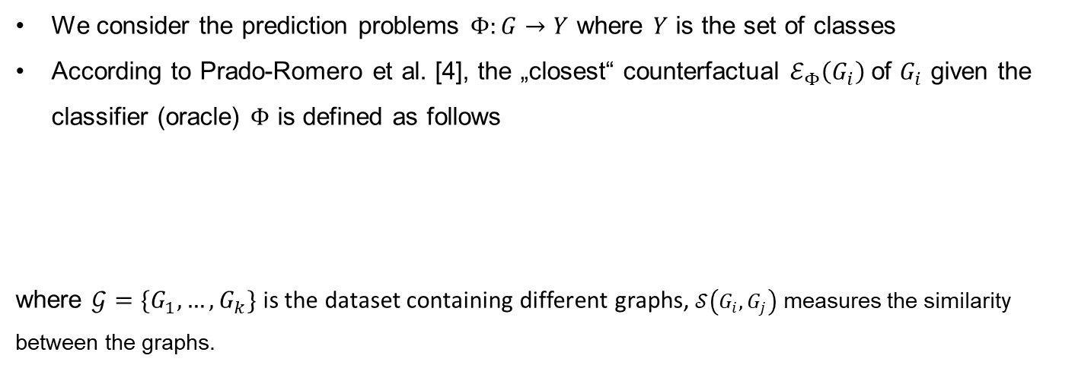
Graph Counterfactual Explainability (GCE)
We consider the prediction problems $Φ:G→Y$ where $Y$ is the set of classes
According to Prado-Romero et al. [4], the „closest“ counterfactual $ℰ_{Φ}\left(G_{i}\right)$of $G_{i}$ given the classifier (oracle) $Φ$ is defined as follows
where $𝒢=\{G_{1},…,G_{k}\}$ is the dataset containing different graphs, $𝒮\left(G_{i},G_{j}\right)$ measures the similarity between the graphs.
$$ℰ_{Φ}\left(G_{i}\right)=\arg{\max{𝒮}}\left(G_{i},G_{j}\right)$$
$$G_{j}∈𝒢,G_{i}≠G_{j},Φ\left(G_{i}\right)≠Φ\left(G_{j}\right)$$

Slide 7
Part Two
Counterfactuals in Dynamic Data Landscapes

Slide 8
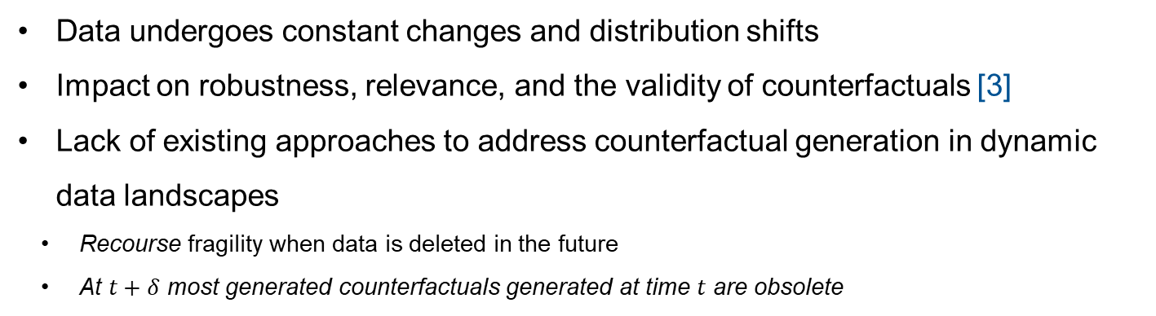
Things get complicated!
Data undergoes constant changes and distribution shifts
Impact on robustness, relevance, and the validity of counterfactuals [3]
Lack of existing approaches to address counterfactual generation in dynamic data landscapes
Recourse fragility when data is deleted in the future
At $t+δ$ most generated counterfactuals generated at time $t$ are obsolete

Slide 9
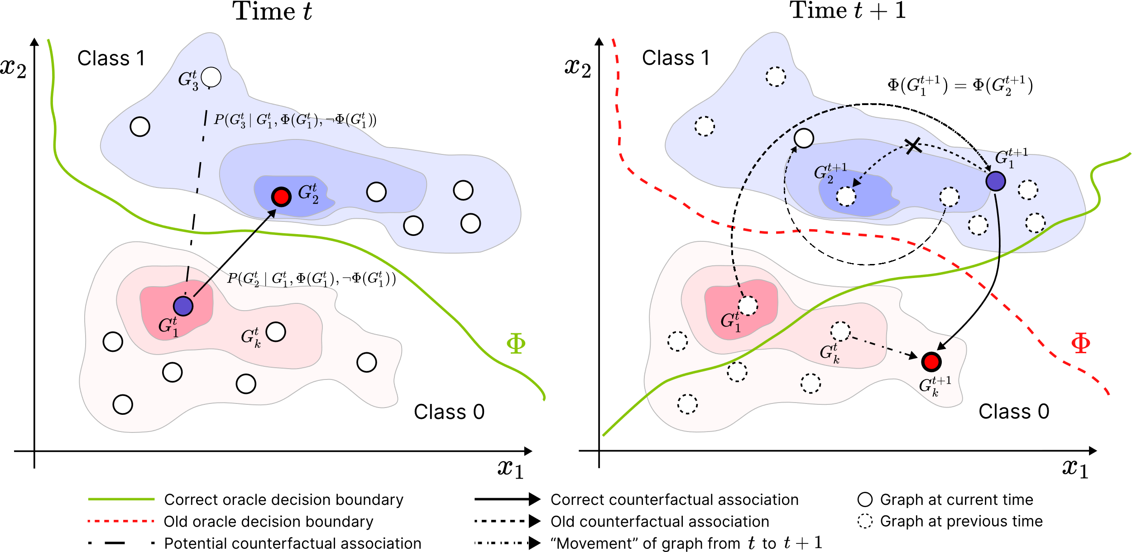

Slide 10
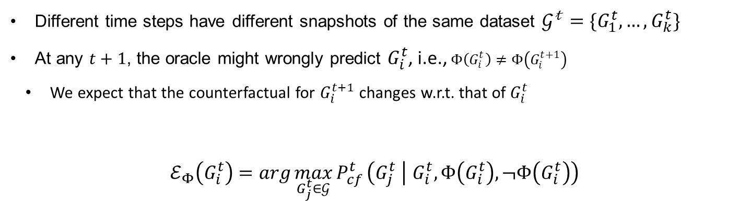
Time-related GCE
Different time steps have different snapshots of the same dataset $𝒢^{𝓉}=\{G_{1}^{t},…,G_{k}^{t}\}$
At any $t+1$, the oracle might wrongly predict $G_{i}^{t}$, i.e., $Φ\left(G_{i}^{t}\right)≠Φ\left(G_{i}^{t+1}\right)$
We expect that the counterfactual for $G_{i}^{t+1}$ changes w.r.t. that of $G_{i}^{t}$
$$ℰ_{Φ}\left(G_{i}^{t}\right)=\arg{\max_{G_{j}^{t}∈𝒢}{P_{cf}^{t}}}\left(G_{j}^{t} | G_{i}^{t},Φ\left(G_{i}^{t}\right),¬Φ\left(G_{i}^{t}\right)\right)$$

Slide 11
Part Three
DyGRACE

Slide 12
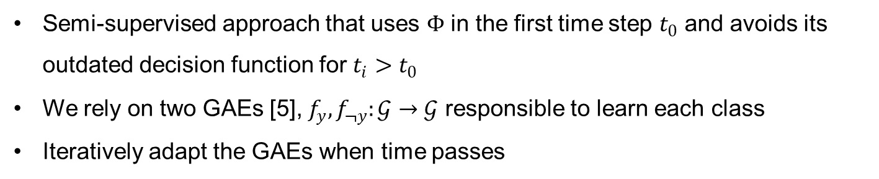
Architectural overview (1)
Semi-supervised approach that uses $Φ$ in the first time step $t_{0}$ and avoids its outdated decision function for $t_{i}>t_{0}$
We rely on two GAEs [5], $f_{y},f_{¬y}:𝒢→𝒢$ responsible to learn each class
Iteratively adapt the GAEs when time passes

Slide 13
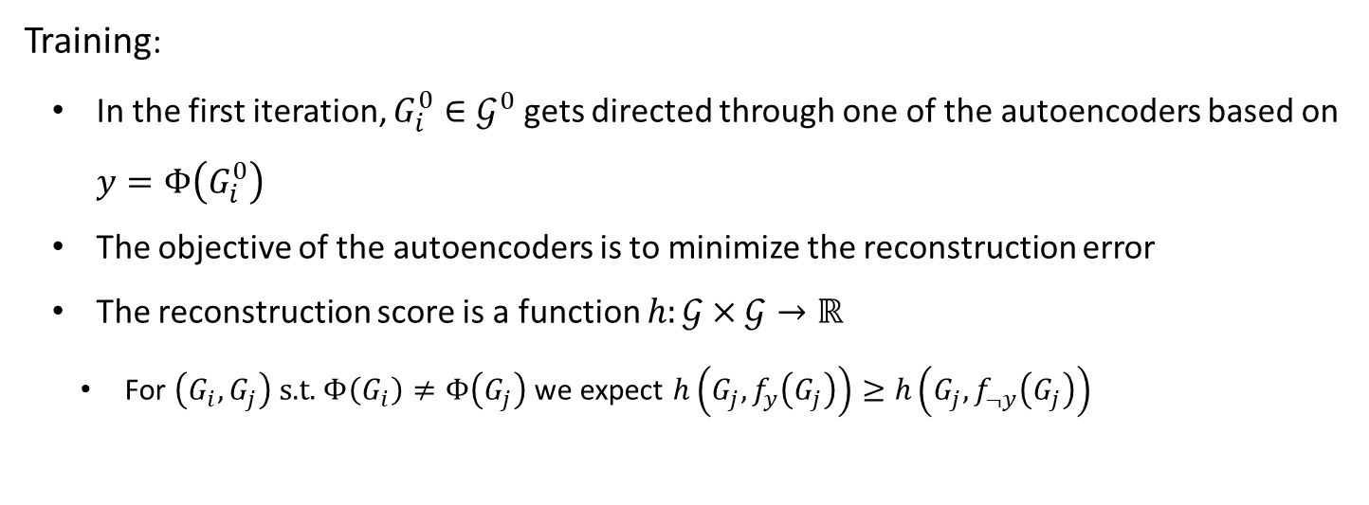
Architectural overview (2)
Training:
In the first iteration, $G_{i}^{0}∈𝒢^{0}$ gets directed through one of the autoencoders based on $y=Φ\left(G_{i}^{0}\right)$
The objective of the autoencoders is to minimize the reconstruction error
The reconstruction score is a function $h:𝒢×𝒢→ℝ$
For $\left(G_{i},G_{j}\right) \text{s}\text{.}\text{t}\text{. }Φ\left(G_{i}\right)≠Φ\left(G_{j}\right)$ we expect $h\left(G_{j},f_{y}\left(G_{j}\right)\right)≥h\left(G_{j},f_{¬y}\left(G_{j}\right)\right)$

Slide 14
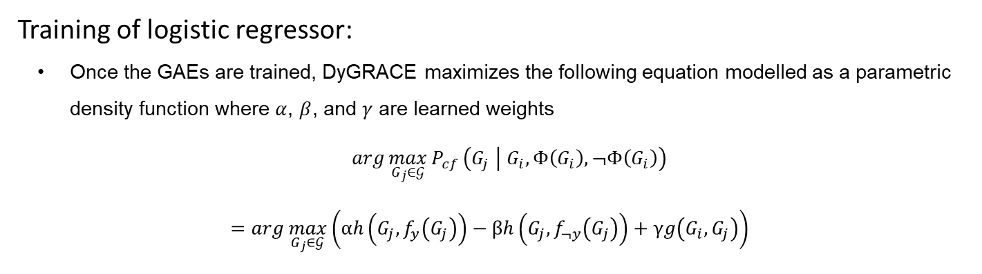
Architectural overview (2)
Training of logistic regressor:
Once the GAEs are trained, DyGRACE maximizes the following equation modelled as a parametric density function where $α$, $β$, and $γ$ are learned weights
$\arg{\max_{G_{j}∈𝒢}{P_{cf}}}\left(G_{j} | G_{i},Φ\left(G_{i}\right),¬Φ\left(G_{i}\right)\right)$
$$=arg{\max_{G_{j}∈𝒢}\left(αh\left(G_{j},f_{y}\left(G_{j}\right)\right)−βh\left(G_{j},f_{¬y}\left(G_{j}\right)\right)+γg\left(G_{i},G_{j}\right)\right)}$$
graph similarity function

Slide 15
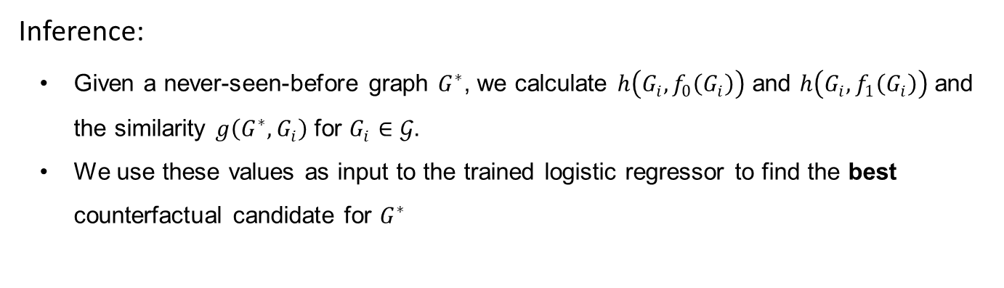
Architectural overview (3)
Inference:
Given a never-seen-before graph $G^{∗}$, we calculate $h\left(G_{i},f_{0}\left(G_{i}\right)\right)$ and $h\left(G_{i},f_{1}\left(G_{i}\right)\right)$ and the similarity $g\left(G^{∗},G_{i}\right)$ for $G_{i}∈𝒢.$
We use these values as input to the trained logistic regressor to find the best counterfactual candidate for $G^{∗}$

Slide 16
Architectural overview (4)
Continual adaptation:
Find the top k counterfactuals via the logistic regressor
Use them to update the knowledge of the counterfactual GAE and minimize the reconstruction error
Use them to update the maximize the reconstruction error of the factual GAE
The logistic regressor can be updated (or trained from scratch) on the updated GAEs

Slide 17
Part Four
Experiments

Slide 18
Datasets
DynTree-Cycles adaptation from [6,7]:
Contains cyclic (1) and acyclic (0) graphs
Graphs evolve in time modifying their structure, and thus their class
We guarantee that each graph appears during the entire monitoring time
DBLP-Coauthors [8]:
Author co-authorship relations varying in time
Trace the ego-network evolution from 2000 to 2010
An author collaboration can be categorized into impactful (1) and not-impactful (0)

Slide 19
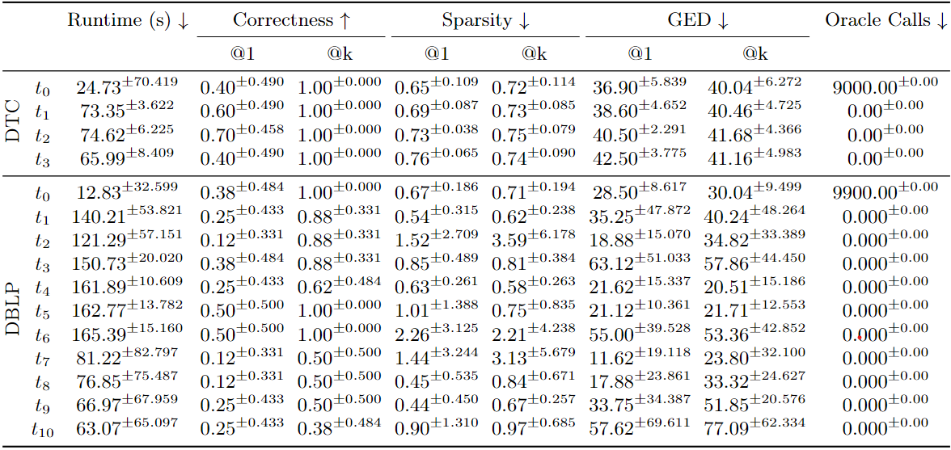
Average of DyGRACE’s performance on DynTree-Cycles (DTC) and DBLP-Coauthors (DBLP) on 10-fold cross-validation. k = 10

Slide 20
Part Five
Conclusive Remarks

Slide 21
Take aways
DyGRACE manages to discern between factual and counterfactual graphs in real-world dataset
The non-increasing GED shows that the model doesn’t deviate significantly from the separating hyperplane to identify valid counterfactuals
The more counterfactuals are sampled to update the GAEs, the better the performances (see Correctness@k)

Slide 22

Check out HANSEL:
A Framework for Timed-Graph Counterfactual Explainers

Slide 23
Bibliography
[1] "EUR-Lex - 52021PC0206 - EN - EUR-Lex". eur-lex.europa.eu. Archived from the original on 23 August 2021.
[2] Wachter, S., Mittelstadt, B. and Russell, C., 2017. Counterfactual explanations without opening the black box: Automated decisions and the GDPR. Harv. JL & Tech., 31, p.841.
[3] Pawelczyk, M., Leemann, T., Biega, A., Kasneci, G.: On the trade-off between actionable explanations and the right to be forgotten. In: Proceedings of the Eleventh International Conference on Learning Representations (2023)
[4] Prado-Romero, M.A., Prenkaj, B., Stilo, G., Giannotti, F.: A survey on graph counterfactual explanations: Definitions, methods, evaluation, and research challenges. ACM Comput. Surveys 2023.
[5] Kipf, T.N., Welling, M.: Variational graph auto-encoders. In: NeurIPS Workshop on Bayesian Deep Learning (2016)
[6] Prado-Romero, M.A., Stilo, G.: Gretel: Graph counterfactual explanation evalu ation framework. In: Proceedings of the 31st ACM International Conference on Information & Knowledge Management. pp. 4389–4393 (2022)
[7] Ying, Z., Bourgeois, D., You, J., Zitnik, M., Leskovec, J.: Gnnexplainer: Generating explanations for graph neural networks. In: Wallach, H.M., Larochelle, H., Beygelzimer, A., d’Alché-Buc, F., Fox, E.B., Garnett, R. (eds.) Advances in Neural Information Processing Systems 32: Annual Conference on Neural Informatio Processing Systems 2019, NeurIPS 2019, December 8-14, 2019, Vancouver, BC,
Canada. pp. 9240–9251 (2019)
[8] Benson, A.R., Abebe, R., Schaub, M.T., Jadbabaie, A., Kleinberg, J.: Simplicial closure and higher-order link prediction. Proceedings of the National Academy of Sciences 115(48), E11221–E11230 (2018)

