Slide 1





A Reproducibility Study of Deep and Surface Machine Learning Methods for Human-related Trajectory Prediction
Bardh Prenkaj, Paola Velardi, Damiano Distante, Stefano Faralli

Slide 2
Introduction on Trajectory Prediction
Characteristics:
Long-term sequence of event types
Irregular intervals between events
Absence of an event order
Hidden long-term dependencies within the sequence
Task: Predict the probability of events in the future or predict a single high-risk event
This paper: Risk prediction (i.e., patient hospitalisation, student dropout)

Slide 3
Datasets
 | Num. of event types | Max. time window length in days | Num. of trajectories
XuetangX | 22 | 30 | ~24k
KDDCup15 | 7 | 25 | ~120k
eICU | 9 | 30 | ~65k
 | Avg. per-day sparsity | Avg. day gap between events | Class distribution (0:1)
XuetangX | ~90% | ~11 土 2 | ~39% : 61%
KDDCup15 | ~91% | ~18 土 2 | ~21% : 79%
eICU | ~73% | ~8 土 8 | ~91% : 9%

Slide 4
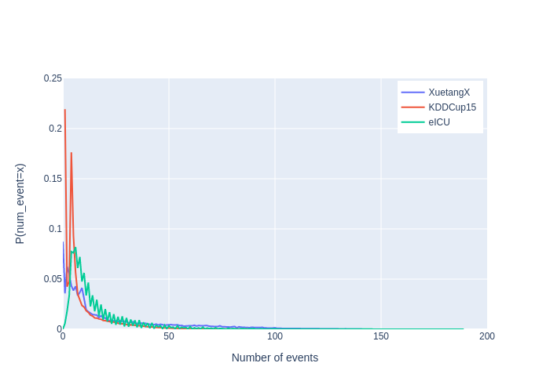
Datasets

Slide 5
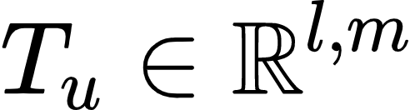


Input modelling
Daily grouping of events
…
Time-matrix for each individual in the datasets
…
…
Maximum temporal length for experimentation purposes
…
…
…
…
…
…
Number of events

Slide 6
Methods
Simple ML: logistic regression (LR), Gaussian naive Bayes (GNB), decision tree (DT), SVM with rbf kernel, KNN with two neighbours, majority class prediction.
Ensembles: random forest (RF) and KENS [1] with WINNOW, 1-NN, GNB for the base components
Deep feedforward NN: three- and five-layered DNNs with a shrinking factor of 0.5 from each layer

Slide 7
Methods
Deep sequential:
SimpleLSTM [2] - inspired by the architecture of LeNet
ConRec [3] - combination of CNNs and RNNs + final dense layer with sigmoid act. function
Deep sequential with attention:
CFIN [4] - without feature augmentation, but with an initialisation of the context vector according to a uniform distribution
HAN [5] - local and global attention mechanism with LSTMs

Slide 8
Experimental setup
Metrics:
AUCPR
F1, Recall both weighted by support
Time-window:
As minimal as possible to ensure real-time risk prediction
Multiple time-window dimensions to assess a non-decreasing trend in performances
Data imbalance:
Oversampling method ADASYN [6] on eICU to achieve equal number of instances in the minority and majority class

Slide 9
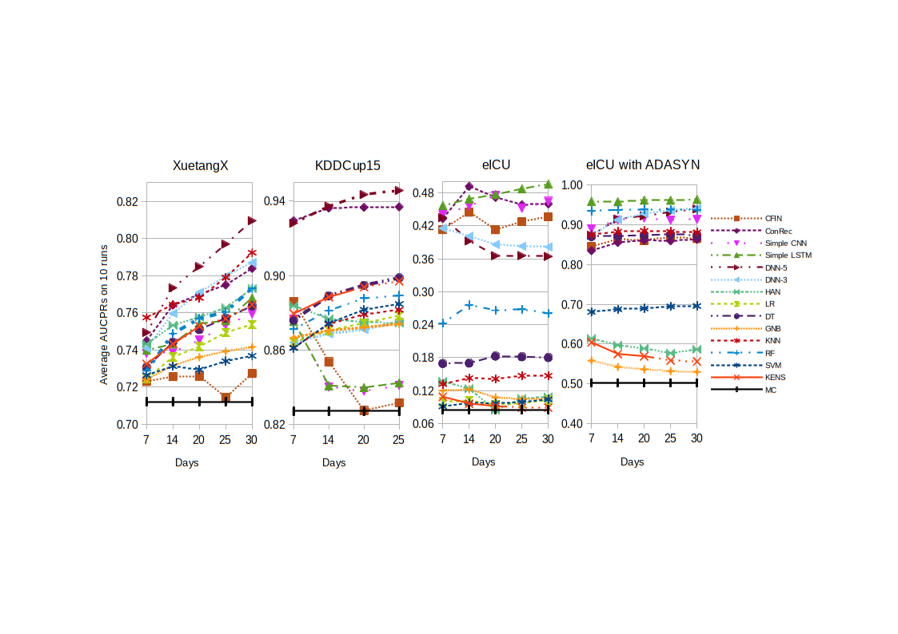
Results

Slide 10
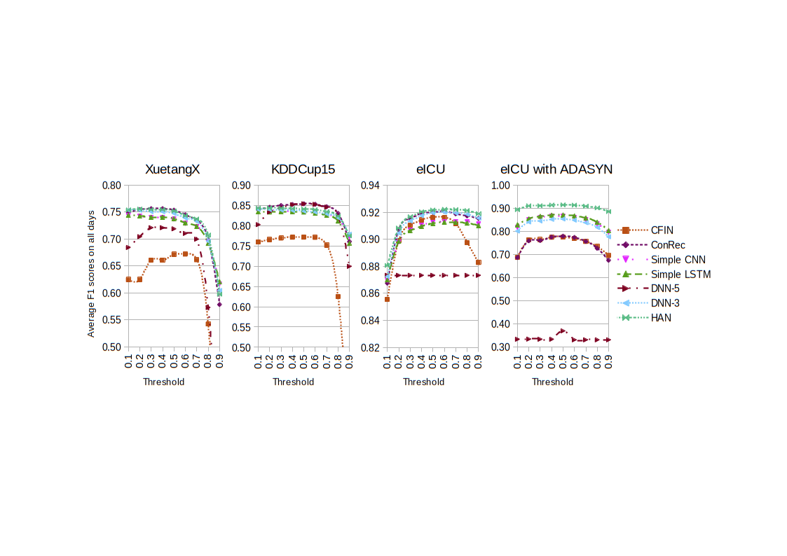
Results

Slide 11
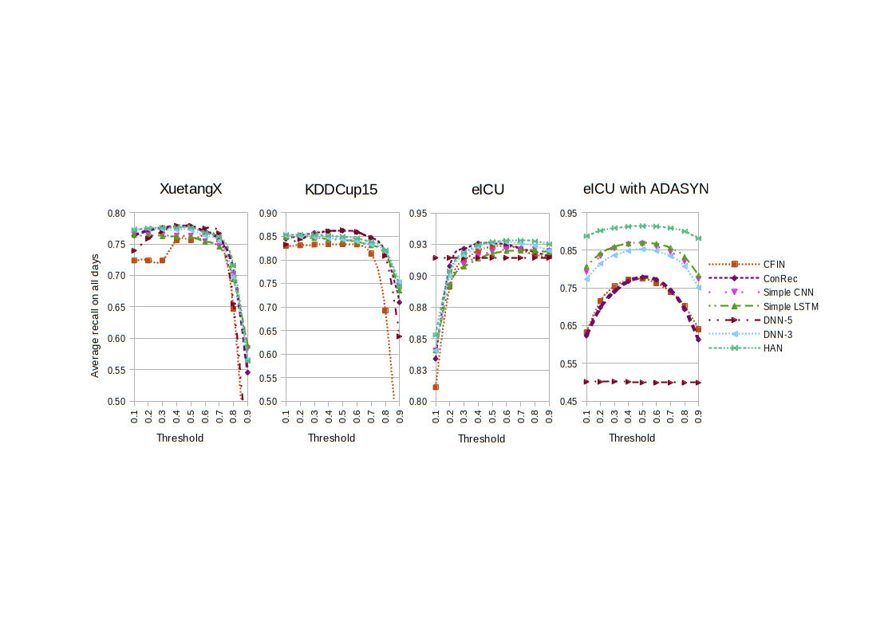
Results

Slide 12
Conclusions
Deep methods outperform simple ML (as expected), however the superiority of deep methods is often minimal:
Highest impact due to the input data complexity or data imbalance methods (see details in the paper)
Performance of algorithms can change (even reversing the ranking!) if different metrics are adopted:
Risk prediction - recall is more relevant than precision
Can we blindly trust papers pretending to outperform the state of the art?

Slide 13
THANK YOU
SIGIR Travel Grants program
MIUR under the grant of “Dipartimenti di eccellenza 2018-2022” of the Department of Computer Science of Sapienza University
Partly supported by Università di Roma Unitelma Sapienza

