Slide 1
RoboCup Project Presentation SYSC 5103F
Aron Arany-Takacs, Bardia Parmoun, & Dylan Leveille
aaran043@uottawa.ca
bardiaparmoun@cmail.carleton.ca
dylanleveille@cmail.carleton.ca
December 6th, 2024

Slide 2
Outline
Primary Contribution
Program Design
Player Functionalities
Goalie
Defender
Attacker
Agent Software Design

Slide 3
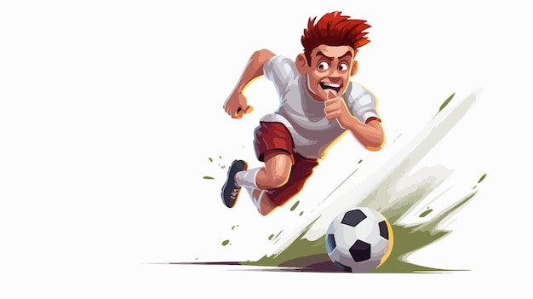
Primary Contribution
The development of RoboCup players/agents that prioritize their positioning on the field.
Achieve by ensuring players maintain a heightened sense of spatial awareness!

Slide 4
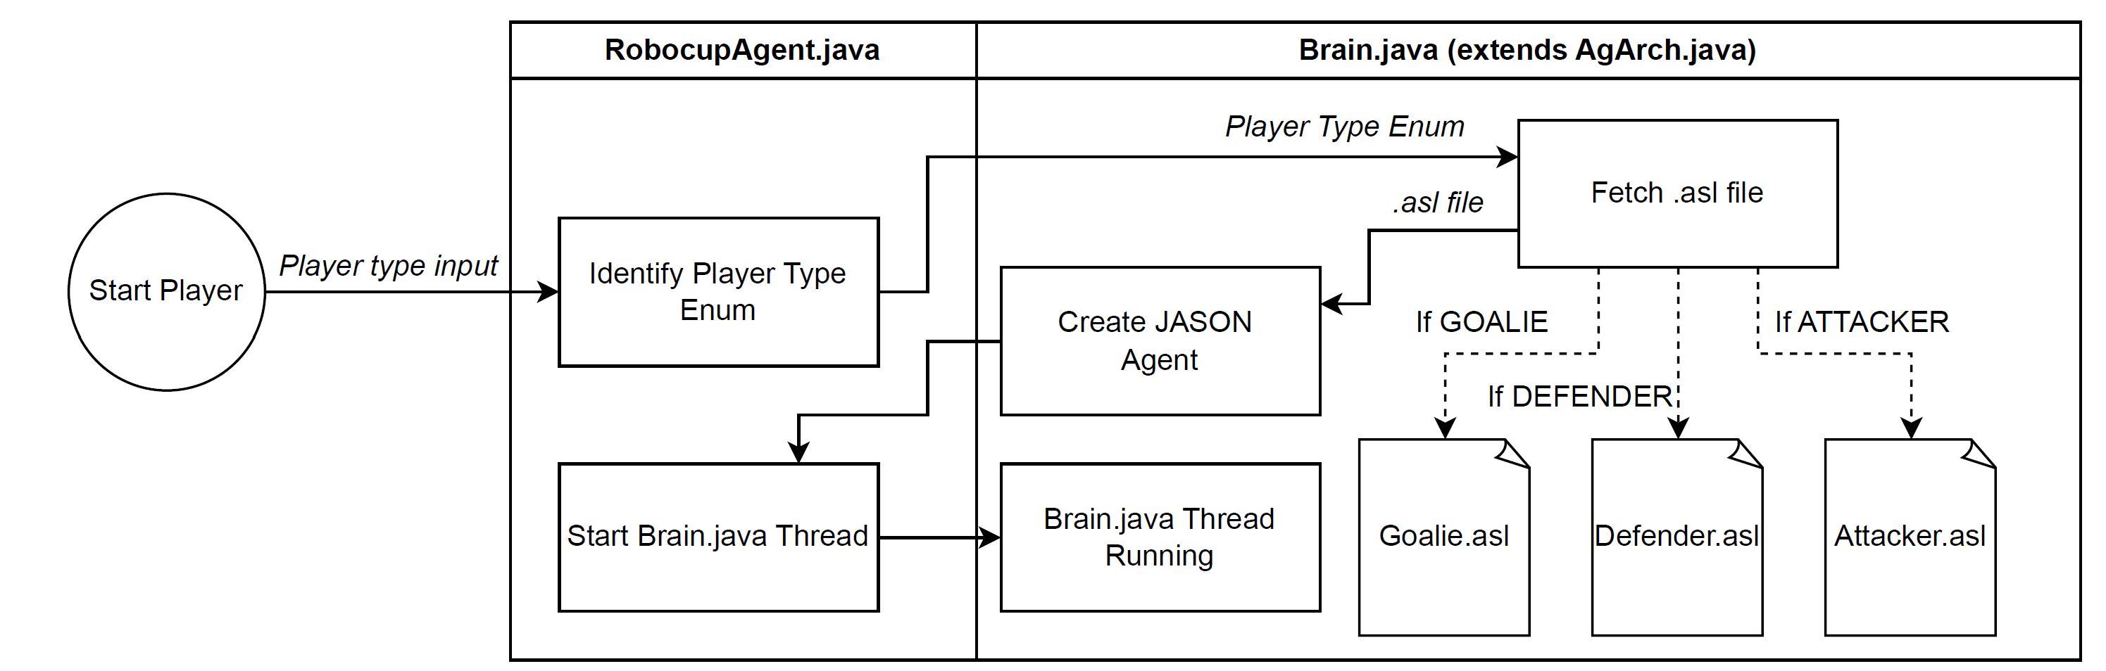
Program Design - Initializing a RoboCup Player

Slide 5
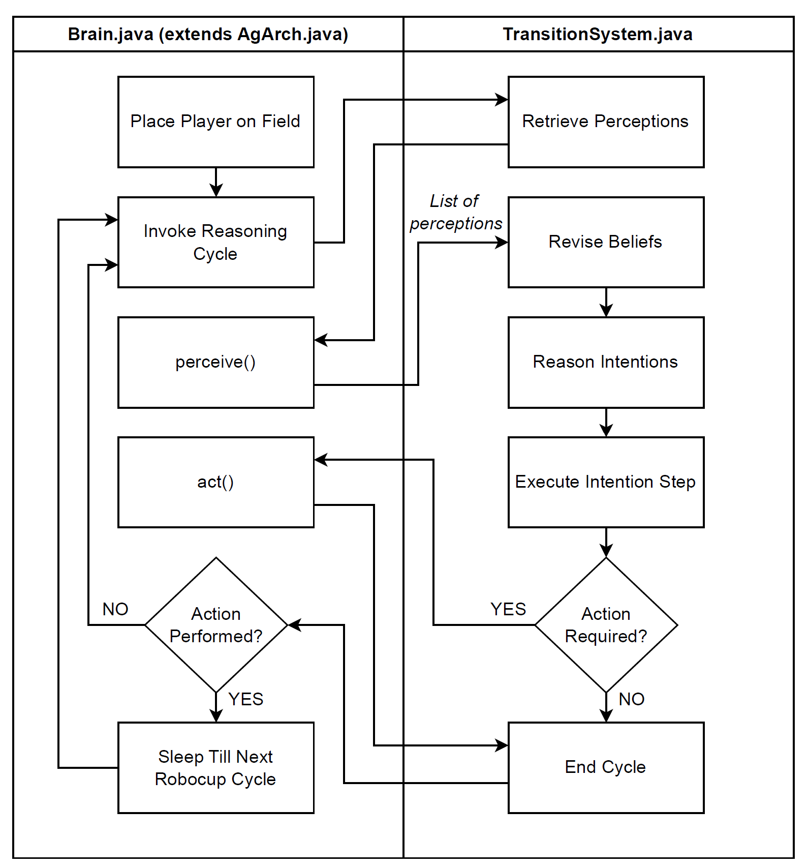
Program Design – Execution of a RoboCup Player

Slide 6
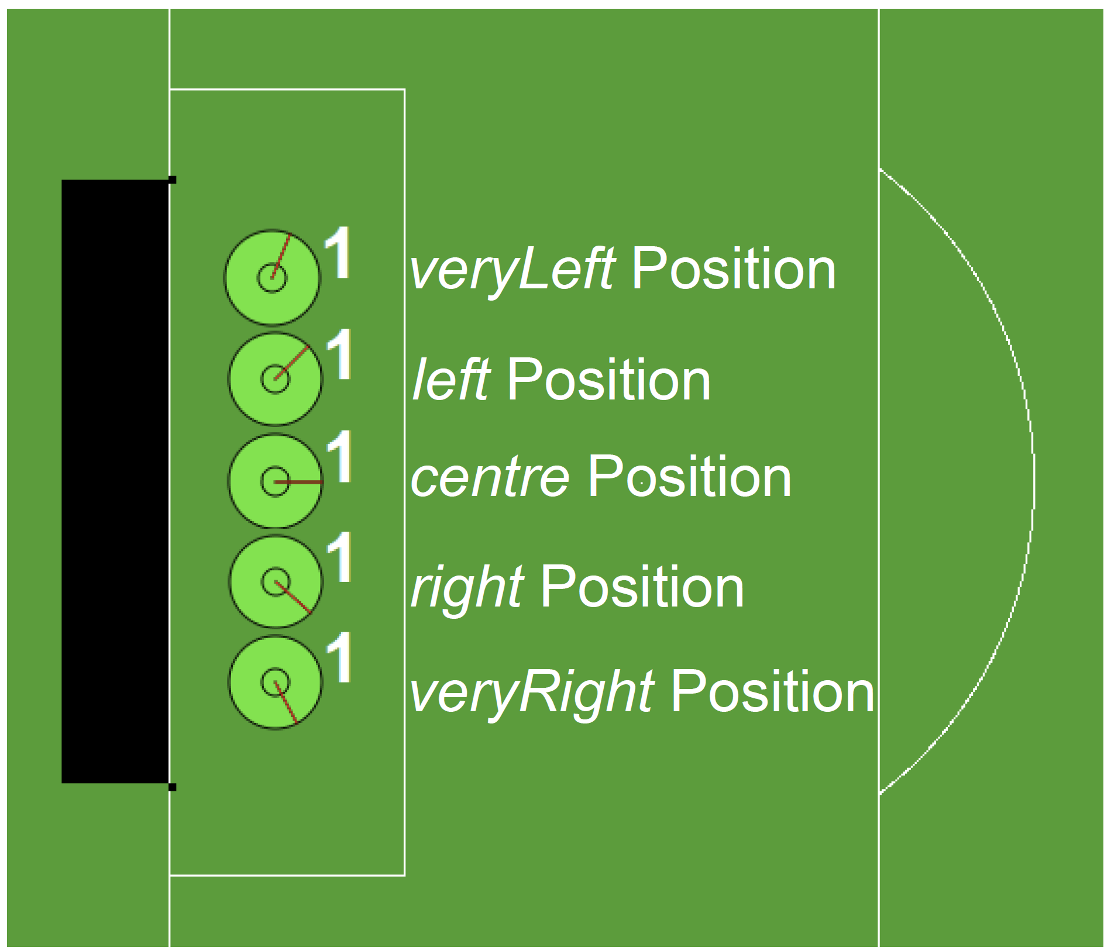
Player Functionalities/Behaviours – Goalie
Initial Goal: !wait
Change position based on ball angle.
centre: 20 degrees from centre flag (flag c 0)
left: 5 degrees from centre-top flag (flag c t)
right: 5 degrees from centre-bottom flag (flag c b)
veryLeft: 20 degrees from centre-top flag (flag c t)
veryRight: 20 degrees from centre-bottom flag (flag c b)

Slide 7
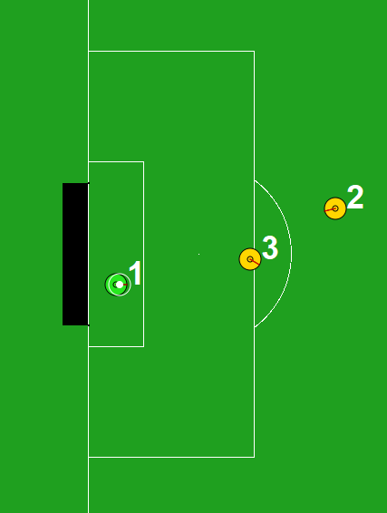
Player Functionalities/Behaviours – Goalie
Ball within 10 meters and angle to ball is 7.5 degrees
Run to ball, and attempt catch
If caught:
Kick to furthest defender if available
Kick to nearest attacker if available
Else, kick at a 45 degree angle

Slide 8
Player Functionalities/Behaviours – Defender
Three main goals:
Get ball and score/pass → !wait
Stay in home zone → !run_to_home_zone
Wait for kickoff → !give_goalie_space
!wait
Very similar to Krislet!
With the addition of passing to an attacker if no goal is visible

Slide 9
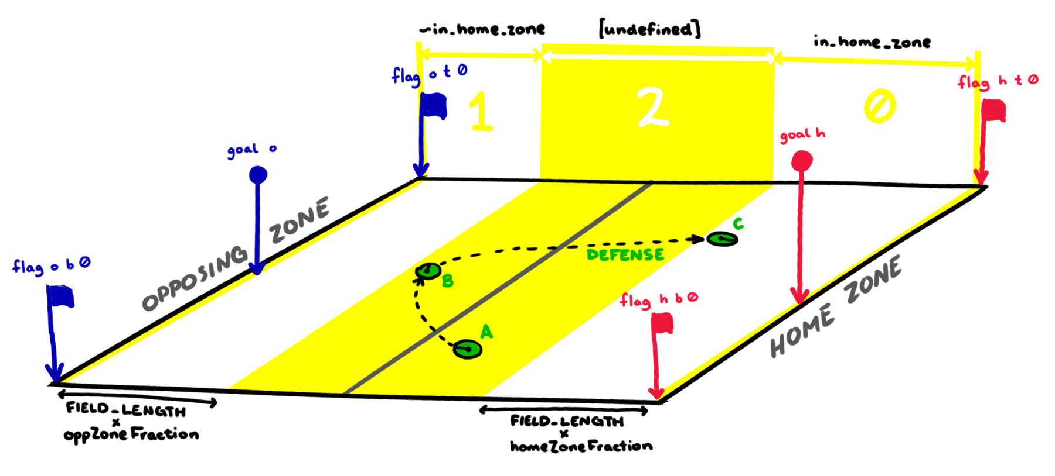
Player Functionalities/Behaviours – Defender
!run_to_homezone
1. Determine if you are outside home zone
2. Find your own goal
3. Align with the goal (± 40 degrees)
4. Run until back in the zone

Slide 10
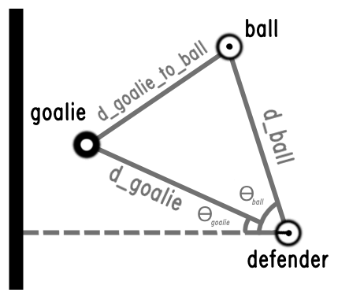
Player Functionalities/Behaviours – Defender
!give_goalie_space
1. Anticipate if goalie catches the ball
2. Check if close to the goalie
3. If close, head back to center
4. Wait

Slide 11
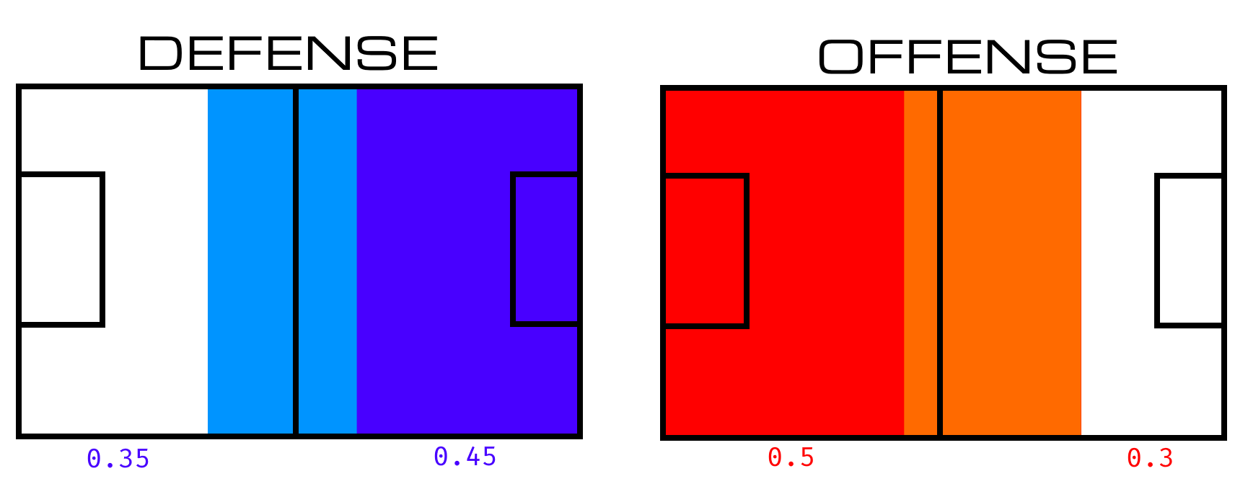
Player Functionalities/Behaviours – Attacker
Positioning & Aggression
Uses inverse positioning logic to defense
(~in_home_zone target)
Move back home and undefined zones to position the agent more effectively

Slide 12
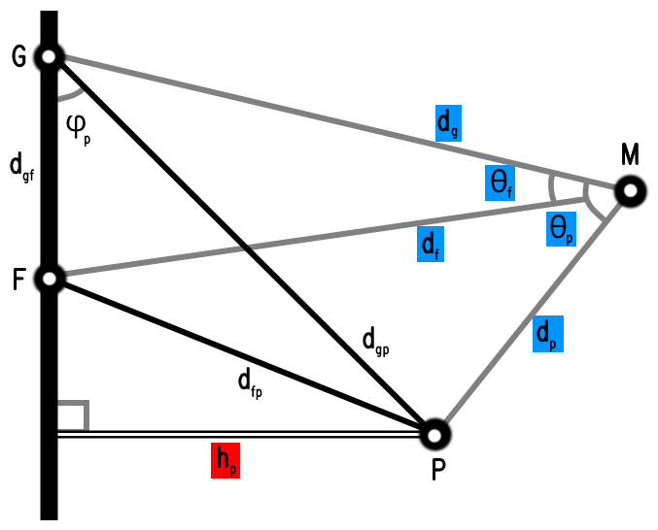
Player Functionalities/Behaviours – Attacker
Offside Foul Mitigation
Prevent over-aggression by offence
Implemented as a simple belief to be processed by the Jason agent (ball_offside)
If offside detected, run at reduced speed

Slide 13
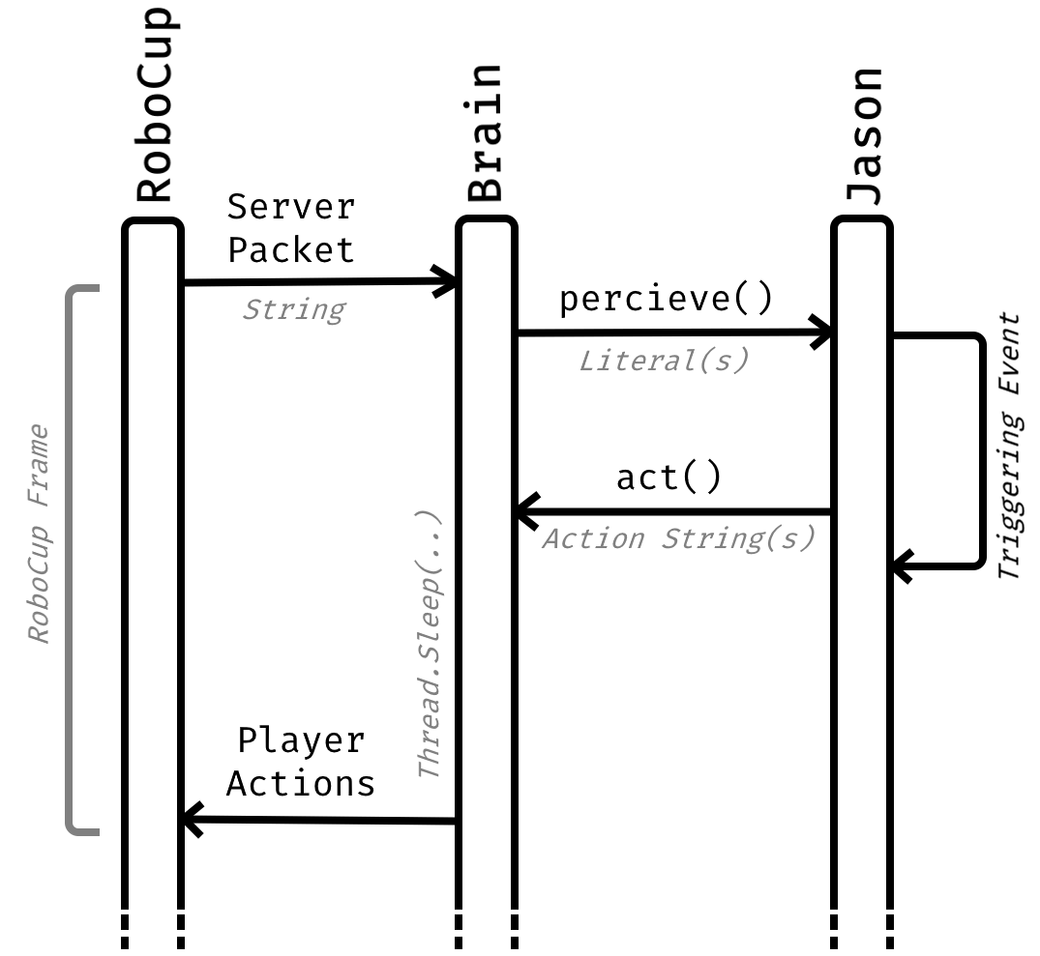
Agent Software Design
Focus on segmentation
Simplify belief inputs to Jason
Processing & Synchronization in Brain.java
Issues
Coordinating between the two can be finicky
All logic must be bilaterally mirrored

Slide 14
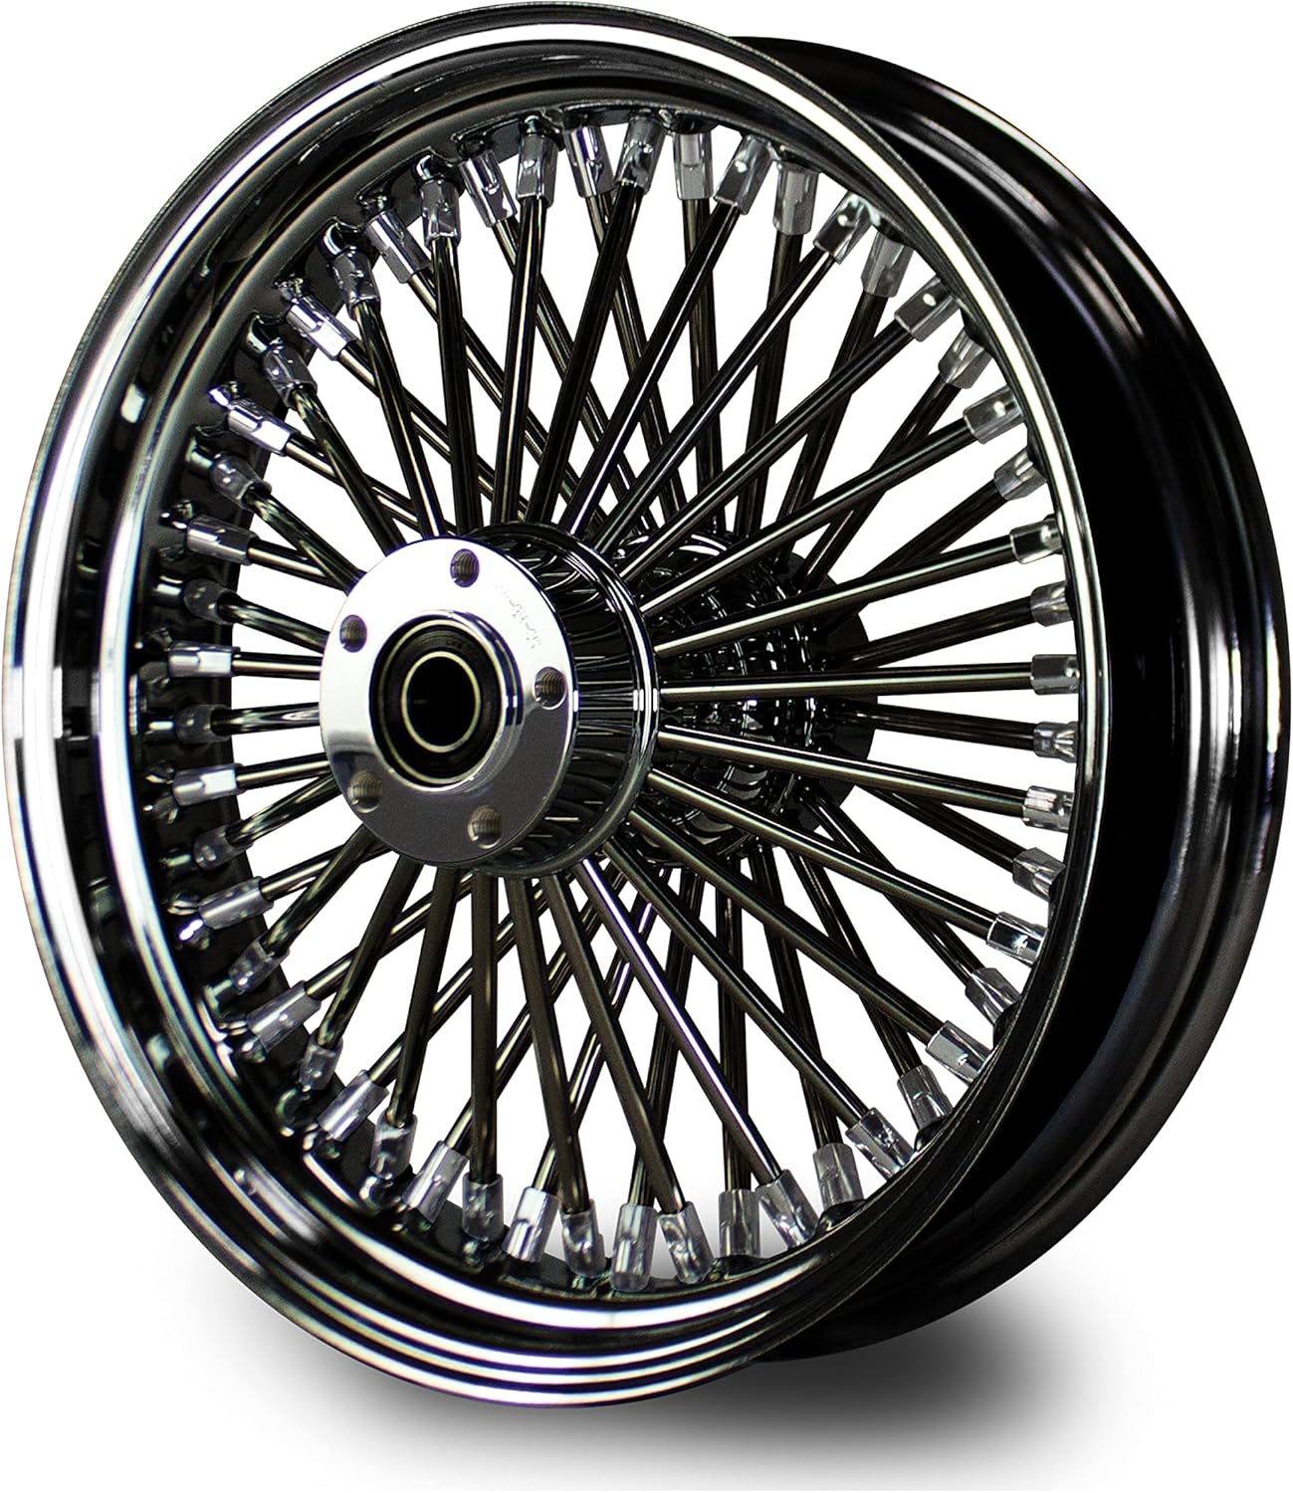
Agent Software Design
BDI Catchment and Pathways
Implementation of a "Hub-and-Spoke" control flow
Multiple hubs can be tied to one another (e.g., Goalie positions)
Approach allows for greater control over belief catchment
Comes at the cost of expandability for complex reasoning

Slide 15
Notes:
Some more social media icons can be found here: https://www.iconfinder.com/social-media-icons

